Slide 1
Introduction to Clustering
CSCI 347
Adiesha Liyana Ralalage

Slide 2
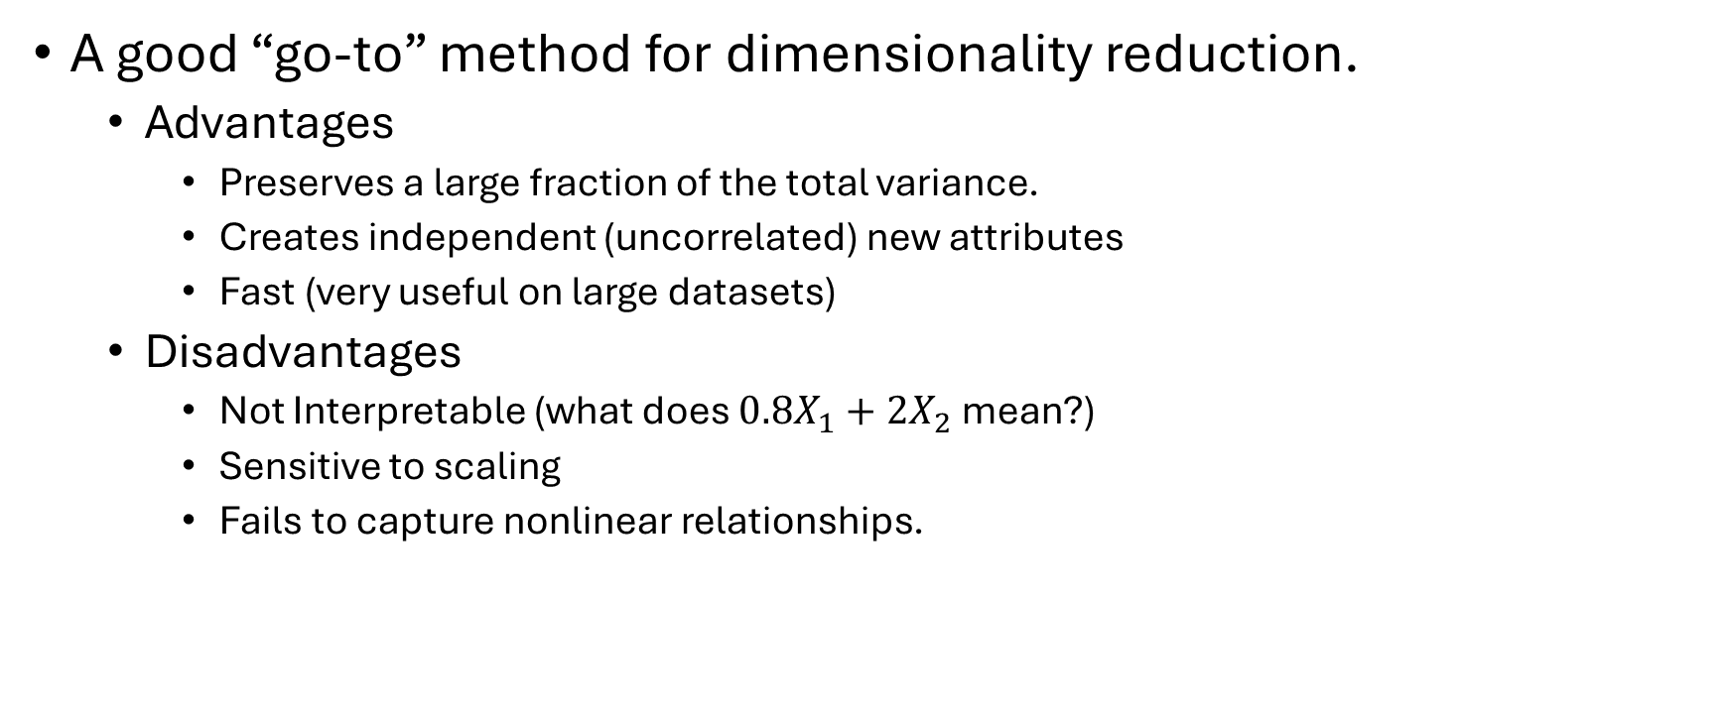
PCA summary
A good “go-to” method for dimensionality reduction.
Advantages
Preserves a large fraction of the total variance.
Creates independent (uncorrelated) new attributes
Fast (very useful on large datasets)
Disadvantages
Not Interpretable (what does ${0.8X}_{1}+2X_{2}$ mean?)
Sensitive to scaling
Fails to capture nonlinear relationships.

Slide 3
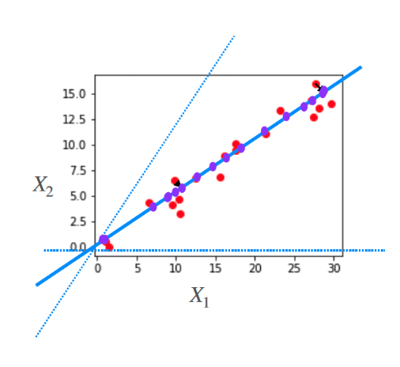
Data often lies close to one dimensional linear space

Slide 4
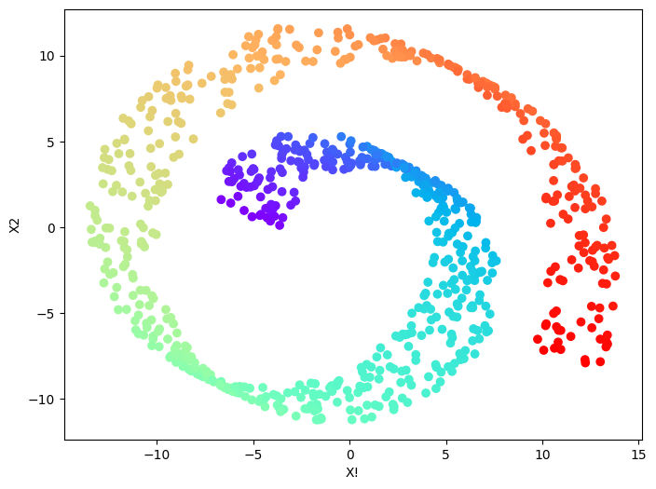
Data often lies close to one dimensional linear space

Slide 5
What can we use for nonlinear dimensionality reduction?
Kernel PCA
Laplacian eigenmaps
Locally linear embedding
T-SNE
UMAP
ISOMAP

Slide 6

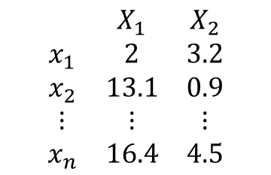


What are clusters in a dataset
$$\begin{matrix} & X_{1} & X_{2} \\ x_{1} & 2 & 3.2 \\ x_{2} & 13.1 & 0.9 \\ ⋮ & ⋮ & ⋮ \\ x_{n} & 16.4 & 4.5\end{matrix}$$
Data Matrix
$$x_{n}$$
$$x_{1}$$
$$x_{2}$$

Slide 7
Applications of clustering
$$\begin{matrix} & X_{1} & X_{2} \\ x_{1} & 2 & 3.2 \\ x_{2} & 13.1 & 0.9 \\ ⋮ & ⋮ & ⋮ \\ x_{n} & 16.4 & 4.5\end{matrix}$$
Data Matrix
People
$$x_{n}$$
$$x_{1}$$
$$x_{2}$$

Slide 8
Applications of clustering
$$\begin{matrix} & X_{1} & X_{2} \\ x_{1} & 2 & 3.2 \\ x_{2} & 13.1 & 0.9 \\ ⋮ & ⋮ & ⋮ \\ x_{n} & 16.4 & 4.5\end{matrix}$$
Data Matrix
Genes
$$x_{n}$$
$$x_{1}$$
$$x_{2}$$

Slide 9
Applications of clustering
$$\begin{matrix} & X_{1} & X_{2} \\ x_{1} & 2 & 3.2 \\ x_{2} & 13.1 & 0.9 \\ ⋮ & ⋮ & ⋮ \\ x_{n} & 16.4 & 4.5\end{matrix}$$
Data Matrix
Documents
$$x_{n}$$
$$x_{1}$$
$$x_{2}$$

Slide 10
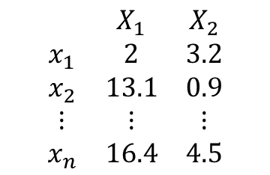
How do we find clusters in a dataset?
$$\begin{matrix} & X_{1} & X_{2} \\ x_{1} & 2 & 3.2 \\ x_{2} & 13.1 & 0.9 \\ ⋮ & ⋮ & ⋮ \\ x_{n} & 16.4 & 4.5\end{matrix}$$
Our goal is to gather data instances into groups with high within-group similarity
$$x_{n}$$
$$x_{1}$$
$$x_{2}$$

Slide 11
How do we find clusters in a dataset?
$$\begin{matrix} & X_{1} & X_{2} \\ x_{1} & 2 & 3.2 \\ x_{2} & 13.1 & 0.9 \\ ⋮ & ⋮ & ⋮ \\ x_{n} & 16.4 & 4.5\end{matrix}$$
Representative-based methods
Find a representative that best represents each cluster, and group points based on their closest representative.
$$x_{n}$$
$$x_{1}$$
$$x_{2}$$

Slide 12
How do we find clusters in a dataset?
$$\begin{matrix} & X_{1} & X_{2} \\ x_{1} & 2 & 3.2 \\ x_{2} & 13.1 & 0.9 \\ ⋮ & ⋮ & ⋮ \\ x_{n} & 16.4 & 4.5\end{matrix}$$
Density-based methods:
Find regions of high density (# points / some
small volume)
Low density around this point.
$$x_{n}$$
$$x_{1}$$
High density around this point.
$$x_{2}$$

Slide 13
How do we find clusters in a dataset?
$$\begin{matrix} & X_{1} & X_{2} \\ x_{1} & 2 & 3.2 \\ x_{2} & 13.1 & 0.9 \\ ⋮ & ⋮ & ⋮ \\ x_{n} & 16.4 & 4.5\end{matrix}$$
Density-based methods:
Find regions of high density (# points / some
small volume)
Low density around this point.
$$x_{n}$$
$$x_{1}$$
High density around this point.
$$x_{2}$$

Slide 14
How do we find clusters in a dataset?
$$\begin{matrix} & X_{1} & X_{2} \\ x_{1} & 2 & 3.2 \\ x_{2} & 13.1 & 0.9 \\ ⋮ & ⋮ & ⋮ \\ x_{n} & 16.4 & 4.5\end{matrix}$$
Hierarchical methods:
Clusters within clusters
$$x_{n}$$
$$x_{1}$$
$$x_{2}$$

Slide 15
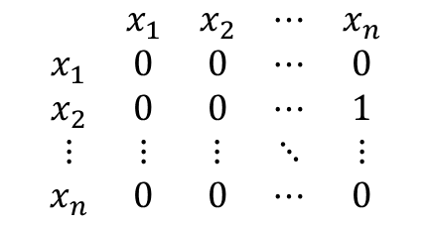
How do we find clusters in a dataset?
$$\begin{matrix} & X_{1} & X_{2} \\ x_{1} & 2 & 3.2 \\ x_{2} & 13.1 & 0.9 \\ ⋮ & ⋮ & ⋮ \\ x_{n} & 16.4 & 4.5\end{matrix}$$
$$\begin{matrix} & x_{1} & x_{2} & ⋯ & x_{n} \\ x_{1} & 0 & 0 & ⋯ & 0 \\ x_{2} & 0 & 0 & ⋯ & 1 \\ ⋮ & ⋮ & ⋮ & ⋱ & ⋮ \\ x_{n} & 0 & 0 & ⋯ & 0\end{matrix}$$
Graph based methods:
Find subgraphs with high edge connectivity
$$x_{n}$$
$$x_{1}$$
$$x_{2}$$

Slide 16
How do we find clusters in a dataset?
$$\begin{matrix} & X_{1} & X_{2} \\ x_{1} & 2 & 3.2 \\ x_{2} & 13.1 & 0.9 \\ ⋮ & ⋮ & ⋮ \\ x_{n} & 16.4 & 4.5\end{matrix}$$
Soft clustering or probabilistic clustering
Estimate the probability distribution that the
points come from
$$x_{n}$$
$$x_{1}$$
$$x_{2}$$

Slide 17
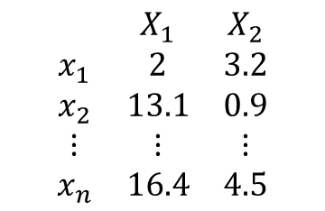
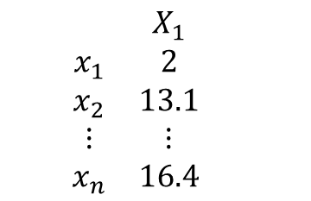
How do we find clusters in a dataset?
$$\begin{matrix} & X_{1} & X_{2} \\ x_{1} & 2 & 3.2 \\ x_{2} & 13.1 & 0.9 \\ ⋮ & ⋮ & ⋮ \\ x_{n} & 16.4 & 4.5\end{matrix}$$
$$\begin{matrix} & X_{1} & \\ x_{1} & 2 & \\ x_{2} & 13.1 & \\ ⋮ & ⋮ & \\ x_{n} & 16.4 & \end{matrix}$$
Spectral or subspace clustering methods:
Find a lower dimensional space
that better represents the
clusters
$$x_{n}$$
$$x_{1}$$
$$x_{2}$$

Slide 18
Clustering techniques
$$\begin{matrix} & X_{1} & X_{2} \\ x_{1} & 2 & 3.2 \\ x_{2} & 13.1 & 0.9 \\ ⋮ & ⋮ & ⋮ \\ x_{n} & 16.4 & 4.5\end{matrix}$$
$$\begin{matrix} & X_{1} & \\ x_{1} & 2 & \\ x_{2} & 13.1 & \\ ⋮ & ⋮ & \\ x_{n} & 16.4 & \end{matrix}$$
Spectral or subspace clustering methods:
Find a lower dimensional space
that better represents the
clusters
$$x_{n}$$
$$x_{1}$$
$$x_{2}$$

Slide 19
Clustering technique
Foundations
Representative-based method
Density-based methods
Hierarchical methods
Spectral methods
Graph-based methods
Advanced topics and applications
Parallel algorithms
Subspace clustering
Core sets
Deep learning
Document clustering
Clustering for outlier detection
$$x_{n}$$
$$x_{1}$$
$$x_{2}$$

Slide 20
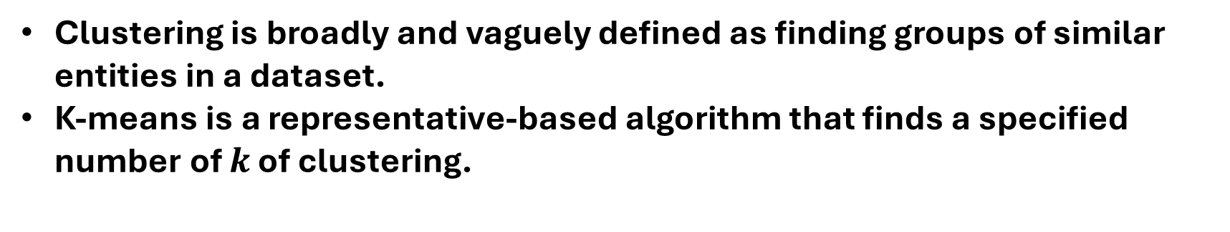
Clustering
Clustering is broadly and vaguely defined as finding groups of similar entities in a dataset.
K-means is a representative-based algorithm that finds a specified number of $k$ of clustering.
$$x_{n}$$
$$x_{1}$$
$$x_{2}$$

