Slide 1
SVD: Singular Value Decomposition
CSCI 347
Adiesha Liyanage

Slide 2
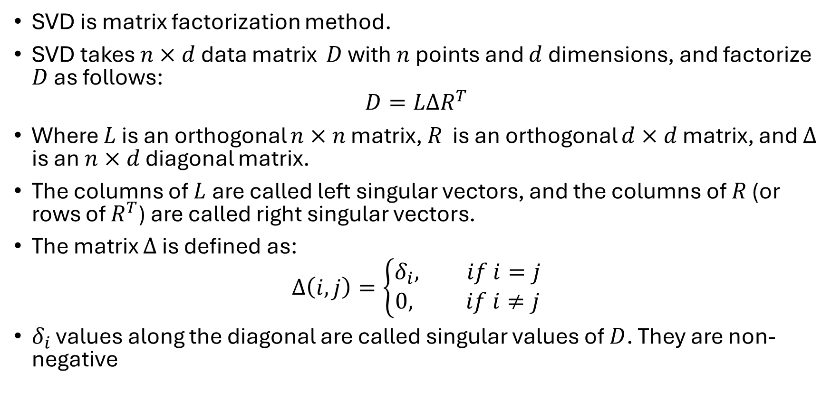
What is SVD?
SVD is matrix factorization method.
SVD takes $n×d$ data matrix $D$ with $n$ points and $d$ dimensions, and factorize $D$ as follows:
$$D=LΔR^{T}$$
Where $L$ is an orthogonal $n×n$ matrix, $R$ is an orthogonal $d×d$ matrix, and $Δ$ is an $n×d$ diagonal matrix.
The columns of $L$ are called left singular vectors, and the columns of $R$ (or rows of $R^{T}$) are called right singular vectors.
The matrix $Δ$ is defined as:
$$Δ\left(i,j\right)=\left\{\begin{aligned}δ_{i}, if i=j \\ &0, if i≠j\end{aligned}\right.$$
$δ_{i}$ values along the diagonal are called singular values of $D$. They are non-negative

Slide 3
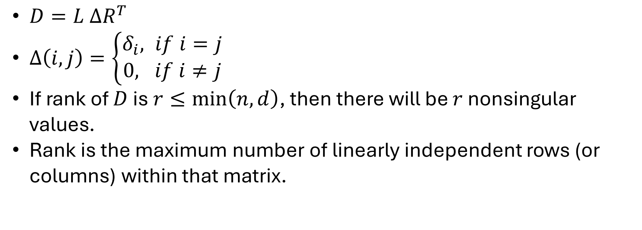
$D=L ΔR^{T}$
$Δ\left(i,j\right)=\left\{\begin{aligned}δ_{i}, if i=j \\ &0, if i≠j\end{aligned}\right.$
If rank of $D$ is $r≤\min\left(n,d\right)$, then there will be $r$ nonsingular values.
Rank is the maximum number of linearly independent rows (or columns) within that matrix.

Slide 4

SVD
Basic structure of the SVD
$$D=LΔR^{T}$$
$$D=\left(\begin{matrix}| & | & & | \\ l_{1} & l_{2} & ⋯ & l_{n} \\ | & | & & |\end{matrix} \right)\left(\begin{matrix}δ_{1} & 0 & ⋯ & 0 \\ 0 & δ_{2} & ⋯ & 0 \\ ⋮ & ⋮ & ⋱ & ⋮ \\ 0 & 0 & ⋯ & δ_{n}\end{matrix} \right)\left(\begin{matrix}\text{━} & r_{1}^{T} & \text{━} \\ \text{━} & r_{2}^{T} & \text{━} \\ \text{━} & ⋮ & \text{━} \\ \text{━} & r_{n}^{T} & \text{━}\end{matrix}\right)$$

Slide 5
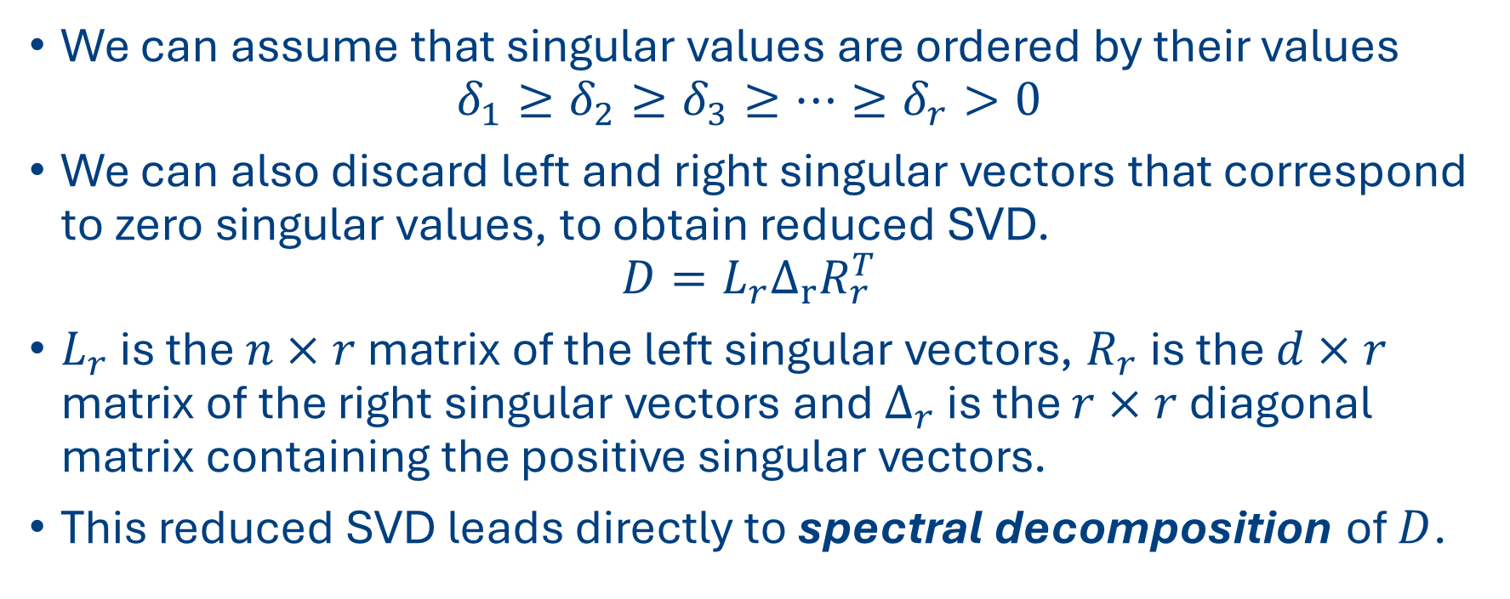
SVD cont
We can assume that singular values are ordered by their values
$$δ_{1}≥δ_{2}≥δ_{3}≥⋯≥δ_{r}>0$$
We can also discard left and right singular vectors that correspond to zero singular values, to obtain reduced SVD.
$$D=L_{r}Δ_{r}R_{r}^{T}$$
$L_{r}$ is the $n×r$ matrix of the left singular vectors, $R_{r}$ is the $d×r$ matrix of the right singular vectors and $Δ_{r}$ is the $r×r$ diagonal matrix containing the positive singular vectors.
This reduced SVD leads directly to spectral decomposition of $D$.

Slide 6
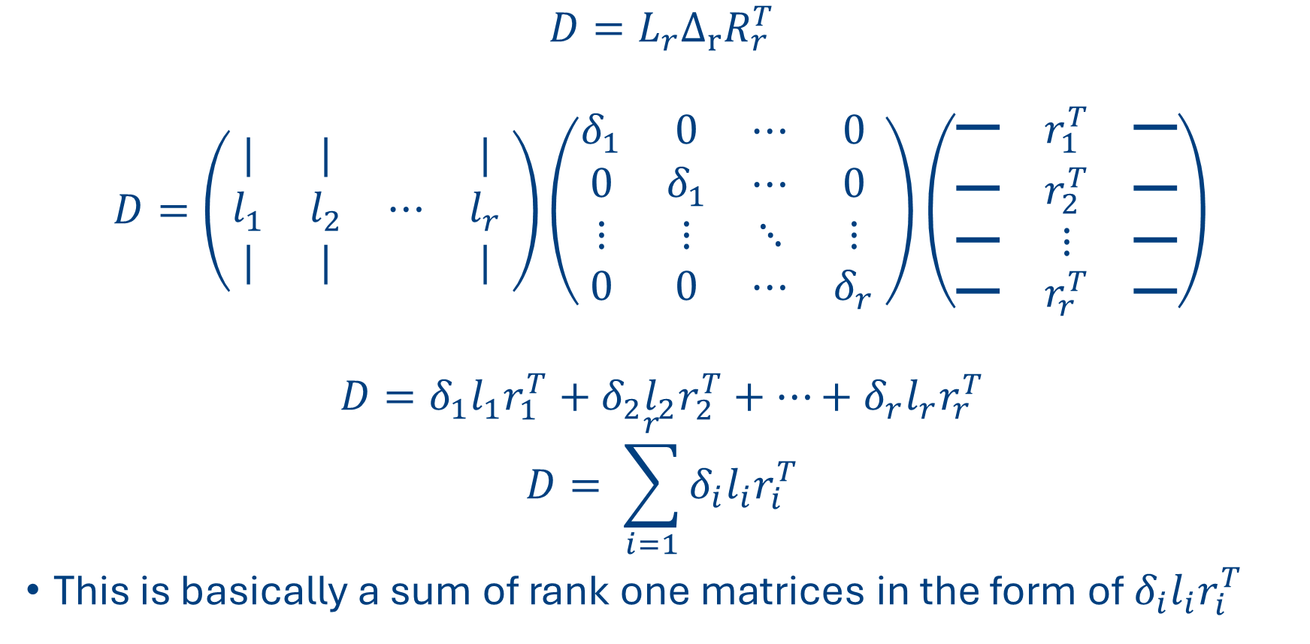
SVD cont
$$D=L_{r}Δ_{r}R_{r}^{T}$$
$$D=\left(\begin{matrix}| & | & & | \\ l_{1} & l_{2} & ⋯ & l_{r} \\ | & | & & |\end{matrix} \right)\left(\begin{matrix}δ_{1} & 0 & ⋯ & 0 \\ 0 & δ_{1} & ⋯ & 0 \\ ⋮ & ⋮ & ⋱ & ⋮ \\ 0 & 0 & ⋯ & δ_{r}\end{matrix} \right)\left(\begin{matrix}\text{━} & r_{1}^{T} & \text{━} \\ \text{━} & r_{2}^{T} & \text{━} \\ \text{━} & ⋮ & \text{━} \\ \text{━} & r_{r}^{T} & \text{━}\end{matrix}\right)$$
$$D=δ_{1}l_{1}r_{1}^{T}+δ_{2}l_{2}r_{2}^{T}+⋯+δ_{r}l_{r}r_{r}^{T}$$
$$D= \sum_{i=1}^{r}{δ_{i}l_{i}r_{i}^{T}}$$
This is basically a sum of rank one matrices in the form of $δ_{i}l_{i}r_{i}^{T}$

Slide 7
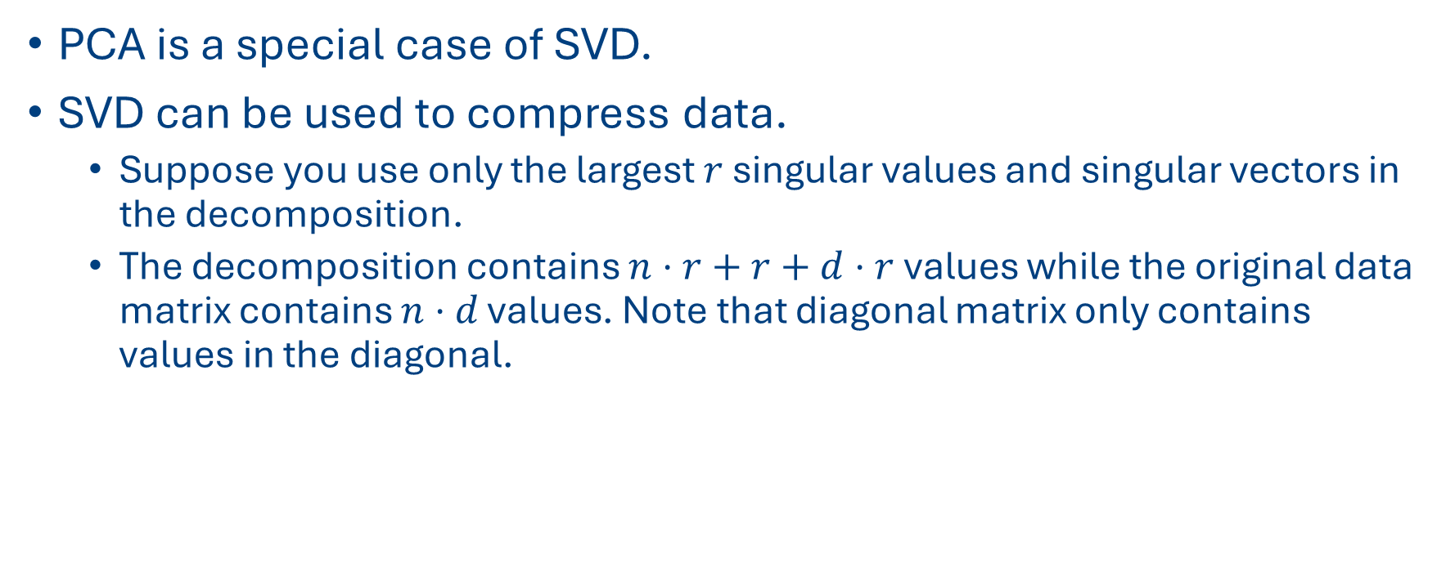
Why does this matter?
PCA is a special case of SVD.
SVD can be used to compress data.
Suppose you use only the largest $r$ singular values and singular vectors in the decomposition.
The decomposition contains $n⋅r+r+d⋅r$ values while the original data matrix contains $n⋅d$ values. Note that diagonal matrix only contains values in the diagonal.

