Slide 1
Linear algebra review and distance measurements
CSCI 347 - Data Mining

Slide 2
Assignment 1, Quiz 1
Assignment 1 is available now.
You should be able to finish this after this class.
Quiz 1 is available.
Only 1 attempt is allowed (50 mins)
Quiz does not take 50 mins to complete.

Slide 3

Common Data Formats
Data can be represented by data matrix.
$$D=\begin{matrix} & X_{1} & X_{2} & X_{3} & X_{4} \\ x_{1} & 0.2 & 23 & A & 5.7 \\ x_{2} & 0.4 & 1 & B & 5.4 \\ x_{3} & 1.8 & 0.5 & D & 5.2 \\ x_{4} & 5.6 & 50 & C & 5.1 \\ x_{5} & −0.5 & 34 & F & 5.3 \\ x_{6} & 0.4 & 19 & G & 5.4 \\ x_{7} & 1.1 & 11 & A & 5.5\end{matrix}$$

Slide 4
Common Data Formats
Data can be represented by data matrix.
$$D=\begin{matrix} & X_{1} & X_{2} & X_{3} & X_{4} \\ x_{1} & 0.2 & 23 & A & 5.7 \\ x_{2} & 0.4 & 1 & B & 5.4 \\ x_{3} & 1.8 & 0.5 & D & 5.2 \\ x_{4} & 5.6 & 50 & C & 5.1 \\ x_{5} & −0.5 & 34 & F & 5.3 \\ x_{6} & 0.4 & 19 & G & 5.4 \\ x_{7} & 1.1 & 11 & A & 5.5\end{matrix}$$
The columns commonly represent attributes/properties of the data
The rows commonly represent entities and their observed values for each attribute

Slide 5
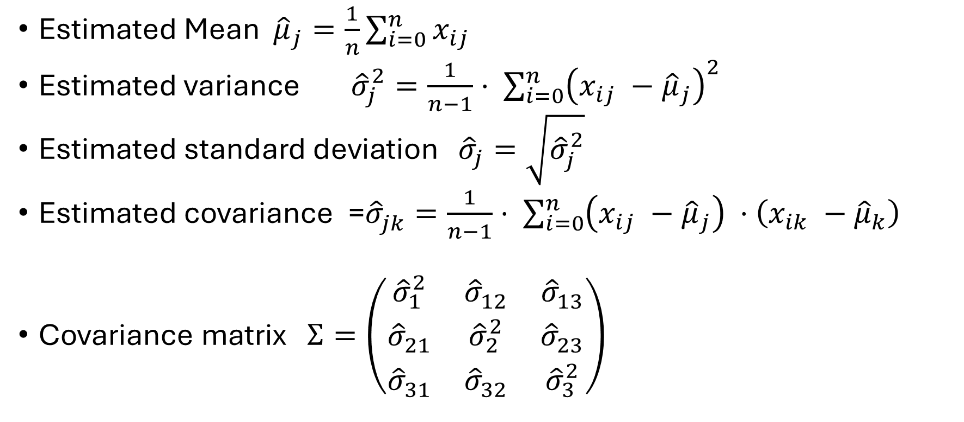
Review of stats
Estimated Mean ${\hat{μ}}_{j}=\frac{1}{n}\sum_{i=0}^{n}{x_{ij}}$
Estimated variance ${\hat{σ}}_{j}^{2}=\frac{1}{n−1}⋅ \sum_{i=0}^{n}{{\left(x_{ij} −{\hat{μ}}_{j}\right)}^{2}}$
Estimated standard deviation ${\hat{σ}}_{j}=\sqrt{{\hat{σ}}_{j}^{2}}$
Estimated covariance =${\hat{σ}}_{jk}^{ }=\frac{1}{n−1}⋅ \sum_{i=0}^{n}{{\left(x_{ij} −{\hat{μ}}_{j}\right)}^{ }⋅{\left(x_{ik} −{\hat{μ}}_{k}\right)}^{ }}$
Covariance matrix $Σ=\left(\begin{matrix}{\hat{σ}}_{1}^{2} & {\hat{σ}}_{12}^{ } & {\hat{σ}}_{13}^{ } \\ {\hat{σ}}_{21}^{ } & {\hat{σ}}_{2}^{2} & {\hat{σ}}_{23}^{ } \\ {\hat{σ}}_{31}^{ } & {\hat{σ}}_{32}^{ } & {\hat{σ}}_{3}^{2}\end{matrix}\right)$

Slide 6
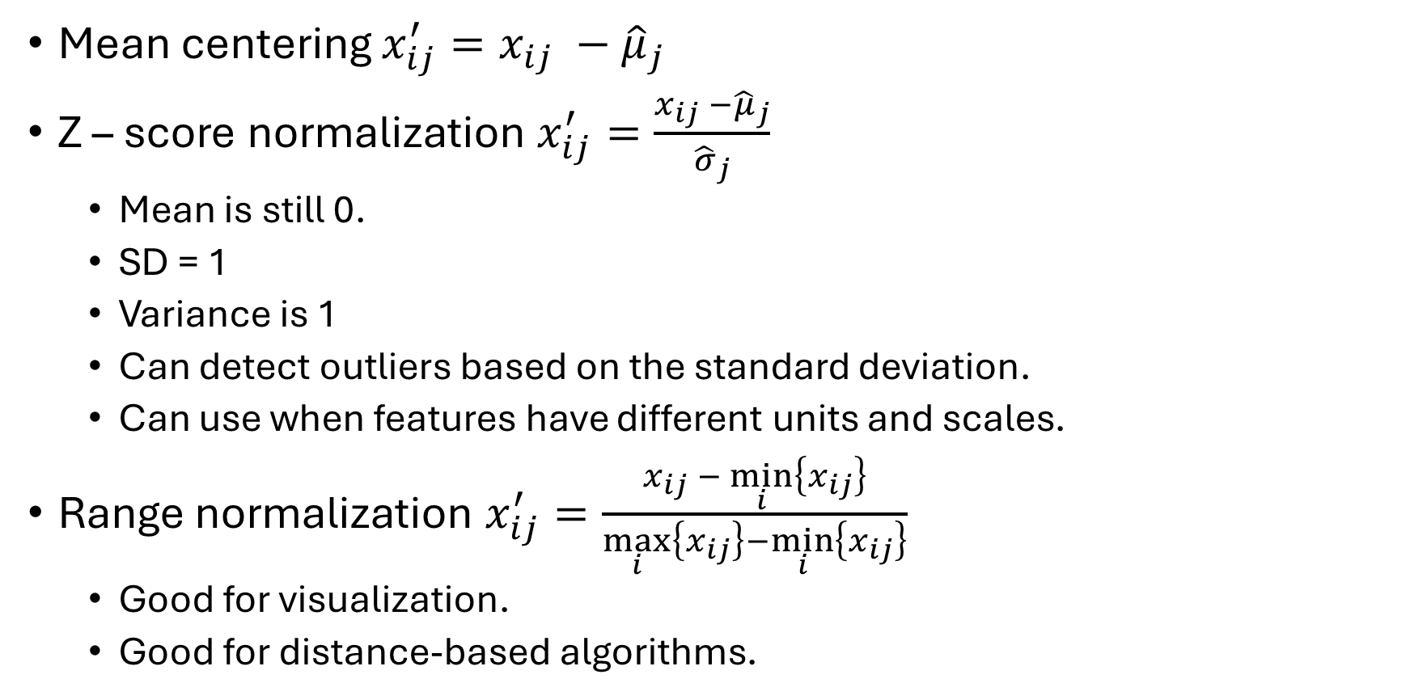
More stats…
Normalization is the process of adjusting or transforming data into a standard or common format.
Mean centering $x_{ij}^{′}=x_{ij} −{\hat{μ}}_{j}$
Z – score normalization $x_{ij}^{′}=\frac{x_{ij} −{\hat{μ}}_{j}}{{\hat{σ}}_{j}}$
Mean is still 0.
SD = 1
Variance is 1
Can detect outliers based on the standard deviation.
Can use when features have different units and scales.
Range normalization $x_{ij}^{′}=\frac{x_{ij} − \min_{i}\left\{x_{ij}\right\}}{\max_{i}\left\{x_{ij}\right\}−\min_{i}\left\{x_{ij}\right\}}$
Good for visualization.
Good for distance-based algorithms.

Slide 7
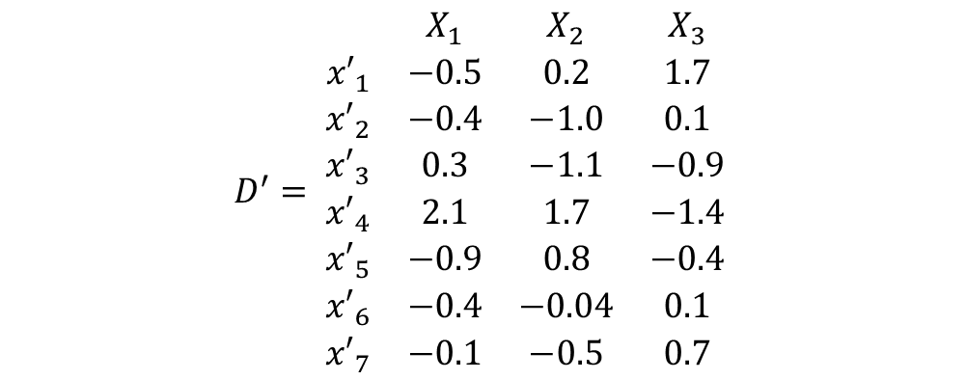
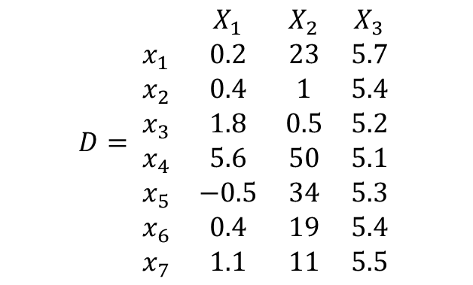

Z-Score normalization example
Z-score or standard score normalization tells us how many standard deviations each entity value is from the attribute mean:
$x_{11}^{′}=\frac{\left(0.2−1.285\right)}{2.035}=−0.533$
$$D= \begin{matrix} & X_{1} & X_{2} & X_{3} \\ x_{1} & 0.2 & 23 & 5.7 \\ x_{2} & 0.4 & 1 & 5.4 \\ x_{3} & 1.8 & 0.5 & 5.2 \\ x_{4} & 5.6 & 50 & 5.1 \\ x_{5} & −0.5 & 34 & 5.3 \\ x_{6} & 0.4 & 19 & 5.4 \\ x_{7} & 1.1 & 11 & 5.5\end{matrix}$$
$$D^{′}= \begin{matrix} & X_{1} & X_{2} & X_{3} \\ {x′}_{1} & −0.5 & 0.2 & 1.7 \\ {x′}_{2} & −0.4 & −1.0 & 0.1 \\ {x′}_{3} & 0.3 & −1.1 & −0.9 \\ {x′}_{4} & 2.1 & 1.7 & −1.4 \\ {x′}_{5} & −0.9 & 0.8 & −0.4 \\ {x′}_{6} & −0.4 & −0.04 & 0.1 \\ {x′}_{7} & −0.1 & −0.5 & 0.7\end{matrix}$$

Slide 8
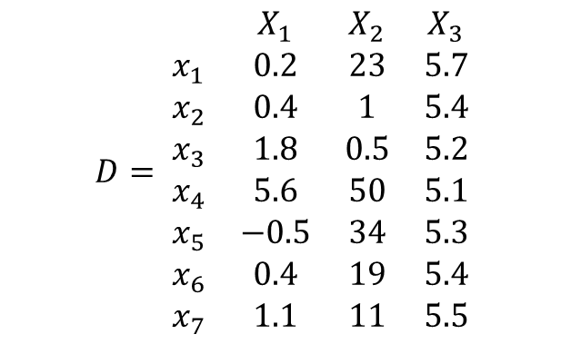
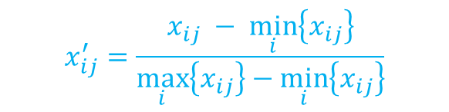
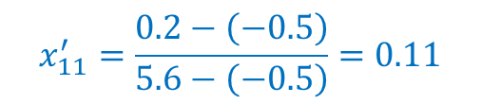
Range normalization
$$x_{ij}^{′}=\frac{x_{ij} − \min_{i}\left\{x_{ij}\right\}}{\max_{i}\left\{x_{ij}\right\}−\min_{i}\left\{x_{ij}\right\}}$$
Ensure comparability across features
Some algorithms may disproportionately weigh feature with larger ranges. (Ex: k-means)
Facilitate Visualization and Interpretation.
Some algorithms assume normalized inputs.
$$D= \begin{matrix} & X_{1} & X_{2} & X_{3} \\ x_{1} & 0.2 & 23 & 5.7 \\ x_{2} & 0.4 & 1 & 5.4 \\ x_{3} & 1.8 & 0.5 & 5.2 \\ x_{4} & 5.6 & 50 & 5.1 \\ x_{5} & −0.5 & 34 & 5.3 \\ x_{6} & 0.4 & 19 & 5.4 \\ x_{7} & 1.1 & 11 & 5.5\end{matrix}$$
$$x_{11}^{′}=\frac{0.2−\left(−0.5\right)}{5.6−\left(−0.5\right)}=0.11$$

Slide 9
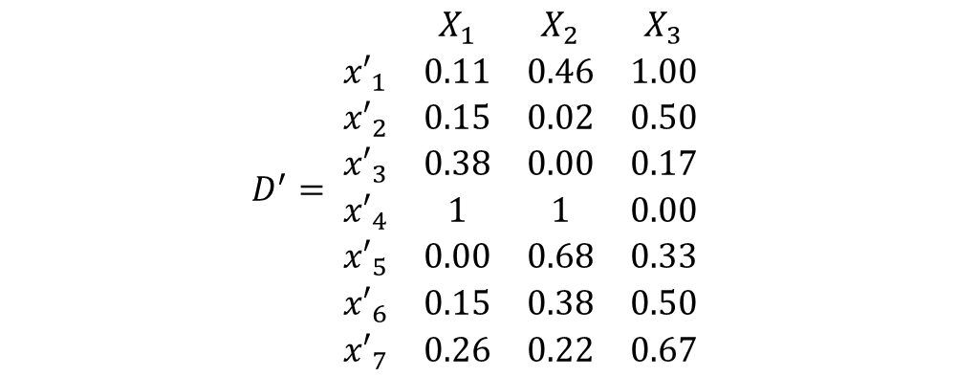
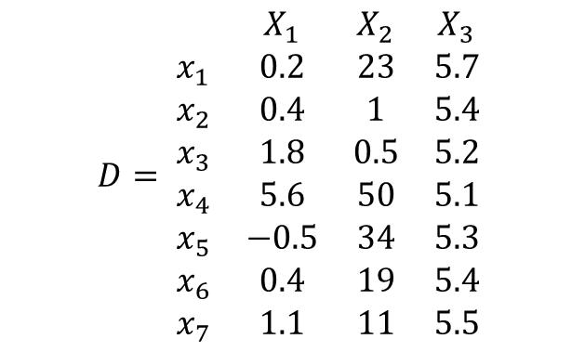
Range normalization example
$$D= \begin{matrix} & X_{1} & X_{2} & X_{3} \\ x_{1} & 0.2 & 23 & 5.7 \\ x_{2} & 0.4 & 1 & 5.4 \\ x_{3} & 1.8 & 0.5 & 5.2 \\ x_{4} & 5.6 & 50 & 5.1 \\ x_{5} & −0.5 & 34 & 5.3 \\ x_{6} & 0.4 & 19 & 5.4 \\ x_{7} & 1.1 & 11 & 5.5\end{matrix}$$
$$D^{′}= \begin{matrix} & X_{1} & X_{2} & X_{3} \\ {x′}_{1} & 0.11 & 0.46 & 1.00 \\ {x′}_{2} & 0.15 & 0.02 & 0.50 \\ {x′}_{3} & 0.38 & 0.00 & 0.17 \\ {x′}_{4} & 1 & 1 & 0.00 \\ {x′}_{5} & 0.00 & 0.68 & 0.33 \\ {x′}_{6} & 0.15 & 0.38 & 0.50 \\ {x′}_{7} & 0.26 & 0.22 & 0.67\end{matrix}$$

Slide 10

Geometric view of data
Projection
D $=\begin{matrix} & X_{1} & X_{2} & X_{3} & X_{4} \\ x_{1} & 0.2 & 23 & A & 5.7 \\ x_{2} & 0.4 & 1 & B & 5.4 \\ x_{3} & 1.8 & 0.5 & D & 5.2 \\ x_{4} & 5.6 & 50 & C & 5.1 \\ x_{5} & −0.5 & 34 & F & 5.3 \\ x_{6} & 0.4 & 19 & G & 5.4 \\ x_{7} & 1.1 & 11 & A & 5.5\end{matrix}$

Slide 11

Geometric view of data
Projection
$D=\begin{matrix} & X_{1} & X_{2} & X_{3} & X_{4} \\ x_{1} & 0.2 & 23 & A & 5.7 \\ x_{2} & 0.4 & 1 & B & 5.4 \\ x_{3} & 1.8 & 0.5 & D & 5.2 \\ x_{4} & 5.6 & 50 & C & 5.1 \\ x_{5} & −0.5 & 34 & F & 5.3 \\ x_{6} & 0.4 & 19 & G & 5.4 \\ x_{7} & 1.1 & 11 & A & 5.5\end{matrix} \underset{→}{π_{12}}$ $\begin{matrix} & X_{1} & X_{2} \\ x_{1} & 0.2 & 23 \\ x_{2} & 0.4 & 1 \\ x_{3} & 1.8 & 0.2 \\ x_{4} & 5.6 & 50 \\ x_{5} & −0.5 & 34 \\ x_{6} & 0.4 & 19 \\ x_{7} & 1.1 & 11\end{matrix}$

Slide 12

Geometric view of data
Projection
$D=\begin{matrix} & X_{1} & X_{2} & X_{3} & X_{4} \\ x_{1} & 0.2 & 23 & A & 5.7 \\ x_{2} & 0.4 & 1 & B & 5.4 \\ x_{3} & 1.8 & 0.5 & D & 5.2 \\ x_{4} & 5.6 & 50 & C & 5.1 \\ x_{5} & −0.5 & 34 & F & 5.3 \\ x_{6} & 0.4 & 19 & G & 5.4 \\ x_{7} & 1.1 & 11 & A & 5.5\end{matrix} \underset{→}{π_{12}}$ $\begin{matrix} & X_{1} & X_{2} \\ x_{1} & 0.2 & 23 \\ x_{2} & 0.4 & 1 \\ x_{3} & 1.8 & 0.2 \\ x_{4} & 5.6 & 50 \\ x_{5} & −0.5 & 34 \\ x_{6} & 0.4 & 19 \\ x_{7} & 1.1 & 11\end{matrix}$

Slide 13

Geometric view of data
Projection and re-label
$D=\begin{matrix} & X_{1} & X_{2} & X_{3} & X_{4} \\ x_{1} & 0.2 & 23 & A & 5.7 \\ x_{2} & 0.4 & 1 & B & 5.4 \\ x_{3} & 1.8 & 0.5 & D & 5.2 \\ x_{4} & 5.6 & 50 & C & 5.1 \\ x_{5} & −0.5 & 34 & F & 5.3 \\ x_{6} & 0.4 & 19 & G & 5.4 \\ x_{7} & 1.1 & 11 & A & 5.5\end{matrix} \underset{→}{π_{42}}$ $\begin{matrix} & X_{1}^{′} & X_{2}^{′} \\ x_{1} & 5.7 & 23 \\ x_{2} & 5.4 & 1 \\ x_{3} & 5.2 & 0.5 \\ x_{4} & 5.1 & 50 \\ x_{5} & 5.3 & 34 \\ x_{6} & 5.4 & 19 \\ x_{7} & 5.5 & 11\end{matrix}$

Slide 14
Geometric view of data
Points
Location in a coordinate system
No direction or magnitude (simply a position)
(2,1)

Slide 15
Geometric view of data
Vector
A vector represents a quantity with both magnitude (size) and direction.
[2,1]

Slide 16
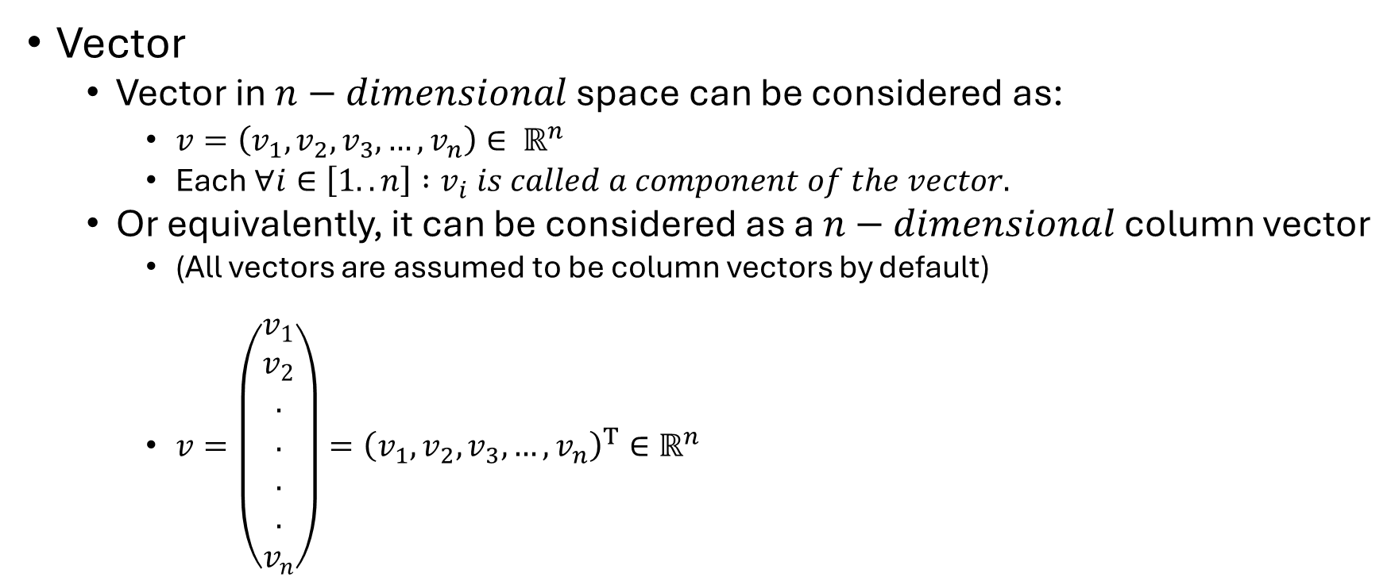
Geometric view of data
Vector
Vector in $n−dimensional$ space can be considered as:
$v=\left(v_{1}, v_{2}, v_{3}, …, v_{n}\right)∈ ℝ^{n}$
Each $∀i∈\left[1..n\right] :v_{i} is called a component of the vector.$
Or equivalently, it can be considered as a $n−dimensional$ column vector
(All vectors are assumed to be column vectors by default)
$v=\left(\begin{matrix}v_{1} \\ v_{2} \\ . \\ . \\ . \\ . \\ v_{n}\end{matrix}\right)={\left(v_{1}, v_{2}, v_{3}, …, v_{n}\right)}^{T}∈ℝ^{n}$

Slide 17
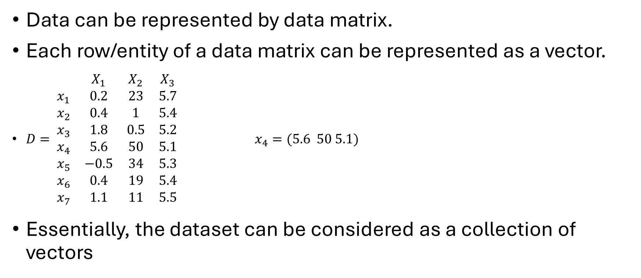
Common Data Formats
Data can be represented by data matrix.
Each row/entity of a data matrix can be represented as a vector.
$D= \begin{matrix} & X_{1} & X_{2} & X_{3} \\ x_{1} & 0.2 & 23 & 5.7 \\ x_{2} & 0.4 & 1 & 5.4 \\ x_{3} & 1.8 & 0.5 & 5.2 \\ x_{4} & 5.6 & 50 & 5.1 \\ x_{5} & −0.5 & 34 & 5.3 \\ x_{6} & 0.4 & 19 & 5.4 \\ x_{7} & 1.1 & 11 & 5.5\end{matrix}$ $x_{4}=(5.6 50 5.1)$
Essentially, the dataset can be considered as a collection of vectors

Slide 18


Geometric view of data
Vector addition $a+b=\left(a_{x}+b_{x} a_{y}+b_{y}\right)$
$$a=\left(\begin{matrix}a_{x} & a_{y}\end{matrix}\right)$$
$$b=\left(\begin{matrix}b_{x} & b_{y}\end{matrix}\right)$$
b
a

Slide 19
Geometric view of data
Vector addition $a+b=\left(a_{x}+b_{x} a_{y}+b_{y}\right)$
a
b
a

Slide 20
Geometric view of data
Vector addition $a+b=\left(a_{x}+b_{x} a_{y}+b_{y}\right)$
a
a + b
b
a

Slide 21
Geometric view of data
Vector addition $a+b=\left(a_{x}+b_{x} a_{y}+b_{y}\right)$
a
b
b
a + b
a

Slide 22

Geometric view of data
Vector subtraction $a − b=\left(a_{x}− b_{x} a_{y} − b_{y}\right)$
a
a -b
b

Slide 23

Geometric view of data
Scaling: For $α∈ ℝ, αv=\left(αv_{x} αv_{y}\right)$
v

Slide 24

Geometric view of data
Scaling: For $α∈ ℝ, αv=\left(αv_{x} αv_{y}\right)$
Basically, take $α$ copies of v, and add them.
v

Slide 25

Geometric view of data
Scaling: For $α∈ ℝ, αv=\left(αv_{x} αv_{y}\right)$
Let $α=3$, then
3v
v

Slide 26
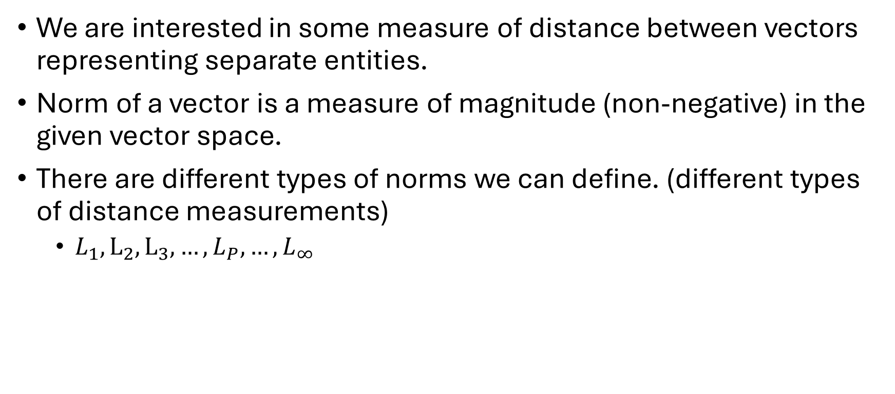
Distance between vectors
We are interested in some measure of distance between vectors representing separate entities.
Norm of a vector is a measure of magnitude (non-negative) in the given vector space.
There are different types of norms we can define. (different types of distance measurements)
$L_{1}, L_{2},L_{3}, …, L_{P}, …, L_{∞}$

Slide 27

Distance between vectors
$L_{2}$ norm of the vector $x_{i}$ with $m$ dimensions (columns/attributes)
$${\left\|x_{i}\right\|}_{2}=\sqrt{\sum_{k=1}^{m}{x_{ik}^{2}}} D= \begin{matrix} & X_{1} & X_{2} & X_{3} \\ x_{1} & 0.2 & 23 & 5.7 \\ x_{2} & 0.4 & 1 & 5.4 \\ x_{3} & 1.8 & 0.5 & 5.2 \\ x_{4} & 5.6 & 50 & 5.1 \\ x_{5} & −0.5 & 34 & 5.3 \\ x_{6} & 0.4 & 19 & 5.4 \\ x_{7} & 1.1 & 11 & 5.5\end{matrix}$$

Slide 28
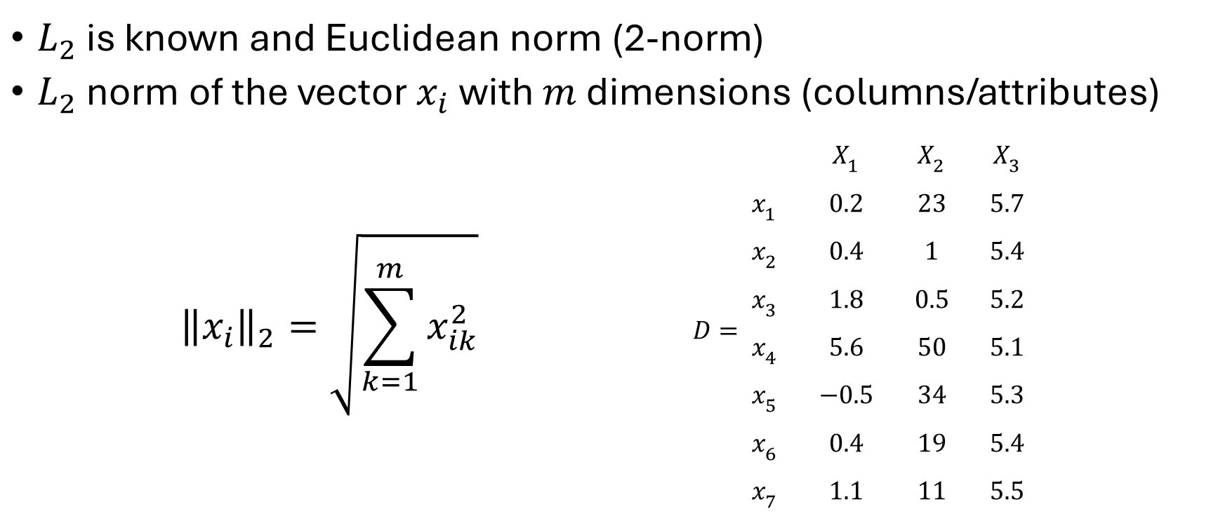
Distance between vectors
$L_{2}$ is known and Euclidean norm (2-norm)
$L_{2}$ norm of the vector $x_{i}$ with $m$ dimensions (columns/attributes)
$${\left\|x_{i}\right\|}_{2}=\sqrt{\sum_{k=1}^{m}{x_{ik}^{2}}} D= \begin{matrix} & X_{1} & X_{2} & X_{3} \\ x_{1} & 0.2 & 23 & 5.7 \\ x_{2} & 0.4 & 1 & 5.4 \\ x_{3} & 1.8 & 0.5 & 5.2 \\ x_{4} & 5.6 & 50 & 5.1 \\ x_{5} & −0.5 & 34 & 5.3 \\ x_{6} & 0.4 & 19 & 5.4 \\ x_{7} & 1.1 & 11 & 5.5\end{matrix}$$

Slide 29

Distance between vectors
$L_{2}$ example
${\left\|x_{7}\right\|}_{2}=\sqrt{\sum_{k=1}^{m}{\left(x_{7k}^{2}\right) } }=\sqrt{(x_{71}^{2}+x_{72}^{2})}=\sqrt{\left({1.1}^{2}+{11}^{2}\right)}= 11.05 \begin{matrix} & X_{1} & X_{2} \\ x_{1} & 0.2 & 23 \\ x_{2} & 0.4 & 1 \\ x_{3} & 1.8 & 0.2 \\ x_{4} & 5.6 & 50 \\ x_{5} & −0.5 & 34 \\ x_{6} & 0.4 & 19 \\ x_{7} & 1.1 & 11\end{matrix}$

Slide 30
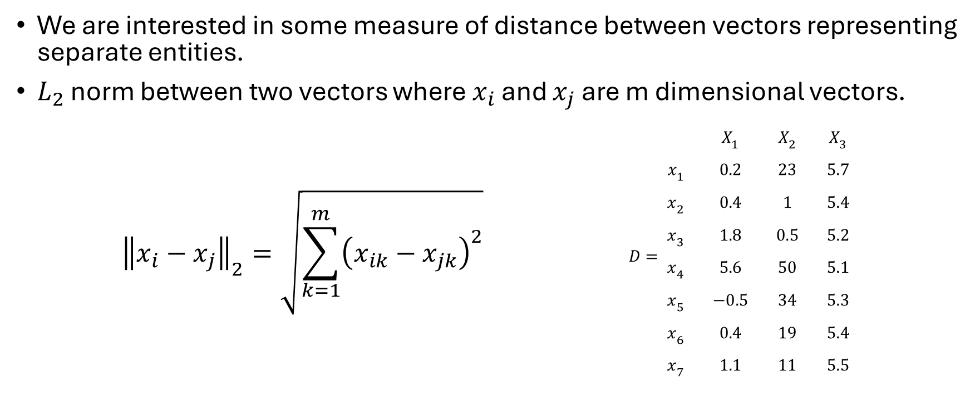
Distance between vectors
We are interested in some measure of distance between vectors representing separate entities.
$L_{2}$ norm between two vectors where $x_{i}$ and $x_{j}$ are m dimensional vectors.
$${\left\|x_{i}−x_{j}\right\|}_{2}=\sqrt{\sum_{k=1}^{m}{{\left(x_{ik}−x_{jk}\right)}^{2}}} D= \begin{matrix} & X_{1} & X_{2} & X_{3} \\ x_{1} & 0.2 & 23 & 5.7 \\ x_{2} & 0.4 & 1 & 5.4 \\ x_{3} & 1.8 & 0.5 & 5.2 \\ x_{4} & 5.6 & 50 & 5.1 \\ x_{5} & −0.5 & 34 & 5.3 \\ x_{6} & 0.4 & 19 & 5.4 \\ x_{7} & 1.1 & 11 & 5.5\end{matrix}$$

Slide 31
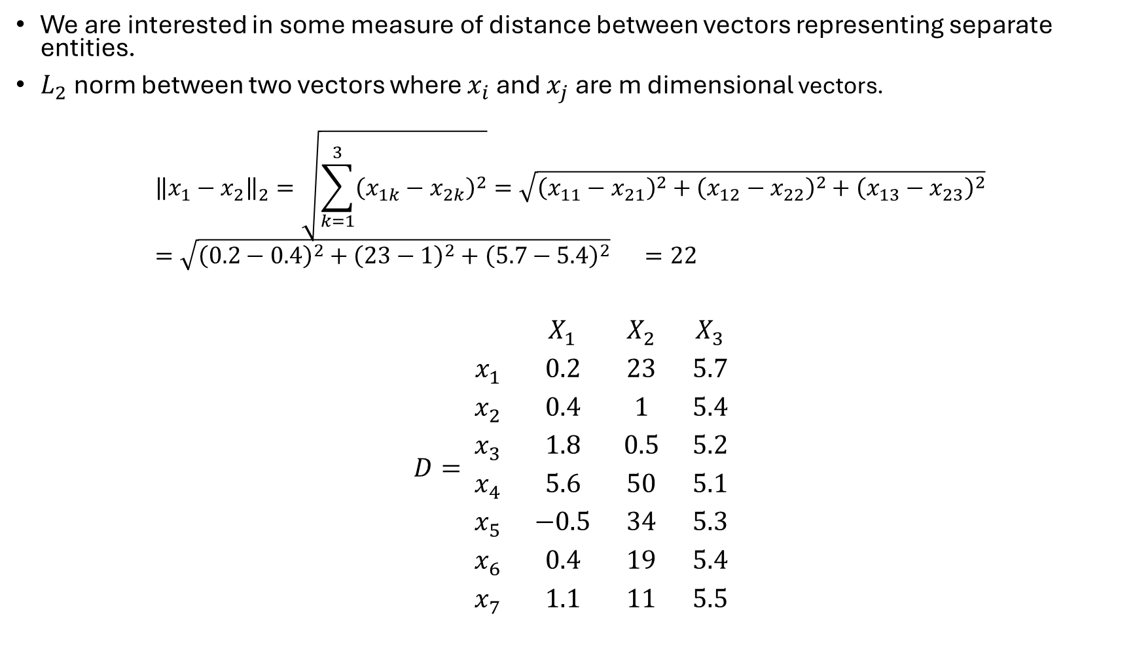
We are interested in some measure of distance between vectors representing separate entities.
$L_{2}$ norm between two vectors where $x_{i}$ and $x_{j}$ are m dimensional vectors.
$${\left\|x_{1}−x_{2}\right\|}_{2}=\sqrt{\sum_{k=1}^{3}{{\left(x_{1k}−x_{2k}\right)}^{2}}}=\sqrt{{\left(x_{11}−x_{21}\right)}^{2}+{\left(x_{12}−x_{22}\right)}^{2}+{\left(x_{13}−x_{23}\right)}^{2}}=\sqrt{{\left(0.2−0.4\right)}^{2}+{\left(23−1\right)}^{2}+{\left(5.7−5.4\right)}^{2}} =22$$
$$D= \begin{matrix} & X_{1} & X_{2} & X_{3} \\ x_{1} & 0.2 & 23 & 5.7 \\ x_{2} & 0.4 & 1 & 5.4 \\ x_{3} & 1.8 & 0.5 & 5.2 \\ x_{4} & 5.6 & 50 & 5.1 \\ x_{5} & −0.5 & 34 & 5.3 \\ x_{6} & 0.4 & 19 & 5.4 \\ x_{7} & 1.1 & 11 & 5.5\end{matrix}$$

Slide 32
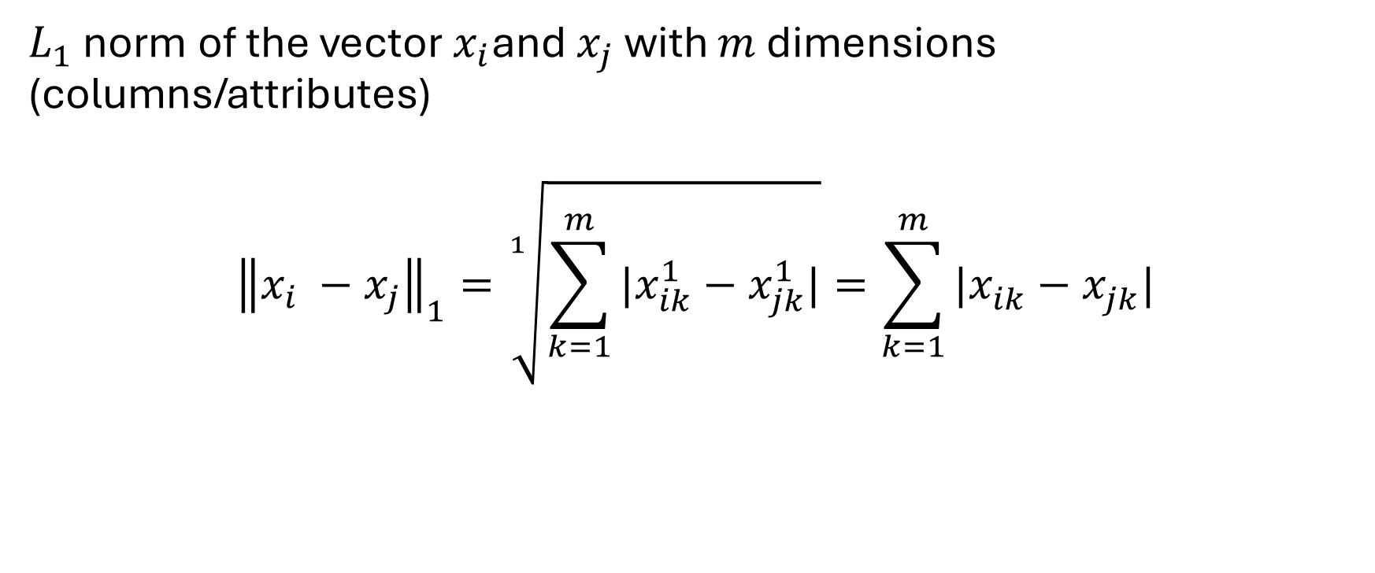
Distance between vectors
$L_{1}$ norm of the vector $x_{i}$and $x_{j}$ with $m$ dimensions (columns/attributes)
$${\left\|x_{i} −x_{j}\right\|}_{1}=\sqrt[1]{\sum_{k=1}^{m}{|x_{ik}^{1}−x_{jk}^{1}|}}=\sum_{k=1}^{m}{|x_{ik}^{ }−x_{jk}^{ }|}$$

Slide 33
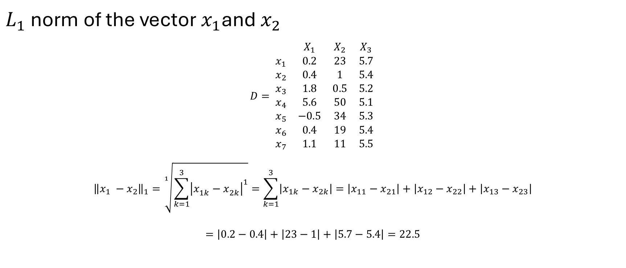
Distance between vectors
$L_{1}$ norm of the vector $x_{1}$and $x_{2}$
$$D= \begin{matrix} & X_{1} & X_{2} & X_{3} \\ x_{1} & 0.2 & 23 & 5.7 \\ x_{2} & 0.4 & 1 & 5.4 \\ x_{3} & 1.8 & 0.5 & 5.2 \\ x_{4} & 5.6 & 50 & 5.1 \\ x_{5} & −0.5 & 34 & 5.3 \\ x_{6} & 0.4 & 19 & 5.4 \\ x_{7} & 1.1 & 11 & 5.5\end{matrix}$$
$${\left\|x_{1} −x_{2}\right\|}_{1}=\sqrt[1]{\sum_{k=1}^{3}{{\left|x_{1k}^{ }−x_{2k}^{ }\right|}^{1}}}=\sum_{k=1}^{3}{\left|x_{1k}−x_{2k}\right|=\left|x_{11}−x_{21}\right|+\left|x_{12}−x_{22}\right|+\left|x_{13}−x_{23}\right|}$$
$$=\left|0.2−0.4\right|+\left|23−1\right|+\left|5.7−5.4\right|=22.5$$

Slide 34
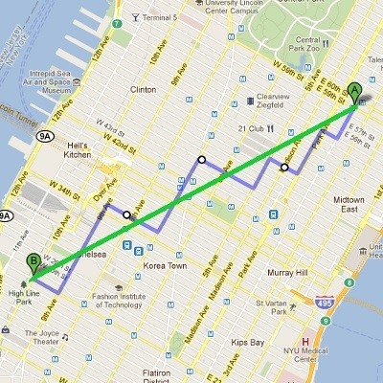


What does $L_{1}$ norm between two vectors mean?
$L_{1}$norm is the sum of absolute values of the components of the vector.
This is also called Manhattan distance/norm or taxicab norm.

Slide 35
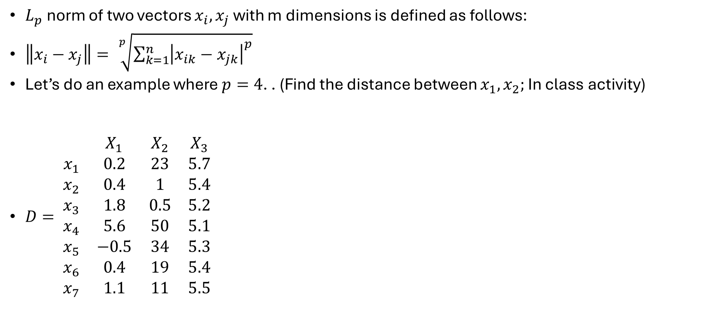
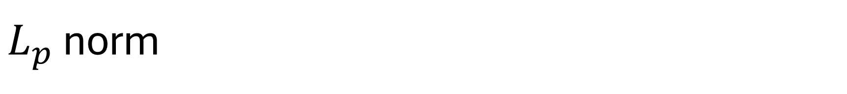
$L_{p}$ norm
$L_{p}$ norm of two vectors $x_{i}, x_{j}$ with m dimensions is defined as follows:
$\left\|x_{i}−x_{j}\right\|= \sqrt[p]{\sum_{k=1}^{n}{{\left|x_{ik}−x_{jk}\right|}^{p}}}$
Let’s do an example where $p=4$. . (Find the distance between $x_{1},x_{2};$In class activity)
$D= \begin{matrix} & X_{1} & X_{2} & X_{3} \\ x_{1} & 0.2 & 23 & 5.7 \\ x_{2} & 0.4 & 1 & 5.4 \\ x_{3} & 1.8 & 0.5 & 5.2 \\ x_{4} & 5.6 & 50 & 5.1 \\ x_{5} & −0.5 & 34 & 5.3 \\ x_{6} & 0.4 & 19 & 5.4 \\ x_{7} & 1.1 & 11 & 5.5\end{matrix}$

Slide 36
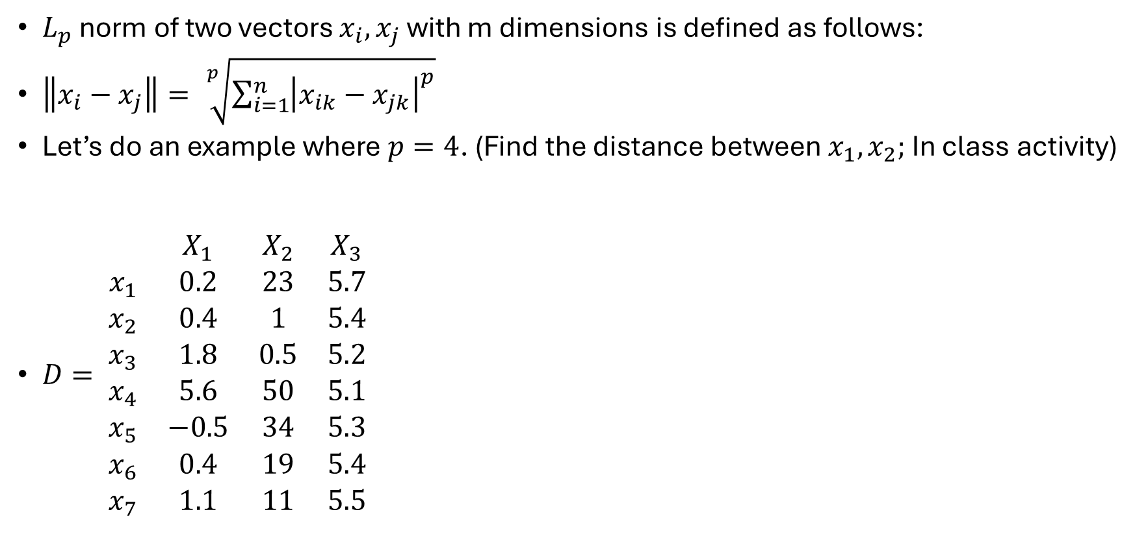

$L_{p}$ norm
$L_{p}$ norm of two vectors $x_{i}, x_{j}$ with m dimensions is defined as follows:
$\left\|x_{i}−x_{j}\right\|= \sqrt[p]{\sum_{i=1}^{n}{{\left|x_{ik}−x_{jk}\right|}^{p}}}$
Let’s do an example where $p=4$. (Find the distance between $x_{1},x_{2};$In class activity)
$D= \begin{matrix} & X_{1} & X_{2} & X_{3} \\ x_{1} & 0.2 & 23 & 5.7 \\ x_{2} & 0.4 & 1 & 5.4 \\ x_{3} & 1.8 & 0.5 & 5.2 \\ x_{4} & 5.6 & 50 & 5.1 \\ x_{5} & −0.5 & 34 & 5.3 \\ x_{6} & 0.4 & 19 & 5.4 \\ x_{7} & 1.1 & 11 & 5.5\end{matrix}$
$$\left\|x_{1} −x_{2}\right\|= \sqrt[4]{\sum_{i=1}^{3}{{\left|x_{1k}−x_{2k}\right|}^{4}}}$$
$$= \sqrt[4]{{\left|0.2−0.4\right|}^{4}+{\left|23−1\right|}^{4}+{\left|5.7−5.4\right|}^{4}}$$
$$=22.0000002277$$
$$≅22$$

Slide 37

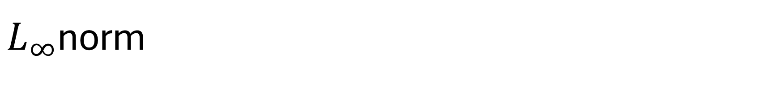
$L_{∞}$norm
$L_{∞}$ norm of two vectors $x_{i}, x_{j}$ with m dimensions is defined as follows:
$$\left\|x_{i}−x_{j}\right\|= \lim_{p→∞}{\sqrt[p]{\sum_{i=1}^{m}{{\left|x_{ik}−x_{jk}\right|}^{p}}} }=\max{(\left|x_{i1}−x_{j1}\right|, \left|x_{i2}−x_{j2}\right|, …, \left|x_{im}−x_{jm}\right|)}$$
Basically, the largest component of the difference of the vectors.

Slide 38

Dot product of two vectors
Dot product: Given two vectors $a,b$ of $m$ dimensions
$$a⋅b=a^{T}b=\sum_{i=1}^{m}{a_{k}b_{k}}$$

Slide 39
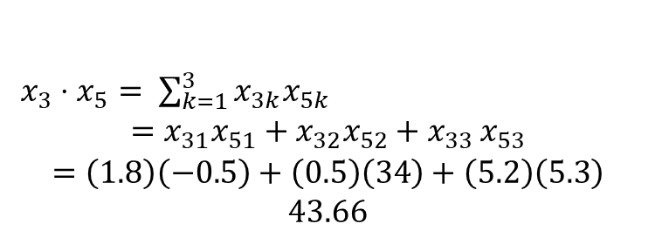

Dot product of two vectors
Dot product between $x_{3}$and $x_{5}$:
$D= \begin{matrix} & X_{1} & X_{2} & X_{3} \\ x_{1} & 0.2 & 23 & 5.7 \\ x_{2} & 0.4 & 1 & 5.4 \\ x_{3} & 1.8 & 0.5 & 5.2 \\ x_{4} & 5.6 & 50 & 5.1 \\ x_{5} & −0.5 & 34 & 5.3 \\ x_{6} & 0.4 & 19 & 5.4 \\ x_{7} & 1.1 & 11 & 5.5\end{matrix}$
$x_{3}⋅x_{5}= \sum_{k=1}^{3}{x_{3k}x_{5k}}$
$$=x_{31}x_{51}+x_{32}x_{52}+x_{{33}_{ }}x_{53}$$
$$=\left(1.8\right)\left(−0.5\right)+\left(0.5\right)\left(34\right)+\left(5.2\right)\left(5.3\right)$$
$$43.66$$

Slide 40
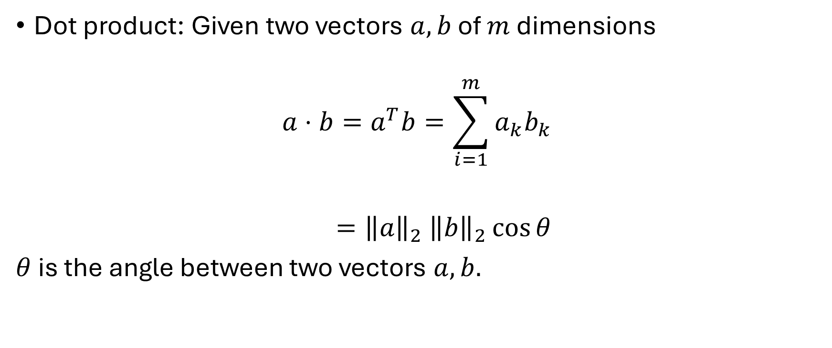
Dot product of two vectors
Dot product: Given two vectors $a,b$ of $m$ dimensions
$$a⋅b=a^{T}b=\sum_{i=1}^{m}{a_{k}b_{k}}$$
$={\left\|a\right\|}_{2}$ ${\left\|b\right\|}_{2}\cos{θ}$
$θ$ is the angle between two vectors $a,b.$

Slide 41

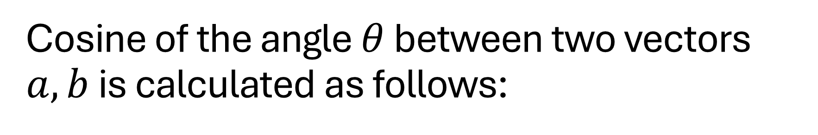
Cosine of the angle $θ$ between two vectors $a,b$ is calculated as follows:
$$\cos{θ=\frac{a⋅b}{{\left\|a\right\|}_{2}{\left\|b\right\|}_{2}}}$$

Slide 42


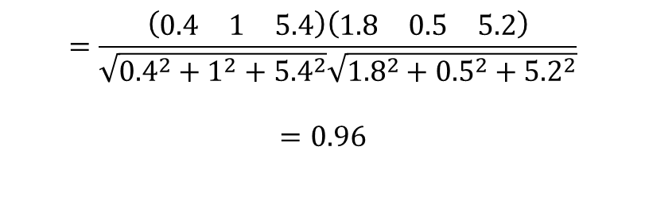
Example: cosine of the angle between $x_{2}, x_{3}$is:
$D= \begin{matrix} & X_{1} & X_{2} & X_{3} \\ x_{1} & 0.2 & 23 & 5.7 \\ x_{2} & 0.4 & 1 & 5.4 \\ x_{3} & 1.8 & 0.5 & 5.2 \\ x_{4} & 5.6 & 50 & 5.1 \\ x_{5} & −0.5 & 34 & 5.3 \\ x_{6} & 0.4 & 19 & 5.4 \\ x_{7} & 1.1 & 11 & 5.5\end{matrix}$
$$\frac{x_{2}⋅x_{3}}{{\left\|x_{2}\right\|}_{2}{\left\|x_{3}\right\|}_{2}}$$
$$=\frac{\left(\begin{matrix}0.4 & 1 & 5.4\end{matrix}\right)\left(\begin{matrix}1.8 & 0.5 & 5.2\end{matrix}\right)}{\sqrt{{0.4}^{2}+1^{2}+{5.4}^{2}}\sqrt{{1.8}^{2}+{0.5}^{2}+{5.2}^{2}}}$$
$$=0.96$$

Slide 43

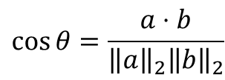



Distance between vectors
$$\cos{θ=\frac{a⋅b}{{\left\|a\right\|}_{2}{\left\|b\right\|}_{2}}}$$
a
$$θ$$
b
$$\cos{θ_{1}≈1}$$
$$\cos{θ_{1}≈0}$$
$$\cos{θ_{1}=−1 }$$

Slide 44
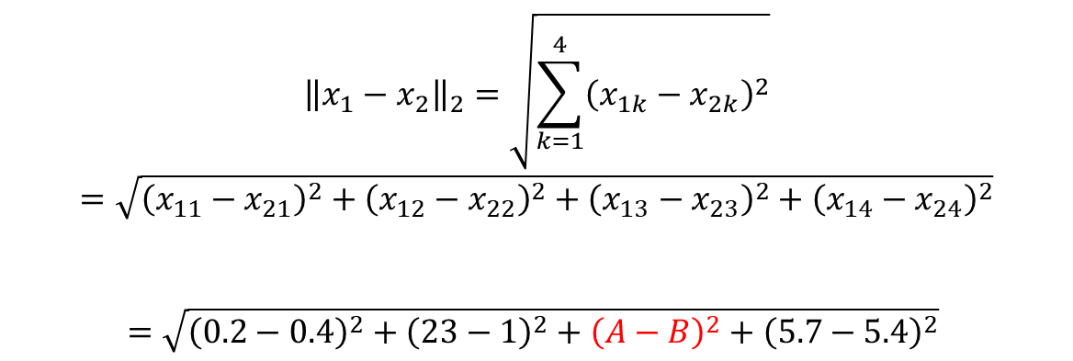
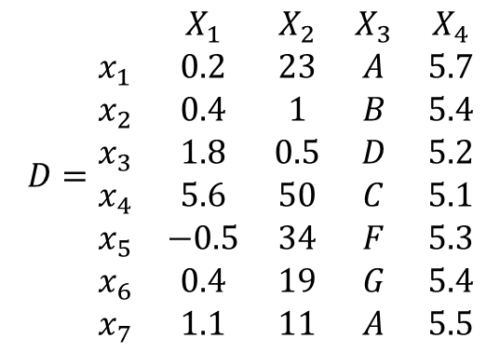
What if we have categorical attributes?
$$D=\begin{matrix} & X_{1} & X_{2} & X_{3} & X_{4} \\ x_{1} & 0.2 & 23 & A & 5.7 \\ x_{2} & 0.4 & 1 & B & 5.4 \\ x_{3} & 1.8 & 0.5 & D & 5.2 \\ x_{4} & 5.6 & 50 & C & 5.1 \\ x_{5} & −0.5 & 34 & F & 5.3 \\ x_{6} & 0.4 & 19 & G & 5.4 \\ x_{7} & 1.1 & 11 & A & 5.5\end{matrix}$$
$${\left\|x_{1}−x_{2}\right\|}_{2}=\sqrt{\sum_{k=1}^{4}{{\left(x_{1k}−x_{2k}\right)}^{2}}}$$
$$=\sqrt{{\left(x_{11}−x_{21}\right)}^{2}+{\left(x_{12}−x_{22}\right)}^{2}+{\left(x_{13}−x_{23}\right)}^{2}+{\left(x_{14}−x_{24}\right)}^{2}}$$
$$=\sqrt{{\left(0.2−0.4\right)}^{2}+{\left(23−1\right)}^{2}+{{\left(A−B\right)}^{2}+\left(5.7−5.4\right)}^{2}}$$
What can we do about this?

Slide 45
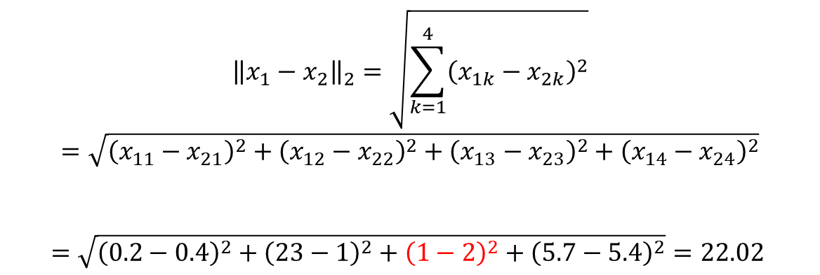
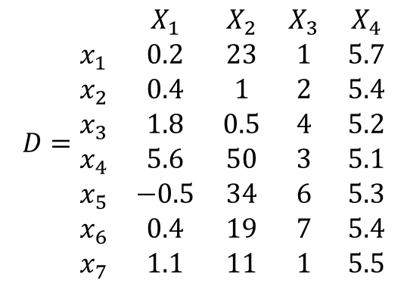
What if we have categorical attributes? Integer encoding
$${\left\|x_{1}−x_{2}\right\|}_{2}=\sqrt{\sum_{k=1}^{4}{{\left(x_{1k}−x_{2k}\right)}^{2}}}$$
$$=\sqrt{{\left(x_{11}−x_{21}\right)}^{2}+{\left(x_{12}−x_{22}\right)}^{2}+{\left(x_{13}−x_{23}\right)}^{2}+{\left(x_{14}−x_{24}\right)}^{2}}$$
$$=\sqrt{{\left(0.2−0.4\right)}^{2}+{\left(23−1\right)}^{2}+{{\left(1−2\right)}^{2}+\left(5.7−5.4\right)}^{2}}=22.02$$
$$D=\begin{matrix} & X_{1} & X_{2} & X_{3} & X_{4} \\ x_{1} & 0.2 & 23 & 1 & 5.7 \\ x_{2} & 0.4 & 1 & 2 & 5.4 \\ x_{3} & 1.8 & 0.5 & 4 & 5.2 \\ x_{4} & 5.6 & 50 & 3 & 5.1 \\ x_{5} & −0.5 & 34 & 6 & 5.3 \\ x_{6} & 0.4 & 19 & 7 & 5.4 \\ x_{7} & 1.1 & 11 & 1 & 5.5\end{matrix}$$

Slide 46


What if we have categorical attributes?
$$D=\begin{matrix} & X_{1} & X_{2} & X_{3} & X_{4} \\ x_{1} & 0.2 & 23 & 1 & 5.7 \\ x_{2} & 0.4 & 1 & 2 & 5.4 \\ x_{3} & 1.8 & 0.5 & 4 & 5.2 \\ x_{4} & 5.6 & 50 & 3 & 5.1 \\ x_{5} & −0.5 & 34 & 6 & 5.3 \\ x_{6} & 0.4 & 19 & 7 & 5.4 \\ x_{7} & 1.1 & 11 & 1 & 5.5\end{matrix}$$
$${\left\|x_{1}−x_{2}\right\|}_{2}=\sqrt{\sum_{k=1}^{4}{{\left(x_{1k}−x_{2k}\right)}^{2}}}$$
$$=\sqrt{{\left(x_{11}−x_{21}\right)}^{2}+{\left(x_{12}−x_{22}\right)}^{2}+{\left(x_{13}−x_{23}\right)}^{2}+{\left(x_{14}−x_{24}\right)}^{2}}$$
$$=\sqrt{{\left(0.2−0.4\right)}^{2}+{\left(23−1\right)}^{2}+{{\left(1−2\right)}^{2}+\left(5.7−5.4\right)}^{2}}=22.02$$
This is appropriate if the categorical attribute is ordinal (there is an order)
Not a good approach for nominal attributes
Easy to implement

Slide 47



One-Hot encoding
Appropriate for nominal data.
Create a binary column for each possible value in the category.
Ex: $X_{3}$ is replaced by columns $X_{3A},X_{3B}, X_{3C}, X_{3D}, X_{3F}, X_{3G}$
If category A is present in the row, then the observed value for the new column $X_{3A}$ is 1, and all the other new columns are 0.
$$D=\begin{matrix} & X_{1} & X_{2} & X_{3} & X_{4} \\ x_{1} & 0.2 & 23 & A & 5.7 \\ x_{2} & 0.4 & 1 & B & 5.4 \\ x_{3} & 1.8 & 0.5 & D & 5.2 \\ x_{4} & 5.6 & 50 & C & 5.1 \\ x_{5} & −0.5 & 34 & F & 5.3 \\ x_{6} & 0.4 & 19 & G & 5.4 \\ x_{7} & 1.1 & 11 & A & 5.5\end{matrix}$$
$$D=\begin{matrix} & X_{1} & X_{2} & X_{3A} & X_{3B} & X_{3C} & X_{3D} & X_{3F} & X_{3G} & X_{4} \\ x_{1} & 0.2 & 23 & 1 & 0 & 0 & 0 & 0 & 0 & 5.7 \\ x_{2} & 0.4 & 1 & 0 & 1 & 0 & 0 & 0 & 0 & 5.4 \\ x_{3} & 1.8 & 0.5 & 0 & 0 & 0 & 1 & 0 & 0 & 5.2 \\ x_{4} & 5.6 & 50 & 0 & 0 & 1 & 0 & 0 & 0 & 5.1 \\ x_{5} & −0.5 & 34 & 0 & 0 & 0 & 0 & 1 & 0 & 5.3 \\ x_{6} & 0.4 & 19 & 0 & 0 & 0 & 0 & 0 & 1 & 5.4 \\ x_{7} & 1.1 & 11 & 1 & 0 & 0 & 0 & 0 & 0 & 5.5\end{matrix}$$

Slide 48


One-Hot encoding
$$D=\begin{matrix} & X_{1} & X_{2} & X_{3A} & X_{3B} & X_{3C} & X_{3D} & X_{3F} & X_{3G} & X_{4} \\ x_{1} & 0.2 & 23 & 1 & 0 & 0 & 0 & 0 & 0 & 5.7 \\ x_{2} & 0.4 & 1 & 0 & 1 & 0 & 0 & 0 & 0 & 5.4 \\ x_{3} & 1.8 & 0.5 & 0 & 0 & 0 & 1 & 0 & 0 & 5.2 \\ x_{4} & 5.6 & 50 & 0 & 0 & 1 & 0 & 0 & 0 & 5.1 \\ x_{5} & −0.5 & 34 & 0 & 0 & 0 & 0 & 1 & 0 & 5.3 \\ x_{6} & 0.4 & 19 & 0 & 0 & 0 & 0 & 0 & 1 & 5.4 \\ x_{7} & 1.1 & 11 & 1 & 0 & 0 & 0 & 0 & 0 & 5.5\end{matrix}$$
$${\left\|x_{1}−x_{2}\right\|}_{2}=\sqrt{\sum_{k=1}^{9}{{\left(x_{1k}−x_{2k}\right)}^{2}}}$$
$$=$$
$$=\sqrt{{\left(0.2−0.4\right)}^{2}+{\left(23−1\right)}^{2}{+\left(5.7−5.4\right)}^{2}+{\left(1−0\right)}^{2}+{\left(0−1\right)}^{2}+{\left(0−0\right)}^{2}+{\left(0−0\right)}^{2}+{\left(0−0\right)}^{2}+{\left(0−0\right)}^{2}}=22.05$$

Slide 49


Putting it together
Application: How far is $a$ from the line through $b?$
How long is the dotted line?
a
$$θ$$
b

Slide 50



Putting it together
Application: How far is $a$ from the line through $b?$
How long is the dotted line?
a
$$θ$$
b
$$a_{b}={\left\|a\right\|}_{2}\cos{θ={\left\|a\right\|}_{2}⋅\frac{a⋅b }{{{\left\|a\right\|}_{2}\left\|b\right\|}_{2}}=\frac{a⋅b }{{\left\|b\right\|}_{2}}}$$
Scalar projection of $a$ in direction of $b$

Slide 51


Putting it together
Application: How far is $a$ from the line through $b?$
How long is the dotted line?
a
$$θ$$
p
$$\cos{θ=\frac{a⋅b}{{\left\|a\right\|}_{2}{\left\|b\right\|}_{2}}}$$
b
$$p=a_{b}b=(\left\|a\right\|cos θ) b{=\left(\frac{a⋅b }{\left\|b\right\|}\right)}b$$

Slide 52
Putting it together
Application: How far is $a$ from the line through $b?$
How long is the dotted line?
a
a-p
$$θ$$
p
$$\cos{θ=\frac{a⋅b}{{\left\|a\right\|}_{2}{\left\|b\right\|}_{2}}}$$
b
$$p=a_{b}b=(\left\|a\right\|cos θ) b{=\left(\frac{a⋅b }{\left\|b\right\|}\right)}b$$

Slide 53

Putting it together
Application: How far is $a$ from the line through $b?$
How long is the dotted line?
Answer: ${\left\|a−p\right\|}_{2}$
a
a-p
$$θ$$
p
$$\cos{θ=\frac{a⋅b}{{\left\|a\right\|}_{2}{\left\|b\right\|}_{2}}}$$
b
$$p=a_{b}b=(\left\|a\right\|cos θ) b{=\left(\frac{a⋅b }{\left\|b\right\|}\right)}b$$

