Slide 1
CSCI 347 Data Mining
More about distance measures and similarity measures

Slide 2
Peer note taker is needed for CSCI 347
A peer note taker is needed in this course. Taking notes for another student benefits both students. Note takers usually find the quality of their notes improves when they know someone else will be reading them. They may include this service on a resume, and know they are delivering a needed accommodation for a fellow student.
To be a peer note taker, you should meet these three criteria:
Commit to regularly attend class
Type all notes during or after class. Math and some science courses may be handwritten and scanned
Be in good academic standing and have strong note taking skills

Slide 3
This position is PAID, and more hours may be available outside of the regular class time. You must have identification for hiring purposes immediately available (passport OR driver's license, military or state identification AND social security card or birth certificate)
If you meet these criteria and are interested in this paid position, please contact the Office of Disability Services in person 137 Romney Hall, notetaking@montana.edu or 406-994-2824.

Slide 4
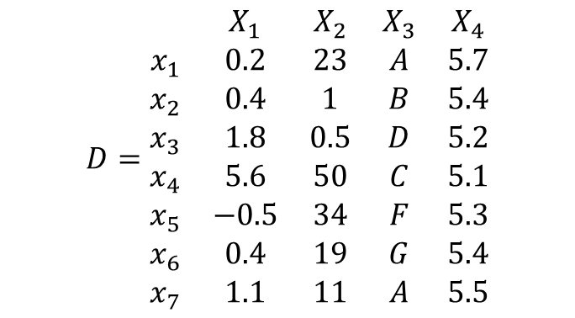
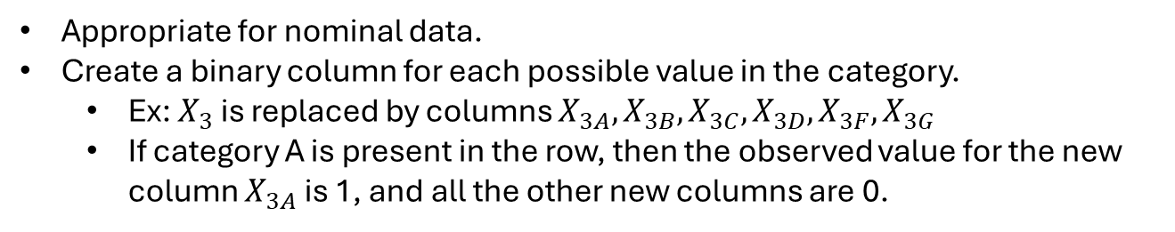
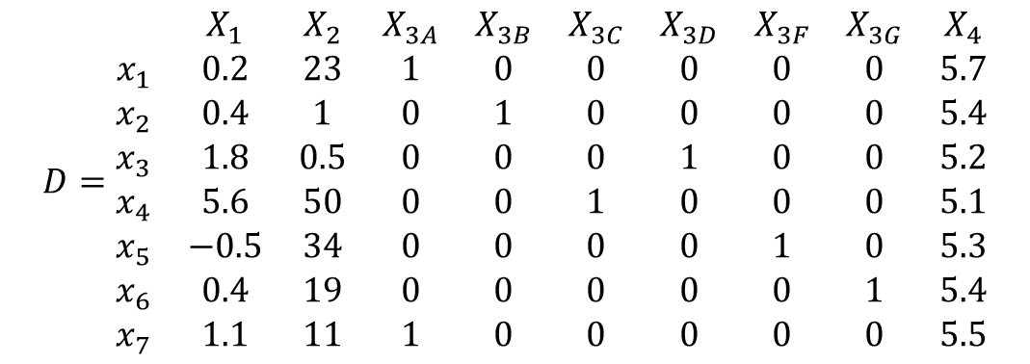
One-Hot encoding
Appropriate for nominal data.
Create a binary column for each possible value in the category.
Ex: $X_{3}$ is replaced by columns $X_{3A},X_{3B}, X_{3C}, X_{3D}, X_{3F}, X_{3G}$
If category A is present in the row, then the observed value for the new column $X_{3A}$ is 1, and all the other new columns are 0.
$$D=\begin{matrix} & X_{1} & X_{2} & X_{3} & X_{4} \\ x_{1} & 0.2 & 23 & A & 5.7 \\ x_{2} & 0.4 & 1 & B & 5.4 \\ x_{3} & 1.8 & 0.5 & D & 5.2 \\ x_{4} & 5.6 & 50 & C & 5.1 \\ x_{5} & −0.5 & 34 & F & 5.3 \\ x_{6} & 0.4 & 19 & G & 5.4 \\ x_{7} & 1.1 & 11 & A & 5.5\end{matrix}$$
$$D=\begin{matrix} & X_{1} & X_{2} & X_{3A} & X_{3B} & X_{3C} & X_{3D} & X_{3F} & X_{3G} & X_{4} \\ x_{1} & 0.2 & 23 & 1 & 0 & 0 & 0 & 0 & 0 & 5.7 \\ x_{2} & 0.4 & 1 & 0 & 1 & 0 & 0 & 0 & 0 & 5.4 \\ x_{3} & 1.8 & 0.5 & 0 & 0 & 0 & 1 & 0 & 0 & 5.2 \\ x_{4} & 5.6 & 50 & 0 & 0 & 1 & 0 & 0 & 0 & 5.1 \\ x_{5} & −0.5 & 34 & 0 & 0 & 0 & 0 & 1 & 0 & 5.3 \\ x_{6} & 0.4 & 19 & 0 & 0 & 0 & 0 & 0 & 1 & 5.4 \\ x_{7} & 1.1 & 11 & 1 & 0 & 0 & 0 & 0 & 0 & 5.5\end{matrix}$$

Slide 5
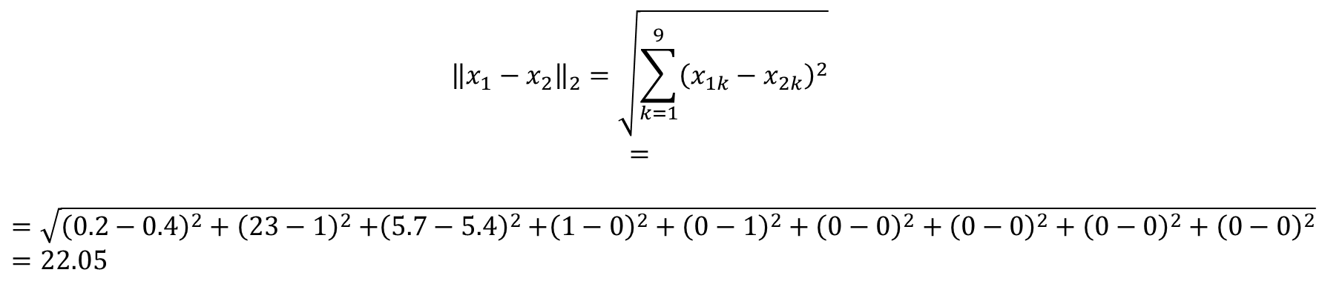
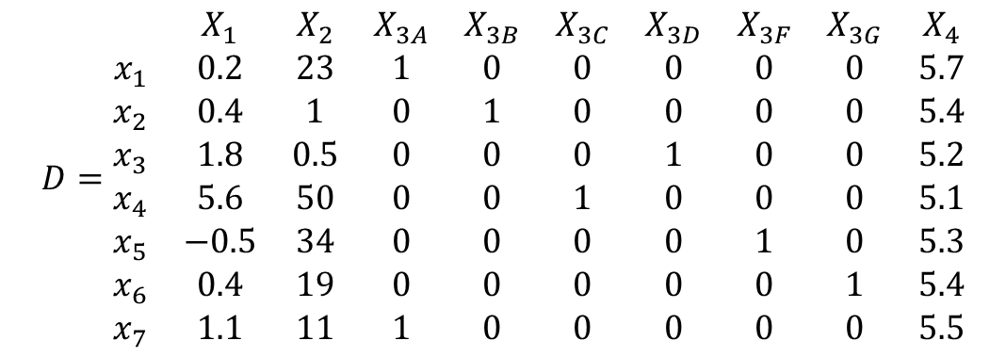
One-Hot encoding
$$D=\begin{matrix} & X_{1} & X_{2} & X_{3A} & X_{3B} & X_{3C} & X_{3D} & X_{3F} & X_{3G} & X_{4} \\ x_{1} & 0.2 & 23 & 1 & 0 & 0 & 0 & 0 & 0 & 5.7 \\ x_{2} & 0.4 & 1 & 0 & 1 & 0 & 0 & 0 & 0 & 5.4 \\ x_{3} & 1.8 & 0.5 & 0 & 0 & 0 & 1 & 0 & 0 & 5.2 \\ x_{4} & 5.6 & 50 & 0 & 0 & 1 & 0 & 0 & 0 & 5.1 \\ x_{5} & −0.5 & 34 & 0 & 0 & 0 & 0 & 1 & 0 & 5.3 \\ x_{6} & 0.4 & 19 & 0 & 0 & 0 & 0 & 0 & 1 & 5.4 \\ x_{7} & 1.1 & 11 & 1 & 0 & 0 & 0 & 0 & 0 & 5.5\end{matrix}$$
$${\left\|x_{1}−x_{2}\right\|}_{2}=\sqrt{\sum_{k=1}^{9}{{\left(x_{1k}−x_{2k}\right)}^{2}}}$$
$$=$$
$$=\sqrt{{\left(0.2−0.4\right)}^{2}+{\left(23−1\right)}^{2}{+\left(5.7−5.4\right)}^{2}+{\left(1−0\right)}^{2}+{\left(0−1\right)}^{2}+{\left(0−0\right)}^{2}+{\left(0−0\right)}^{2}+{\left(0−0\right)}^{2}+{\left(0−0\right)}^{2}}=22.05$$

Slide 6
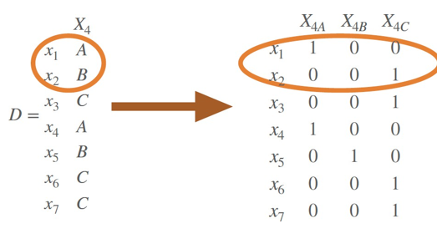

Dot product and binary data
If we take the one-hot encoding data, then the dot product of two vectors (projection of one-hot encoded data) is the number of matching categorical values.
$$x_{1}^{T}x_{2}=1\left(0\right)+0\left(0\right)+0\left(1\right)=0$$
$$s\left(x_{1},x_{2}\right)=0 because x_{14}=A and x_{24}=B$$

Slide 7
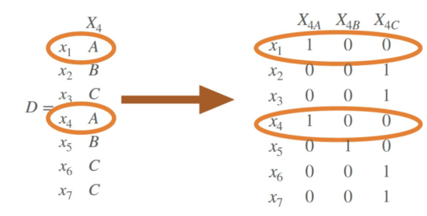

Dot product and binary data
If we take the one-hot encoding data, then the dot product of two vectors (projection of one-hot encoded data) is the number of matching categorical values.
$x_{1}^{T}x_{4}=1\left(1\right)+0\left(0\right)+0\left(0\right)=1$
$$s\left(x_{1},x_{2}\right)=0 because x_{14}=A and x_{24}=B for X_{4}$$
$$s\left(x_{1},x_{4}\right)=1 because x_{14}=A and x_{44}=A for attribute X_{4}$$

Slide 8
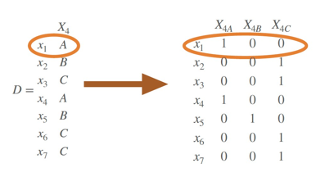


Dot product and binary data
For one-hot encoded data, the number categorical attributes d is the squared 2-norm each point:
$$d={\left\|x_{i}\right\|}^{2}=x_{i}^{T}x_{i}$$
$${‖x}_{1}^{2}‖=1^{2}+0^{2}+0^{2}=1=d$$

Slide 9
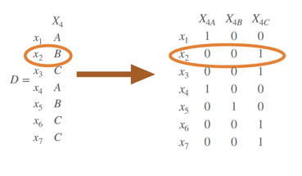

Dot product and binary data
For one-hot encoded data, the number categorical attributes d is the squared 2-norm each point:
$$d={\left\|x_{i}\right\|}^{2}=x_{i}^{T}x_{i}$$
$${‖x}_{2}^{2}‖=0^{2}+0^{2}+1^{2}=1 =d$$

Slide 10
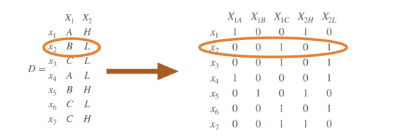

Dot product and binary data
For one-hot encoded data, the number categorical attributes d is the squared 2-norm each point:
$$d={\left\|x_{i}\right\|}^{2}=x_{i}^{T}x_{i}$$
$${‖x}_{2}^{2}‖=0^{2}+0^{2}+1^{2}+0^{2}+1^{2}=2 =d$$

Slide 11

Hamming distance
Hamming Distance: number of mismatches between two vectors
$$δ_{H}\left(x_{i}, x_{j}\right)= \sum_{k=1}^{m}{\left(x_{ik}⊕x_{jk}\right)}$$

Slide 12

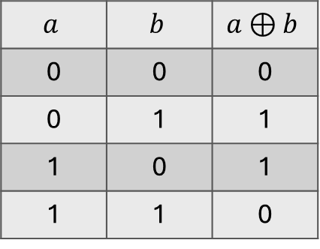
Hamming distance
Hamming Distance: number of mismatches between two vectors
$$δ_{H}\left(x_{i}, x_{j}\right)= \sum_{k=1}^{m}{\left(x_{ik}⊕x_{jk}\right)}$$
Recall that $XOR⊕$
$$a$$ | $$b$$ | $$a⊕b$$
0 | 0 | 0
0 | 1 | 1
1 | 0 | 1
1 | 1 | 0

Slide 13
Hamming distance
Hamming Distance: number of mismatches between two vectors
$$δ_{H}\left(x_{i}, x_{j}\right)= \sum_{k=1}^{m}{\left(x_{ik}⊕x_{jk}\right)}$$
Recall that $XOR⊕$
$$a$$ | $$b$$ | $$a⊕b$$
0 | 0 | 0
0 | 1 | 1
1 | 0 | 1
1 | 1 | 0

Slide 14
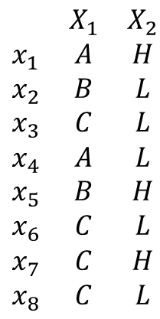
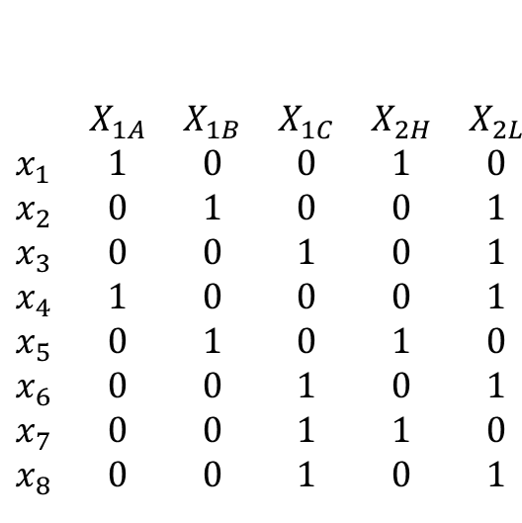
Hamming distance
Hamming Distance: number of mismatches between two vectors
$$δ_{H}\left(x_{i}, x_{j}\right)= \sum_{k=1}^{m}{\left(x_{ik}⊕x_{jk}\right)}$$
$$\begin{matrix} & X_{1A} & X_{1B} & X_{1C} & X_{2H} & X_{2L} \\ x_{1} & 1 & 0 & 0 & 1 & 0 \\ x_{2} & 0 & 1 & 0 & 0 & 1 \\ x_{3} & 0 & 0 & 1 & 0 & 1 \\ x_{4} & 1 & 0 & 0 & 0 & 1 \\ x_{5} & 0 & 1 & 0 & 1 & 0 \\ x_{6} & 0 & 0 & 1 & 0 & 1 \\ x_{7} & 0 & 0 & 1 & 1 & 0 \\ x_{8} & 0 & 0 & 1 & 0 & 1\end{matrix}$$
$$\begin{matrix} & X_{1} & X_{2} \\ x_{1} & A & H \\ x_{2} & B & L \\ x_{3} & C & L \\ x_{4} & A & L \\ x_{5} & B & H \\ x_{6} & C & L \\ x_{7} & C & H \\ x_{8} & C & L\end{matrix}$$

Slide 15
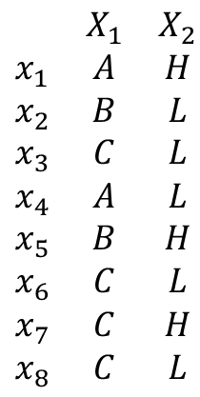
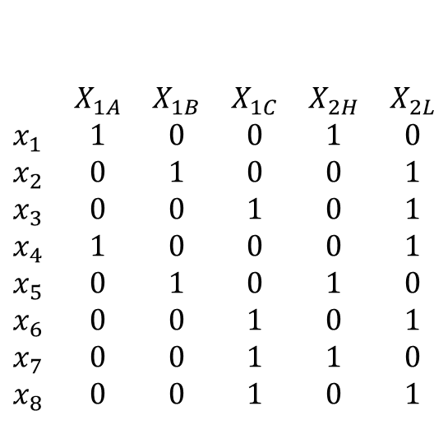
Hamming distance
Hamming Distance: number of mismatches between two vectors
$$δ_{H}\left(x_{i}, x_{j}\right)= \sum_{k=1}^{m}{\left(x_{ik}⊕x_{jk}\right)}$$
$$\begin{matrix} & X_{1A} & X_{1B} & X_{1C} & X_{2H} & X_{2L} \\ x_{1} & 1 & 0 & 0 & 1 & 0 \\ x_{2} & 0 & 1 & 0 & 0 & 1 \\ x_{3} & 0 & 0 & 1 & 0 & 1 \\ x_{4} & 1 & 0 & 0 & 0 & 1 \\ x_{5} & 0 & 1 & 0 & 1 & 0 \\ x_{6} & 0 & 0 & 1 & 0 & 1 \\ x_{7} & 0 & 0 & 1 & 1 & 0 \\ x_{8} & 0 & 0 & 1 & 0 & 1\end{matrix}$$
$$\begin{matrix} & X_{1} & X_{2} \\ x_{1} & A & H \\ x_{2} & B & L \\ x_{3} & C & L \\ x_{4} & A & L \\ x_{5} & B & H \\ x_{6} & C & L \\ x_{7} & C & H \\ x_{8} & C & L\end{matrix}$$
$$δ_{H}\left(x_{1},x_{2}\right)=\left(1⊕0\right)+\left(0⊕1\right)+\left(0⊕0\right)+\left(1⊕0\right)+\left(0⊕1\right) =4$$

Slide 16
Hamming distance
Hamming Distance: number of mismatches between two vectors
$$δ_{H}\left(x_{i}, x_{j}\right)= \sum_{k=1}^{m}{\left(x_{ik}⊕x_{jk}\right)}$$
$$\begin{matrix} & X_{1A} & X_{1B} & X_{1C} & X_{2H} & X_{2L} \\ x_{1} & 1 & 0 & 0 & 1 & 0 \\ x_{2} & 0 & 1 & 0 & 0 & 1 \\ x_{3} & 0 & 0 & 1 & 0 & 1 \\ x_{4} & 1 & 0 & 0 & 0 & 1 \\ x_{5} & 0 & 1 & 0 & 1 & 0 \\ x_{6} & 0 & 0 & 1 & 0 & 1 \\ x_{7} & 0 & 0 & 1 & 1 & 0 \\ x_{8} & 0 & 0 & 1 & 0 & 1\end{matrix}$$
$$\begin{matrix} & X_{1} & X_{2} \\ x_{1} & A & H \\ x_{2} & B & L \\ x_{3} & C & L \\ x_{4} & A & L \\ x_{5} & B & H \\ x_{6} & C & L \\ x_{7} & C & H \\ x_{8} & C & L\end{matrix}$$
$$δ_{H}\left(x_{3},x_{8}\right)= ?$$

Slide 17
Hamming distance
Hamming Distance: number of mismatches between two vectors
$$δ_{H}\left(x_{i}, x_{j}\right)= \sum_{k=1}^{m}{\left(x_{ik}⊕x_{jk}\right)}$$
$$\begin{matrix} & X_{1A} & X_{1B} & X_{1C} & X_{2H} & X_{2L} \\ x_{1} & 1 & 0 & 0 & 1 & 0 \\ x_{2} & 0 & 1 & 0 & 0 & 1 \\ x_{3} & 0 & 0 & 1 & 0 & 1 \\ x_{4} & 1 & 0 & 0 & 0 & 1 \\ x_{5} & 0 & 1 & 0 & 1 & 0 \\ x_{6} & 0 & 0 & 1 & 0 & 1 \\ x_{7} & 0 & 0 & 1 & 1 & 0 \\ x_{8} & 0 & 0 & 1 & 0 & 1\end{matrix}$$
$$\begin{matrix} & X_{1} & X_{2} \\ x_{1} & A & H \\ x_{2} & B & L \\ x_{3} & C & L \\ x_{4} & A & L \\ x_{5} & B & H \\ x_{6} & C & L \\ x_{7} & C & H \\ x_{8} & C & L\end{matrix}$$
$$δ_{H}\left(x_{3},x_{8}\right)=\left(0⊕0\right)+\left(0⊕0\right)+\left(1⊕1\right)+\left(0⊕0\right)+\left(1⊕1\right)$$

Slide 18

Hamming distance
Hamming Distance: number of mismatches between two vectors
$$δ_{H}\left(x_{i}, x_{j}\right)= \sum_{k=1}^{m}{\left(x_{ik}⊕x_{jk}\right)}=d −s$$
$$\begin{matrix} & X_{1A} & X_{1B} & X_{1C} & X_{2H} & X_{2L} \\ x_{1} & 1 & 0 & 0 & 1 & 0 \\ x_{2} & 0 & 1 & 0 & 0 & 1 \\ x_{3} & 0 & 0 & 1 & 0 & 1 \\ x_{4} & 1 & 0 & 0 & 0 & 1 \\ x_{5} & 0 & 1 & 0 & 1 & 0 \\ x_{6} & 0 & 0 & 1 & 0 & 1 \\ x_{7} & 0 & 0 & 1 & 1 & 0 \\ x_{8} & 0 & 0 & 1 & 0 & 1\end{matrix}$$
$$\begin{matrix} & X_{1} & X_{2} \\ x_{1} & A & H \\ x_{2} & B & L \\ x_{3} & C & L \\ x_{4} & A & L \\ x_{5} & B & H \\ x_{6} & C & L \\ x_{7} & C & H \\ x_{8} & C & L\end{matrix}$$
$δ_{H}\left(x_{3},x_{8}\right)=\left(0⊕0\right)+\left(0⊕0\right)+\left(1⊕1\right)+\left(0⊕0\right)+\left(1⊕1\right)=0=2 −2$

Slide 19


Side note
$$δ_{H}\left(x_{i}, x_{j}\right)= \sum_{k=1}^{m}{\left(x_{ik}⊕x_{jk}\right)}=d −s$$
$${\left\|x_{i}−x_{j}\right\|}_{2}=\sqrt{x_{i}^{T}x_{i} −2x_{i}x_{j}+x_{j}^{T}x_{j}}=\sqrt{2\left(d−s\right)}$$

Slide 20
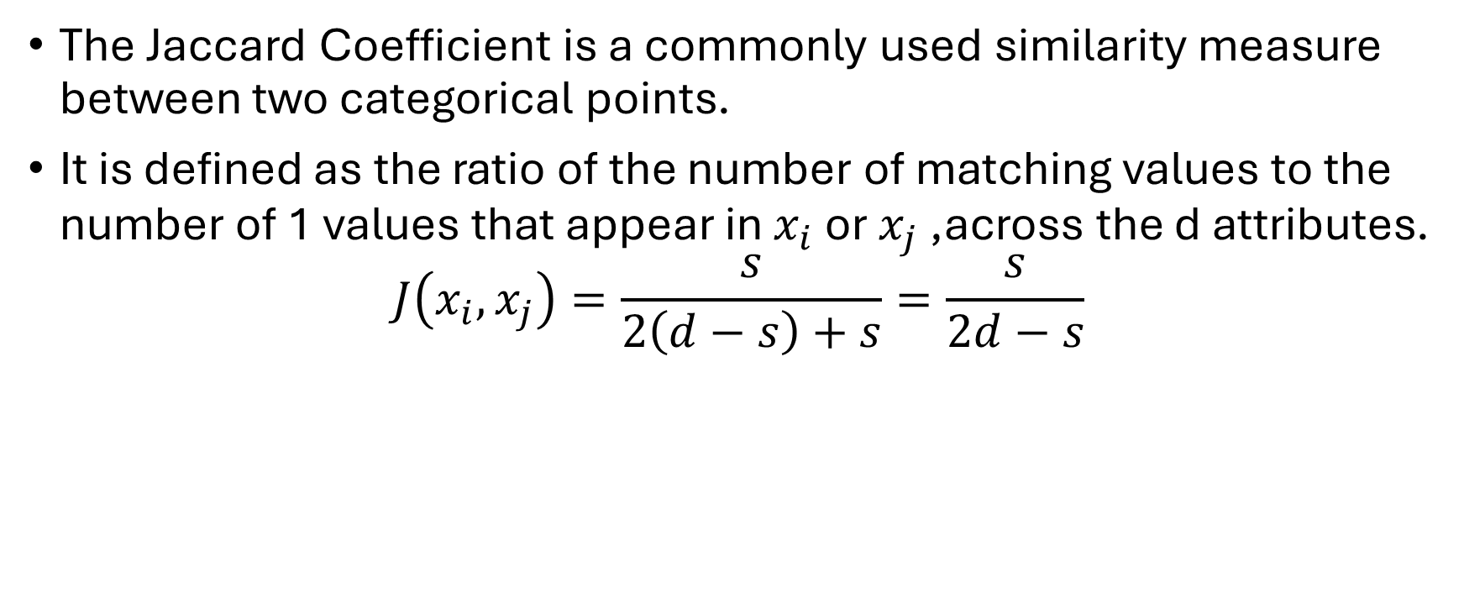
Jaccard similarity
The Jaccard Coefficient is a commonly used similarity measure between two categorical points.
It is defined as the ratio of the number of matching values to the number of 1 values that appear in $x_{i}$ or $x_{j}$ ,across the d attributes.
$$J\left(x_{i}, x_{j}\right)=\frac{s}{2\left(d−s\right)+s}=\frac{s}{2d−s}$$

Slide 21
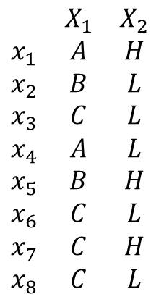
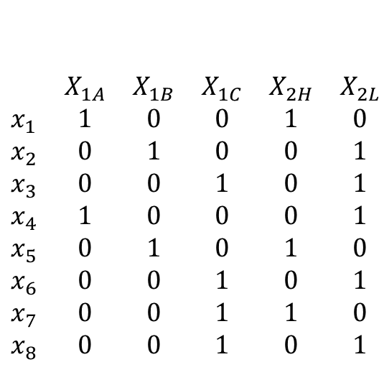
Jaccard similarity
$$J\left(x_{i}, x_{j}\right)=\frac{s}{2\left(d−s\right)+s}=\frac{s}{2d−s}$$
$$\begin{matrix} & X_{1A} & X_{1B} & X_{1C} & X_{2H} & X_{2L} \\ x_{1} & 1 & 0 & 0 & 1 & 0 \\ x_{2} & 0 & 1 & 0 & 0 & 1 \\ x_{3} & 0 & 0 & 1 & 0 & 1 \\ x_{4} & 1 & 0 & 0 & 0 & 1 \\ x_{5} & 0 & 1 & 0 & 1 & 0 \\ x_{6} & 0 & 0 & 1 & 0 & 1 \\ x_{7} & 0 & 0 & 1 & 1 & 0 \\ x_{8} & 0 & 0 & 1 & 0 & 1\end{matrix}$$
$$\begin{matrix} & X_{1} & X_{2} \\ x_{1} & A & H \\ x_{2} & B & L \\ x_{3} & C & L \\ x_{4} & A & L \\ x_{5} & B & H \\ x_{6} & C & L \\ x_{7} & C & H \\ x_{8} & C & L\end{matrix}$$

Slide 22
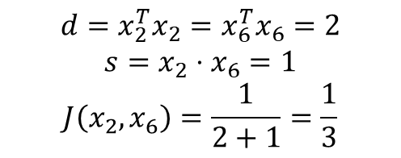
Jaccard similarity
$$J\left(x_{i}, x_{j}\right)=\frac{s}{2\left(d−s\right)+s}=\frac{s}{2d−s}$$
$$\begin{matrix} & X_{1A} & X_{1B} & X_{1C} & X_{2H} & X_{2L} \\ x_{1} & 1 & 0 & 0 & 1 & 0 \\ x_{2} & 0 & 1 & 0 & 0 & 1 \\ x_{3} & 0 & 0 & 1 & 0 & 1 \\ x_{4} & 1 & 0 & 0 & 0 & 1 \\ x_{5} & 0 & 1 & 0 & 1 & 0 \\ x_{6} & 0 & 0 & 1 & 0 & 1 \\ x_{7} & 0 & 0 & 1 & 1 & 0 \\ x_{8} & 0 & 0 & 1 & 0 & 1\end{matrix}$$
$$\begin{matrix} & X_{1} & X_{2} \\ x_{1} & A & H \\ x_{2} & B & L \\ x_{3} & C & L \\ x_{4} & A & L \\ x_{5} & B & H \\ x_{6} & C & L \\ x_{7} & C & H \\ x_{8} & C & L\end{matrix}$$
$$d=x_{2}^{T}x_{2}=x_{6}^{T}x_{6}=2$$
$$s=x_{2}⋅x_{6}=1$$
$$J\left(x_{2},x_{6}\right)=\frac{1}{2+1}=\frac{1}{3}$$

Slide 23

Jaccard similarity
$$J\left(x_{i}, x_{j}\right)=\frac{s}{2\left(d−s\right)+s}=\frac{s}{2d−s}$$
$$\begin{matrix} & X_{1A} & X_{1B} & X_{1C} & X_{2H} & X_{2L} \\ x_{1} & 1 & 0 & 0 & 1 & 0 \\ x_{2} & 0 & 1 & 0 & 0 & 1 \\ x_{3} & 0 & 0 & 1 & 0 & 1 \\ x_{4} & 1 & 0 & 0 & 0 & 1 \\ x_{5} & 0 & 1 & 0 & 1 & 0 \\ x_{6} & 0 & 0 & 1 & 0 & 1 \\ x_{7} & 0 & 0 & 1 & 1 & 0 \\ x_{8} & 0 & 0 & 1 & 0 & 1\end{matrix}$$
$$\begin{matrix} & X_{1} & X_{2} \\ x_{1} & A & H \\ x_{2} & B & L \\ x_{3} & C & L \\ x_{4} & A & L \\ x_{5} & B & H \\ x_{6} & C & L \\ x_{7} & C & H \\ x_{8} & C & L\end{matrix}$$
Let’s calculate the $J(x_{6},x_{8})$

Slide 24
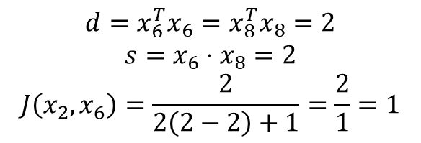
Jaccard similarity
$$J\left(x_{i}, x_{j}\right)=\frac{s}{2\left(d−s\right)+s}=\frac{s}{2d−s}$$
$$\begin{matrix} & X_{1A} & X_{1B} & X_{1C} & X_{2H} & X_{2L} \\ x_{1} & 1 & 0 & 0 & 1 & 0 \\ x_{2} & 0 & 1 & 0 & 0 & 1 \\ x_{3} & 0 & 0 & 1 & 0 & 1 \\ x_{4} & 1 & 0 & 0 & 0 & 1 \\ x_{5} & 0 & 1 & 0 & 1 & 0 \\ x_{6} & 0 & 0 & 1 & 0 & 1 \\ x_{7} & 0 & 0 & 1 & 1 & 0 \\ x_{8} & 0 & 0 & 1 & 0 & 1\end{matrix}$$
$$\begin{matrix} & X_{1} & X_{2} \\ x_{1} & A & H \\ x_{2} & B & L \\ x_{3} & C & L \\ x_{4} & A & L \\ x_{5} & B & H \\ x_{6} & C & L \\ x_{7} & C & H \\ x_{8} & C & L\end{matrix}$$
$$d=x_{6}^{T}x_{6}=x_{8}^{T}x_{8}=2$$
$$s=x_{6}⋅x_{8}=2$$
$$J\left(x_{2},x_{6}\right)=\frac{2}{2\left(2−2\right)+1}=\frac{2}{1}=1$$

Slide 25
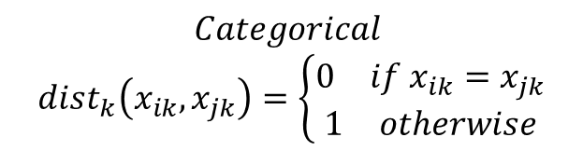

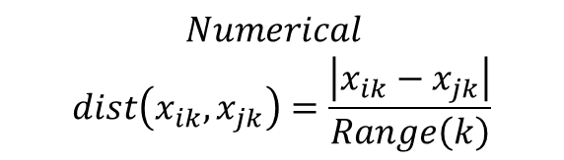
Gower distance
Gower distance is a similarity or dissimilarity measure designed to handle mixed data types, including numerical, categorical, ordinal, and binary data.
$$G\left(x_{i}, x_{j}\right)=\frac{1}{d}⋅\sum_{k=1}^{d}{dist_{k}\left(x_{ik}, x_{jk}\right)}$$
$$Categorical$$
$$dist_{k}\left(x_{ik}, x_{jk}\right)=\left\{\begin{aligned}\begin{matrix}0 & if x_{ik}=x_{jk}\end{matrix} \\ \begin{matrix}1 & otherwise\end{matrix}\end{aligned}\right.$$
$$Numerical$$
$$dist\left(x_{ik}, x_{jk}\right)=\frac{\left|x_{ik}−x_{jk}\right|}{Range\left(k\right)}$$
$$Range\left(k\right):Difference between maximum value of the k^{th}$$
$$feature and the minimum value$$

Slide 26
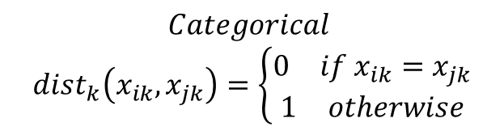

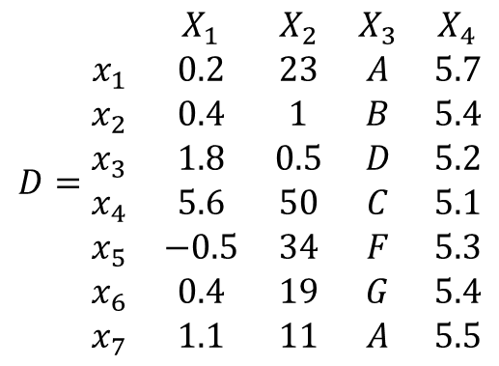
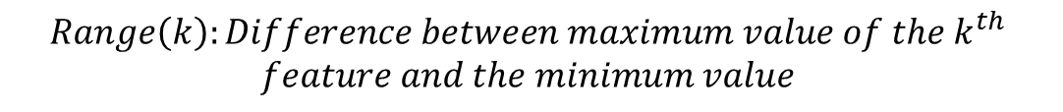
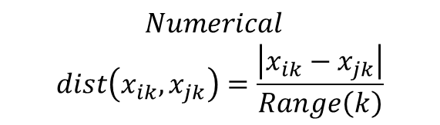
Example: Gower distance
$$G\left(x_{i}, x_{j}\right)=\frac{1}{d}⋅\sum_{k=1}^{d}{dist_{k}\left(x_{ik}, x_{jk}\right)}$$
$$Numerical$$
$$dist\left(x_{ik}, x_{jk}\right)=\frac{\left|x_{ik}−x_{jk}\right|}{Range\left(k\right)}$$
$$D=\begin{matrix} & X_{1} & X_{2} & X_{3} & X_{4} \\ x_{1} & 0.2 & 23 & A & 5.7 \\ x_{2} & 0.4 & 1 & B & 5.4 \\ x_{3} & 1.8 & 0.5 & D & 5.2 \\ x_{4} & 5.6 & 50 & C & 5.1 \\ x_{5} & −0.5 & 34 & F & 5.3 \\ x_{6} & 0.4 & 19 & G & 5.4 \\ x_{7} & 1.1 & 11 & A & 5.5\end{matrix}$$
$$Categorical$$
$$dist_{k}\left(x_{ik}, x_{jk}\right)=\left\{\begin{aligned}\begin{matrix}0 & if x_{ik}=x_{jk}\end{matrix} \\ \begin{matrix}1 & otherwise\end{matrix}\end{aligned}\right.$$
$$Range\left(k\right):Difference between maximum value of the k^{th}$$
$$feature and the minimum value$$

Slide 27
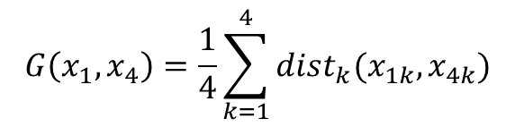
Example: Gower distance
$$G\left(x_{i}, x_{j}\right)=\frac{1}{d}⋅\sum_{k=1}^{d}{dist_{k}\left(x_{ik}, x_{jk}\right)}$$
$$Numerical$$
$$dist\left(x_{ik}, x_{jk}\right)=\frac{\left|x_{ik}−x_{jk}\right|}{Range\left(k\right)}$$
$$G\left(x_{1}, x_{4}\right)=\frac{1}{4}\sum_{k=1}^{4}{dist_{k}(x_{1k},x_{4k})}$$
$$D=\begin{matrix} & X_{1} & X_{2} & X_{3} & X_{4} \\ x_{1} & 0.2 & 23 & A & 5.7 \\ x_{2} & 0.4 & 1 & B & 5.4 \\ x_{3} & 1.8 & 0.5 & D & 5.2 \\ x_{4} & 5.6 & 50 & C & 5.1 \\ x_{5} & −0.5 & 34 & F & 5.3 \\ x_{6} & 0.4 & 19 & G & 5.4 \\ x_{7} & 1.1 & 11 & A & 5.5\end{matrix}$$
$$Categorical$$
$$dist_{k}\left(x_{ik}, x_{jk}\right)=\left\{\begin{aligned}\begin{matrix}0 & if x_{ik}=x_{jk}\end{matrix} \\ \begin{matrix}1 & otherwise\end{matrix}\end{aligned}\right.$$
$$Range\left(k\right):Difference between maximum value of the k^{th}$$
$$feature and the minimum value$$

Slide 28
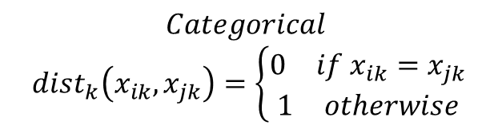
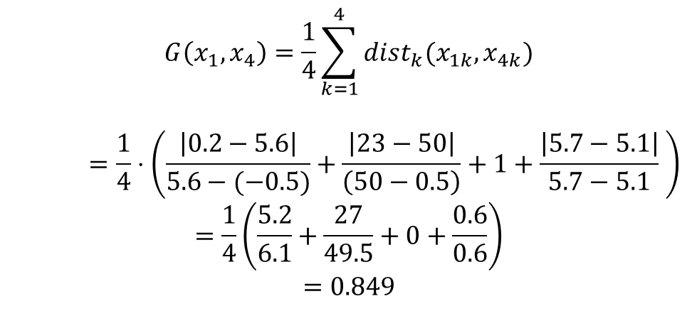
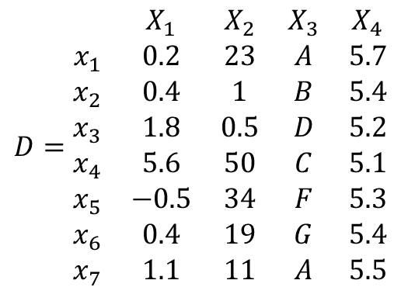
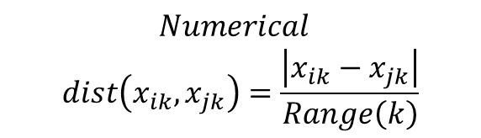
Example: Gower distance
$$G\left(x_{i}, x_{j}\right)=\frac{1}{d}⋅\sum_{k=1}^{d}{dist_{k}\left(x_{ik}, x_{jk}\right)}$$
$$G\left(x_{1}, x_{4}\right)=\frac{1}{4}\sum_{k=1}^{4}{dist_{k}(x_{1k},x_{4k})}$$
$$=\frac{1}{4}⋅\left(\frac{\left|0.2−5.6\right|}{5.6−(−0.5)}+\frac{\left|23−50\right|}{\left(50−0.5\right)}+1+\frac{\left|5.7−5.1\right|}{5.7−5.1} \right)$$
$$=\frac{1}{4}\left(\frac{5.2}{6.1}+\frac{27}{49.5}+0+\frac{0.6}{0.6}\right)$$
$$=0.849$$
$$D=\begin{matrix} & X_{1} & X_{2} & X_{3} & X_{4} \\ x_{1} & 0.2 & 23 & A & 5.7 \\ x_{2} & 0.4 & 1 & B & 5.4 \\ x_{3} & 1.8 & 0.5 & D & 5.2 \\ x_{4} & 5.6 & 50 & C & 5.1 \\ x_{5} & −0.5 & 34 & F & 5.3 \\ x_{6} & 0.4 & 19 & G & 5.4 \\ x_{7} & 1.1 & 11 & A & 5.5\end{matrix}$$
$$Numerical$$
$$dist\left(x_{ik}, x_{jk}\right)=\frac{\left|x_{ik}−x_{jk}\right|}{Range\left(k\right)}$$
$$Categorical$$
$$dist_{k}\left(x_{ik}, x_{jk}\right)=\left\{\begin{aligned}\begin{matrix}0 & if x_{ik}=x_{jk}\end{matrix} \\ \begin{matrix}1 & otherwise\end{matrix}\end{aligned}\right.$$
$$Range\left(k\right):Difference between maximum value of the k^{th}$$
$$feature and the minimum value$$

Slide 29

Activity: Gower distance
$$G\left(x_{i}, x_{j}\right)=\frac{1}{d}⋅\sum_{k=1}^{d}{dist_{k}\left(x_{ik}, x_{jk}\right)}$$
$$G\left(x_{1}, x_{7}\right)=\frac{1}{4}\sum_{k=1}^{4}{dist_{k}(x_{1k},x_{7k})}$$
$$D=\begin{matrix} & X_{1} & X_{2} & X_{3} & X_{4} \\ x_{1} & 0.2 & 23 & A & 5.7 \\ x_{2} & 0.4 & 1 & B & 5.4 \\ x_{3} & 1.8 & 0.5 & D & 5.2 \\ x_{4} & 5.6 & 50 & C & 5.1 \\ x_{5} & −0.5 & 34 & F & 5.3 \\ x_{6} & 0.4 & 19 & G & 5.4 \\ x_{7} & 1.1 & 11 & A & 5.5\end{matrix}$$
$$Numerical$$
$$dist\left(x_{ik}, x_{jk}\right)=\frac{\left|x_{ik}−x_{jk}\right|}{Range\left(k\right)}$$
$$Categorical$$
$$dist_{k}\left(x_{ik}, x_{jk}\right)=\left\{\begin{aligned}\begin{matrix}0 & if x_{ik}=x_{jk}\end{matrix} \\ \begin{matrix}1 & otherwise\end{matrix}\end{aligned}\right.$$
$$Range\left(k\right):Difference between maximum value of the k^{th}$$
$$feature and the minimum value$$

Slide 30
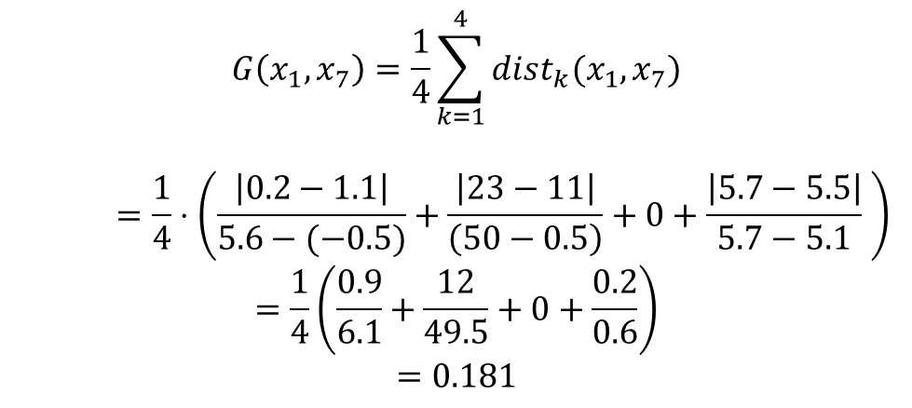
Activity: Gower distance
$$G\left(x_{i}, x_{j}\right)=\frac{1}{d}⋅\sum_{k=1}^{d}{dist_{k}\left(x_{ik}, x_{jk}\right)}$$
$$G\left(x_{1}, x_{7}\right)=\frac{1}{4}\sum_{k=1}^{4}{dist_{k}(x_{1},x_{7})}$$
$$=\frac{1}{4}⋅\left(\frac{\left|0.2−1.1\right|}{5.6−(−0.5)}+\frac{\left|23−11\right|}{\left(50−0.5\right)}+0+\frac{\left|5.7−5.5\right|}{5.7−5.1} \right)$$
$$=\frac{1}{4}\left(\frac{0.9}{6.1}+\frac{12}{49.5}+0+\frac{0.2}{0.6}\right)$$
$$=0.181$$
$$D=\begin{matrix} & X_{1} & X_{2} & X_{3} & X_{4} \\ x_{1} & 0.2 & 23 & A & 5.7 \\ x_{2} & 0.4 & 1 & B & 5.4 \\ x_{3} & 1.8 & 0.5 & D & 5.2 \\ x_{4} & 5.6 & 50 & C & 5.1 \\ x_{5} & −0.5 & 34 & F & 5.3 \\ x_{6} & 0.4 & 19 & G & 5.4 \\ x_{7} & 1.1 & 11 & A & 5.5\end{matrix}$$
$$Numerical$$
$$dist\left(x_{ik}, x_{jk}\right)=\frac{\left|x_{ik}−x_{jk}\right|}{Range\left(k\right)}$$
$$Categorical$$
$$dist_{k}\left(x_{ik}, x_{jk}\right)=\left\{\begin{aligned}\begin{matrix}0 & if x_{ik}=x_{jk}\end{matrix} \\ \begin{matrix}1 & otherwise\end{matrix}\end{aligned}\right.$$
$$Range\left(k\right):Difference between maximum value of the k^{th}$$
$$feature and the minimum value$$

Slide 31
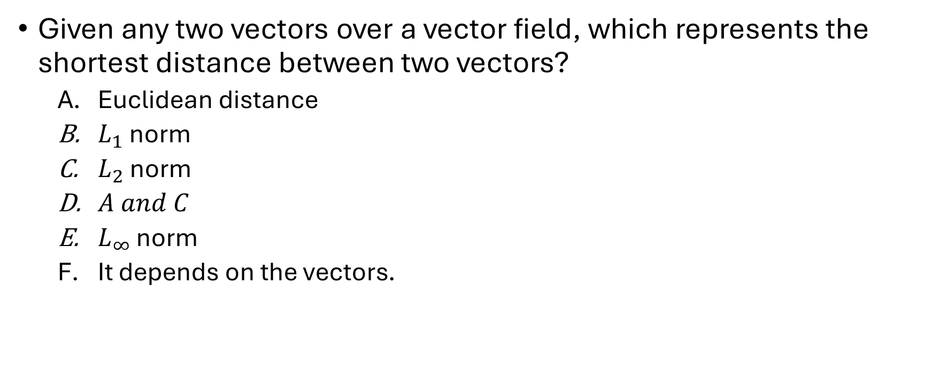
Review Quiz
Given any two vectors over a vector field, which represents the shortest distance between two vectors?
Euclidean distance
$L_{1}$ norm
$L_{2}$ norm
$A and C$
$L_{∞}$ norm
It depends on the vectors.

Slide 32
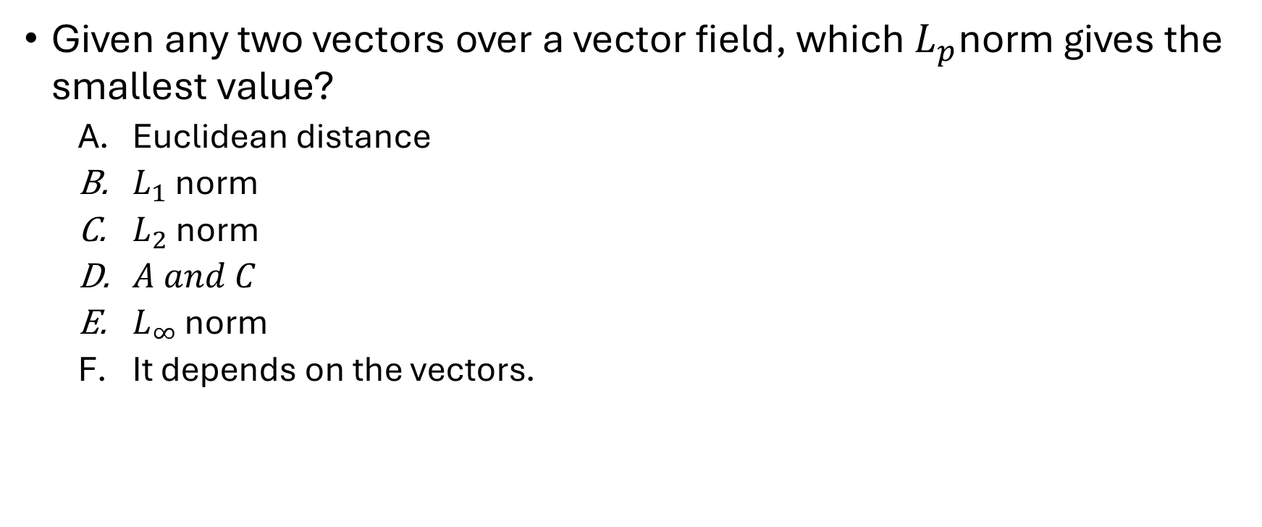
Review Quiz
Given any two vectors over a vector field, which $L_{p}$norm gives the smallest value?
Euclidean distance
$L_{1}$ norm
$L_{2}$ norm
$A and C$
$L_{∞}$ norm
It depends on the vectors.

Slide 33
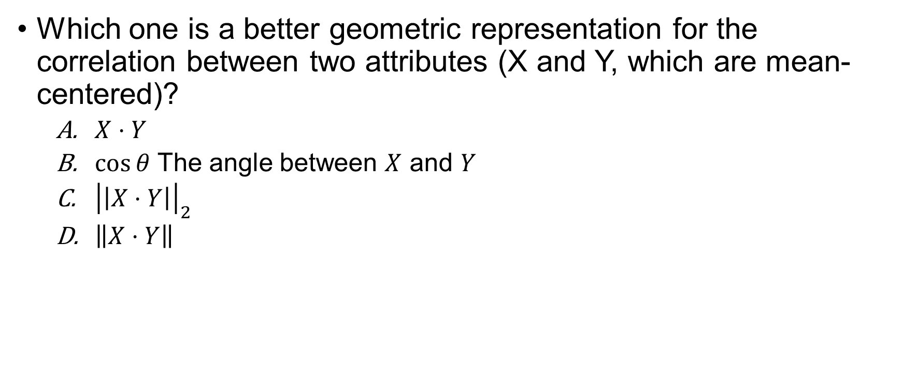
Review Quiz
Which one is a better geometric representation for the correlation between two attributes (X and Y, which are mean-centered)?
$X⋅Y$
$\cos{θ}$ The angle between $X$ and $Y$
${\left|\left|X⋅Y\right|\right|}_{2}$
$\left\|X⋅Y\right\|$

Slide 34

Review Quiz
What is the dot product of the vectors below
$$a=\left(\begin{matrix}2 & −1 & 2 & 1 & 0\end{matrix}\right)$$
$$b=\left(\begin{matrix}5 & 0 & −1 & 3 & 9\end{matrix}\right)$$
$16$
$20$
$11$
$\left(\begin{matrix}5 & 0 & 1 & 2 & 0\end{matrix}\right)$

Slide 35
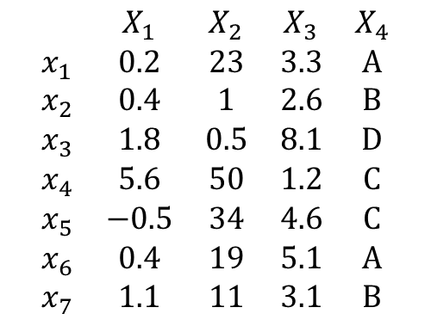
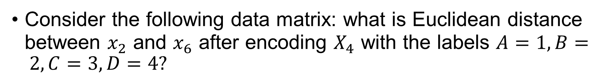
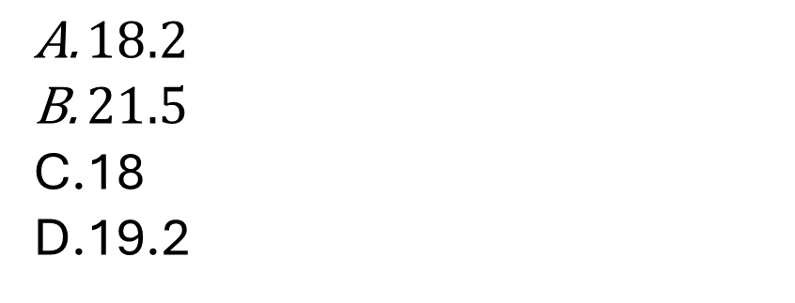
Review Quiz
Consider the following data matrix: what is Euclidean distance between $x_{2}$ and $x_{6}$ after encoding $X_{4}$ with the labels $A=1, B= 2, C=3, D=4?$
$$\begin{matrix} & X_{1} & X_{2} & X_{3} & X_{4} \\ x_{1} & 0.2 & 23 & 3.3 & A \\ x_{2} & 0.4 & 1 & 2.6 & B \\ x_{3} & 1.8 & 0.5 & 8.1 & D \\ x_{4} & 5.6 & 50 & 1.2 & C \\ x_{5} & −0.5 & 34 & 4.6 & C \\ x_{6} & 0.4 & 19 & 5.1 & A \\ x_{7} & 1.1 & 11 & 3.1 & B\end{matrix}$$
$18.2$
$21.5$
18
19.2

