Slide 1
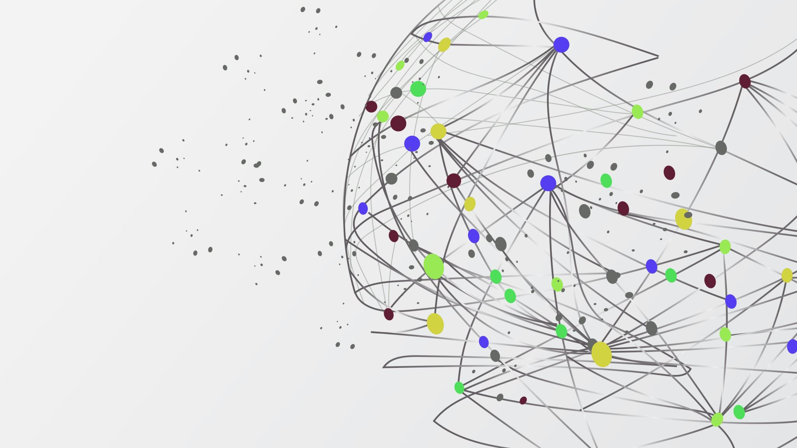
How to share a secret?
Diffie Hellman algorithm

Slide 2
Prerequisite
Goals of cryptography
Confidentiality (eavesdroppers should not be able to read the contents.)
Integrity (the recipient should be able to verify that the message was received correctly)
Authentication (the recipient should be able to verify the identity of the sender.)
Symmetric key cryptography
Symmetric key cryptography is a type of encryption where the same key is used for both encryption and decryption of information.
Hash functions

Slide 3



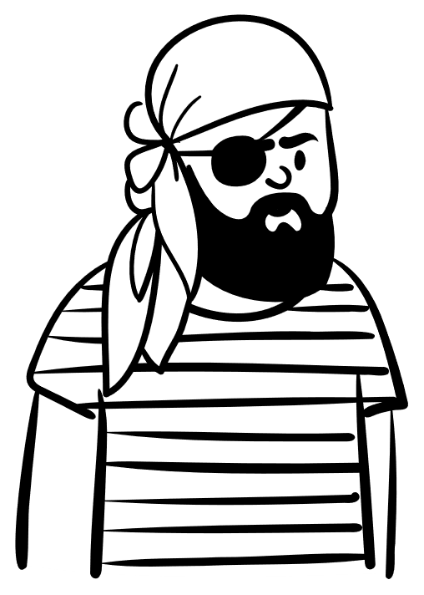
Alice
Bob
Mallory

Slide 4
A hypothetical problem
Alice and Bob want to communicate with each other.
However, there is an adversary in the middle
Goal: Alice and Bob wants to communicate securely
Assume the message can be interpreted by the adversary
What are their possible options?

Slide 5
Options?
Encrypt the communications using a shared secret?
Symmetric Key Cryptography
Adversary can look at the message but cannot decrypt
Both parties need to know the secret
What if the messages are tampered by a nefarious party?
Hashing (send the encrypted hash of the message along with the encrypted message)
What if they did not have shared secret?
We need a better approach
How can we share a secret that we have not agreed upon?

Slide 6
Diffie-Hellman key exchange?
We saw that you cannot just pick a secret and send it to the other party.
What if Alice and Bob picks separate secrets, then find a way to combine then to create a common secret (without sharing the original secrets)
Let’s try following strategy.

Slide 7
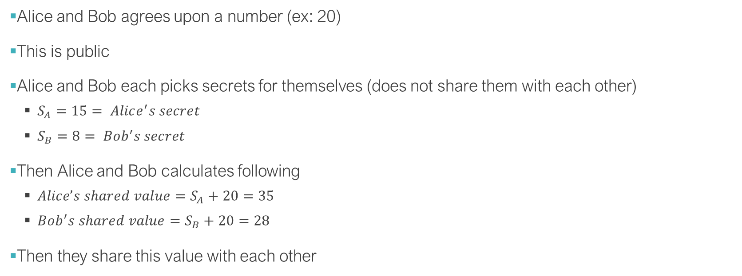
An example idea
Alice and Bob agrees upon a number (ex: 20)
This is public
Alice and Bob each picks secrets for themselves (does not share them with each other)
$S_{A}=15= Alice^{′}s secret$
$S_{B}=8= Bob^{′}s secret$
Then Alice and Bob calculates following
$Alice’s shared value=S_{A}+20=35$
$Bob^{′}s shared value=S_{B}+20=28$
Then they share this value with each other

Slide 8
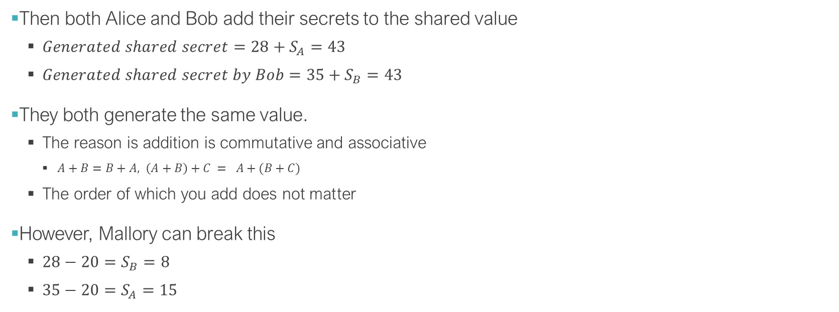
An example idea
Then both Alice and Bob add their secrets to the shared value
$Generated shared secret=28+S_{A}=43$
$Generated shared secret by Bob=35+S_{B}=43$
They both generate the same value.
The reason is addition is commutative and associative
$A+B=B+A, \left(A+B\right)+C = A+(B+C)$
The order of which you add does not matter
However, Mallory can break this
$28−20=S_{B}=8$
$35−20=S_{A}=15$

Slide 9

An example idea
This does not work as addition operation is inverted easily.
What if we have a better operation?
Modular exponentiation
Easy to calculate
Difficult to invert
$Base = x, Exponent = y, modulus = z$
Calculate $X^{Y}mod Z$

Slide 10

An example idea
However, the reverse is not easy
Given base and modulus and a value:
$X^{?} mod z=k, find ?$
This is difficult
No known general efficient algorithm.
This is called discrete logarithm problem

Slide 11
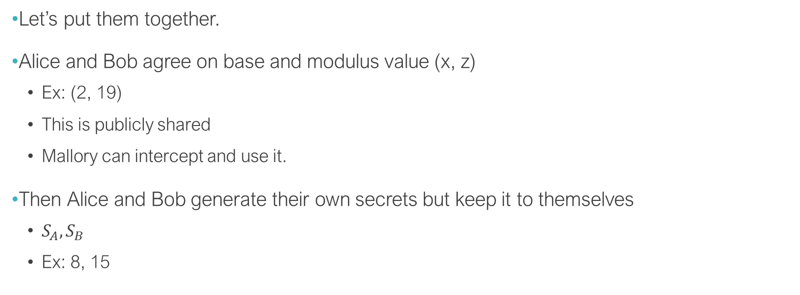
Diffie-Hellman key exchange
Let’s put them together.
Alice and Bob agree on base and modulus value (x, z)
Ex: (2, 19)
This is publicly shared
Mallory can intercept and use it.
Then Alice and Bob generate their own secrets but keep it to themselves
$S_{A}, S_{B}$
Ex: 8, 15

Slide 12
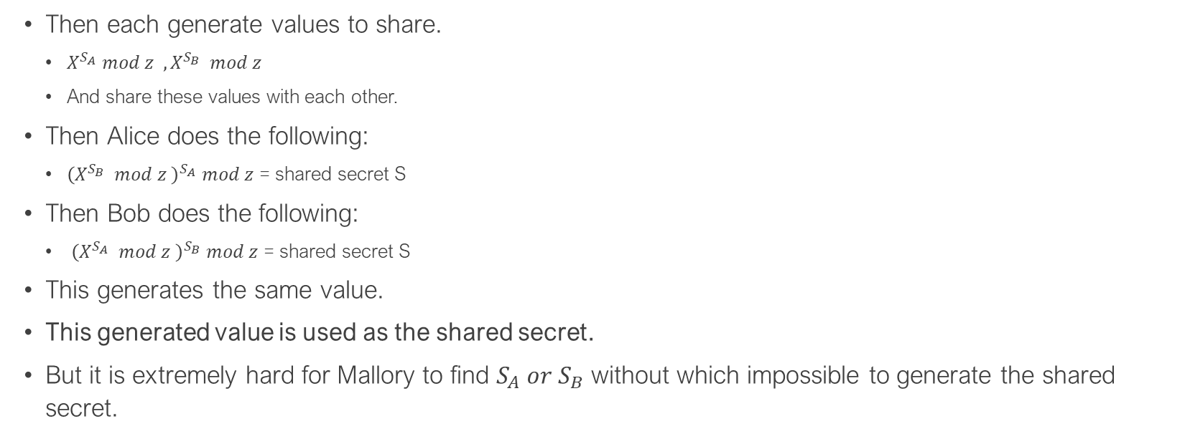
Diffie-Hellman key exchange
Then each generate values to share.
$X^{S_{A}} mod z , X^{S_{B}} mod z$
And share these values with each other.
Then Alice does the following:
${\left(X^{S_{B}} mod z \right)}^{S_{A}} mod z$ = shared secret S
Then Bob does the following:
${\left(X^{S_{A}} mod z \right)}^{S_{B}} mod z$ = shared secret S
This generates the same value.
This generated value is used as the shared secret.
But it is extremely hard for Mallory to find $S_{A} or S_{B}$ without which impossible to generate the shared secret.

Slide 13
Diffie-Hellman key exchange
Key points
Modulus
Should be large number
Needs to be a prime (makes it harder to brute force)
Base
Does not need to be a large number
However, it must be able to generate all the possible remainder values for the given modulus (otherwise easier to brute force)

Slide 14
Diffie-Hellman key exchange
Try 1 as base and 19 as the modulus
Remainder is 1 for all the powers of 1. (shared secret can only be 1)
Try 4 and 19
Only few numbers are generated as the remainders

Slide 16
Questions?

