Slide 1
Computer System Overview

Slide 2
Basic Elements
Processor
Main Memory
I/O modules
System Bus
At a top level, a computer consists of processor, memory, and I/O components, with one or more modules of each type. These components are interconnected in some fashion to achieve the main function of the computer, which is to execute programs.

Slide 3
Processor
Controls the operations of the computer
Performs the data processing functions
Referred to as the Central Processing Unit

Slide 4
Main Memory
Stores data and programs
Typically, volatile
Contents of the memory is lost when the computer is shut down
Referred to as real memory or primary memory
Hard disk (Secondary storage) and main memory are two different things.

Slide 5
I/O Modules
Move data between the computer and its external environments
Secondary memory devices
Communication equipment
Terminals

Slide 6
System Bus
Provides for communication among processors, main memory, and I/O modules

Slide 7
Notes:
IO BR specialized register used to temporarily store data being transferred between the CPU and I/O devices
IO IR The IR holds instructions that direct the CPU to perform I/O operations, such as reading from or writing to an external device (e.g., a hard disk, keyboard, or printer).

Slide 8
Microprocessor
Contains a processor on a single chip
Microprocessors are now multiprocessors.

Slide 9
GPU
Provide efficient computation on arrays of data using Single-Instruction Multiple Data (SIMD) techniques pioneered in supercomputers
Not just used for rendering graphics
Training and running neural networks
Scientific computation
Crypto mining
Big data analysis
And many more….

Slide 10
Digital Signal Processor (DSP)
Deal with streaming signals such as audio or video.
Used to be embedded in I/O devices like modems
Are now becoming first-class computational devices, especially in handhelds
Encoding/decoding speech and video (codecs)
Provide support for encryption and security
Ex: Broadcom BCM5862x Series DSP

Slide 11
System on a Chip (SoC)
The classic microprocessor is giving way to the SoC.
Other components of the system, such as DSPs, GPUs, I/O devices (such as codecs) and main memory, in addition to the CPUs and caches, are on the same chip.
Used in handheld devices
Qualcomm Snapdragon 8 Gen 3:

Slide 12
Instruction Execution
A program consists of a set of instructions stored in memory
Processor reads (fetches) instructions from memory
Processor executes each instruction

Slide 13
Notes:
The processing required for a single instruction is called an instruction cycle.
Using a simplified two-step description, the instruction cycle is depicted in Figure 1.2 .
The two steps are referred to as the fetch stage and the execute stage.
Program execution halts only if the processor is turned off, some sort of unrecoverable error occurs, or a program instruction that halts the processor is encountered.

Slide 14
Instruction Fetch and Execute
The processor fetches an instruction from memory
The program counter (PC) holds the address of the next instruction to be fetched
PC is incremented after each fetch.

Slide 15
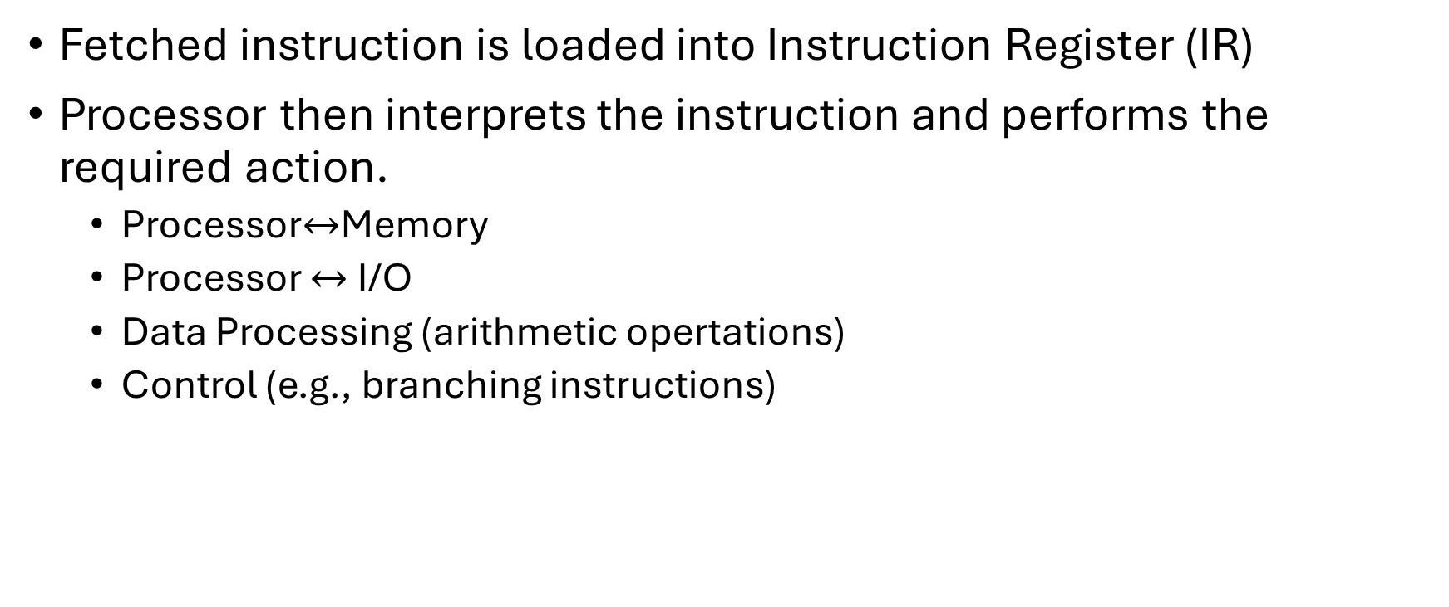
Instruction Register
Fetched instruction is loaded into Instruction Register (IR)
Processor then interprets the instruction and performs the required action.
Processor$↔$Memory
Processor $↔$ I/O
Data Processing (arithmetic opertations)
Control (e.g., branching instructions)

Slide 16
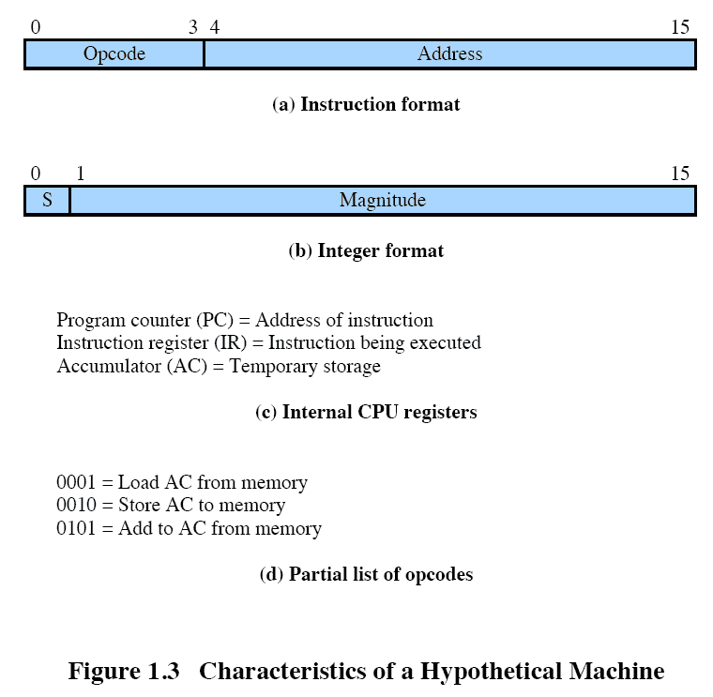

Slide 17
Interrupts
Mechanism by which other modules may interrupt the normal sequencing of the processor
Provided to improve processor utilization
Most I/O devices are slower than the processor
Processor must pause to wait for device
Wasteful use of the processor

Slide 18
Types of interrupts
Program | Generated by some condition that occurs as a result of an instruction execution, such as arithmetic overflow, division by zero, attempt to execute an illegal machine instruction, and reference outside a user's allowed memory space.
Timer | Generated by a timer within the processor. This allows the operating system to perform certain functions on a regular basis.
I/O | Generated by an I/O controller, to signal normal completion of an operation or to signal a variety of error conditions.
Hardware failure | Generated by a failure, such as power failure or memory failure parity error.
Notes:
Parity error: integrity of data breached

Slide 19
What if we do not have interrupts
Let’s look at a flow control without interrupts.
Notes:
To give a specific example, consider a PC that operates at 1 GHz, which would allow roughly 10⁹ instructions per second. A typical hard disk has a rotational speed of 7200 revolutions per minute for a half-track rotation time of 4 ms, which is 4 million times slower than the processor.
Figure 1.5a illustrates this state of affairs. The user program performs a series of WRITE calls interleaved with processing. The solid vertical lines represent segments of code in a program. Code segments 1, 2, and 3 refer to sequences of instructions that do not involve I/O. The WRITE calls are to an I/O routine that is a system utility and that will perform the actual I/O operation. The I/O program consists of three sections:
• A sequence of instructions, labeled 4 in the figure, to prepare for the actual I/O operation. This may include copying the data to be output into a special buffer and preparing the parameters for a device command.
• The actual I/O command. Without the use of interrupts, once this command is issued, the program must wait for the I/O device to perform the requested function (or periodically check the status, or poll, the I/O device). The program might wait by simply repeatedly performing a test operation to determine if the I/O operation is done.
• A sequence of instructions, labeled 5 in the figure, to complete the operation. This may include setting a flag indicating the success or failure of the operation.
The dashed line represents the path of execution followed by the processor; that is, this line shows the sequence in which instructions are executed. Thus, after the first WRITE instruction is encountered, the user program is interrupted and execution continues with the I/O program. After the I/O program execution is complete, execution resumes in the user program immediately following the WRITE Instruction.
Because the I/O operation may take a relatively long time to complete, the I/O program is hung up waiting for the operation to complete; hence, the user program is stopped at the point of the WRITE call for some considerable period of time.

Slide 20
With interrupts
Notes:
With interrupts, the processor can be engaged in executing other instructions while an I/O operation is in progress. Consider the flow of control in Figure 1.5b . As before, the user program reaches a point at which it makes a system call in the form of a WRITE call. The I/O program that is invoked in this case consists only of the preparation code and the actual I/O command. After these few instructions have been executed, control returns to the user program. Meanwhile, the external device is busy accepting data from computer memory and printing it. This I/O operation is conducted concurrently with the execution of instructions in the user program.
When the external device becomes ready to be serviced, that is, when it is ready to accept more data from the processor, the I/O module for that external device sends an interrupt request signal to the processor. The processor responds by suspending operation of the current program; branching off to a routine to service that particular I/O device, known as an interrupt handler; and resuming the original execution after the device is serviced. The points at which such interrupts occur are indicated by X in Figure 1.5b . Note that an interrupt can occur at any point in the main program, not just at one specific instruction.

Slide 22
Notes:
To accommodate interrupts, an interrupt stage is added to the instruction cycle, as shown in Figure 1.7 (compare Figure 1.2 ). In the interrupt stage, the processor checks to see if any interrupts have occurred, indicated by the presence of an interrupt signal. If no interrupts are pending, the processor proceeds to the fetch stage and fetches the next instruction of the current program. If an interrupt is pending, the processor suspends execution of the current program and executes an interrupt handler routine. The interrupt-handler routine is generally part of the OS. Typically, this routine determines the nature of the interrupt and performs whatever actions are needed. In the example we have been using, the handler determines which I/O module generated the interrupt and may branch to a program that will write more data out to that I/O module. When the interrupt-handler routine is completed, the processor can resume execution of the user program at the point of interruption.
It is clear that there is some overhead involved in this process. Extra instructions must be executed (in the interrupt handler) to determine the nature of the interrupt and to decide on the appropriate action. Nevertheless, because of the relatively large amount of time that would be wasted by simply waiting on an I/O operation, the processor can be employed much more efficiently with the use of interrupts.

Slide 23
Operating System
OS is the computing system that manages all the hardware and software.
Controls the execution of application programs.
Acts as an interface between applications and hardware.
Provides a set of services to system users.
Objectives:
Convenience
Efficiency
Ability to evolve

Slide 24
Operating System
In the first part of this course, we will mainly focus on how OS works, the related concepts as well as algorithms.
Some concepts related to distributed computing and network operating systems will be covered later in the course.
Some concepts on computer architecture and hardware will be covered as well.

Slide 25
What is OS composed of?
Memory Manager
Controls and manages the main memory.
Processor Manager
Decides how to allocate processing power to processes.
Device Manager
Manages every device, channel, and control unit.
File Manager
Manges file system.
Network Manager
Manages network connections.

Slide 26
Operating system services
Program development
Program execution
Access I/O devices
Controlled access to files
System access
Error detection and response
Accounting
Notes:
Briefly, the OS typically provides services in the following areas:
• Program development: The OS provides a variety of facilities and services,
such as editors and debuggers, to assist the programmer in creating programs.
Typically, these services are in the form of utility programs that, while not
strictly part of the core of the OS, are supplied with the OS and are referred to
as application program development tools.
• Program execution: A number of steps need to be performed to execute a
program. Instructions and data must be loaded into main memory, I/O devices
and files must be initialized, and other resources must be prepared. The OS
handles these scheduling duties for the user.
• Access to I/O devices: Each I/O device requires its own peculiar set of instructions
or control signals for operation. The OS provides a uniform interface
that hides these details so that programmers can access such devices using simple
reads and writes.
• Controlled access to files: For file access, the OS must reflect a detailed understanding
of not only the nature of the I/O device (disk drive, tape drive) but
also the structure of the data contained in the files on the storage medium.
In the case of a system with multiple users, the OS may provide protection
mechanisms to control access to the files.
• System access: For shared or public systems, the OS controls access to the
system as a whole and to specific system resources. The access function must
provide protection of resources and data from unauthorized users and must
resolve conflicts for resource contention.
• Error detection and response: A variety of errors can occur while a computer
system is running. These include internal and external hardware errors, such
as a memory error, or a device failure or malfunction; and various software
errors, such as division by zero, attempt to access forbidden memory location,
and inability of the OS to grant the request of an application. In each case,
the OS must provide a response that clears the error condition with the least
impact on running applications. The response may range from ending the program
that caused the error, to retrying the operation, to simply reporting the
error to the application.
• Accounting: A good OS will collect usage statistics for various resources and
monitor performance parameters such as response time. On any system, this
information is useful in anticipating the need for future enhancements and in
tuning the system to improve performance. On a multiuser system, the information
can be used for billing purposes.

Slide 27
Evolution of operating system
Serial Processing
Simple Batch Systems
Multiprogrammed Batch Systems
Time Sharing Systems
Types of operating systems

Slide 28
Serial processing
No operating system
Programmers interacted directly with the hardware.
Users have access to the computers in “series”
Problems
Scheduling was horrendous.
Took considerable amount of time to set up a program to run.

Slide 29
Batch processing
People wanted to maximize processor utilization.
Introduced Monitor.
Monitor
User no longer has direct access to processor.
Job is submitted to computer operator who batches them together and places them on an input device.
Program branches back to the monitor when finished.
Notes:
Mid 1950
Job control language
A problem-oriented language that is designed to express statements in a job that are used to identify the job or to describe its requirements to an operating system

Slide 30
Batch processing
Monitor controls the sequence of events.
Resident Monitor is a software that is always in the memory.
Monitor reads in job and gives control.
Job returns control to monitor.

Slide 31
Batch processing
From the point of view of the processor:
Processor executes instructions from the memory containing monitor.
At some point it has instruction to load and execute next job.
Processor executes the job until it ends or finds an error condition.
Either of these two event causes processor to invoke instructions from the monitor.

Slide 32
Important to note the following
Monitor is just a software.
For monitor to work properly special hardware features must be available.
Memory protection
While the user program is executing, it must not alter the memory area containing the monitor
Timer
Prevents a job from monopolizing the system
Privileged instructions
Can only be executed by the monitor
Interrupts
Gives OS more flexibility in controlling user programs

Slide 33
Memory protection led to modes of operation
User Mode
User program executes in user mode
Certain areas of memory are protected from user access
Certain instructions may not be executed
Kernel Mode
Monitor executes in kernel mode
Privileged instructions may be executed
Protected areas of memory may be accessed

Slide 34
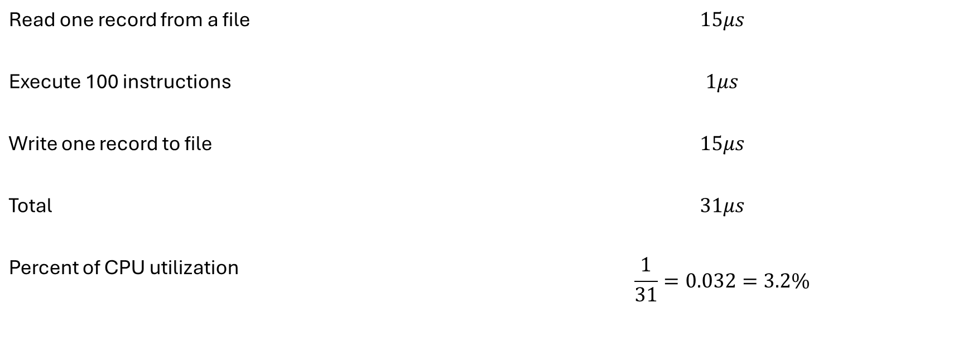
Read one record from a file | $$15μs$$
Execute 100 instructions | $$1μs$$
Write one record to file | $$15μs$$
Total | $$31μs$$
Percent of CPU utilization | $$\frac{1}{31}=0.032=3.2\%$$

Slide 35
Multiprogrammed batch systems
Even though batch systems somewhat improved processor utilization, processor is often idle because of I/O operations.
This led to multiprogrammed batch systems.

Slide 36
Uniprogramming
The processor spends a certain amount of time executing, until it reaches an I/O instruction; it must then wait until that I/O instruction concludes before proceeding

Slide 37
Multiprogramming

Slide 38
Time sharing systems
In multiprogramming batch systems users did not interact with the computer directly.
People needed computers to handle interactive jobs.
For this to happen a new type of OS was introduced—Time sharing systems.
Multiple users can simultaneously access the computer through terminals.
OS interleaves execution of each user program in short burst or quantum of computation.

Slide 39
Time sharing systems vs Batch Multiprogramming systems
 | Batch Multiprogramming | Time sharing
Principle objective | Maximize processor use | Maximize response time
Source directive to OS | Job control language commands provided with the job | Commands entered at the terminals.

Slide 40
OS generations
Early computing (1940-1950)
No OS
First generation (1950-1960)
Mainframes and batch systems
Multiprogramming
Second generation (1960-1970)
Multiprogramming and timesharing
Third generation (1970-1980)
Personal computing
Development of GUI
Fourth generation (1980-2000)
Microkernels: A modular approach to OS design.
Modern OS (2000-present)
Mobile OS
Could and virtualization: Cloud based OS (Ex: Azure)
Distributed OS: work seamless across multiple devices
Real-time and embedded systems: OS tailored for specific devices and applications

