Slide 1
Compiler Project
By: Ameya Dighe, Kelvin Lopez, Mohammad Naqvi, An Tran

Slide 2
Overview
Grammar
Programming Language
Demo
Questions

Slide 3
AKA
Our language is a combination of Java, Python, and our own unique twists.
We selected aspects that we liked from each one of these.
Java: Curly braces, semicolons
Python: Formating
AKA: $ for comments

Slide 4
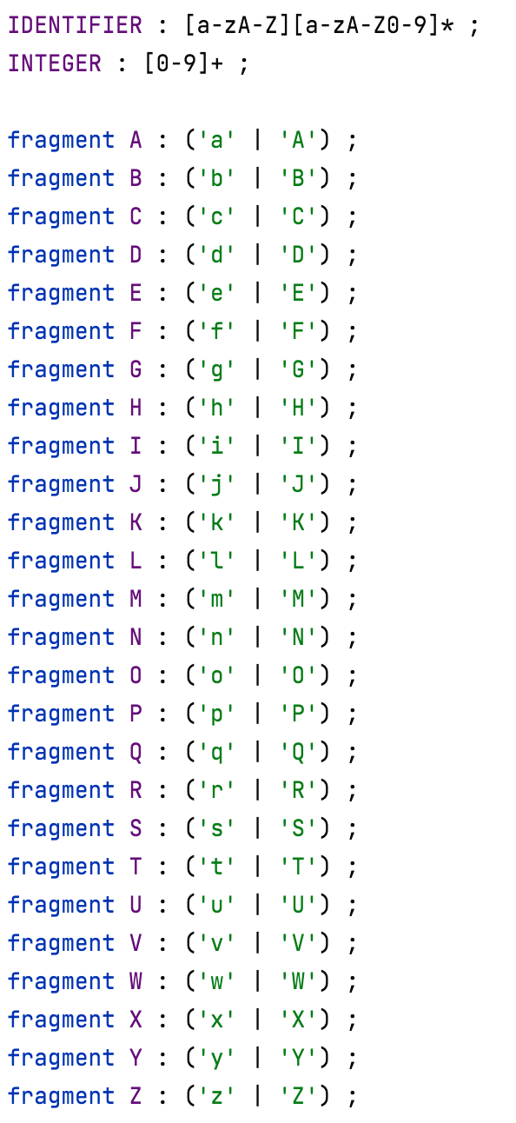
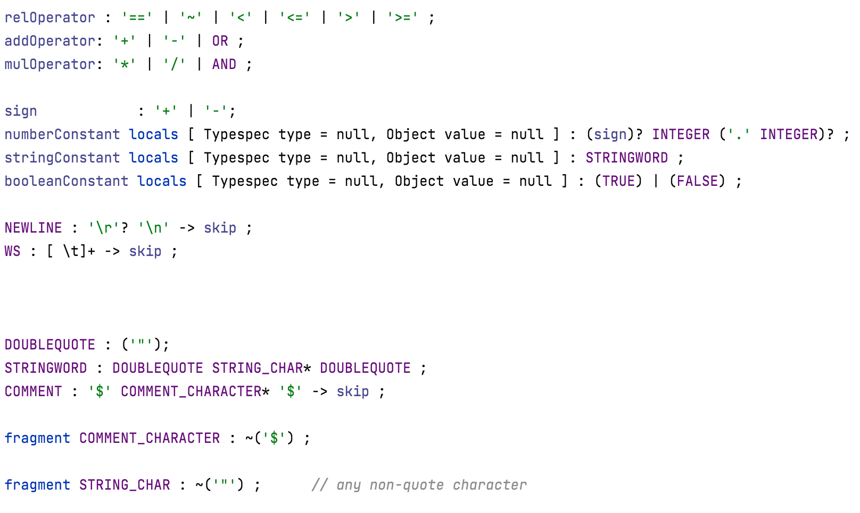
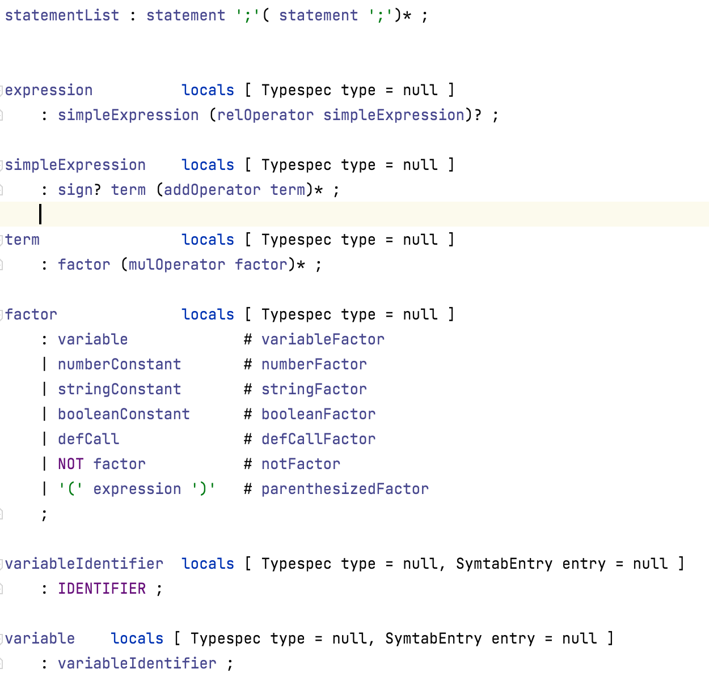
Grammar
(Language Format)

Slide 5
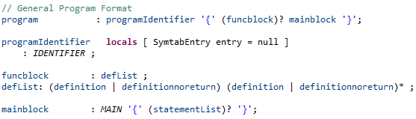
Grammar
(Program Format)

Slide 6
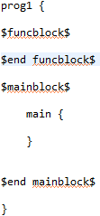
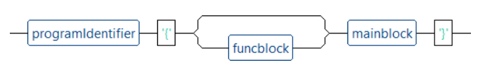
Programming Language
(Programming Format)

Slide 7
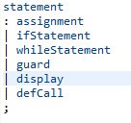
Grammar
(Statements Overview)

Slide 8
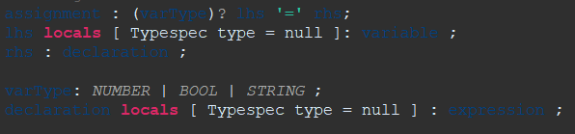
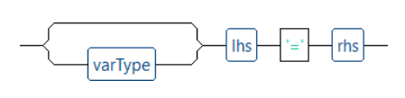
Grammar
(Assignment Statement)

Slide 9
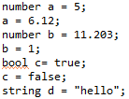
Programming Language
(Assignment Statement)

Slide 10
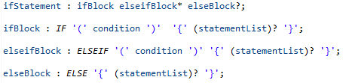
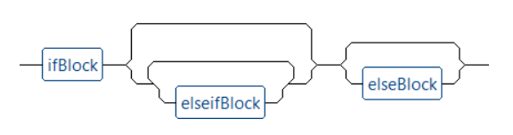
Grammar
(If Statement)

Slide 11
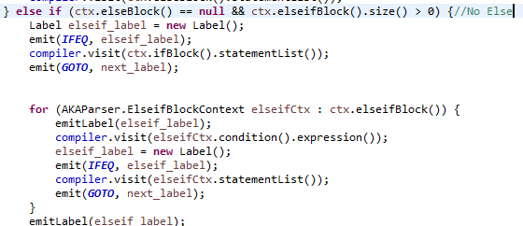
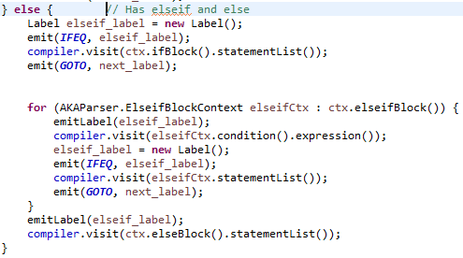
Programming Language
(If Statement)

Slide 12
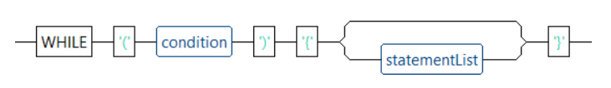
Grammar(While Statement)

Slide 13

Grammar
(Guard Statement)

Slide 14
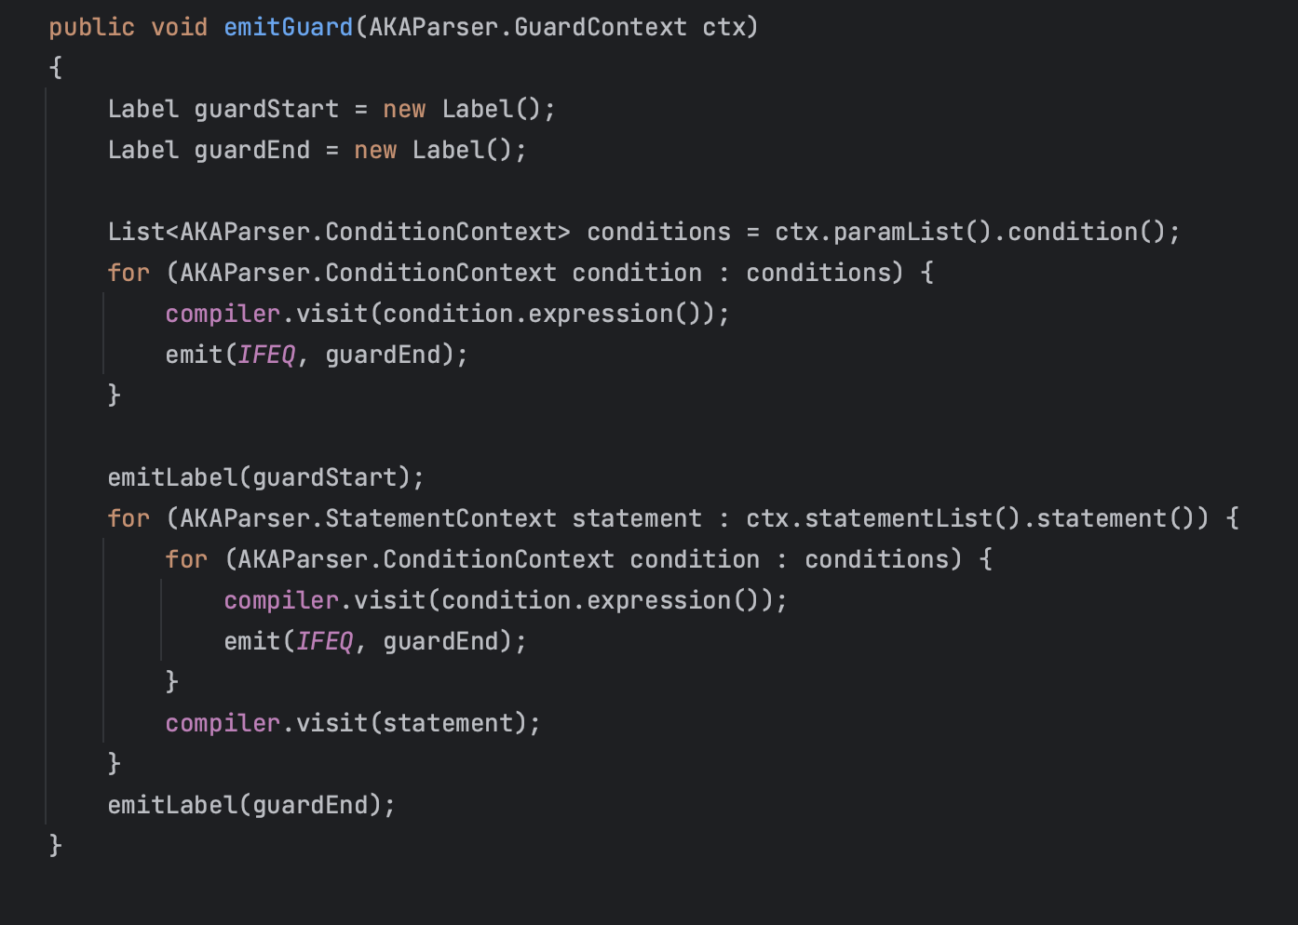
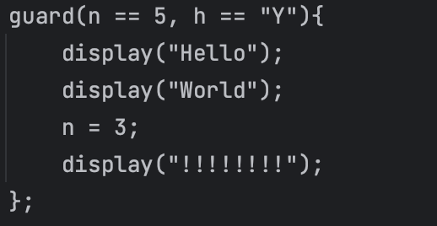
Programming Language
(Guard Statement)

Slide 15
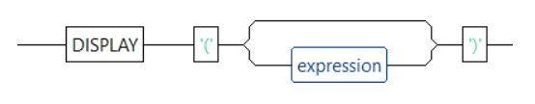
Grammar
(Display Statement)
Notes:
Primitive data types
Complex expressions
Functions that evaluate to values
variables

Slide 16
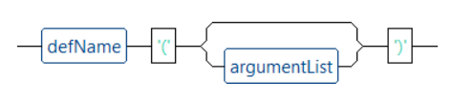
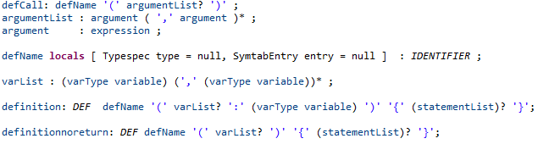
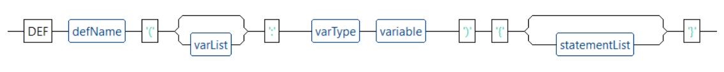

Grammar
(Definitions aka Functions/Procedures)
Notes:
Composition of defCall
varList
Both types of definitions

Slide 17
Notable Features
Guard statement
Function Definitions with and without return types
Reduces chance for unintended side effects
Main block
Explicit Type Definitions in Assignment

Slide 18
Demo

Slide 19
Prospective Features
Implicit type conversions for return type checking
Allowing an integer return type to be compatible with a declared real type
Lambda expressions
Increased functionality of “display” statement
String concatenations, interpolation
Complete Guard statement
When flow breaks from the guard, change guard variable to original state
Data structures
Lists

Slide 20
Any questions?

