Slide 1
6.1 Ratios & Proportion
fguilbert

Slide 2
A RATIO is a quotient
that compare 2 quantities.
3
4
3 : 4
3 to 4
These are all the same.
fguilbert

Slide 3
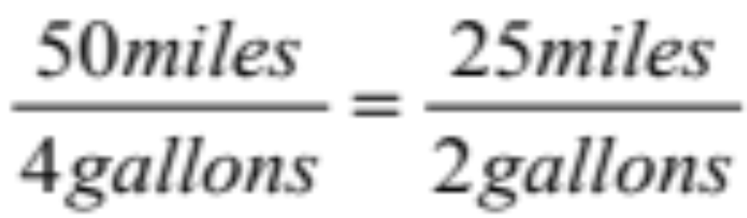
A Proportion is an equation of two equal ratios.
fguilbert

Slide 4
all
reduce
to 1/2
3 4 5
6 8 10
=
=
Proportion is true if fractions are equal when in lowest terms.
fguilbert

Slide 5
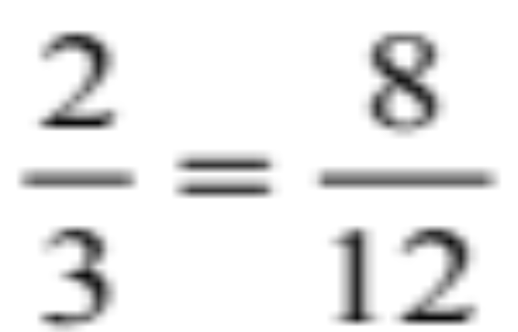
the Extremes.
the Means.
fguilbert

Slide 6
The product of the means equals the product of the extremes.
Cross products are equal.
2 • 12 = 3 • 8
24 = 24
fguilbert

Slide 7
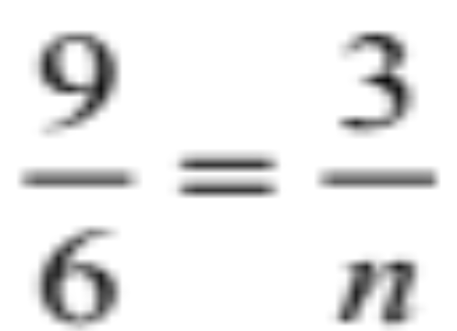
To Solve Proportions
Find n
9 n =
(3) (6)
9 n = 18
n = 2
fguilbert

Slide 8
7
4
w
5000 - w
=
7 ( 5000 - w) = 4 w
35000 - 7 w = 4 w
distributive property
35,000 = 11 w
3182 = w
fguilbert

Slide 9

3: 8 = n : 6
3 = n
8 6
18 = 8 n
18/8 = n
2.25 = n
fguilbert

Slide 10
Similar Figures
E F
A B
C D
G H
Corresponding <s =
Sides are proportional
fguilbert

Slide 11
ABCD ~ EFGH
A B
E F
10
13
12
C D
G H
Find GH
small 10
big 13
12
GH
=
fguilbert

Slide 12

small 10
big 13
12
GH
=
GH = (12)(13)
10 GH = 156
GH = 15.6
fguilbert
mathbyart.com

Slide 13
ABCD ~ EFGH
A B
E F
110
110
C D
G H
Find m<E
~
<A = <E
m<E = 110⁰
fguilbert

Slide 14
AB C ~ DEF
A
D
8
6
E F
B
C
5
Find EF
fguilbert

Slide 15
AB C ~ DEF
A
D
8
6
E F
B
C
5
small
big
6
8
EF
5
=
fguilbert

Slide 16

6
8
EF
5
x
=
(6)(5) = 8x
30 = 8x
30/8 = x
3.75 = x
fguilbert
mathbyart.com

Slide 17
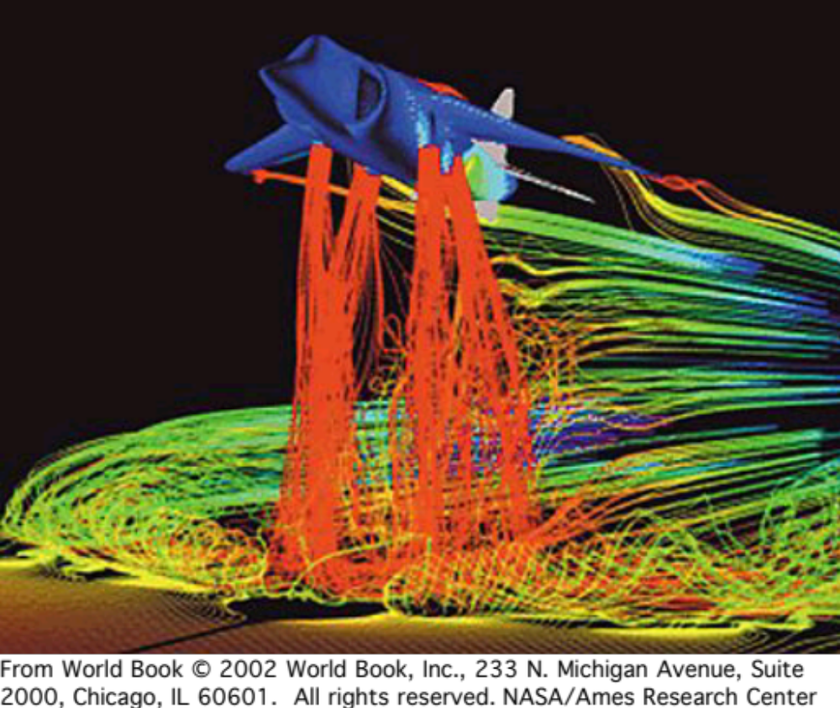
thought for the day
The desire to succeed
means nothing
without the
will to
prepare!
fguilbert

