Slide 1
Translations, Rotations, Reflections, and Dilations
M7G2.a Demonstrate understanding of translations, dilations, rotations, reflections, and relate symmetry to appropriate transformations.

Slide 2
In geometry, a transformation is a way to change the position of a figure.

Slide 3
In some transformations, the figure retains its size and only its position is changed.
Examples of this type of transformation are:
translations, rotations, and reflections
In other transformations, such as dilations, the size of the figure will change.

Slide 4
TRANSLATION

Slide 5
TRANSLATION
A translation is a transformation that slides a figure across a plane or through space.
With translation all points of a figure move the same distance and the same direction.

Slide 6
TRANSLATION
Basically, translation means that a figure has moved.
An easy way to remember what translation means is to remember…
A TRANSLATION IS A CHANGE IN LOCATION.
A translation is usually specified by a direction and a distance.

Slide 7
TRANSLATION
What does a translation look like?
original
image
x
y
Translate from x to y
A TRANSLATION IS A CHANGE IN LOCATION.

Slide 8
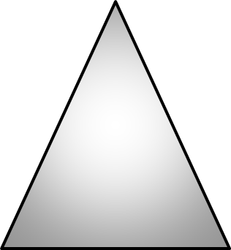

TRANSLATION
In the example below triangle A is translated to become triangle B.
A
B
Triangle A is slide directly to the right.
Describe the translation.

Slide 9


TRANSLATION
In the example below arrow A is translated to become arrow B.
A
B
Arrow A is slide down and to the right.
Describe the translation.

Slide 10
ROTATION

Slide 11
ROTATION
A rotation is a transformation that turns a figure about (around) a point or a line.
Basically, rotation means to spin a shape.
The point a figure turns around is called the center of rotation.
The center of rotation can be on or outside the shape.

Slide 12
ROTATION
What does a rotation look like?
center of rotation
A ROTATION MEANS TO TURN A FIGURE

Slide 13
ROTATION
The triangle was rotated around the point.
This is another way rotation looks
center of rotation
A ROTATION MEANS TO TURN A FIGURE

Slide 14


ROTATION
If a shape spins 360°, how far does it spin?
360°

Slide 15


ROTATION
If a shape spins 180°, how far does it spin?
Rotating a shape 180° turns a shape upside down.
180°

Slide 16
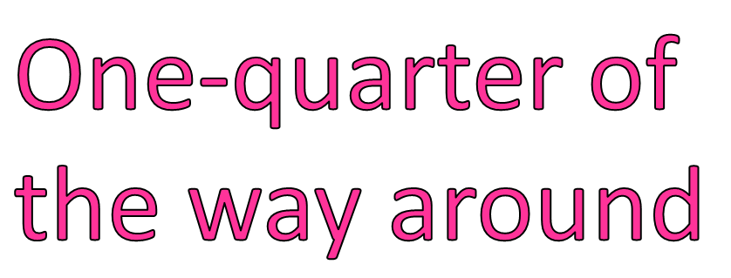

ROTATION
If a shape spins 90°, how far does it spin?
90°

Slide 17
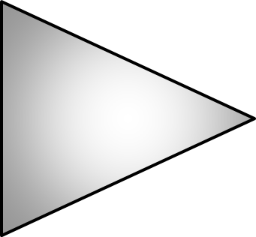
ROTATION
Describe how the triangle A was transformed to make triangle B
A
B
Triangle A was rotated right 90°
Describe the translation.

Slide 18
ROTATION
Describe how the arrow A was transformed to make arrow B
B
A
Arrow A was rotated right 180°
Describe the translation.

Slide 19
ROTATION
When some shapes are rotated they create a special situation called rotational symmetry.
to spin a shape
the exact same

Slide 20
ROTATIONAL SYMMETRY
A shape has rotational symmetry if, after you rotate less than one full turn, it is the same as the original shape.
Here is an example…
As this shape is rotated 360°, is it ever the same before the shape returns to its original direction?
90°
Yes, when it is rotated 90° it is the same as it was in the beginning.
So this shape is said to have rotational symmetry.

Slide 21
ROTATIONAL SYMMETRY
A shape has rotational symmetry if, after you rotate less than one full turn, it is the same as the original shape.
Here is another example…
As this shape is rotated 360°, is it ever the same before the shape returns to its original direction?
Yes, when it is rotated 180° it is the same as it was in the beginning.
So this shape is said to have rotational symmetry.
180°

Slide 22
ROTATIONAL SYMMETRY
A shape has rotational symmetry if, after you rotate less than one full turn, it is the same as the original shape.
Here is another example…
As this shape is rotated 360°, is it ever the same before the shape returns to its original direction?
No, when it is rotated 360° it is never the same.
So this shape does NOT have rotational symmetry.

Slide 23
ROTATION SYMMETRY
Does this shape have rotational symmetry?
Yes, when the shape is rotated 120° it is the same. Since 120 ° is less than 360°, this shape HAS rotational symmetry
120°

Slide 24

REFLECTION

Slide 25

















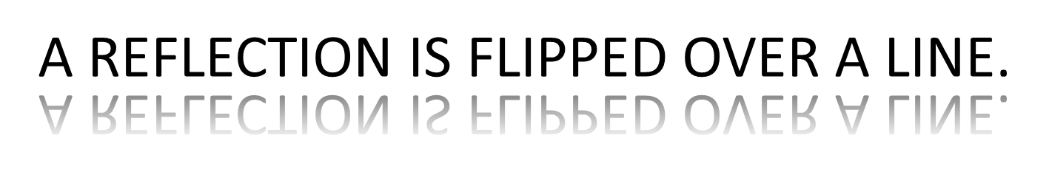
REFLECTION
A reflection is a transformation that flips a figure across a line.

Slide 26
REFLECTION
Remember, it is the same, but it is backwards
After a shape is reflected, it looks like a mirror image of itself.

Slide 27
REFLECTION
The line that a shape is flipped over is called a line of reflection.
The line of reflection can be on the shape or it can be outside the shape.
Line of reflection
Notice, the shapes are exactly the same distance from the line of reflection on both sides.

Slide 28
REFLECTION
Determine if each set of figures shows a reflection or a translation.
A
C
B
C’
B’
A’

Slide 29
REFLECTION
Sometimes, a figure has
reflectional symmetry.
This means that it can be folded along a line of reflection within itself so that the two halves of the figure match exactly, point by point.
Basically, if you can fold a shape in half and it matches up exactly, it has reflectional symmetry.

Slide 30
REFLECTIONAL SYMMETRY
An easy way to understand reflectional symmetry is to think about folding.
Do you remember folding a piece of paper, drawing half of a heart, and then cutting it out?
What happens when you unfold the piece of paper?

Slide 31
REFLECTIONAL SYMMETRY
Line of Symmetry
The line of reflection in a figure with reflectional symmetry is called a line of symmetry.
Reflectional Symmetry
means that a shape can be folded along a line of reflection so the two haves of the figure match exactly, point by point.
The two halves are exactly the same…
They are symmetrical.
The two halves make a whole heart.

Slide 32


REFLECTIONAL SYMMETRY
The line created by the fold is the line of symmetry.
A shape can have more than one line of symmetry.
Where is the line of symmetry for this shape?
How can I fold this shape so that it matches exactly?
Line of Symmetry

Slide 33
REFLECTIONAL SYMMETRY
How many lines of symmetry does each shape have?
3
4
5
Do you see a pattern?

Slide 34




REFLECTIONAL SYMMETRY
Which of these flags have reflectional symmetry?
No
United States of America
Canada
No
Mexico
England

Slide 35
CONCLUSION
We just discussed three types of transformations.
See if you can match the action with the appropriate transformation.
FLIP
REFLECTION
SLIDE
TRANSLATION
TURN
ROTATION

Slide 36
Translation, Rotation, and Reflection all change the position of a shape, while the size remains the same.
The fourth transformation that we are going to discuss is called dilation.

Slide 37
DILATION
Dilation changes the size of the shape without changing the shape.
When you go to the eye doctor, they dilate you eyes. Let’s try it by turning off the lights.
When you enlarge a photograph or use a copy machine to reduce a map, you are making dilations.

Slide 38
DILATION
Enlarge means to make a shape bigger.
Reduce means to make a shape smaller.
The scale factor tells you how much something is enlarged or reduced.

Slide 39
DILATION
Notice each time the shape transforms the shape stays the same and only the size changes.
200%
50%
ENLARGE
REDUCE

Slide 40
DILATION
Look at the pictures below
Dilate the image with a scale factor of 75%
Dilate the image with a scale factor of 150%

Slide 41
DILATION
Look at the pictures below
Dilate the image with a scale factor of 100%
Why is a dilation of 75% smaller, a dilation of 150% bigger, and a dilation of 100% the same?

Slide 42
Lets try to make sense of all of this
TRANSFORMATIONS
CHANGE THE POSTION OF A SHAPE
CHANGE THE SIZE OF A SHAPE
TRANSLATION
ROTATION
REFLECTION
DILATION
Change in location
Turn around a point
Flip over a line
Change size of a shape

Slide 43
See if you can identify the transformation that created the new shapes
TRANSLATION

Slide 44
See if you can identify the transformation that created the new shapes
Where is the line of reflection?
REFLECTION

Slide 45
See if you can identify the transformation that created the new shapes
DILATION

Slide 46
See if you can identify the transformation that created the new shapes
ROTATION

Slide 47

See if you can identify the transformation in these pictures?
REFLECTION

Slide 48
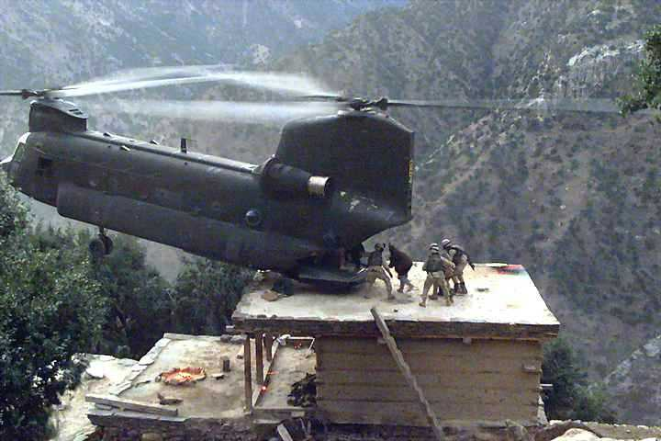
See if you can identify the transformation in these pictures?
ROTATION

Slide 49
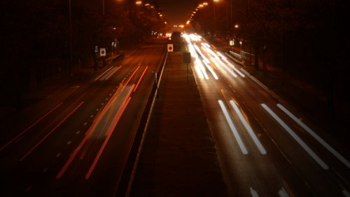
See if you can identify the transformation in these pictures?
TRANSLATION

Slide 50
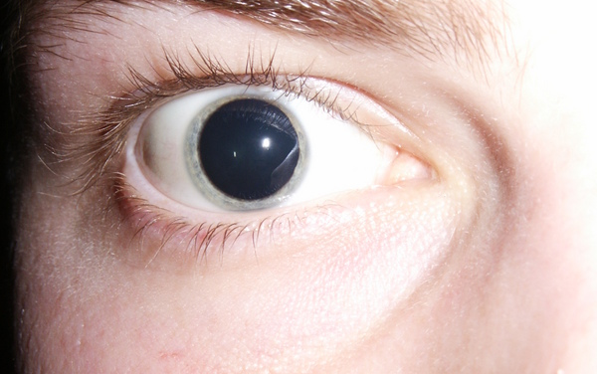
See if you can identify the transformation in these pictures?
DILATION

Slide 51
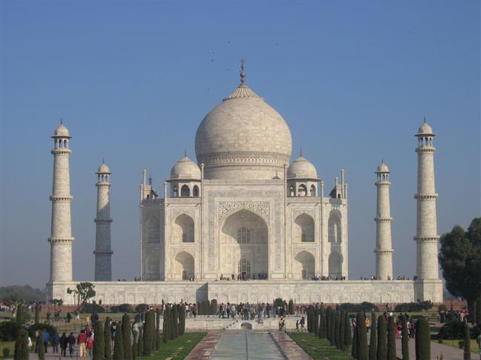
See if you can identify the transformation in these pictures?
REFLECTION

