Slide 1
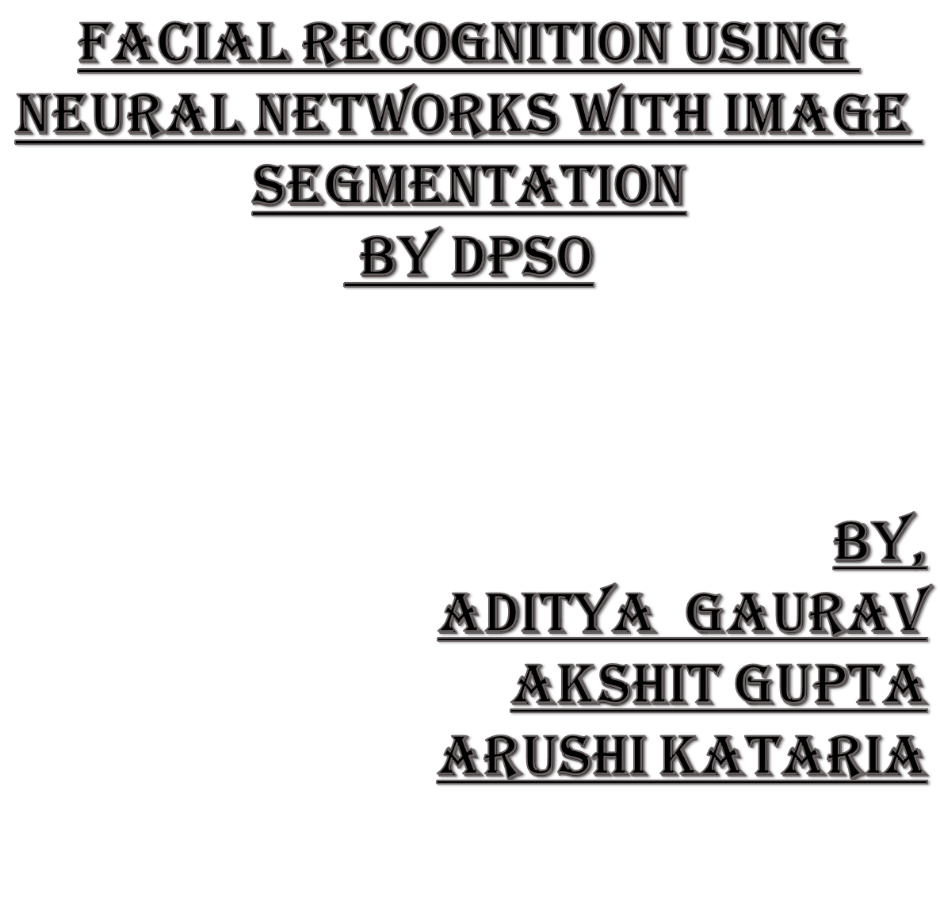
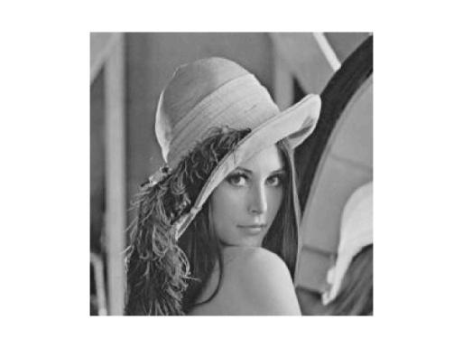
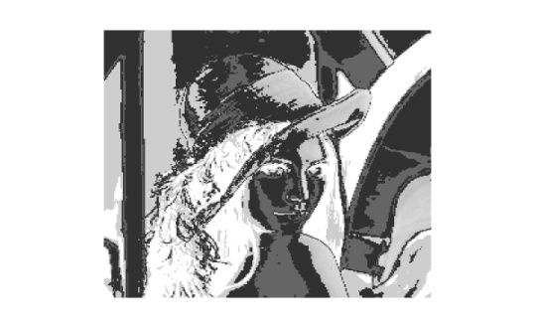

Slide 2
Image Segmentation
Image segmentation is the process of partitioning a digital image into multiple regions (clusters).
In other words, image segmentation
could assign a label to each pixel in the image such that pixels with
the same label share certain visual characteristics. These objects contain more information than individual pixels since the interpretation of images based on objects is more meaningful than that based on individual pixels.
Image segmentation is considered as
an important basic task in the analysis and understanding of
images, thus being widely used for further image processing
purposes such as classification and object recognition

Slide 3
What it is useful for ?
Image segmentation is considered as an important basic task in the analysis and understanding of images, thus being widely used for further image processing purposes such as classification and object recognition.
After a successful segmenting the image, the contours of objects can be extracted using edge detection and/or border following techniques.
Shape of objects can be described.
Based on shape, texture, and color objects can be identified.

Slide 4
Classification of image segmentation
Image segmentation can be classified into four different types:-
Texture analysis based methods
Histogram thresholding
Clustering based methods (k-means algorithm)
Region based split and merging methods

Slide 5
Optimal Threshold Technique:
Bi-level Thresholding Technique:
An optimization problem to probe for the threshold t that maximizes the
and minimizes the
Just one Threshold
Black
White

Slide 6
N- Level Thresholding
This problem could be extended to n-level thresholding through satisfying max of
such that

Slide 7
N- Level Thresholding
Image is split into regions based on intensity such that
Threshold 1
T1*
Threshold 2
T2*
Threshold 3
T3*
Highest intensity L

Slide 8
Otsu Criterion
One way for finding the optimal set of thresholds is the
exhaustive search method. The exhaustive search method based on the Otsu criterion:
The exhaustive search method based on the Otsu criterion (Otsu, 1979) is simple, but it has a disadvantage that it is computationally expensive. Exhaustive search for n -1 optimal thresholds involves evaluations of fitness of
combinations of thresholds so this method is not suitable from a computational cost point of view. The task of determining n -1 optimal thresholds for n-level image thresholding could be formulated as a multidimensional optimization
problem.

Slide 9

Let there be L intensity levels in each RGB (red-green–blue)
component of a given image and these levels are in the range
{0,1,2,...,L -1}. Then one can define:

Slide 10
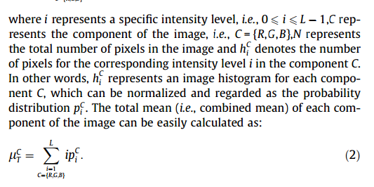

Slide 11
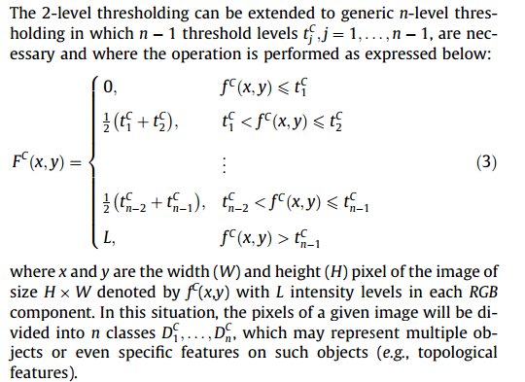
Notes:
Fc(x,y) Intensity of segmented image

Slide 12
Each for R, G,B this is taken :
The various threshold levels are represented by j:-
Threshold 1
T1*
Threshold 2
T2*
Threshold 3
T3*
Highest intensity L

Slide 13

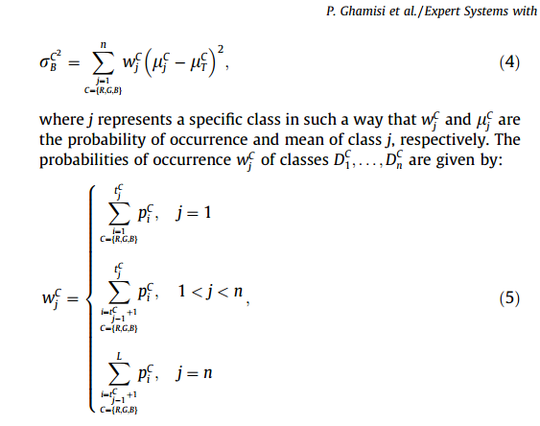
Objective Function

Slide 14
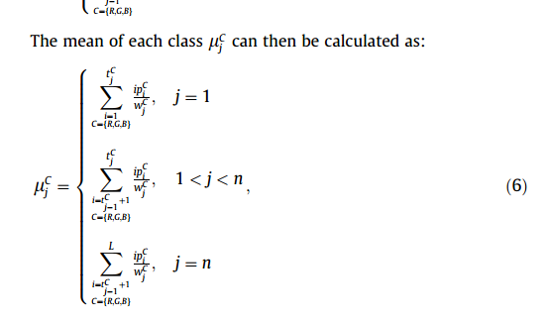

Slide 15
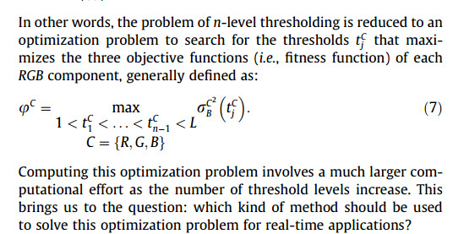

Slide 16
in real-time applications, using a high-speed algorithm is the main objective .
proposing a new thresholding based segmentation method which is robust in terms of the results and runtime, makes up our main goal.

Slide 17
PSO- Particle Swarm Optimization (Swarm Intelligence)
The original PSO algorithm was developed by Eberhart and Kennedy in 1995
The PSO basically takes advantage of the swarm intelligence concept, which is the property of a system whereby the collective behaviours of unsophisticated agents that are interacting locally with their environment, create coherent global functional patterns.

Slide 18
Imagine a flock of birds where each bird cries at an intensity proportional to the amount of food that it finds at its current location.
At the same time each bird can perceive the position of neighbouring birds and can tell which of the neighbouring birds emits the loudest cry.
There is a good chance that the flock will find a spot with the highest concentration of food if each bird follows a trajectory that combines three rules: (i) keep flying in the same direction; (ii) return to the location where it found the highest concentration of insects so far;
and (iii) move toward the neighbouring bird that cries the loudest

Slide 19
In the traditional PSO, the candidate solutions are called particles. These particles travel through the search space to find an optimal solution, by interacting and sharing information with neighbour particles, namely their individual best solution (local best) and computing the neighbourhood best.
Every particle is a candidate solution to the problem.
Also, in each step of the procedure, the global best solution obtained in the entire swarm is updated.
Using all of this information, particles realize the locations of the state space where success was obtained, and are guided by these successes.

Slide 20
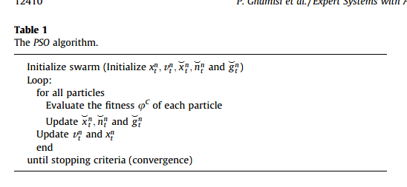

Slide 21
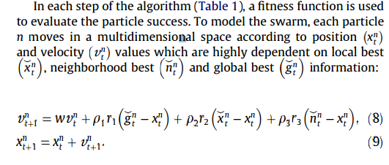

Slide 22
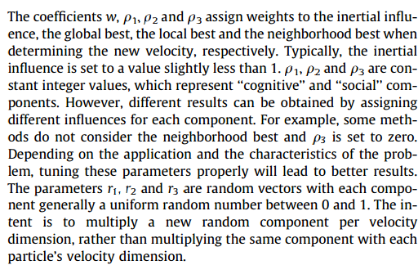

Slide 23
The local, neighborhood and global bests are initialized with the worst possible values, taking into account the nature of the problem.The other parameters that need to be adjusted are population size and stopping criteria.
The population size is very important to optimize to get an overall good solution in an acceptable time limit. Stopping criteria can be a predefined number of iterations without getting better results or other criteria, depending on the problem.
PSO reveals an effect of implicit communication between particles (similar to broadcasting) by updating neighborhood and global information, which affect the velocity and consequent position of particles

Slide 24
A general problem with the PSO and other optimization algorithms is that of becoming trapped in a local optimum such that it may work well on one problem but may fail on another problem.
In search of a better model of natural selection using the PSO algorithm, the Darwinian Particle Swarm Optimization (DPSO) was formulated.

Slide 25
Darwinian Particle Swarm Optimization (DPSO)
It is an algorithm in which many swarms of test solutions may exist at any time. Each swarm individually performs just like an ordinary PSO algorithm with rules governing the collection of swarms that are designed to simulate natural selection.
Darwinian Particle Swarm Optimization (DPSO) extends the PSO to determine if natural selection (Darwinian principle of survival of the fittest) can enhance the ability of the PSO algorithm to escape from local optima.

Slide 26
The idea is to run many simultaneous parallel PSO algorithms, each one a different swarm, on the same test problem.
A simple selection mechanism is applied.When a search tends to a local optimum, the search in that area is simply discarded and another area is searched instead.
In this approach, at each step, swarms that get better are rewarded (extend particle life or spawn a new descendent) and swarms which stagnate are punished (reduce swarm life or delete particles).

Slide 27
Analyzing the general state
To analyze the general state of each swarm, the fitness of all particles is evaluated and the neighborhood and individual best positions of each of the particles are updated.
If a new global solution is found, a new particle is spawned. A particle is deleted if the swarm fails to find a fitter state in a defined number of steps

Slide 28
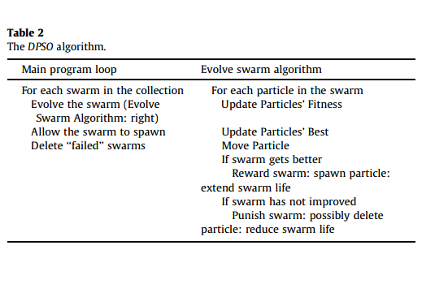

Slide 29
Deletion from swarm
Some simple rules are followed to delete a swarm, delete particles, and spawn a new swarm and a new particle:
when the swarm population falls below a minimum bound, the swarm is deleted; and
the worst performing particle in the swarm is deleted
when a maximum threshold number of steps (search
counter SCmaxC ) without improving the fitness function is reached.

Slide 30
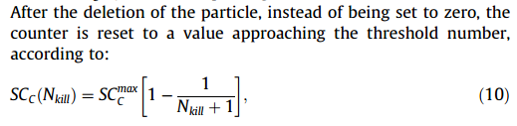
where Nkill is the number of particles deleted from the swarm over a period in which there was no improvement in fitness.
To spawn a new swarm, a swarm must not have any particle ever deleted and the maximum number of swarms must not be exceeded

Slide 31
Limiting Factor
Still, the new swarm is only created with a probability of
p = f/NS, with f a random number in [0,1] and NS the number of swarms. This factor avoids the creation of newer swarms when there are large numbers of swarms in existence.
The parent swarm is unaffected and half of the parent’s particles are selected at random for the child swarm and half of the particles of a random member of the swarm collection are also selected.

Slide 32
If the swarm initial population number is not obtained, the rest of the particles are randomly initialized and added to the new swarm.
A particle is spawned whenever a swarm achieves a new global best and the maximum defined population of a swarm has not been reached.
Like the PSO, a few parameters also need to be adjusted to run the algorithm efficiently:
(i)Initial swarm population;
(ii)maximum and minimum swarm population;
(iii) initial number of swarms;
(iv) maximum and minimum number of swarms; and
(v) stagnancy threshold

Slide 33


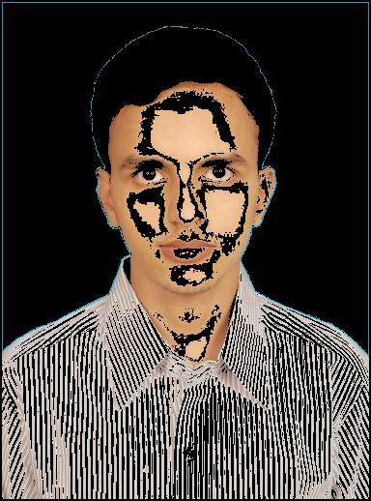
Original Image
Segmented (2)
Segmented (1)

Slide 34
ARTIFICIAL NEURAL NETWORKS

Slide 35
Neural networks are similar to biological neural networks in performing functions collectively and in parallel by the units, rather than there being a clear delineation of subtasks to which various units are assigned.
The term "neural network" usually refers to models employed in statistics, cognitive psychology and artificial intelligence.
Neural network models which emulate the central nervous system are part of theoretical neuroscience and computational neuroscience.
Neural networks have emerged as an important tool for classification.

Slide 36
Training a Neural Network
Randomly initialize the weights
Implement forward propagation to get
Implement the cost function
Implement back propagation to compute partial derivatives
Use gradient checking to confirm that your back propagation works. Then disable gradient checking.
Use gradient descent or a built-in optimization function to minimize the cost function with the weights in theta.

Slide 37

Sigmoid Function
This function is used to generate values between 0 to 1.Here theta`*x is a matrix product.
In a classification problem, for input instance x h(x) gives the probability that the input belongs to the class being tested.

Slide 38
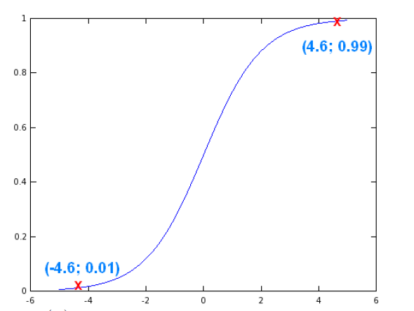
Sigmoid Continued
A lot of interesting functions can be
Generated using sigmoid.
The graph for sigmoid function
is given on the right.

Slide 39
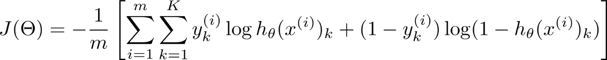
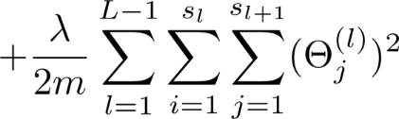
Cost Function
Suppose we have a network like we have a training set
{(x(1), y(1)), (x(2), y(2)), · · · , (x(m), y(m))}
consisting of m pairs of training examples (x(a), y(a)).
We define the cost function as

Slide 40
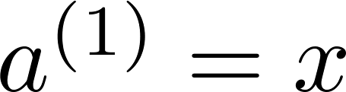
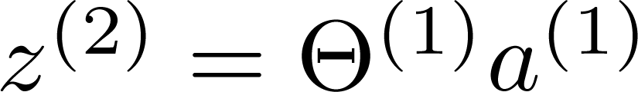
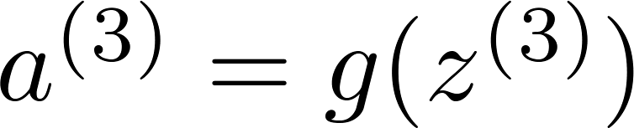
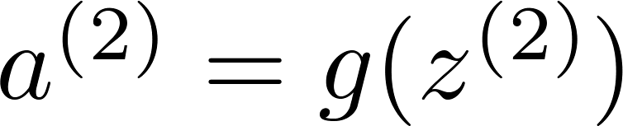
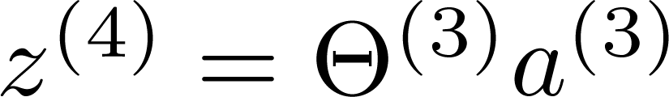
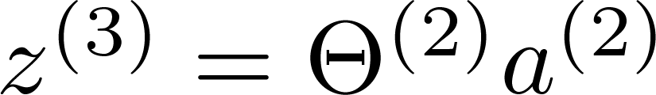
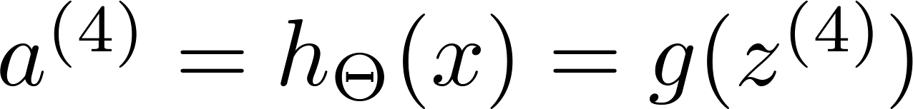
Case of when we have only one training example
The first thing we do is apply forward propagation and compute what neural network actually outputs given the input x.
The vector a(1) are the activation values of the first layer (input layer).
So a(1) = x and then we’re going to compute
and a(2) = g(z(2)), that is, the sigmoid activation function is applied to z(2), and thus we get the activations for all the hidden layers.
a(2)
a(3)
a(4)
a(1)
Layer 1
Layer 2
Layer 3
Layer 4

Slide 41
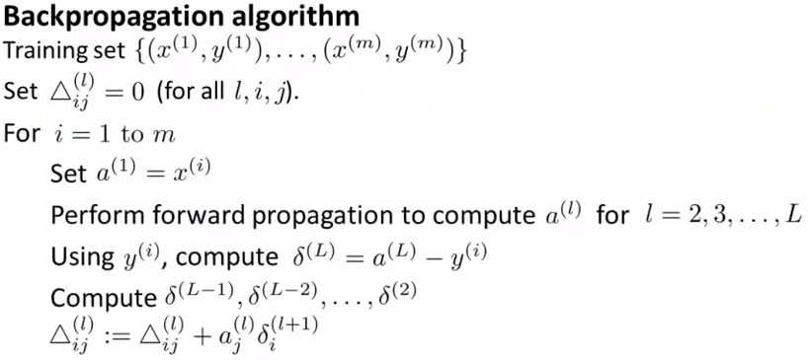

Slide 42
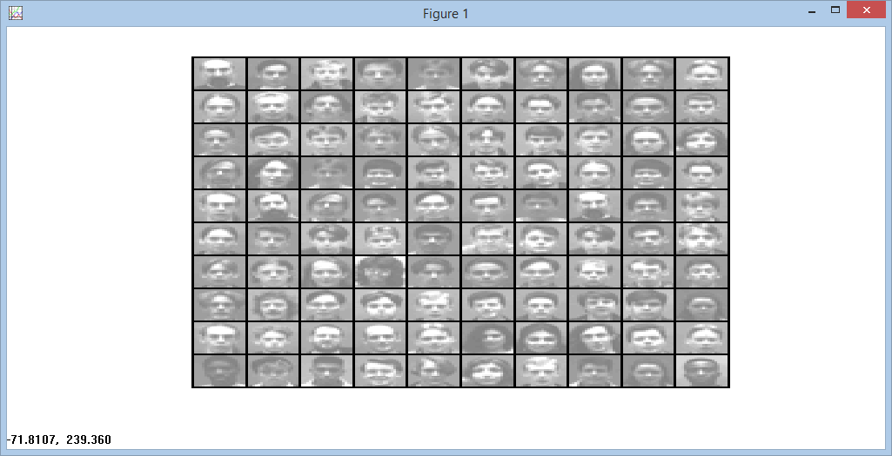
A training dataset was taken, segmented and trained with the neural networks to get a better accuracy than when neural networks were trained on just the images.
Training images:

Slide 43
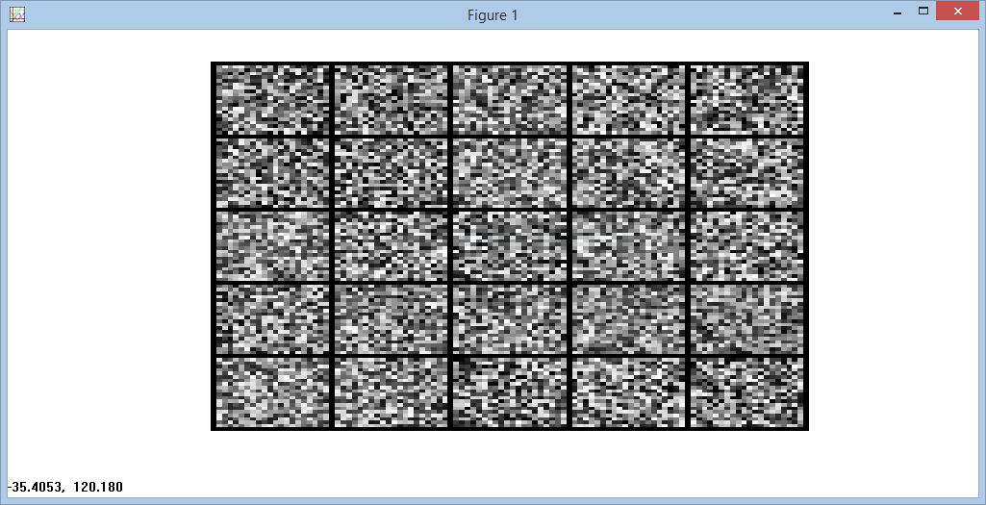
Hidden Layer

Slide 44
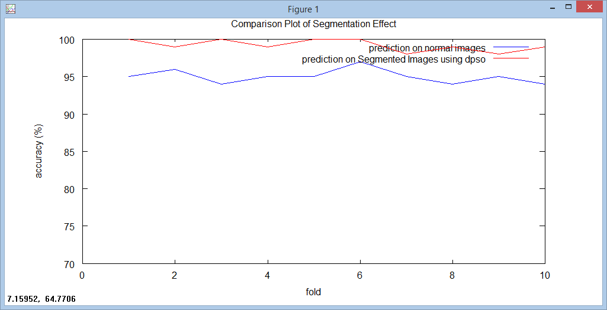

Slide 45
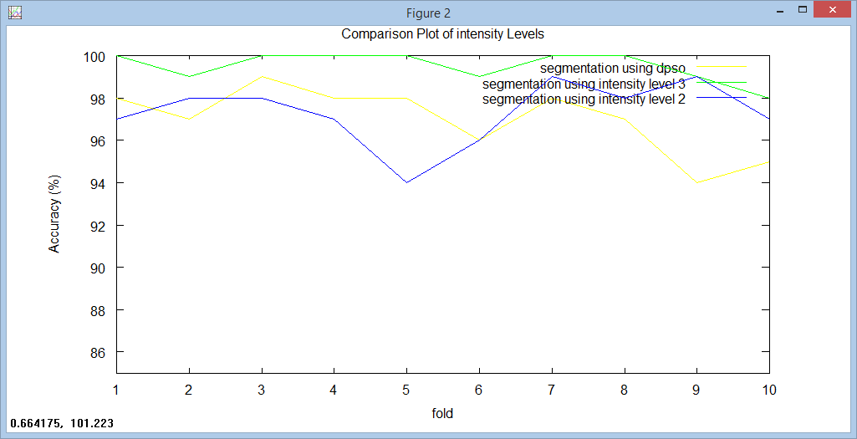

Slide 46
CONCLUSION
Image segmentation is used by the neural network to train on the segmented images and hence, greatly reduce the computation complexity and increase the efficiency, as opposed to non-segmented image processing using neural networks.

Slide 47
THE END

