Slide 1

PERSONAL NOTES API
Backend Engineering Project Demonstration
REST API for a personal knowledge base
PROJECT INTERN
Presented by
Musibau Bolaji
Backend Intern • BeTechified

Slide 2
01 OVERVIEW
Project Overview
01
02
The goal
Technology
A REST API for a personal second-brain application
Node.js, Express, MongoDB Atlas and Mongoose
03
04
Core capability
Advanced queries
Validated CRUD operations
Search, category, pagination and sorting
PERSONAL NOTES API • BETECHIFIED ADVANCED BACKEND ENGINEERING
2

Slide 3
02 SYSTEM DESIGN
Architecture & Technology Stack
POSTMAN / CLIENT
→
EXPRESS API
→
CONTROLLER
→
MONGOOSE
→
MONGODB ATLAS
HTTP requests
Routes and validation
Business logic
Schema and queries
Persistent storage
Node.js • Express • MongoDB Atlas • Mongoose • Joi • dotenv • Render
PERSONAL NOTES API • BETECHIFIED ADVANCED BACKEND ENGINEERING
3

Slide 4
03 MONGODB SCHEMA
Data Model
MongoDB text index
Note document
{ title: "text", content: "text" }
◆
title: String • required
◆
content: String • required
Indexes support full-text keyword search across note titles and content.
◆
category: String • default General
◆
tags: String[]
◆
createdAt: Date • automatic
One note represents a single item of personal knowledge, such as a meeting reminder, idea or reading list.
◆
updatedAt: Date • automatic
PERSONAL NOTES API • BETECHIFIED ADVANCED BACKEND ENGINEERING
4

Slide 5
04 API CAPABILITIES
API Query Features & Demonstration
CRUD
POST • GET • PUT • DELETE
Live API demonstration
PAGINATION
page=1 & limit=10
1. Create five notes
2. Fetch a list and individual note
SORTING
sort=-createdAt
3. Update and delete evidence note
4. Combine page, sort, search and category
TEXT SEARCH
q=meeting or search=meeting
5. Validate success codes and JSON responses
CATEGORY
category=Work
https://personal-notes-api-bavd.onrender.com/api/notes
PERSONAL NOTES API • BETECHIFIED ADVANCED BACKEND ENGINEERING
5

Slide 6
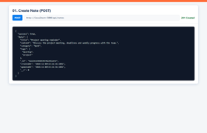
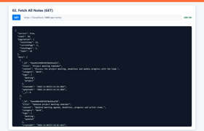




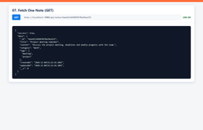

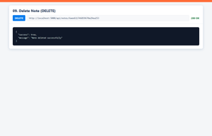
05 DELIVERY QUALITY
Challenges, Learnings & Test Evidence
Challenges & learnings
• MongoDB connection reliability
• Text-index configuration
• Handling validation consistently
• Combining multiple query filters
• Deploying environment variables
• Producing repeatable API evidence
PERSONAL NOTES API • BETECHIFIED ADVANCED BACKEND ENGINEERING
6

Slide 7
Deployment & Conclusion
A production-ready personal knowledge API
Delivered
LIVE DEPLOYMENT
✓ Validated CRUD API
Personal Notes API
✓ Advanced query features
personal-notes-api-bavd.onrender.com
✓ Automated evidence
MongoDB Atlas connected • Public Render service • Verified HTTP 200
✓ Complete README
✓ Public deployment
READY FOR FINAL SUBMISSION
✓ Presentation material
Musibau Bolaji • Backend Intern • BeTechified

