Slide 1
GROUP 5C / RETAIL SYSTEMS API PROJECT
Retail Inventory and
Expiry Management API
Product records, stock visibility, and expiry alerts
David Oladele
Musibau BOLAJI (Adigson)
Precious Chisom
Jamila Umar Adam
Okwara Godfrey
Ezekiel Micheal Danlami
Noah Fater Kusa
Yahaya Sheidu
GROUP 5C | PROJECT TEAM
Express REST API | Demo presentation

Slide 2
01 / PROBLEM AND GOAL
Why this API?
Inventory blind spots
One product service
Actionable alerts
Hard-to-search records make it easier to miss stockouts and products nearing expiry.
A REST API supports creating, viewing, updating, deleting, and searching product records.
Filter by low quantity or an upcoming expiry window to help staff prioritize checks.
Goal: make basic retail inventory information easier to maintain and act on.
RETAIL INVENTORY API | GROUP 5C
2

Slide 3
02 / ARCHITECTURE
A small, focused request path
API client
Postman / HTTP
Express app
CORS + JSON
Routes + validation
Health / products
In-memory store
Product records
?
?
?
Errors are returned as JSON; unknown paths use a 404 response.
Data is held in memory and resets when the server restarts.
RETAIL INVENTORY API | GROUP 5C
3

Slide 4
03 / API DEMONSTRATION
Demo flow in Postman
GET /health ? service status (200)
GET /api/products?category=Dairy ? filter products
POST ? PUT ? DELETE /api/products ? CRUD flow
GET /api/products/low-stock?threshold=10 ? stock alert
GET /api/products/expiring-soon?days=7 ? expiry alert
The collection creates a unique SKU and stores the ID for update/delete.
RETAIL INVENTORY API | GROUP 5C
4

Slide 5
04 / TESTING AND LIMITATIONS
Verification and boundaries
VERIFICATION
CURRENT LIMITATIONS
Automated tests: 33 passed (npm test). PR #5 also records a successful Postman collection import and checks.
Product data is in memory only
No authentication
No user interface
Learning/demo API
Next step: use persistent storage for data that must survive restarts.
RETAIL INVENTORY API | GROUP 5C
5

Slide 6
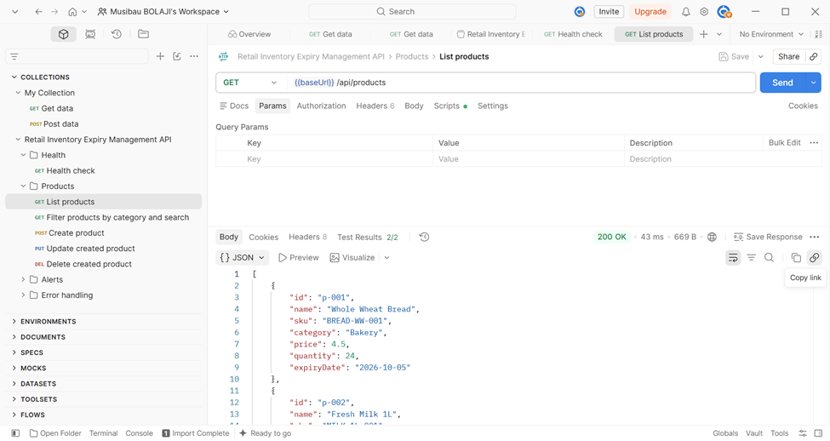
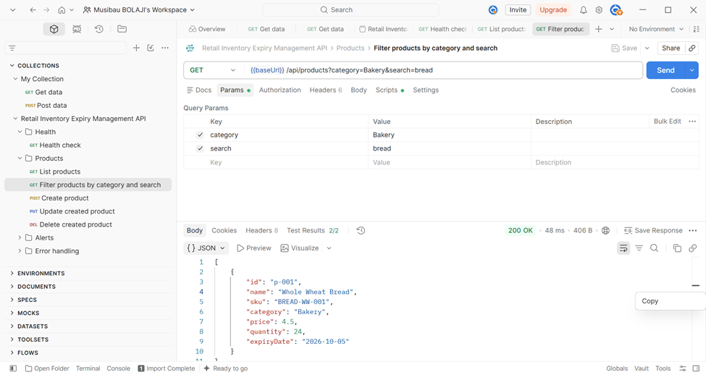
GROUP 5C / POSTMAN CAPTURE 1
Postman response evidence
Health check | GET /health | 200 OK
Product list | GET /api/products | 200 OK
RETAIL INVENTORY API | GROUP 5C
6

Slide 7
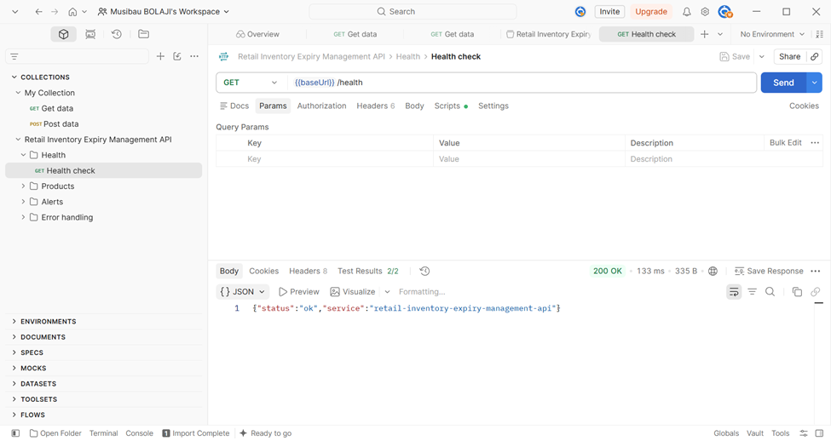
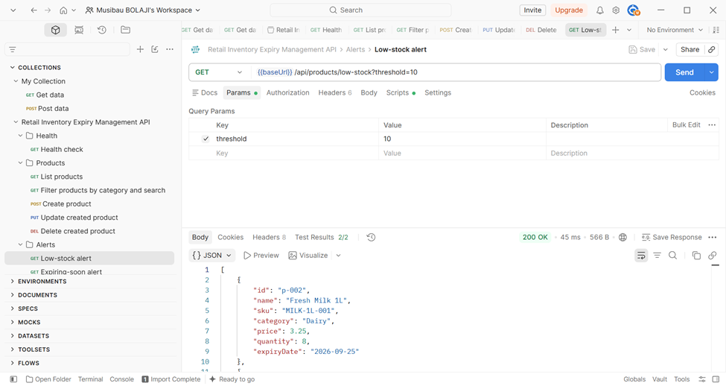
GROUP 5C / POSTMAN CAPTURE 2
Postman response evidence
Category + search filter | 200 OK
Low-stock alert | threshold=10 | 200 OK
RETAIL INVENTORY API | GROUP 5C
7

Slide 8
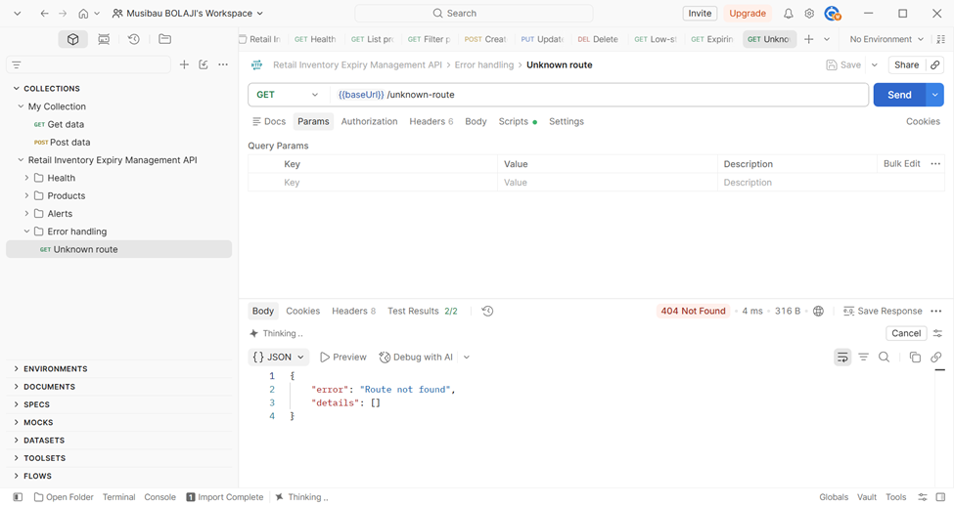
GROUP 5C / POSTMAN CAPTURE 03
Unknown route returns a clear 404
GET /unknown-route | 404 Not Found | JSON error response
RETAIL INVENTORY API | GROUP 5C
8

