Slide 1
Pathology classification using multiple Deep Learning techniques
Guide:Sri Rahul Diwate
Name: Aditya Shirude Gr no: 12010009

Slide 2
Introduction
Many researchers have used open source medical datasets to develop disease detection and prediction applications. In addition, next-generation sequencing has allowed researchers to dig deeper into the complex details of biological systems. Over the last few decades, the rapid population growth has made early detection of disease an important topic in medical research. The risk of death from a serious illness such as cancer increases exponentially as the population grows. A system that helps medical staff diagnose illness, provide reliable, efficient and prompt response, and reduce the risk of death. The proposed model aims to improve the current classification and feature extraction methods in pathological images. The new algorithm surpasses traditional neural training techniques and is designed to detect disease more accurately at an earlier stage. This study compares the accuracy of two neural training techniques on same dataset to find the best algorithm for classifying medical images.

Slide 3
Aim
To automate the classification process of the pathology images generated by the medical institutes more accurately as compared to the traditional CNN techniques by using Adaptive Support Vector Machine-based Transfer Learning.

Slide 4
Objective
To compare the accuracy of CNN model with transfer learning model.
Provide the complete framework that is capable of processing graphical pathology images with better accuracy compared to the traditional neural network algorithms.
Help automate the process of classification of huge pathological data

Slide 5
Problem Identification
Due to the increased amount of pathological data generated in recent years, there is a need for automating the classification of huge pathological image data more accurately and efficiently in the medical sector. There is a need for increasing the efficiency of the algorithms for analysing and classifying such huge amount of graphical images with lesser computational power.

Slide 6
Solution Proposed
This study proposes a neural network with Deep Belief Network for Image Feature Extraction, and two different algorithms namely K Nearest Neighbors and Transfer Learning based on adaptive Support Vector Machine(SVM) for classification of pathological images.
With the proposed system, graphical pathology images will be processed more accurately than with traditional neural network algorithms.

Slide 7
Literature Review
Click Here

Slide 8
Software Requirements
Programming Language/s: Python
Libraries: Numpy, Pandas, Matplotlib
Platforms: Jupyter
Frameworks : Keras

Slide 9
Algorithms Used
CNN:- This image classification technique is a supervised machine learning algorithm, whereby H. learns by recording a marked training set of data X and its labels Y and mapping the input X to the desired output Y.
The results produced by the models will be compared on a scale of 0 to 1 for accuracy.
Transfer Learning:- Using a pre-trained model from keras to retrain it on our dataset. This significantly reduces the total number of trainable parameters and reduces total no of epochs cycles required to train the model.

Slide 10
Methodology
Data acquisition:-
Kaggle chest-xray-pneumonia.
Image Preprocessing:-The images will be resized and blurred using multiple preprocessor techniques to make them more standardized that will make testing and trainer easier.

Slide 11
Methodology
Feature Extraction:-
A multilayer superposition that can extract detailed features from images. Following the initialization of each parameter and given the training period and learning rate, the comparison dispersion algorithm is used to update the training parameters.

Slide 12
Methodology
Classification of Images:
Classification of images will be done by two different models based on different algorithms.
Transfer learning (TL) is a machine learning (ML) research problem that focuses on storing knowledge acquired while solving one problem and applying it to a different but related problem.
Image Classification technique using CNN:-
The used image classification technique is a supervised machine learning algorithm, whereby H. learns by recording a marked training set of data X and its labels Y and mapping the input X to the desired output Y.
The results produced by the models will be compared on a scale of 0 to 1 for accuracy.

Slide 13
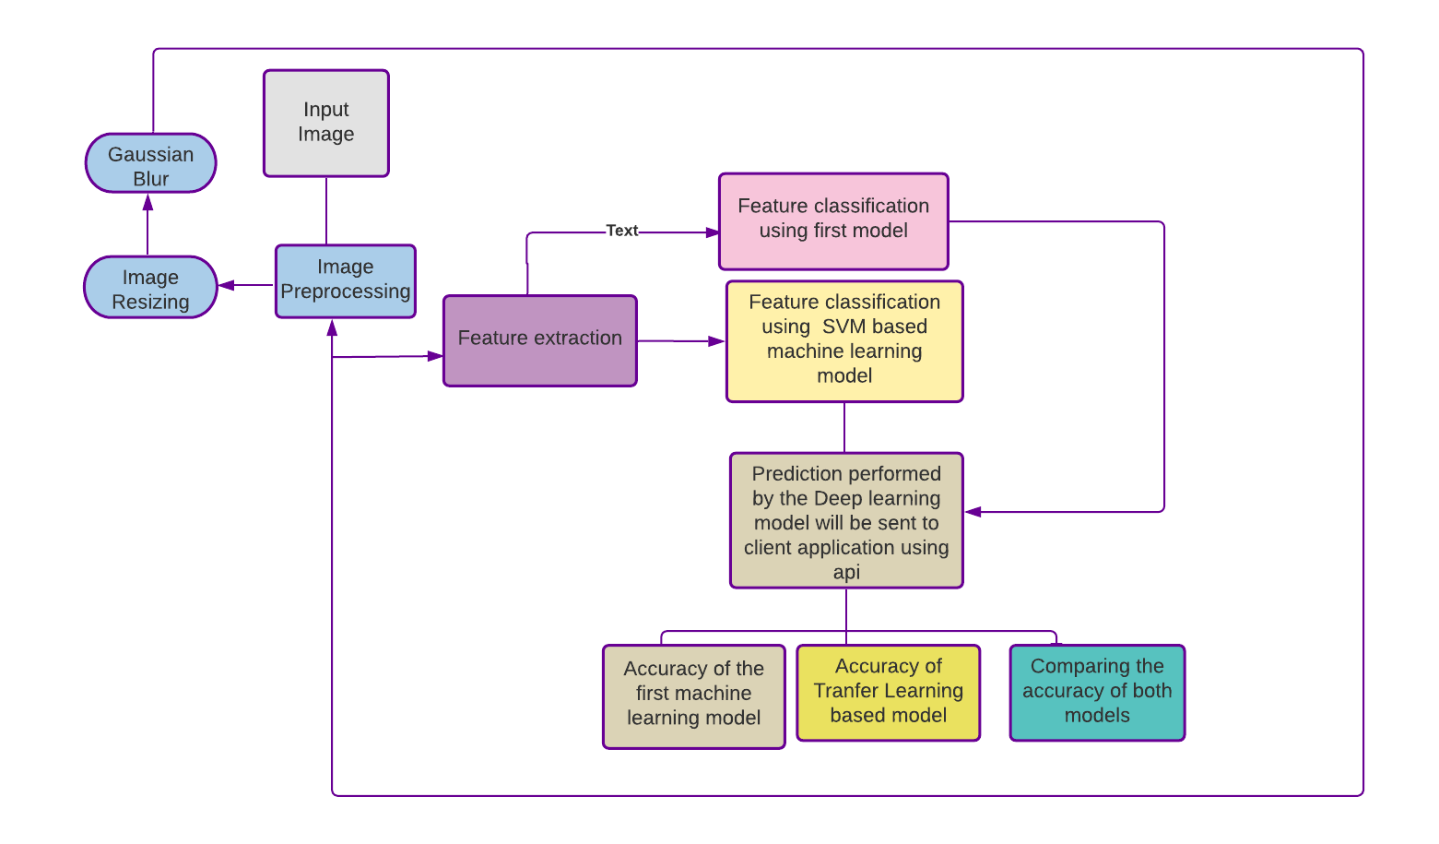
Block Diagram

Slide 14
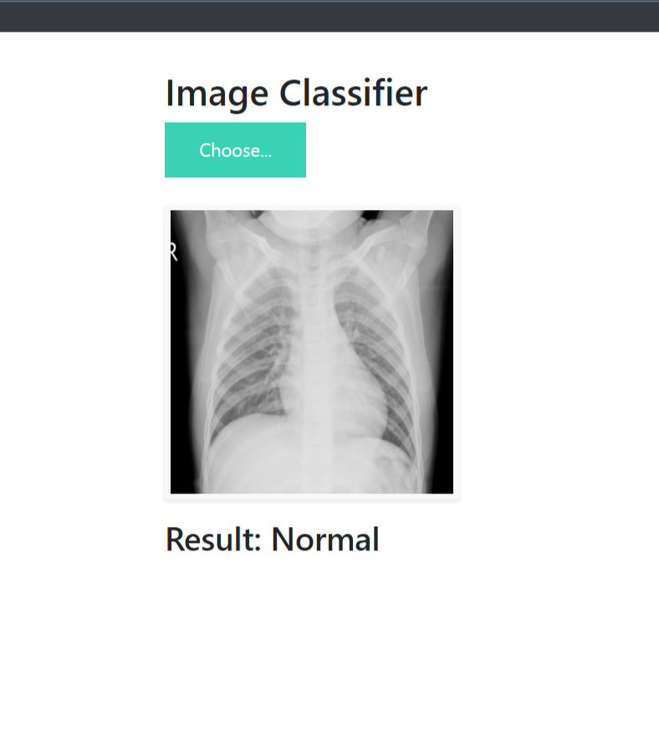
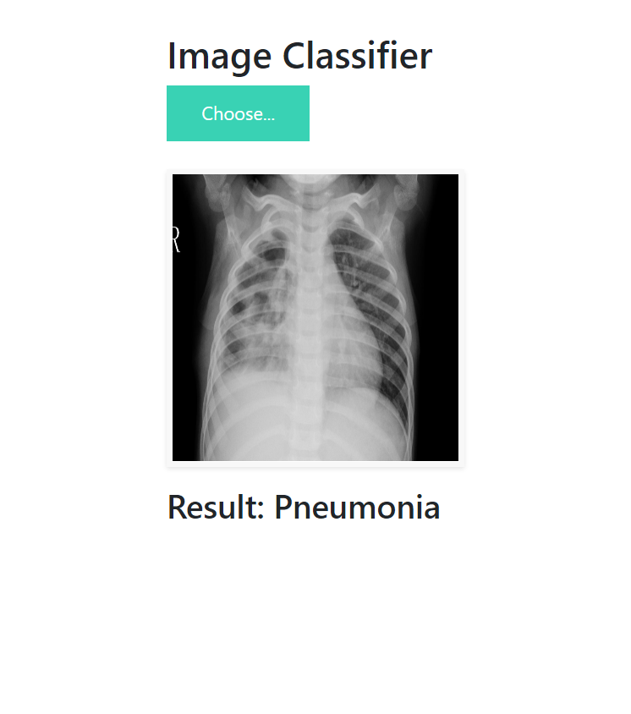
Results

Slide 15
Conclusion
Implementing the pre-trained model to predict more complicated medical imagery like tumor prediction from CT-scan images. The model can be trained so that it can be used to precisely locate possible tumor growth to catch the disease in very early stages. The scope of computer vision combined with deep learning is very vast and can be only explored if we make new and more innovative techniques from current available architecture.

Slide 16
References
Kumar, S. N., Fred, A. L., Padmanabhan, P., Gulyas, B., Kumar, H. A., & Miriam, L. J. (2021). Deep Learning Algorithms in Medical Image Processing for Cancer Diagnosis: Overview, Challenges and Future. Deep Learning for Cancer Diagnosis, 37-66.
Al-Dhief, F. T., Baki, M. M., Latiff, N. M. A. A., Malik, N. N. N. A., Salim, N. S., Albader, M. A. A., ... & Mohammed, M. A. (2021). Voice Pathology Detection and Classification by Adopting Online Sequential Extreme Learning Machine. IEEE Access, 9, 77293-77306.
Hirra, I., Ahmad, M., Hussain, A., Ashraf, M. U., Saeed, I. A., Qadri, S. F., … Alfakeeh, A. S. (2021). Breast Cancer Classification From Histopathological Images Using Patch-Based Deep Learning Modeling. IEEE Access, 9, 24273– 24287.
Koohbanani, N. A., Unnikrishnan, B., Khurram, S. A., Krishnaswamy, P., & Rajpoot, N. (2021). Self-Path: Self-supervision for Classification of Pathology Images with Limited Annotations. IEEE Transactions on Medical Imaging.Self-Path: Self-supervision for Classification of Pathology Images with Limited Annotations. IEEE Transactions on Medical Imaging.
Sharma, A., & Rani, R. (2021). A Systematic Review of Applications of Machine Learning in Cancer Prediction and Diagnosis. Archives of Computational Methods in Engineering, 1-22.
Rajalakshmi, N. R., Sangeetha, B., Vidhyapriya, R., & Ramesh, N. (2021). Combined Radiology and Pathology Based Classification of Tumor Types. In Deep Learning for Cancer Diagnosis (pp. 99-109). Springer, Singapore.
Kumar, S. N., Fred, A. L., Padmanabhan, P., Gulyas, B., Kumar, H. A., & Miriam, L. J. (2021). Deep Learning Algorithms in Medical Image Processing for Cancer Diagnosis: Overview, Challenges and Future. Deep Learning for Cancer Diagnosis, 37-66.
Munir, K., Frezza, F., & Rizzi, A. (2021). Deep Learning for Brain Tumor Segmentation. In Deep Learning for Cancer Diagnosis (pp. 189-201). Springer, Singapore.
Healy, J. J., Curran, K. M., & Trbalic, A. S. (2021). Deep Learning for Magnetic Resonance Images of Gliomas. In Deep Learning for Cancer Diagnosis (pp. 269-300). Springer, Singapore.
Calp, M. H. (2021). Use of Deep Learning Approaches in Cancer Diagnosis. In Deep Learning for Cancer Diagnosis (pp. 249-267). Springer, Singapore.
Deepal, D. A. A., & Fernando, T. G. I. (2021). Convolutional Neural Network Approach for the Detection of Lung Cancers in Chest X-Ray Images. In Deep Learning for Cancer Diagnosis (pp. 203-226). Springer, Singapore.
Basarslan, M. S., & Kayaalp, F. (2021). Performance evaluation of classification algorithms on diagnosis of breast cancer and skin disease. In Deep Learning for Cancer Diagnosis (pp. 27-35). Springer, Singapore.
Yari, Y., Nguyen, T. V., & Nguyen, H. T. (2020). Deep learning applied for histological diagnosis of breast cancer. IEEE Access, 8, 162432-162448.
Islam, M. M., Haque, M. R., Iqbal, H., Hasan, M. M., Hasan, M., & Kabir, M. N. (2020). Breast cancer prediction: a comparative study using machine learning techniques. SN Computer Science, 1(5), 1-14.
Tang, H., & Hu, Z. (2020). Research on medical image classification based on machine learning. IEEE Access, 8, 93145-93154.
Madhupriya, G., Guru, N. M., Praveen, S., & Nivetha, B. (2019). Brain Tumor Segmentation with Deep Learning Technique. 2019 3rd International Conference on Trends in Electronics and Informatics (ICOEI)
Alawad, M., Gao, S., Qiu, J., Schaefferkoetter, N., Hinkle, J. D., Yoon, H. J., ... & Tourassi, G. (2019, May). Deep transfer learning across cancer registries for information extraction from pathology reports. In 2019 IEEE EMBS International Conference on Biomedical & Health Informatics (BHI) (pp. 1-4). IEEE.
Ahmed, S. R. A., UÇAN, O. N., Duru, A. D., & Bayat, O. (2018). Breast cancer detection and image evaluation using augmented deep convolutional neural networks. Aurum journal of engineering systems and architecture, 2(2), 121-129.
Nurmaini, S., Malik, R. F., Abidin, D. Z., Zarkasi, A., & Kunang, Y. N. (2018, October). Breast cancer classification using deep learning. In 2018 International Conference on Electrical Engineering and Computer Science (ICECOS) (pp. 237-242). IEEE.
Chougrad, H., Zouaki, H., & Alheyane, O. (2018). Deep convolutional neural networks for breast cancer screening. Computer methods and programs in biomedicine, 157, 19-30.

Slide 18
1

