Slide 1
CSG2H3 Object Oriented Programming
Collection
and Generic

Slide 2

Java Collection

Slide 3
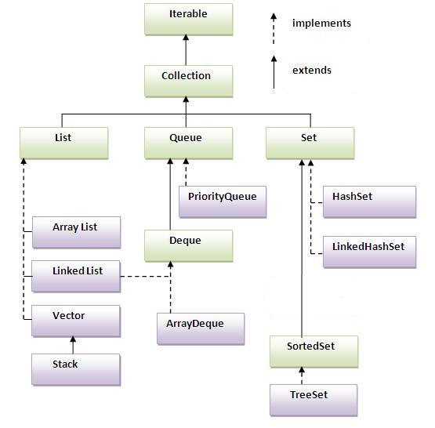
Java Collection
containers of Objects which by polymorphism can hold any class that derives from Object (which is actually, any class)
Using Generics the Collection classes can be aware of the types they store

Slide 4
Java Collection
add( item )
remove( item )
addAll( collection )
removeAll( collection )
retainAll( collection )
contains( item )

Slide 5
Java Collection
List list = new ArrayList();
// normal loop
for (int i = 0; i < list.size() ; i++ ) {
Object o = list.get(i);
System.out.println(o);
}
// loop using for-element
for (Object o : list) {
System.out.println(o);
}

Slide 6
Java Collection
// Loop using iterator
Iterator itr = list.iterator();
while (itr.hasNext()) {
Object o = itr.next();
System.out.println(o);
}
// loop using lambda Expression
list.forEach( o -> System.out.println(o));
// loop using reference
list.forEach( System.out :: println);

Slide 7
Generic Collection
Collection<String> str = new HashSet<String>();
List<Integer> arr_i = new List ();
ArrayList<Employee> emp = new ArrayList ();

Slide 8
Sorting Collection – Comparable
Collections.sort( list ) or list.sort( null )
If the List consists of String elements, it will be sorted into alphabetical order.
If it consists of Date elements, it will be sorted into chronological order
To create a custom ordering for list of objects, the class must implement interface Comparable
implement method public int compareTo( Object )
For arrays, use Arrays.sort( array[] )

Slide 9
Sorting Collection – Comparable
public int compareTo( Object o )
Return < 0 if “this” object will be sorted before Object o
Return = 0 if “this” object and Object o is equal
Return > 0 if “this” object will be sorted after Object o
If the parameter is either String or Date, use compareTo
return this.getString().compareTo(o.getString());
If the parameter is numerical, use substraction
return this.getNumber() – o.getNumber();

Slide 10
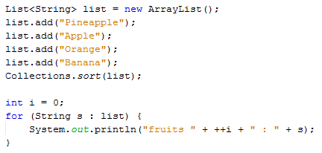
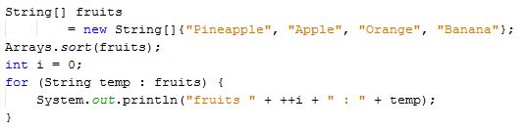
Example - sort(list of string)

Slide 11
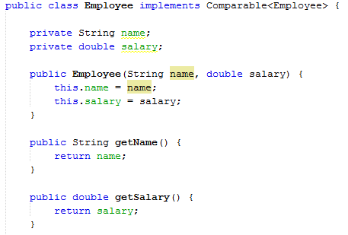
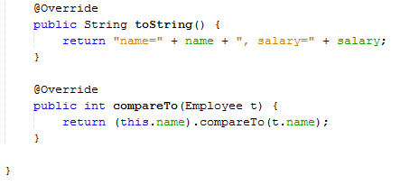
Example – sort(list of object)

Slide 12
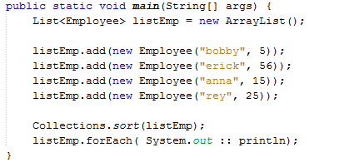
Example – sort(list of object)
name=anna, salary=15.0
name=bobby, salary=5.0
name=erick, salary=56.0
name=rey, salary=25.0

Slide 13
Sorting Collection - Comparator
Comparable Interface only allows to sort a single property.
To sort with multiple properties, you need Comparator class
Collections.sort( list, comparator ) or list.sort( comparator )
For arrays, use Arrays.sort( array[], comparator )

Slide 14
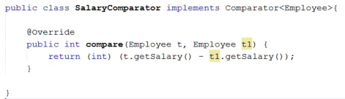
Sorting Collection - Comparator
Create a comparator class implements Comparator interface to compare the element
public interface Comparator<T> { int compare(T object1, T object2); }

Slide 15
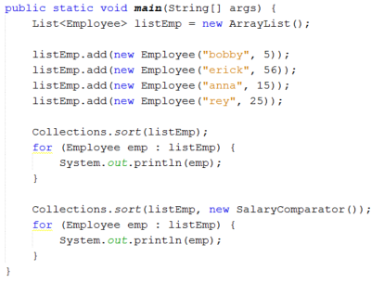
Sorting Collection Example
name=anna, salary=15.0
name=bobby, salary=5.0
name=erick, salary=56.0
name=rey, salary=25.0
name=bobby, salary=5.0
name=anna, salary=15.0
name=rey, salary=25.0
name=erick, salary=56.0

Slide 16
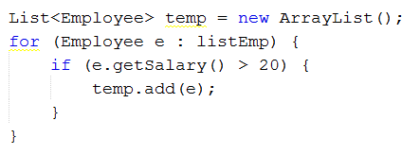
Filter elements from Collections
Select a specific element based on parameter
Select all Employee with salary above 20
Old way

Slide 17
Filter elements from Collections
Select all Employee with salary above 20
Using Lambda expression
list.stream().filter( o -> condition )

Slide 18
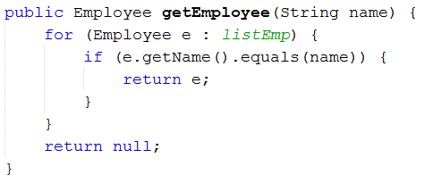
Filter elements from Collections
Retrieve an element based on some attributes
Select Employee by name
Old way

Slide 19
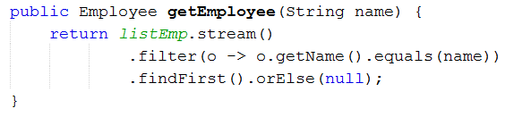
Filter elements from Collections
Select Employee by name
Using Lambda expression
list.stream().filter( o -> condition ).findFirst()
.orElse( x )

Slide 20

Generic Type
A way to define which types are allowed in your class or function
Generic types are declared in class and defined while instantiation

Slide 21
Erasure
the compiler will replace all occurrences in the class of type parameter with the upper bound of the formal type parameter
The default upper bound is the class Object

Slide 22
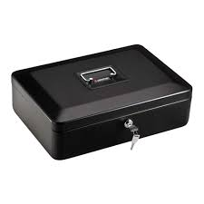
Example
Picture it that we want to create a class to store anything within
Let the class called SafeBox

Slide 23
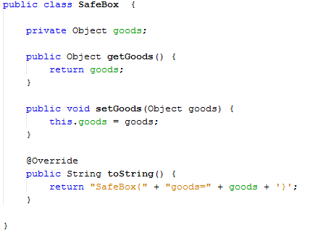
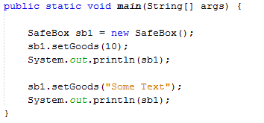
Example
SafeBox{goods=10}
SafeBox{goods=Some Text}

Slide 24
Example
Now, let’s say that we want to create (instantiate) a SafeBox object that can only contain a specific type of value
Here, we can use Generic

Slide 25
Example
Declare Generic type name after class name, enclosed with <>
public class SafeBox <X> { ...
Use Generic type name to declare generic variables
private X genericVar;
Define the Generic type when instantiation
SafeBox sb1 = new SafeBox();
SafeBox<String> sb2 = new SafeBox();

Slide 26
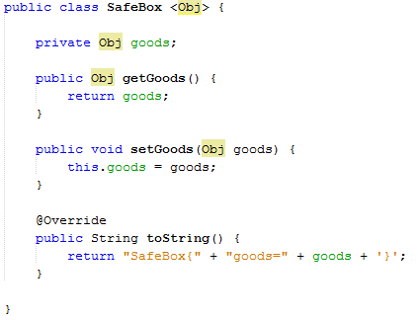
Example
When the SafeBox is instantiate without generic, the default type for <Obj> is Object
SafeBox{goods=10}
SafeBox{goods=Some Text}

Slide 27
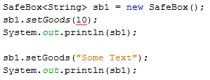
Example
Specify the generic type during instantiation
The defined type will “replace” the generic type
This line is error compile as now goods can only be assigned with String

Slide 28
Wildcard
Suppose we want to use an Object with Generic properties as a parameter of a method
There are 3 ways of using :
Default use
Bounded use
Unbounded use

Slide 29
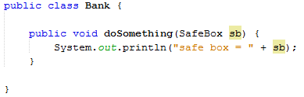
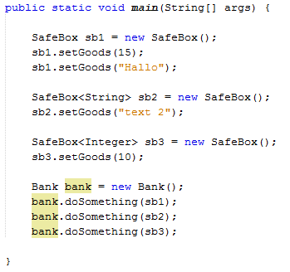
Default use (no Wildcard)
With no wildcard, the method will receive any SafeBox object and treat the Generic type as default Object type
safe box = SafeBox{goods=Hallo}
safe box = SafeBox{goods=text 2}
safe box = SafeBox{goods=10}

Slide 30
Bounded Wildcard
The use of Bounded Wildcard is when we specified a specific type of Generic that can be received by the method
Declare the specified Generic type of a parameter enclosed in <>
public void methodName( SomeObject<Type> )

Slide 31

Bounded Wildcard
This line is error compile as now doSomething can receive Default SafeBox and Integer SafeBox only

Slide 32
Unbounded Wildcard
Using unbounded wildcard will make the method can receive any Generic type Object
Declare Unbounded Wildcard using <?>
public void methodName( SomeObject<?> )

Slide 33
Unbounded Wildcard
The <?> notation means that we don’t know the specific type
In another word, we ignore the type
But not like default use, the use of unbounded wildcard will make the generic value from the Object cannot be modified inside the method
Because we don’t know the type
No modification, only accessed
Non generic variable can still be modified

Slide 34
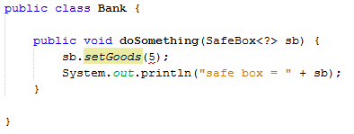
Unbounded Wildcard
This line is error compile as the type of goods is unknown, thus cannot be modified
Can still be accessed

Slide 35
No Wildcard vs Unbounded Wildcard
Since using no wildcard (RAW type) will treat the generic as Object-type, any modification might cause exceptions
Because raw type has no restrictions, using it will easily corrupt the invariant of collection.
In brief, wildcard type is safe and the raw type is not.
We can not put any element into a Set<?>

Slide 36
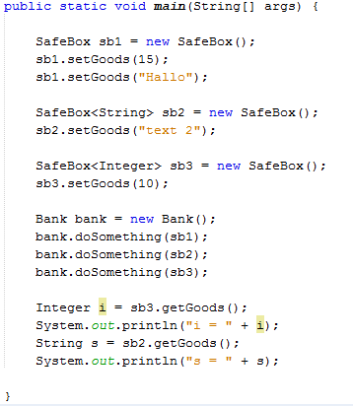
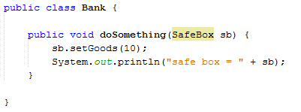
Bounded Wildcard
safe box = SafeBox{goods=10}
safe box = SafeBox{goods=10}
safe box = SafeBox{goods=10}

Slide 37
Bounded Wildcard
No error compile as goods in sb2 IS declared as String
This line will caused an exception as the value of goods is Integer, and want to be retrieved as String

Slide 38
Question?

Slide 39

Credits
Music : Yonezawa Madoka - Oui! Ai Kotoba (Instrumental)

