Slide 1

DSA Mini Project
Deadline Rescue
A task manager that tells you what to do next, built on a custom array, a custom stack and merge sort.
Java (core logic and Swing app) + HTML frontend
Notes:
Introduce the project: Deadline Rescue helps a student see which deadline to rescue first. The logic is written in Java using hand-made data structures, and the HTML frontend runs the same logic in the browser.

Slide 2



Deadlines pile up fast
A flat to-do list has no order
Our goal
Ten tasks look equally important, so the urgent one gets missed.
Show the one task to rescue first, and explain why.
Overdue work hides in the list
Late tasks sit between fresh ones with nothing to flag them.
One wrong tap is hard to take back
Score = priority ÷ time left
Marking the wrong task complete should be one step to reverse.

Slide 3





What the app does
Add tasks
Rank by urgency
Complete tasks
Title, deadline and priority
Or by deadline or priority
Pending, overdue and due today
Undo completion
Search by ID
Keep your tasks
Powered by a custom stack
Linear search with step count
Saved between sessions

Slide 4
How the classes fit together
Dashboard / HTML
TaskManager
DeadlineAnalyzer
User interface: table, buttons, lab
Add, complete, undo, delete, save
Three sort orders
TaskArray
UndoStack
Task
Custom resizable array: add, findById, removeById
Custom stack: push, pop, peek
id, title, deadline, priority, urgencyScore()
Notes:
Dashboard talks only to TaskManager. TaskManager owns the TaskArray and UndoStack. DeadlineAnalyzer sorts copies of the array, so the stored order never changes.

Slide 5
DSA 1: a resizable array built by hand
Capacity 10, full. The 11th task arrives.
1
2
3
4
5
6
7
8
9
10
Capacity doubles to 20. The 10 items are copied across.
1
2
3
4
5
6
7
8
9
10
Add
Find by ID
Remove by ID
O(1) amortized
O(n)
O(n)
Write at index size. Doubling is rare.
Scan from index 0 until the ID matches.
Shift every later item one step left.

Slide 6
DSA 2: a stack that powers undo
complete #3
top
push(action)
data[++top] = action;
pop()
data[top--] = null;
complete #6
complete #1
push and pop
O(1)
Last in, first out: undo always reverses the newest completion.
Capacity
Doubles when full
Saved to disk
No. Session only

Slide 7
The urgency score decides the order
Task | Deadline | Priority | Score
Lab record file | 2 days late | High | 1032
Pay exam fees | Today | High | 30.0
Submit DSA task | 1 day | High | 15.0
Revise stacks | 3 days | Medium | 5.0
Group meeting | 7 days | Low | 1.3
Not overdue
10 × weight
÷ (days left + 1)
Overdue
1000 + 10 × weight + days late
Weight: High 3, Medium 2, Low 1
Completed tasks always sort after pending ones.

Slide 8
Three sort orders, one algorithm
Urgency
Deadline
Priority
Highest score first
Soonest date first
High before Low
Recommended default
Ties broken by title
Ties broken by date
Stable merge sort
O(n log n)
Sorts a copy
Equal items keep their order.
The browser version counts comparisons live.
The stored array is never reordered.

Slide 9
Complexity at a glance
Operation | Where | Time
Index lookup | TaskArray.get | O(1)
Add task | TaskArray.add | O(1) amortized
Find by ID | TaskArray.findById | O(n)
Remove by ID | TaskArray.removeById | O(n)
Push / pop | UndoStack | O(1)
Sort tasks | DeadlineAnalyzer | O(n log n)

Slide 10
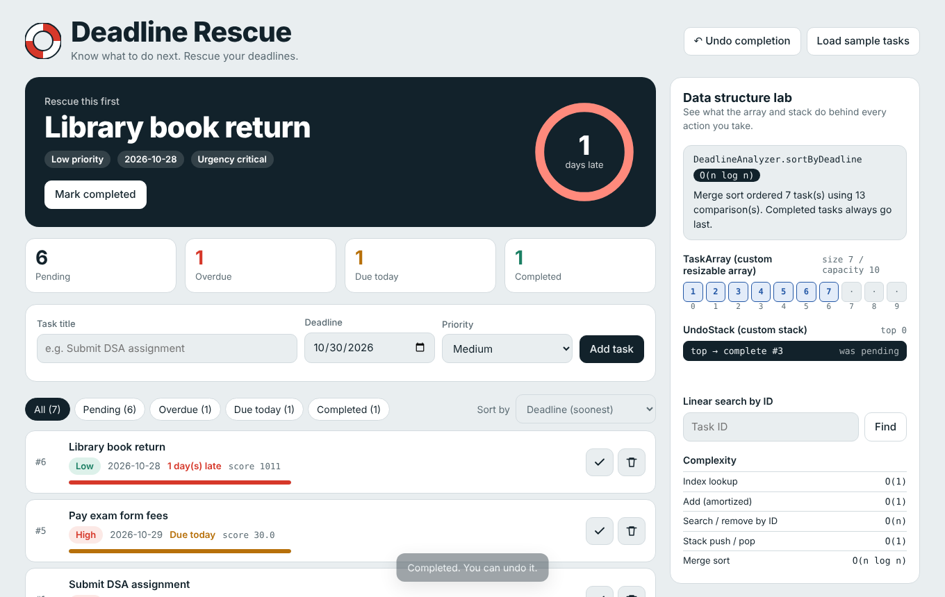
The HTML frontend
One file, no setup
Open index.html in any browser.
Same logic as Java
Array, stack and merge sort are ported.
Data structure lab
Watch cells, stack and step counts change.
Notes:
Demo idea: add 11 tasks to show capacity doubling, complete two tasks and undo, delete a task to show shifting, then search by ID to show the step count.

Slide 11
Testing and one bug fixed
What we checked
Bug found in the Java loader
Array grows from 10 to 20 on the 11th task
Undo restores the newest completion first
Delete shifts later items left
Search counts steps correctly
Tasks survive a page reload
Saved tasks never reloaded because the split pattern was wrong.
before split("\\\\|")
after split("\\|")
Verified with a save and reload round trip.

Slide 12
What we learned
Choosing the right structure sets the cost of every operation.
A stack makes undo simple and fast.
A clear scoring rule turns a list into a plan.
Next steps
Use a min-heap for the most urgent task in O(log n), make delete undoable, and add due-date reminders.
Thank you

