Slide 1

FitPro
Online Fitness Training Platform
Java Servlets | JSP | JDBC | MySQL
      Team Info
Aditya Singh
25scse1180171
Manik
25scse1180216
Harshit vats
25scse1180097
Notes:
Introduce the project: FitPro is a full-stack Java web application where trainers publish workout programs and members enrol, log sessions and track calories. It is built with Servlets, JSP, JDBC and MySQL.

Slide 2
What this presentation covers
About FitPro
1
Problem and features
Slides 3-4
Why FitPro exists and what each role can do
FitPro is an online fitness training platform built in Java. Trainers publish workout programs, and members enrol, log their sessions and track the calories they burn.
This presentation explains the problem, the design, how the code is built, and a walkthrough of the working screens.
2
Application screens
Slides 5-7
Login, dashboard and workout catalogue
3
Core Java implementation
Slides 8-11
OOP, collections, threads, JDBC, servlets, security
4
Technology and design
Slides 12-16
Stack, MVC architecture, project structure, database
2
4
6
5
Rubric, demo and future scope
Slides 17-18
user roles
database tables
servlets
Marks coverage, demo order and next steps
Notes:
Start by explaining what FitPro is in one or two sentences: an online fitness platform where trainers publish programs and members enrol, log sessions and track calories. Then walk through the five parts of the presentation using the agenda: the problem and features, the technology and design, the core Java implementation, the application screens, and finally the rubric coverage, demo and future scope.

Slide 3


The problem and our solution
The problem
Our solution
Gym memberships are costly and time-bound
Workouts are rarely tracked, so progress is invisible
Trainers have no simple way to publish structured programs
Members cannot see calories or trends in one place
One web platform for members and trainers
Trainers publish Cardio, Strength and Yoga programs
Members enrol, log sessions and see calories burned
Dashboard turns raw logs into clear statistics
Notes:
Explain the gap: people want structured training and progress tracking without expensive gym memberships, and independent trainers lack a simple place to publish programs. FitPro solves both with one platform.

Slide 4


Key features by role
Member
Trainer
Register and log in securely
Browse and filter workouts by type
Enrol in programs
Log minutes and body weight
See calories, totals and a chart
Register and log in securely
Publish programs with level and intensity
Choose Cardio, Strength or Yoga
Programs appear for every member
Role-specific dashboard
Shared: password hashing, session login, input validation, friendly error messages
Notes:
Two roles share one login system. Members train and track; trainers publish programs. Role checks are enforced on the server, not only hidden in the interface.

Slide 5
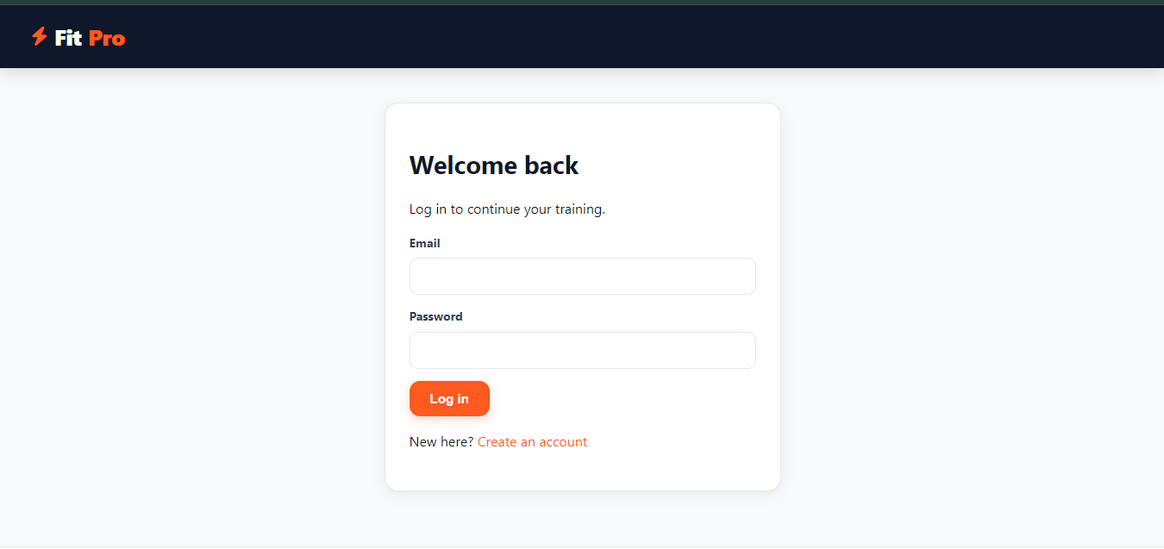
Screen 1: Login page
1
Screen walkthrough
1 Brand bar: FitPro logo shown on every page.
2 Email field: Required; format checked in the browser, then again on the server.
3 Password field: Sent by POST and compared with the stored PBKDF2 hash.
4 Log in button: Starts a fresh session, then opens the dashboard.
5 Create an account: Link to the registration page (Member or Trainer).
2
3
4
5
Behind this screen: POST /login
login.jsp > LoginServlet > AuthService > UserDAO > users table
Notes:
This is the entry point of the application. The form is validated in the browser by app.js and again on the server. LoginServlet asks AuthService to verify the password against the salted PBKDF2 hash. A wrong email or password shows one generic message so attackers learn nothing. On success the old session is discarded and a new one is created, which prevents session fixation, and the user is redirected to the dashboard.

Slide 6
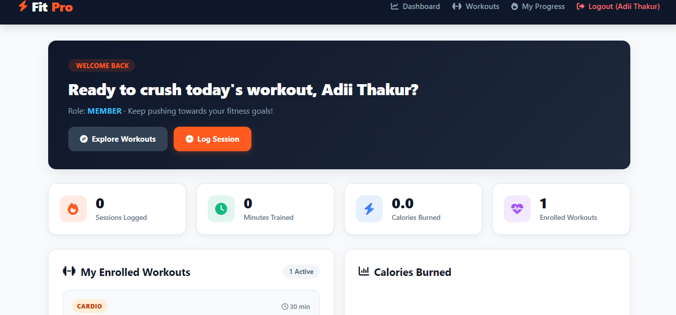
Screen 2: Member dashboard
Screen walkthrough
1
1 Welcome banner: Greeting and role badge (MEMBER) come from the logged-in user object.
2 Quick actions: Jump to Workouts or log a session in one click.
3 Stat cards: Sessions, minutes, calories burned and enrolled programs.
4 My Enrolled Workouts: Programs the member joined, with type and duration.
5 Calories Burned: Chart that fills in after the first logged session.
2
3
4
5
Behind this screen: GET /app/dashboard
DashboardServlet > ProgressService, WorkoutService > dashboard.jsp
Notes:
After login the member lands here. The totals are calculated by ProgressService from the logged sessions, so a new member sees zeros. The enrolled list comes from the enrollments table. The calories chart stays empty until the member logs a session on the My Progress page. A trainer sees a different dashboard with publishing tools instead of these statistics, because the welcome message and role behaviour are overridden per subclass.

Slide 7
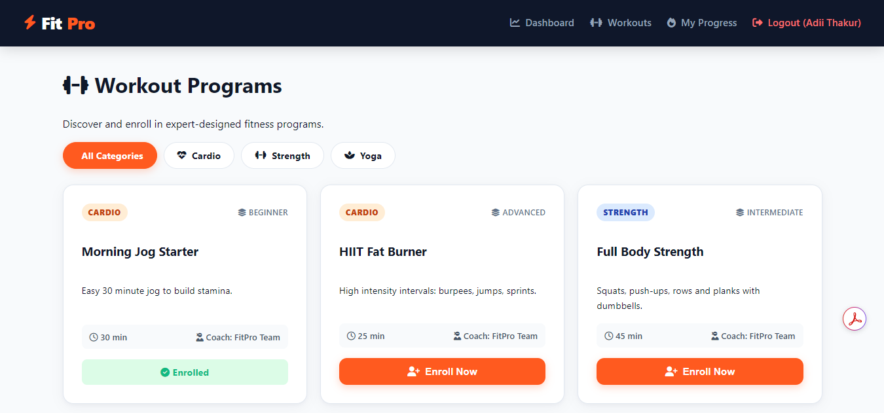
Screen 3: Workout programs
Screen walkthrough
1 Category chips: Filter the catalogue by All, Cardio, Strength or Yoga.
2 Type and level badges: Colour-coded so programs can be scanned quickly.
3 Duration and coach: Shown on every card; FitPro Team for built-in programs.
4 Enroll Now: Saves the enrolment in the database and sends a notification.
5 Enrolled state: Turns green once joined, and duplicate enrolments are blocked.
1
2
3
5
4
Behind this screen: GET and POST /app/workouts
WorkoutServlet > WorkoutService > WorkoutDAO, EnrollmentDAO > workouts.jsp
Notes:
This is the catalogue. Each card is one Workout object; the type badge reflects the subclass (Cardio, Strength or Yoga). The chips filter with a type parameter handled by the servlet. Enroll Now posts to the same servlet, which checks that the user is a member and not already enrolled before saving. Trainers see a publish form on this page instead of the Enroll buttons.

Slide 8





Technology stack
Frontend
Backend
Database
Build
Server
JSP, JSTL, HTML5, CSS3, vanilla JavaScript
Java 11, Servlets 4.0, Filters, Listeners
MySQL 8 accessed through JDBC
Maven, packaged as a WAR file
Apache Tomcat 9 (javax.servlet)
Chosen to cover the rubric directly: Core Java, JDBC database integration, and Servlets with web integration.
Notes:
Each layer uses a standard, industry-relevant technology. JSP with JSTL for the views, Java 11 servlets for control, MySQL accessed through plain JDBC, Maven for the build and Tomcat 9 as the server.

Slide 9
Layered MVC architecture
Browser
JSP views
Servlet
Controller
Service
Business rules
DAO
JDBC queries
MySQL
fitpro database
com.fitpro.servlet
com.fitpro.service
com.fitpro.dao
AuthFilter
Service layer
Listener and threads
Every /app/* request is checked for a logged-in session before it reaches a servlet.
Validation and rules live here, so servlets stay thin and DAOs contain only SQL.
AppContextListener stops the notification thread pool when the app is undeployed.
Notes:
A request flows left to right: the browser calls a servlet (controller), which delegates to a service (business rules), which uses a DAO (JDBC) to talk to MySQL. JSP pages render the response. Keeping layers separate makes the code modular and easy to test.

Slide 10
Project structure
fitpro/
|-- pom.xml
|-- README.md
|-- database/schema.sql
`-- src/main/
|-- java/com/fitpro/
| |-- model/ entities (OOP)
| |-- dao/ JDBC classes
| |-- service/ business logic
| |-- servlet/ controllers
| |-- filter/ listener/
| `-- util/ exception/
|-- resources/db.properties
`-- webapp/ css, js, JSP views
29
7
Java classes
JSP pages
4
6
DB tables
Servlets
Notes:
The repository is organised by responsibility. Model holds entities, dao holds JDBC code, service holds logic, servlet holds controllers. This clean structure is what the README documents for anyone cloning the project from GitHub.

Slide 11
Database design
users
workouts
enrollments
progress_logs
id (PK)
full_name
email (UNIQUE)
password_hash
role: MEMBER / TRAINER
id (PK)
title, description
type, level
duration_min
met_value
trainer_id (FK)
id (PK)
user_id (FK)
workout_id (FK)
enrolled_at
UNIQUE(user, workout)
id (PK)
user_id (FK)
workout_id (FK)
minutes, weight_kg
calories
logged_on
users 1 : N workouts (trainer publishes)
users N : M workouts through enrollments | users 1 : N progress_logs
Notes:
Four tables. users stores both roles. workouts are optionally owned by a trainer. enrollments is a join table between members and workouts with a unique constraint. progress_logs stores each session with the calories calculated by the workout object.

Slide 12
OOP: inheritance, interfaces, polymorphism
Inheritance and abstraction
Interface and polymorphism
<<interface>>
CalorieCalculable
User (abstract)
Workout (abstract)
Member
Trainer
Cardio
Strength
Yoga
One call, different behaviour: workout.caloriesBurned(70 kg, 30 min)
MET 5 -> Cardio 183.8 kcal | Strength 202.1 kcal (+10% afterburn) | Yoga 165.4 kcal (-10%)
Notes:
User is abstract with two subclasses that override getRole and getWelcomeMessage. Workout is abstract and implements the CalorieCalculable interface. Each workout type has its own formula, so the same method call gives different results. The numbers shown come from running the actual code.

Slide 13
Collections, generics and exception handling
Collections and generics
Exception handling
Generic interface BaseDAO<T, ID>
List<Workout> for the catalogue
Set<Integer> for fast enrolled checks
TreeMap + streams: calories per workout
Optional<T> instead of null returns
Custom checked AppException
DAOs wrap SQLException with clear messages
try-with-resources closes every connection
Servlets catch and show a friendly alert
Login errors stay generic (no user hints)
public interface BaseDAO<T, ID> {
Optional<T> findById(ID id) throws AppException;
List<T> findAll() throws AppException;
}
Notes:
BaseDAO is a generic interface reused by every DAO. Sets give constant-time enrolment checks, TreeMap with streams groups calories by workout. A single checked AppException wraps low-level SQL errors so the user only ever sees a friendly message.

Slide 14
Multithreading and synchronization
Request
thread
Thread pool
(2 workers)
Synchronized
counter
Why threads here?
Registration returns instantly
ExecutorService with 2 worker threads
Shared counter guarded by synchronized
Pool shut down cleanly by the listener
Real gateway (email/SMS) can replace the stub
pool.submit(() -> {
Thread.sleep(300); // gateway delay
int n = increment(); // thread-safe
LOG.info("notification #" + n);
});
private synchronized int increment() {
return ++sentCount;
}
Notes:
Sending a welcome or enrolment notification is slow in real life, so it runs on a two-thread pool and the web request returns immediately. Several pool threads update one shared counter, so the increment is synchronized to avoid race conditions.

Slide 15
JDBC and servlet integration
URL | Servlet and purpose
/login | LoginServlet: authenticate
/register | RegisterServlet: sign up
/app/dashboard | DashboardServlet: statistics
/app/workouts | WorkoutServlet: list, enrol, publish
/app/progress | ProgressServlet: log sessions
/app/logout | LogoutServlet: end session
JDBC layer
DBConnection loads the driver and settings once
db.properties, overridable by environment variables
PreparedStatement for every query
try-with-resources for connections and results
Four DAOs: User, Workout, Enrollment, Progress
Every /app/* URL passes through AuthFilter first.
Notes:
DBConnection loads the driver once and reads db.properties, with environment variables overriding it. All SQL uses PreparedStatement. On the web side, six servlets cover the whole application and AuthFilter protects every URL under /app.

Slide 16



Security measures
Password hashing
SQL injection
PBKDF2-HMAC-SHA256 with a random salt. Plain passwords are never stored.
Every query uses PreparedStatement with bound parameters.
Cross-site scripting
Sessions and roles
All JSP output goes through c:out so user text is escaped.
Session regenerated at login, HttpOnly cookies, role checks on the server.
Notes:
Security is built in at several levels: salted PBKDF2 password hashing, prepared statements against SQL injection, escaped output against XSS, and session handling plus server-side role checks. CSRF tokens are listed as future work.

Slide 17
Rubric coverage
Criterion | Marks | Evidence in FitPro
Problem understanding and solution design | 8 | Role-based platform, layered MVC design
Core Java concepts | 10 | OOP, collections, generics, exceptions, threads
Database integration (JDBC) | 8 | DBConnection, 4 DAOs, PreparedStatement
Servlets and web integration | 7 | 6 servlets, filter, listener, JSP and JSTL
33
marks addressed
Bonus: topics from the GUI rubric are also covered (collections, threads, DB classes).
Notes:
This maps the Java Web Based Projects rubric to what was built. The GUI rubric topics, collections and generics, multithreading and synchronization, and database classes, are covered as well.

Slide 18
Live demo flow and future scope
1
Register a Trainer and publish a program
Future scope
CSRF tokens on all forms
Admin approval for trainer accounts
Video lessons and weekly goals
Charts with Chart.js
REST API / Spring Boot version
2
Register a Member and browse workouts
3
Enrol in a program from the catalogue
4
Log a session and open the dashboard
Notes:
Walk through the demo in this order: it shows both roles and every layer. Then mention the planned improvements: CSRF tokens, admin approval for trainers, video lessons, chat and a REST API.

Slide 19
Thank you
https://github.com/adiithakurr110/FitPro-Fitness-Platform
Notes:
Close by thanking the audience and inviting questions. Share the GitHub link so they can clone and run the project.

