Slide 1




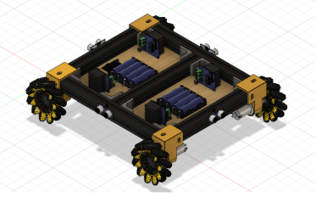
TEAM
Meet the team
TEAM NAME
Tech Minions
MEMBER 1
MEMBER 2
MEMBER 3
Bhawna Singh
Aditya Singh
Harshit Vats
ROLE
Perception & ML
ROLE
Hardware & embedded
ROLE
Navigation & control
Problem Statement 01 · Vision-Based Autonomous Robot
HACK IN HILLS · VISION-BASED AUTONOMOUS ROBOT · TECH MINIONS
01 / 09

Slide 2















PROBLEM STATEMENT & THEME
Vision-Based Autonomous Robot
THE PROBLEM
THEME ALIGNMENT
All 9 suggested technical directions are covered
How can a robot autonomously navigate unfamiliar campuses, hospitals, and warehouses—without a pre-built map?
Cluttered, changing scenes defeat fixed rules
Object detection
Image classification
Scene understanding
Perception-to-action in ~0.2 s
YOLO finds people, chairs, bottles and more
Labels each detected object where needed
Objects + sensor readings give the full picture
Goals arrive as words, not coordinates
IMPACT
Vision-language model
Motor control
Sensors & perception
Logistics
Fetch-and-carry without fixed tracks or QR markers
Optional layer for “Go to the chair” commands
Arduino Mega drives the four mecanum motors
Ultrasonic, LiDAR + camera see the surroundings
Healthcare
Safe delivery around patients and staff
Assistive
Finds objects for visually impaired users
Autonomous navigation
Obstacle avoidance
Real-time decisions
Robot picks its own path toward the target
Spots nearby obstacles and changes direction
Sense → decide → move → check, in a loop
HACK IN HILLS · VISION-BASED AUTONOMOUS ROBOT · TECH MINIONS
02 / 09

Slide 3

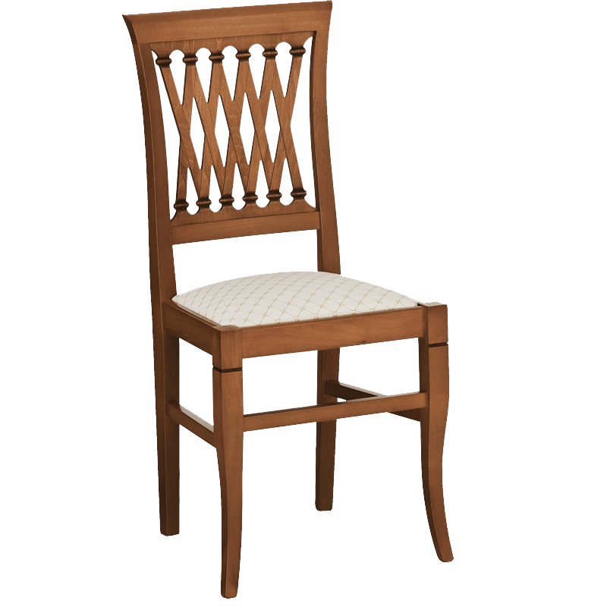



THE SOLUTION
Say what to find. The robot goes there.
WHAT THE ROBOT SEES
SOLUTION OVERVIEW
LIVE CAM-0 10 FPS
Say what to find, for example “go to the chair”. The robot sees it, picks its own path and drives there, sliding around obstacles and stopping for anything in the way.
person 0.94
KEY FEATURES
TARGET chair 0.88
Voice-guided
Say the target and the robot finds and reaches it, no remote control needed.
Moves in any direction
Mecanum wheels slide sideways and spin in place, so it manoeuvres easily in narrow spaces.
Stable omnidirectional base
Aluminium chassis with the sensors built in, designed in Fusion 360.
Safe by design
Stops if something is under 25 cm, the link drops or STOP is touched.
obstacle 0.6 m
UNIQUE VALUE
Illustration of the live dashboard: target found, obstacle ahead, robot steers around it.
A low-cost robot that understands spoken goals, yet keeps its safety reflexes on the robot, so it stays safe even when the AI lags.
HACK IN HILLS · VISION-BASED AUTONOMOUS ROBOT · TECH MINIONS
03 / 09

Slide 4
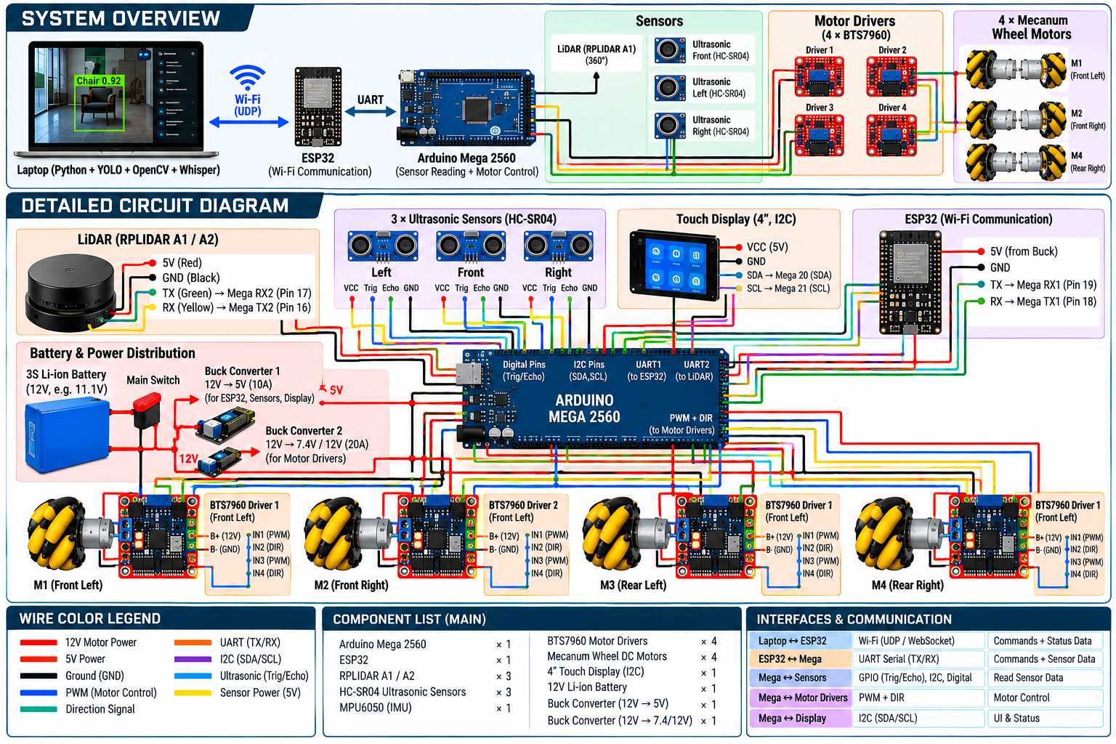
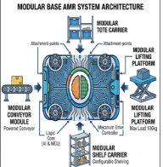



ARCHITECTURE 1 / 2 ARCHITECTURE 2 / 2
Hardware & circuit Software & data flow
01
02
03
04
Command
Perceive
Map
Decide
Voice or text goal from the laptop mic
YOLO11n detects and tracks objects in each frame
LiDAR + ultrasonic + IMU + encoders build an occupancy grid
State machine + A* / DWA pick heading and speed
06
05
Drive
Send
Mecanum IK + PID turn velocity into PWM
JSON over WebSocket to ESP32, UART to Mega
Laptop · Python
Robot firmware · C++
Vision
OpenCV · Ultralytics · ESP32-CAM stream
ESP32 (Arduino core)
WebSocket · LiDAR (UART2) · relay
Voice
SpeechRecognition + Vosk / Whisper
Arduino Mega 2560
Mecanum IK · PID · 50 Hz · watchdog
Mapping & planning
BreezySLAM · NumPy · A* + DWA
Sensor libraries
NewPing · MPU6050 · Encoder
Comms & UI
websockets · asyncio · Streamlit
Status display
Adafruit GFX: target, decision, battery
HACK IN HILLS · VISION-BASED AUTONOMOUS ROBOT · TECH MINIONS
04 / 09
Notes:
Laptop does the heavy AI and talks to the ESP32 over Wi-Fi. ESP32 also reads the LiDAR. The Mega runs the motors through four BTS7960 drivers and reads the ultrasonic sensors, IMU and attachment ID. One 4S pack feeds a 14.8 V rail plus 5 V and 6 V bucks.

Slide 5
DECISION MAKING
How it decides
1. Understand the goal
2. Act on it: state machine
USER SAYS
"Go to the person near the red chair"
AVOID
Vision-language model + camera frame + YOLO detections
obstacle < 40 cm
path clear
{ "target": "person", "track_id": 7,
"anchor": "red chair", "conf": 0.86 }
SEARCH
APPROACH
ARRIVED
target found
dist < 0.5 m
The VLM runs about once a second; YOLO keeps tracking the target at 10 FPS in between.
lost > 2 s
Safety reflex · always wins
Ultrasonic or LiDAR under 25 cm, or no command for 0.5 s → stop, whatever the planner says.
Every cycle: read sensors → update tracks → check transitions → send velocity. Budget under 100 ms.
HACK IN HILLS · VISION-BASED AUTONOMOUS ROBOT · TECH MINIONS
05 / 09
Notes:
The language model turns a sentence into a concrete target; the state machine then searches, approaches, avoids and stops. The safety reflex overrides everything.

Slide 6



MARKET
A fast-growing market
$16.9B
15–18%
$2.8–5.1B
Global autonomous mobile robot market by 2033
Annual growth (CAGR) 2025–2033 across analyst estimates
Market size estimates for 2024–25
Target users
Revenue model
Expected growth
Warehouses & logistics SMEs
Hospitals and care homes
Campuses, malls, security teams
Assistive-tech providers
Robot kit + software licence
Robot-as-a-Service subscription
Licensing the perception stack
Custom integration & support
Year 1: campus pilot, 2–3 robots
Year 2: logistics SME pilots
Year 3: fleet product + RaaS
Rides 15%+ yearly AMR growth
Sources: IMARC Group, Autonomous Mobile Robots Market 2025–2033; Global Market Insights, AMR Market 2025–2034.
HACK IN HILLS · VISION-BASED AUTONOMOUS ROBOT · TECH MINIONS
06 / 09
Notes:
AMR market roughly 17 billion dollars by 2033 at 15-18% a year. Users, revenue model and a three-year growth plan.

Slide 7



FUTURE SCOPE
Where we go next
01
02
03
04
Mobile app deployment
Enterprise integrations
AI model improvement
Scaling to global users
Remote monitoring, task assignment, robot status and basic control through a dedicated mobile app.
Connect with hospitals and industrial systems for workflows, scheduling, alerts and operational data.
Stronger VLM and vision models for better scene understanding, target recognition and decision making.
Expand across multiple sites, environments and use cases with scalable deployment and software updates.
Monitor
Workflows
Stronger VLM
Multi-site
Assign tasks
Scheduling
Vision models
New use cases
Basic control
Alerts
Decisions
Updates
HACK IN HILLS · VISION-BASED AUTONOMOUS ROBOT · TECH MINIONS
07 / 09

Slide 8

Thank you
Questions?
VISION-BASED AUTONOMOUS ROBOT · TECH MINIONS
HACK IN HILLS · VISION-BASED AUTONOMOUS ROBOT · TECH MINIONS
08 / 08

