Slide 1
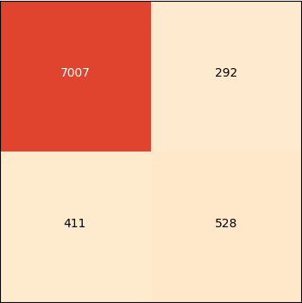
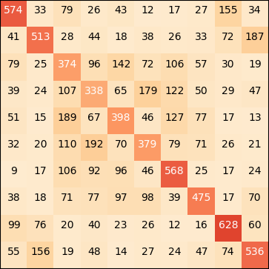
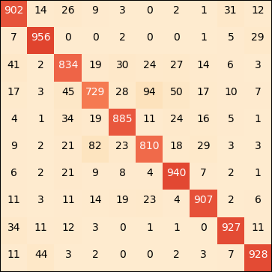
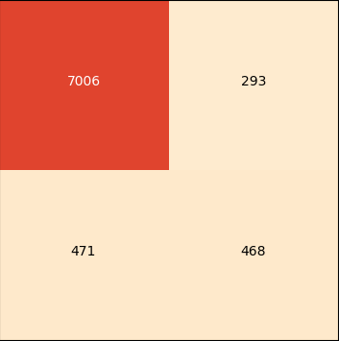


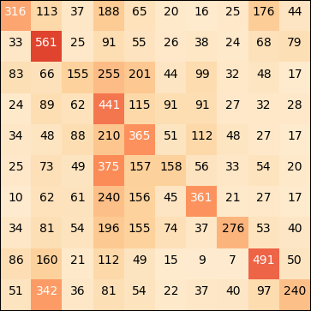
Which algorithm is the most versatile?
Saber Benchalel, Raphaël Jean, Aditya Joshi, Hugo Lafortune-Brunet
University of Montreal
Objective
A - Bank Marketing Results
B - CIFAR-10 Results
Analysis
To investigate the versatility of Support Vector Machine, Gradient Boosted Decision Trees and Convolutional Neural Networks for image recognition and tabular data classification.
Accuracy comparison
Accuracy comparison
1 - Performance Comparison
 | SVM | GBDT | CNN | Always No
Accuracy | 90.8% | 91.4% | 90.7% | 88.7%
True Positive Rate | 67.0% | 64.3% | 61.5% | -
True Negative Rate | 92.4% | 94.4% | 93.7% | 88.7%
 | SVM |  | GBDT | CNN | Random
 | 1 vs 1 | 1 vs All
Accuracy | 49.1% | 33.6% | 47.8% | 88.2% | 10.0%
A - Bank Telemarketing
Issues with data imbalance with all tested algorithms,
Low true positive rate. (Issue in real life when trying to sell a term deposit).
SVM outperform other algorithms by a small margin on the TPR.
Approach
Confusion Matrix
We determined the optimal algorithms for each task by training the three algorithms on a Bank telemarketing dataset for structured data and on the CIFAR-10 for image classification. We compared the accuracy of the algorithms, and analyzed the performance problems encountered.
Confusion Matrix
GBDT
GBDT
Airplane
B - CIFAR-10
Automobile
Bird
CNN outperformed all other algorithms by a wide margin (12% error rate)
Confusion between animals, such as cat vs dog vs deer
Less confusion between animals and machines.
Seem to require distinctive visual features.
Other methods would overfit or overfit the data.
True Label
No
7007
292
Cat
True Label
Deer
Dog
Frog
Horse
Yes
411
528
Ship
Datasets
Truck
Airplane
Automobile
Bird
Cat
Deer
Dog
Frog
Horse
Ship
Truck
A - Bank Telemarketing Dataset (Structured)
No
Yes
Predicted Label
Provided by UCI.
Produced from phone marketing campaigns of a Portuguese banking institution.
Contains various attributes of clients
Used to predict if a client will subscribe to a term deposit or not.
Unbalanced with 11.3% ‘Yes’ and 88.7% ‘No’.
Pre-processing applied:
One-hot encoding as a preprocessing step for all the categorical variables
Data normalization.
20% of data used as the test dataset.
Predicted Label
CNN
2 – Model specificities
CNN
Airplane
Automobile
GBDT
Bird
Performs well on complex data.
Needs to perform predictions only for in domain data.
Data is not spatially invariant.
Very likely to overfit.
Can memorize relatively complex training set.
Have issues with low density data.
Input data is spatially invariant, such as images or sound.
Perform well on image recognition problems.
Very likely to overfit.
Can memorize relatively complex training set.
Data is separable. (Linearly or through a kernel)
Data is not spatially invariant.
True Label
7006
Cat
No
293
Deer
True Label
Dog
Frog
Horse
471
468
Ship
B - CIFAR-10 Dataset (Unstructured)
Yes
Truck
Airplane
Automobile
Bird
Cat
Deer
Dog
Frog
Horse
Ship
Truck
Provided by Alex Krizhevsky (University of Toronto)
60 000 32x32 RBG Images
10 Balanced Classes
50 000 training images (split into 45 000 training images and 5000 validation images)
10 000 test images
No
Yes
Predicted Label
Predicted Label
SVM 1 vs 1
CNN
Airplane
Automobile
Bird
SVM
True Label
Cat
Deer
Algorithms
Dog
7128
Frog
Gradient Boosting Decision Tree (GBDT)
No
173
Horse
True Label
Ship
GBDT is an ensemble of decision trees built in a stage-wise boosting fashion. GBDT is renown for its great results in data science competitions with structured data.
Truck
Airplane
Automobile
Bird
Cat
Deer
Dog
Frog
Horse
Ship
Truck
SVM
Support Vector Machine (SVM)
Yes
587
352
Predicted Label
SVM is an algorithm that classifies data points that belong to two classes with an optimal separating hyperplane. This algorithm deals well with high dimensionality and can be generalized to classification problems with more than two classes.
No
Yes
SVM 1 vs All
Conclusions
Predicted Label
Airplane
Automobile
Convolutional Neural Networks (CNN)
Bird
We need to choose the right tool for the right problem.
SVM can give surprising results in spite of having a relatively low complexity on both datasets.
Careful review of algorithms prior assumptions is required when choosing which one must be used.
There is no single algorithm that can be used in every situation with good results.
True Label
Cat
CNN is a variant of the feedforward neural network designed for image analysis. Similarly to a neural network, if enough data is used, the algorithm designs and learns the parameters without a need for hand picking the features. CNN performs well on grid-like datasets such as images. It uses local connectivity and parameter sharing to reduce the number of parameters to learn. CNN also uses pooling to reduce the number of hidden units in a hidden layer and makes the algorithm invariant to translations in the sample.
Deer
Dog
Frog
Horse
Ship
Truck
Airplane
Automobile
Bird
Cat
Deer
Dog
Frog
Horse
Ship
Truck
Predicted Label

