Slide 1
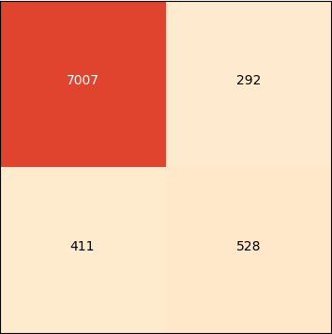
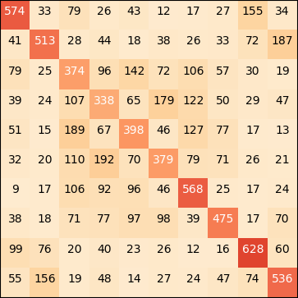
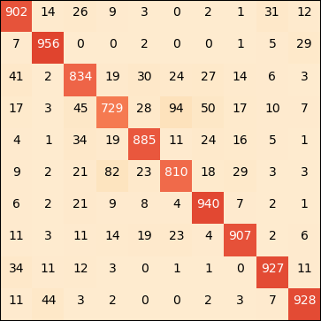
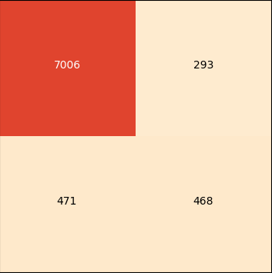


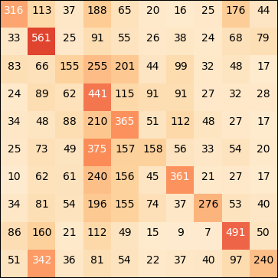
Which algorithm is the most versatile?
Saber Benchalel, Raphaël Jean, Aditya Joshi, Hugo Lafortune-Brunet
University of Montreal
Abstract
Bank Marketing Results
CIFAR-10 Results
Analysis
In this project, investigates the versatility of Support Vector Machine, Gradient Boosted Decision Trees and Convolutional Neural Networks by testing them on both an image recognition task and a tabular data classification task. The three algorithms are trained on a Bank telemarketing dataset for structured data and on the CIFAR-10 for image classification. We compares the results of the algorithms, the performance problems encountered and suggests the optimal tested algorithm for specific tasks
Accuracy comparison
Accuracy comparison
 | SVM | GBDT | CNN | Always No
Accuracy | 90.8% | 91.4% | 90.7% | 88.7%
True Positive Rate | 67.0% | 64.3% | 61.5% | -
True Negative Rate | 92.4% | 94.4% | 93.7% | 88.7%
 | SVM |  | GBDT | CNN | Random
 | 1 vs 1 | 1 vs All
Accuracy | 49.1% | 33.6% | 47.8% | 88.2% | 10.0%
Performance Comparison
Bank Telemarketing
Confusion Matrix
All the algorithms we tested had issues with the data imbalance in the banking dataset, and had a relatively low True Positive Rate (TPR) when compared to the True Negative Rate. This seems to imply that all the models we used for training are assuming a balanced training set. The SVM outperformed the other methods with regards to the TPR.
Confusion Matrix
GBDT
Our Approach
GBDT
Airplane
CIFAR-10
In order to investigate this question, we decided to use a structured and an unstructured dataset to compare the algorithms.
Automobile
The performance of the CNN on CIFAR-10 greatly exceeded all other methods, but it still has a 12% error rate. Using the confusion matrix, we can see that most algorithms have a higher misclassification rate between similar concepts. For instances, we see higher misclassification between animals, such as cat vs dog vs deer, but almost no confusion between horse and automobile. Ship is in the easiest thing to classify for all algorithms, while cat is the hardest. This seems to be consistent with the fact that ships have some distinctive visual features, such as being surrounded by water and lack features that are shared by other classes like wheels, legs or eyes. The higher misclassification rate between misclassification between animals could be explained by them all being hairy creatures, with ears, legs and eyes. Obviously, it might not be those features that the algorithms capture, but the idea is that some classes of images are visually further apart from each other than others.
Bird
True Label
The Dataset
No
Cat
True Label
Deer
Bank Telemarketing
Dog
Frog
The structured dataset is the Bank Marketing Data Set provided by UCI. This dataset was produced from phone marketing campaigns of a Portuguese banking institution. The data contains various attributes of clients and is used to predict if a client will subscribe to a term
deposit or not. The banking data is unbalanced with 11.3% ‘Yes’ and 88.7% ‘No’.
We used one-hot encoding as a preprocessing step for
all the categorical variables. We have also used data normalization. After the one hot encoding our dataset has 63 features. We use 20% of our
data for our test dataset
Horse
Yes
Ship
Truck
Airplane
Automobile
Bird
Cat
Deer
Dog
Frog
Horse
Ship
Truck
No
Yes
Predicted Label
Predicted Label
CNN
Prior Assumptions
CNN
Airplane
CNN
Automobile
Bird
The GBDT fits the data by separating the space into regions. It does this by building an ensemble of decision trees in a stage-wise boosting fashion and it makes no interpolation. As a result, it is likely to perform very poorly for out of domain data. Also it seems to have trouble when the density of the data is too low. The training and validation errors tends to quickly overfit when training on CIFAR-10. In other words, it merely memorizes the training set.
CNN makes the prior assumptions that the samples are image-like to use local connectivity and parameter sharing. It is true in the case of the CIFAR and we see that CNN outperforms the other methods. For the banking data, the input is not an image and both the local connectivity and the parameter sharing can hurt the model. While CNN can outperform a dummy classifier, it does not perform significantly better than SVM or GBDT.
The linear SVM tries to separate the data with a hyperplane and shows lower results when the data is not linearly separable. However, the SVM using a gaussian kernel and a 1v1 approach shows much better results than expected on the CIFAR-10 and results comparable to GBDT. It benefits greatly from the kernel trick where we implicitly map inputs to a higher dimension.
True Label
CIFAR-10
Cat
No
Deer
The chosen unstructured dataset CIFAR-10 is an image dataset that contains 60 000 32x32 RGB images split in 10 balanced classes. The dataset is pre-split with 50 000 training images and 10 000 test images. The images were flattened to produce a single 3 072 feature vector per sample
True Label
Dog
Frog
Horse
Ship
The Algorithm
Yes
Truck
Airplane
Automobile
Bird
Cat
Deer
Dog
Frog
Horse
Ship
Truck
SVM
Gradient Boosting Decision Tree (GBDT)
No
Yes
Predicted Label
GBDT is an ensemble of decision trees built in a stage-wise boosting fashion. GBDT is renown for its great results in data science competitions with structured data.
Predicted Label
SVM 1 vs 1
Airplane
Automobile
Bird
GBDT
SVM
True Label
Cat
Support Vector Machine (SVM)
Deer
Dog
SVM is an algorithm that classifies data points that belong to two classes with an optimal separating hyperplane. This algorithm deals well with high dimensionality and can be generalized to classification problems with more than two classes.
Frog
No
Horse
True Label
Ship
CONCLUSIONS
Truck
Airplane
Automobile
Bird
Cat
Deer
Dog
Frog
Horse
Ship
Truck
Our main objective in this project was to explore the versatility of different algorithms. Each algorithm performs better with a certain type of data and no algorithm is consistently better than the other on both datasets. The GBDT shows the best results when used on structural data but has difficulty in higher dimensions when the data is less dense. The CNN performs very well for image classification, but is outperformed when the local connectivity and parameter sharing likely hurt the performance of the model. The SVM is consistently in the middle of the pack and doesn't outshine the other algorithms on either dataset. We find that the prior assumptions are indicative of when an algorithm should be used and preference should be given to the algorithms that have their prior assumptions respected.
Convolutional Neural Networks (CNN)
Yes
Predicted Label
CNN is a variant of the feedforward neural network designed for image analysis. Similarly to a neural network, if enough data is used, the algorithm designs and learns the parameters without a need for hand picking the features. CNN performs well on grid-like datasets such as images. It uses local connectivity and parameter sharing to reduce the number of parameters to learn. CNN also uses pooling to reduce the number of hidden units in a hidden layer and makes the algorithm invariant to translations in the sample.
SVM 1 vs All
No
Yes
Airplane
Predicted Label
Automobile
Bird
True Label
Cat
Deer
Dog
Frog
Horse
Ship
Truck
Airplane
Automobile
Bird
Cat
Deer
Dog
Frog
Horse
Ship
Truck
Predicted Label

