Slide 1
Machine Learning for Data Imputation, Real-time Reconstruction & Synthetic Data Generation in V2X Communication
Masters Thesis Presentation
Radio Communications and Navigation Department (WICON)
Supervisor: Prof. Dr.-Ing. Hans D. Schotten, M.Sc. Sanket Partani
Aditya Jawahar Kansara
08.07.2026, Kaiserslautern

Slide 2
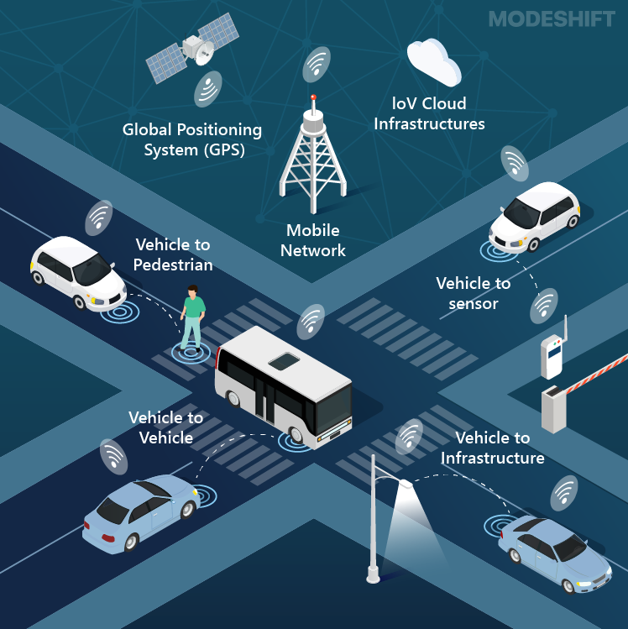
Agenda
Introduction
Problem Statement
Machine Learning for V2X Data
Berlin V2X Dataset
Dataset Description
Cellular dataset
Data Analysis
Data Imputation
Data Preparation
Data Imputation Methods
Evaluation and Results
Data Generation
Purpose of Synthetic data
Data Generation Methods
Evaluation and Results
Conclusion & Future Work
Intelligent Transportation System

Slide 3
1
Introduction

Slide 4




Introduction
A Vehicle-to-Everything (V2X) communication system consists of:
Vehicle-to-Vehicle (V2V)
Vehicle-to-Infrastructure (V2I)
Vehicle-to-Network (V2N)
Vehicle-to-Pedestrain (V2P)
These communication systems exchange information:
Vehicle Mobility
Network Quality
Traffic conditions
Communication Performance
V2N
V2I
V2V
V2P
Types of V2X Communication

Slide 5
Introduction Problem Statement
A real-world operation of communication systems faces challenges such as:
Connectivity Interruptions
Unstable wireless conditions
Hardware limitations
Measurement Failures
Therefore, intelligent methods are required to reconstruct missing measurements and generate realistic communication data.
Challenges
Data Loss
Missing Values
Measurement Gaps

Slide 6
Introduction Machine Learning for V2X Data
The structure of vehicle communication data is generally:
Highly Dense
Heterogeneous
Spatial and Temporally Dependent
Hence, we use advanced techniques like Machine Learning methods for handling communication data.
Machine Learning
Learn Temporal patterns
Handle Feature dependency
Generate or predict realistic data

Slide 7
Introduction Machine Learning for V2X Data
The primary objective is to:
Fill up missing values in V2X dataset
Generate realistic data for missing measurement timestamps
Selected Dataset → Berlin V2X Dataset
Why Berlin V2X?
Real-world measurement data
V2V and V2I Communication Data
Heterogenous features (GPS, traffic data, radio signal indicators, QoS data and weather data)
Suitable for studying signal fluctuations, time dependent behavior and missing values in V2X communication

Slide 8
2
Berlin V2X Dataset

Slide 9
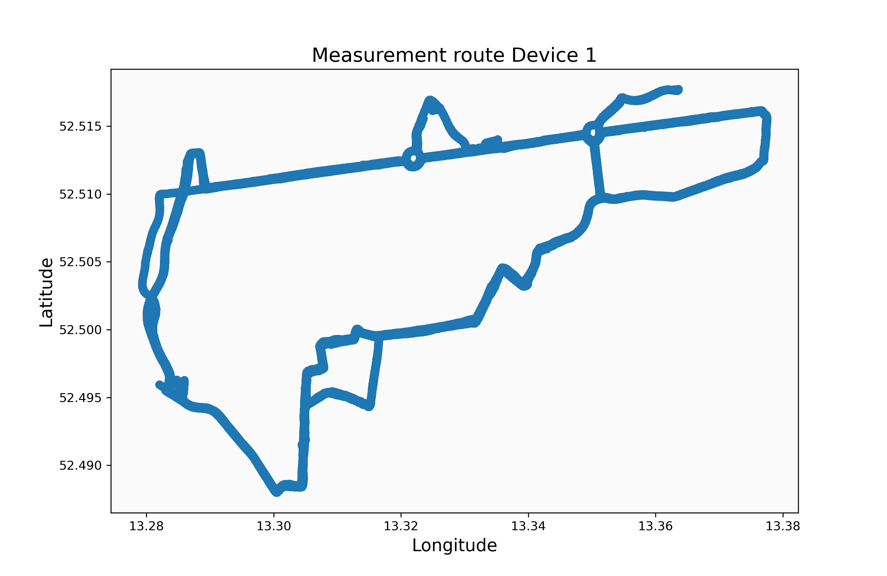
Berlin V2X Dataset Dataset Description
Primary purpose: High resolution data of vehicle mobility and wireless network performance
4 Measurement Devices (Platoon, 2 x 2)
Urban Traffic conditions (residential streets, avenues, parks, tunnels,
and highways)
Two Radio Access Technologies:
Cellular Communication (V2I)
Sidelink Communication (V2V)
Measurement route

Slide 10
Berlin V2X Dataset Cellular Dataset
Real-world measurement of Vehicle communication over cellular (LTE) networks
Dataset shape: 207,434 rows x 159 columns
Data Category | Features
GPS | Latitude, Longitude, Altitude, Speed, COG, Area
Weather and Environmental | Temperature/apparentTemperature, precipProbability/ precipIntensity, dewPoint, humidity, windSpeed, cloudCover, uvIndex, visibility
QoS | Ping, Datarate, Jitter
Network Data | Signal Data: RSRP, RSRQ, RSSI, SNR RRC: Downlink/ Uplink frequency, Downlink/Uplink Bandwidth, Resource Blocks in Modulation and Coding Scheme(MCS), Cell ID/Cell Identity
Temporal Features and Identifiers | timestamps/ts-gps Device IDs Metadata (uplink, downlink, datarate/latency, scenario)

Slide 11
Berlin V2X Dataset Data Analysis
Feature Group | #Feature | Avg. Missing % | Examples
Temporal | 2 | 0% | timestamp, ts_gps
Identifiers | 8 | 0-5% | device, operator, scenario, direction
GPS / Mobility | 7 | 1-2% | Latitude, Longitude, speed_kmh, COG
Weather | 11 | 1-2% | temperature, humidity, wind speed
Traffic | 3 | 1-2% | Traffic Jam Factor, Traffic Distance
Network QoS | 3 | 10-30% | datarate, ping_ms, jitter
PCell Signal | 21 | 5-15% | RSRP, RSRQ, RSSI, SNR
PCell DL / UL | 42 | 5-80% | MCS, RBs, TB Size, Tx Power
SCell Features | 53 | 70-100% | Secondary cell signal and radio data
The Cellular Dataset:
159 raw features
9 semantic groups
Overall missingness (approximately 26%)
Missingness neither uniform nor random
Missing Pattern
Missing Completely at Random (MCAR)
Missing at Random (MAR)
Missing Not at Random (MNAR)

Slide 12

Berlin V2X Dataset Data Analysis
Data Cleaning
Feature Engineering
Row removal: 1.2% of rows removed
→ sensor initialization periods (no positional context)
Data type correction: bandwidth columns
→ text to numeric format
Feature Removal:
3 SCell features (100% missing)
7 quasi-constant operator IDs
1 redundant weather feature
4 low-variance weather features removed
MCS Aggregation: 32 MCS columns
→ Low (QPSK), Mid (16-QAM), High (64-QAM/256-QAM)
Log Transformation: 13 right-skewed features (datarate, ping, TB Size, RBs) → Normalization
Missing Value Indicators: Binary flags to encode absence
Categorical Encoding: One-hot encoding (device, area, direction, QoS mode); Binary encoding (operator)
Temporal Features: Hour of day, Day of week

Slide 13
Berlin V2X Dataset Data Analysis
Engineered Dataset
Baseline Imputation Methods
GRU-D
Completed Dataset
Baseline Data Generation Method
GRU-GAN
Synthetic Data Generation

Slide 14
3
Data Imputation

Slide 15
Data Imputation Data Preparation
Temporal split
Outlier clipping → (0.5th–99.5th percentile) to limit extreme values.
Feature Scaling → standardized using StandardScaler.
Artificial Masking: 15% of observed values randomly masked in validation and test sets.
→ Used as ground truth to evaluate imputation accuracy using RMSE and MAE.
Split | Proportion | Training
Training | 70% (first in time) | Model parameter learning and scaler fitting
Validation | 15% (middle) | Hyperparameter tuning and early stopping
Test | 15% (last in time) | Final performance metrics (RMSE, MAE)

Slide 16
Data Imputation Data Imputation Methods
Baseline: KNN Imputation
Denoising Autoencoder
For k=5, imputation by calculating mean of 5 similar observed values
Capture cross-feature relationships
Limitation:
Cannot capture temporal dependency
Treat each row independently
Neural-network based approach
Fully connected symmetric encoder-decoder
Learns nonlinear cross-feature relationships by reconstructing clean data from corrupted(noisy) input
Limitation:
Limited performance on sequential V2X communication data
Does not explicitly model temporal dependencies

Slide 17
Data Imputation Data Imputation Methods
GRU-D (Gated Recurrent Unit with Decay)
RNN based → extension of traditional GRU model
Ensure Temporal dependency of Sequential Data
Missingness Mask (Informative Signal)
A binary indicator is created for each feature → value (observed or missing)
Fed directly into the model as an explicit input
Time decay mechanism
The longer a feature has been missing, the less the model relies on its last known value.
GRU-D gradually shift toward the empirical mean as the gap grows.

Slide 18


Data Imputation Data Imputation Methods
Input (per timestamp)
Output Head
GRU Cell
Feature Values (x(t)) Input Features
Forward Propagation
Temporal Decay
Hidden State
Update Gate
Adjust input and previous hidden state
ReLU Activation
Imputed Feature Values Current timestamp (t)
Missingness Mask (m(t)) 1-observed, 0-missing
Reset Gate
Dropout
Time Gap δ(t) Time since last observed
Hidden state (h(t-1)) feedback previous timestamp

Slide 19
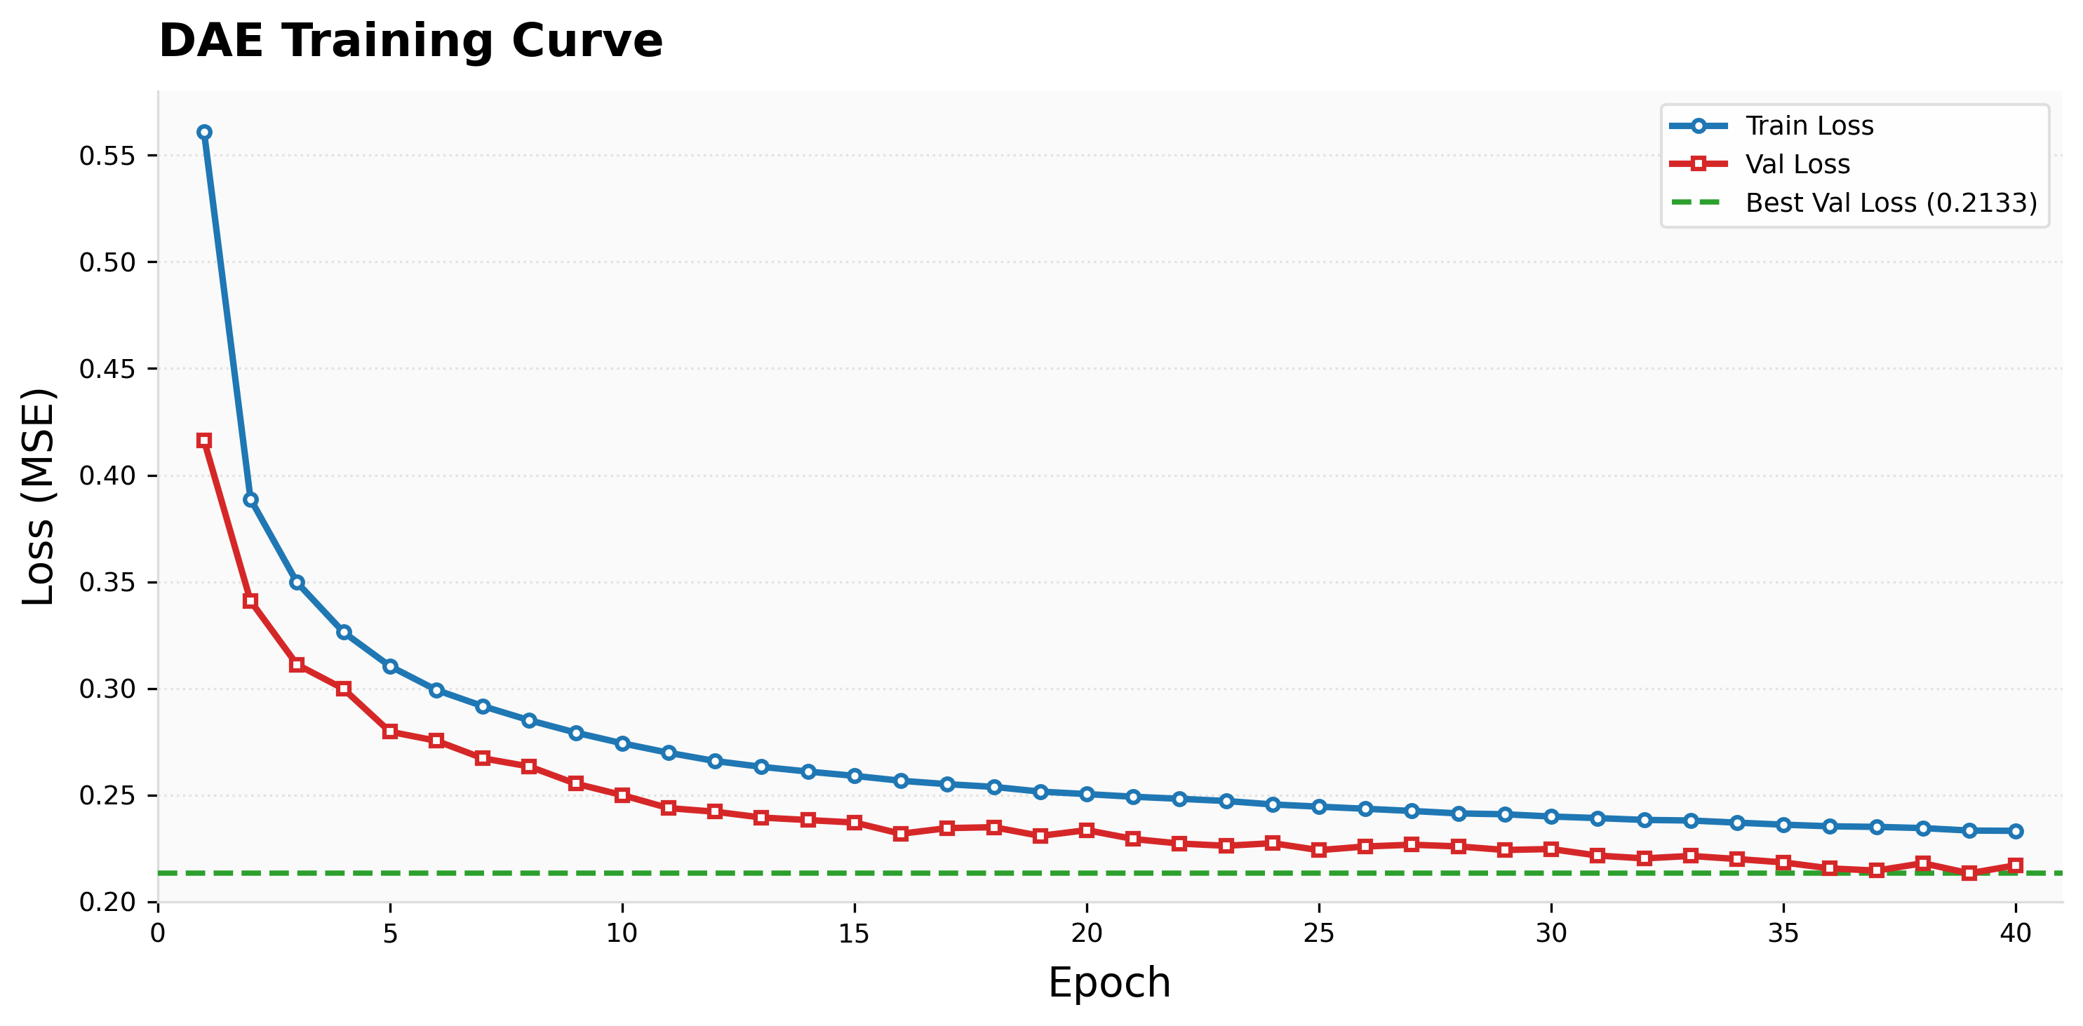
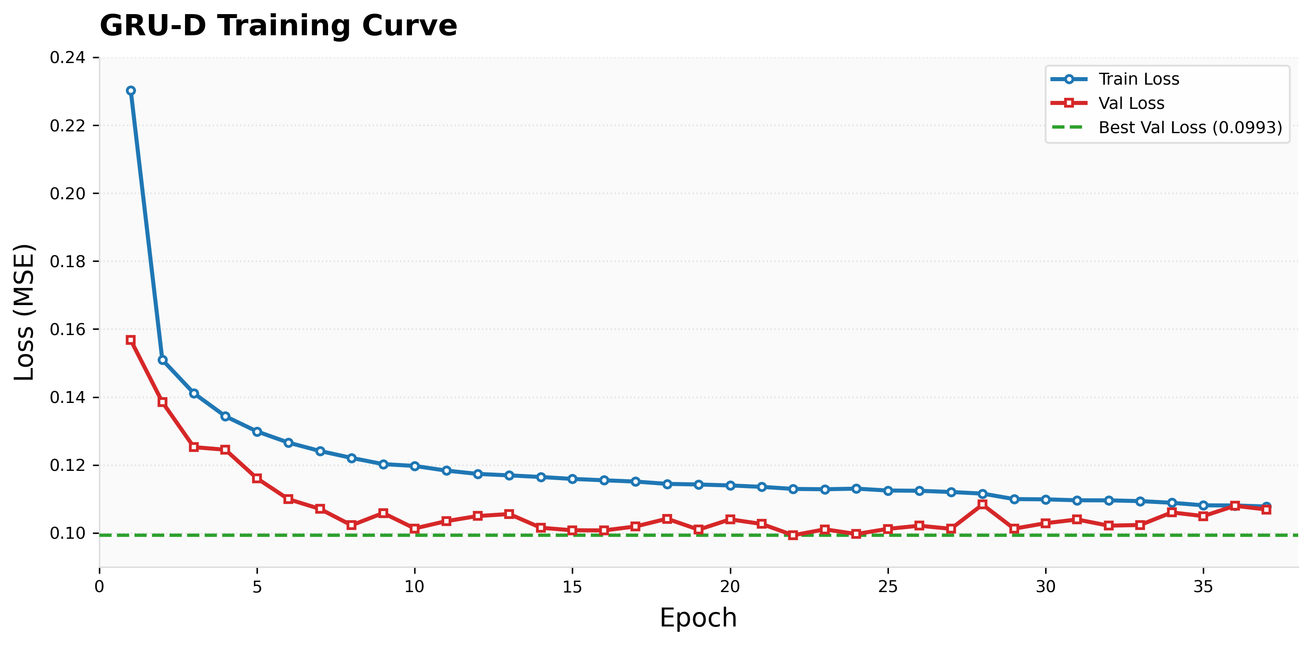
Data Imputation Evaluation Methods
Evaluation Metrics: RMSE and MAE
GRU-D achieves the best performance → improvement on signal quality features such as RSRQ, SNR, and RSSI where temporal structure is most critical.
Model | RMSE | MAE
KNN | 14771.35 | 41.12
DAE | 10.71 | 2.99
GRU-D | 5.45 | 1.80

Slide 20
Data Imputation Results
The trained GRU-D model was applied to the complete dataset, successfully reconstructing all missing values across continuous features.
Key Outcomes:
262,254 missing values imputed
→ training, validation and test sets
Final dataset: 204,942 rows and 72 columns
no missing values remaining
Completed dataset → input for the synthetic data generation pipeline
Feature | Missing Before | After GRU-D
Ping | 28.16% | 0%
Datarate | 7.65% | 0%
Jitter | 7.65% | 0%
PCell_Band_ Indicator | 6.15% | 0%

Slide 21
4
Data Generation

Slide 22
Data Generation Purpose of Synthetic Data
During the measurement campaign, all four devices experienced periods of measurement gaps.
A Generative model that is able to predict sequences and maintain temporal continuity is required.
The Problem
Gaps:
1.3 minutes to 2 hours
Standard imputation cannot fill these gaps
A generative model
→ reconstruct complete measurement sequences
The Challenge
Signal features (RSRP, datarate, and ping) exhibit rapid fluctuations
The generated sequences must:
Replicate behavior of signal features
Preserve distribution characteristics
Maintain temporal continuity
A conventional regression model predicts sequences
→ overly smooth and regular.
 | → Observed gaps:
Device | Duration
pc1 | 20.2 mins
pc1 | 129.0 mins
pc2 | 11.5 mins
pc2 | 17.7 mins

Slide 23
Data Generation Data Generation Methods
Simplest approach to autoregressive sequence generation is to use a LSTM network
Input
10 base context features + 38 target features at each timestep
Prediction
Predicts all 38 features simultaneously for the next timestep
Feedback Loop
Predicted values are fed back for next input
→ repeated to generate a full sequence
Limitation
Generating all 38 features from shared hidden state cannot enforce the physical dependencies
GPS, cell configuration, signal quality, and QoS are all predicted at the same level.
→ Produce feature combinations that cannot represent real-world measurements.

Slide 24
Data Generation Data Generation Methods
The 38 target features are divided into five levels based on their physical dependency structure.
Level | Description | Example Features
1a | GPS Position | Latitude, Longitude
1b | Vehicle Mobility | Speed, Heading, Altitude
1c | Environment | Weather, Traffic
2a | Cellular Configuration | Frequency, Bandwidth
2b | Signal Quality & QoS | RSRP, SNR, Ping, Datarate
Vehicle position
cell connection
signal quality
cell configuration
QoS

Slide 25
Data Generation Data Generation Methods
To achieve physical dependency and maintain statistical realism, a generative model that generates sequences resembling real values is required.
A Generative Adversarial Network (GAN) → uses a discriminator that penalizes unrealistic outputs.
GRU-LSTM: Different architectures for generator and discriminator prevent mode collapse.
Generator: GRU
Generate sequences → context features and preceding level outputs
Used across all five levels.
Discriminator: LSTM
Evaluates whether a sequence is real or generated
Output: a real or fake score by comparing to real data

Slide 26
Data Imputation Data Generation Methods- Training Process
Real Dataset
Level 1a- GPS
Level 1b- Mobility
Level 1c- Environment
Level 2a- Cell Config
Level 2b – Signal & QoS
Generator- GRU
Generator- GRU
Generator- GRU
Generator- GRU
Generator- GRU
Generated Sequence
Input
Seed Window:
20 real timestamp
Base Context
L1a + Base Context
L1a + L1b + Base Context
L1a + L1b + L1c + Base Context
L1a + L1b + L1c + L2a + Base Context
LSTM Discriminator
Output L1a
Output L1b
Output L1c
Output L2a
Adversarial Training- GAN
Base Context Features (device, hour, day, direction, operator )
Feedback (Real or fake)
Model parameters from each Level

Slide 27
Data Imputation Data Generation Methods
Level 1a- GPS
Level 1b- Mobility
Level 1c- Environment
Level 2a- Cell Config
Level 2b – Signal & QoS
Generated Sequence
Generator- GRU
Generator- GRU
Generator- GRU
Generator- GRU
Generator- GRU
Input
Seed Window:
20 real timestamp
Base Context
L1a + Base Context
L1a +L1b + Base Context
L1a + L1b + L1c + Base Context
L1a + L1b + L1c + L2a + Base Context
Output (GPS)
Output (Mobility)
Output (Environment)
Output (Cell Config)
Output (Signal & QoS)
Base Context Features (device, hour, day, direction, operator )
The output from each level is passed to the next level

Slide 28
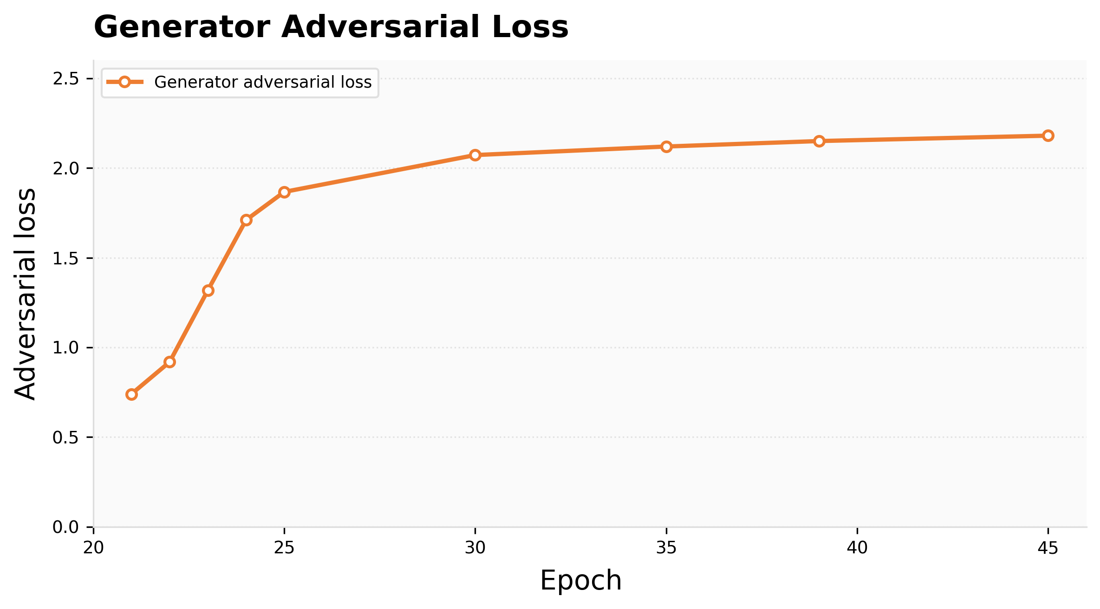
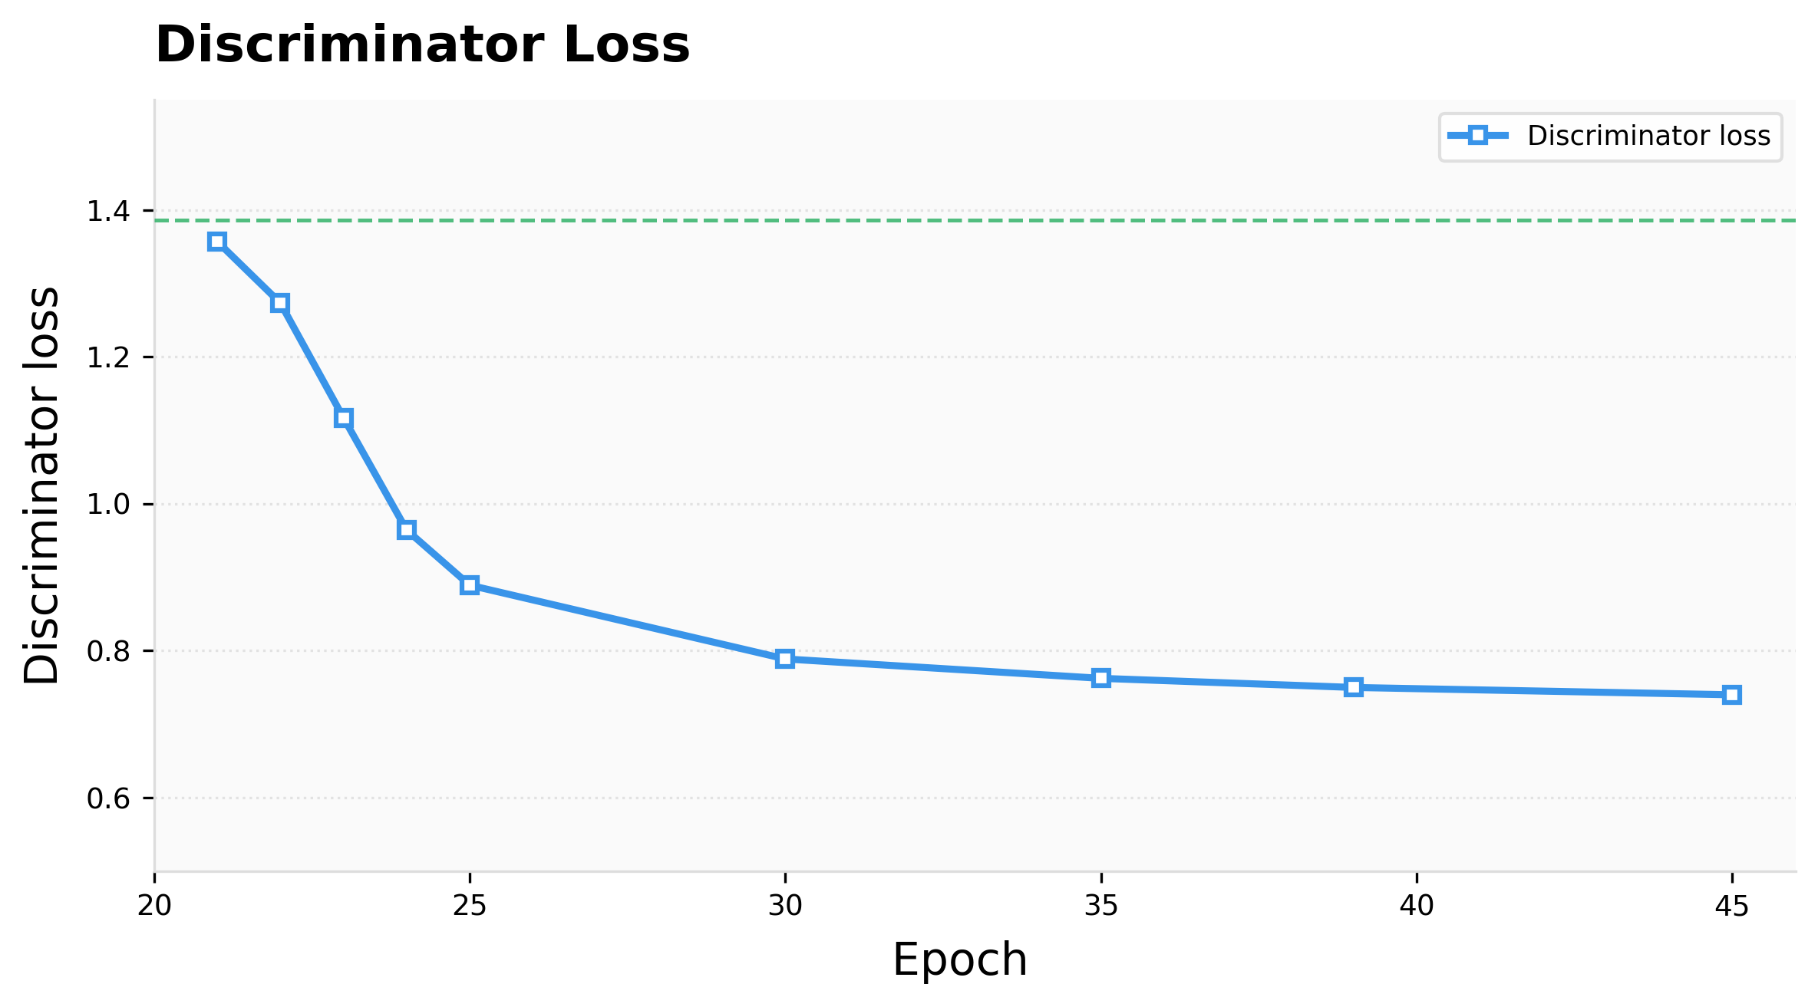
Data Generation Data Generation Methods
Generator adversarial loss: 0.782 → 2.148 Discriminator loss: 1.338 → 0.748.
Best model selected at epoch 30.

Slide 29
Data Generation Evaluation Methods
GRU-GAN and LSTM models are evaluated on the held-out test set.
Limitation: LSTM performs better for slowly varying features such as temperature and GPS where the level-based structure provides less advantage.
Feature | RMSE
 | LSTM | GRU-GAN
Datarate | 1.787 | 0.562
Ping_ms | 1.302 | 0.564
PCell_RSRQ_max | 2.086 | 1.316
PCell_RSSI_max | 7.220 | 4.547
PCell_Uplink_Num_RBs | 2.338 | 0.690
Target_datarate | 2.470 | 0.339
Temperature | 0.387 | 1.925
Latitude | 0.006 | 0.011
Key Findings
GRU-GAN reduces RMSE by 21-86% for signal and QoS features
Level-based causal structure and adversarial training preserve natural signal variability.

Slide 30
Data Generation Evaluation Methods
Evaluation discriminator is trained → Validate the generated sequences from GRU-GAN model
A score of 0.0926 means the classifier generated sequences that are statistically close to real measurements and difficult to distinguish.
Real Sequence
(V2X Dataset)
Evaluation Discriminator
(LSTM Classifier)
Classification
(Real or Generated)
Discriminative score
Initial model: 0.29 (78.26%)
Final Model: 0.0926 (59.26%)
Generated Sequences
(GRU-GAN)
Discriminative Score= |Accuracy – 0.5|
0.00 (perfect generation) → Cannot Distinguish
0.50 (worst result) → Easy to Distinguish

Slide 31
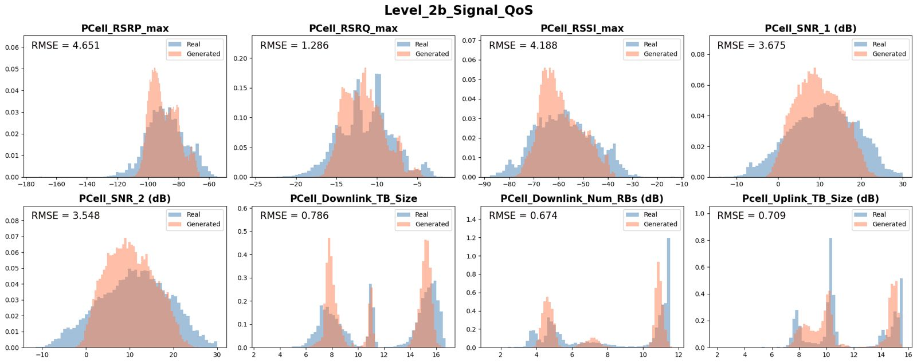
Data Generation Results
Real vs Generated Feature-wise Data Distribution

Slide 32
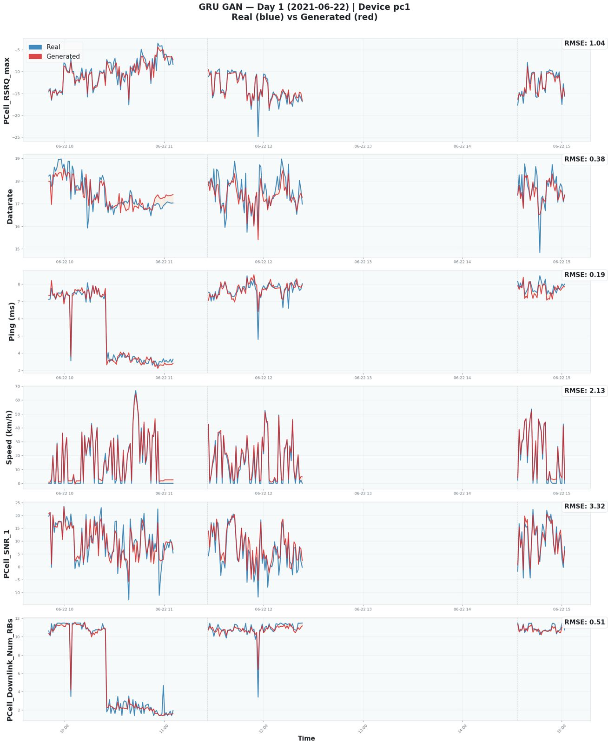
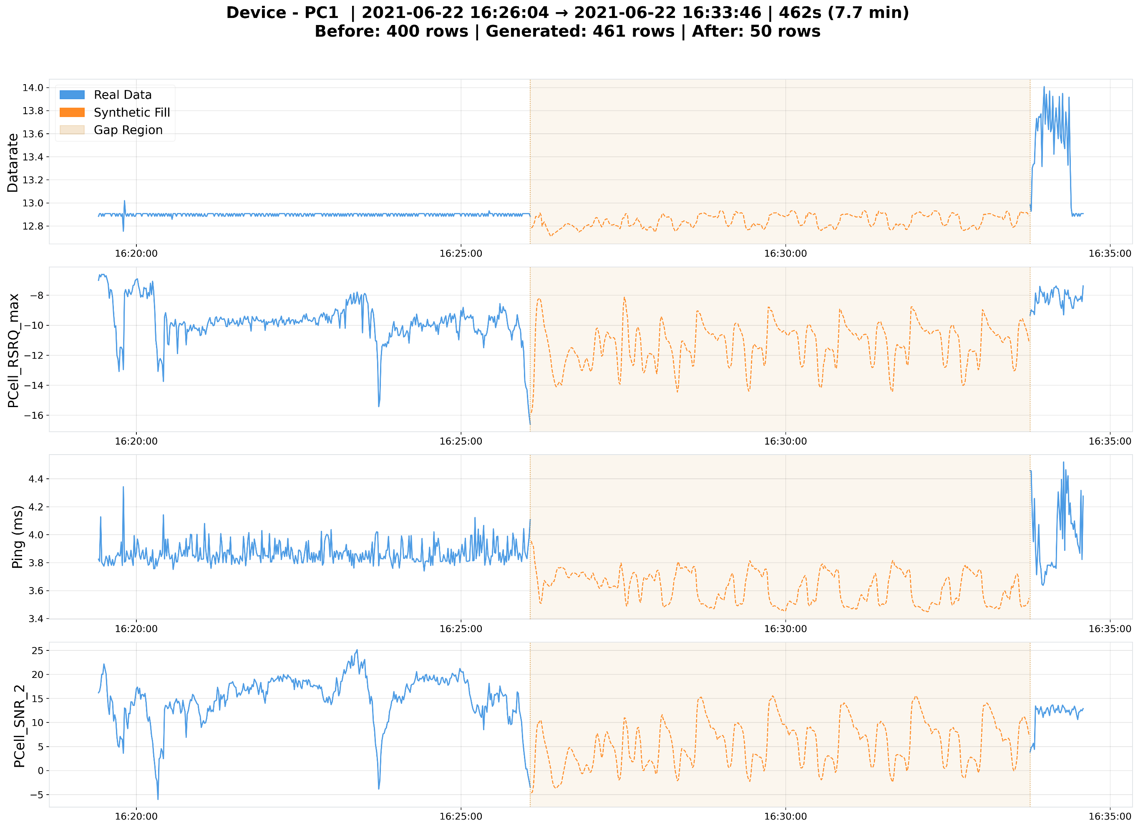
Data Generation Results

Slide 33
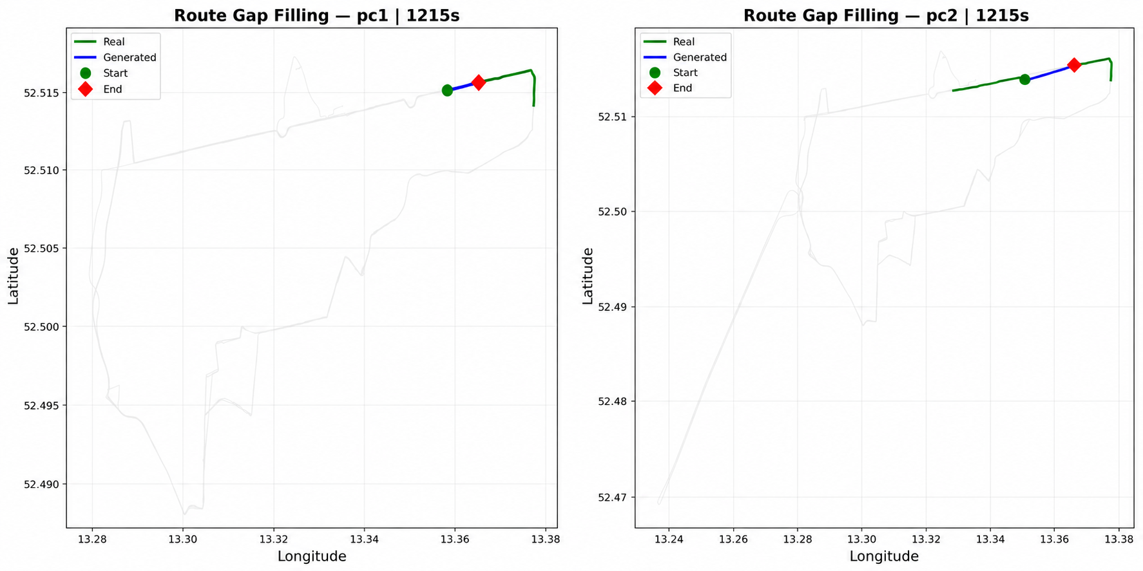
Data Generation Results
GPS Data

Slide 34
Conclusion
GRU-D effectively reconstructs missing cellular measurements
→ Treat missing values in the V2X dataset
GRU-GAN generates statistically realistic synthetic sequences for missing timestamp intervals
A Discriminative score of 0.0926 confirms generated sequences are statistically close to real measurements
Future Work:
Apply the pipeline to V2V communication datasets
Extend generation to unseen routes and new timestamps beyond the training distribution
Minimize error propagation for longer autoregressive sequence generation
Adapt the pipeline for real-time deployment during live measurement campaigns

Slide 35
Thank you!

