Slide 1

Minimal APIs in ASP.NET Core
Miroslav Popović
Technical Lead @Seavus @miroslavpopovic https://miroslavpopovic.com/ https://github.com/miroslavpopovic/

Slide 2

Introduction
Attribution: All icons in this presentation are downloaded from flaticon.com
Notes:
<a href="https://www.flaticon.com/free-icons/introduction" title="introduction icons">Introduction icons created by Arkinasi - Flaticon</a>

Slide 3

MVC and Razor Pages
MVC – ever since ASP.NET MVC
December 10th, 2007 – first CTP
March 13th, 2009 – first release
April 12th 2022 – Version 5.2.8 (current)
Web API – ever since ASP.NET MVC 4
May 31st 2012 – first version
ASP.NET Core MVC
June 27th 2016 – first version – ASP.NET vNext, ASP.NET 5
Merges MVC and Web API
ASP.NET Razor Pages
August 14th 2017 – first version with ASP.NET Core 2
Notes:
<a href="https://www.flaticon.com/free-icons/web-development" title="web development icons">Web development icons created by piksart - Flaticon</a>

Slide 4
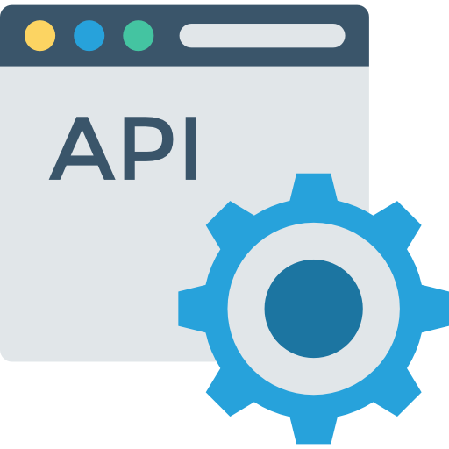
Minimal APIs
New hosting APIs
WebApplication and WebApplicationBuilder
New routing APIs
New templates
Notes:
<a href="https://www.flaticon.com/free-icons/api" title="api icons">Api icons created by DinosoftLabs - Flaticon</a>

Slide 5
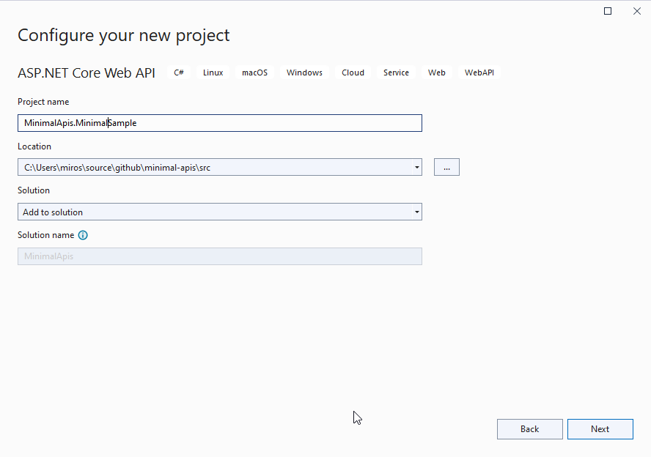
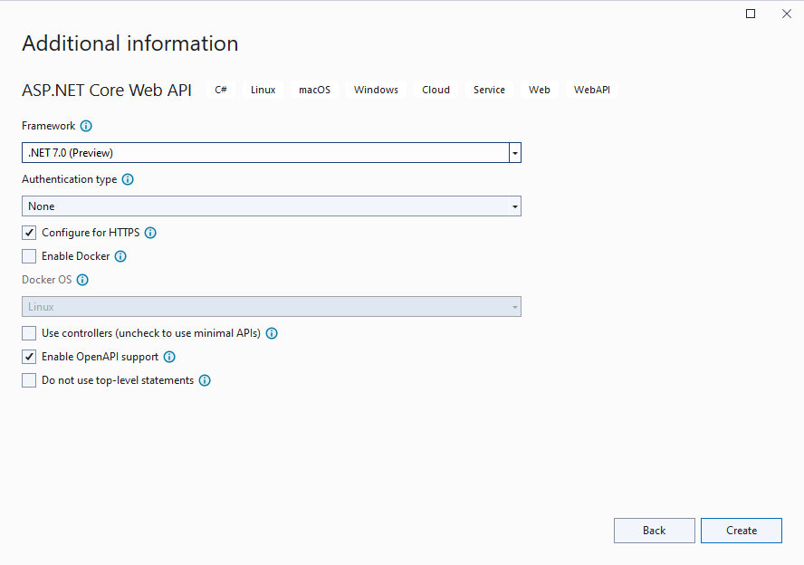
New ASP.NET Core templates

Slide 6
var builder = WebApplication.CreateBuilder(args);
// Add services to the container.
builder.Services.AddEndpointsApiExplorer();
builder.Services.AddSwaggerGen();
var app = builder.Build();
// Configure the HTTP request pipeline.
if (app.Environment.IsDevelopment())
{
app.UseSwagger();
app.UseSwaggerUI();
}
app.UseHttpsRedirection();

Slide 7
var summaries = new[]
{
"Freezing", "Bracing", "Chilly", "Cool", "Mild", "Warm", "Balmy"
};
app.MapGet("/weatherforecast", ()
=> Enumerable.Range(1, 5).Select(index =>
new WeatherForecast
(
DateOnly.FromDateTime(DateTime.Now.AddDays(index)),
Random.Shared.Next(-20, 55),
summaries[Random.Shared.Next(summaries.Length)]
))
.ToArray())
.WithName("GetWeatherForecast")
.WithOpenApi();
app.Run();
internal record WeatherForecast(DateOnly Date, int TemperatureC, string? Summary)
{
public int TemperatureF => 32 + (int)(TemperatureC / 0.5556);
}

Slide 8


Why Minimal APIs?
Performance
Beginner friendliness
Notes:
<a href="https://www.flaticon.com/free-icons/meter" title="meter icons">Meter icons created by Freepik - Flaticon</a>
<a href="https://www.flaticon.com/free-icons/user" title="user icons">User icons created by Freepik - Flaticon</a>

Slide 9

Minimal APIs Features
Notes:
<a href="https://www.flaticon.com/free-icons/feature" title="feature icons">Feature icons created by Freepik - Flaticon</a>

Slide 10

Routing
app.MapGet("/", () => "This is a GET");
app.MapPost("/", () => "This is a POST");
app.MapPut("/", () => "This is a PUT");
app.MapDelete("/", () => "This is a DELETE");
app.MapGroup("/");
app.MapMethods( "/options-or-head", new[] { "OPTIONS", "HEAD" },
() => "This is an options or head request ");
Notes:
<a href="https://www.flaticon.com/free-icons/different" title="different icons">Different icons created by Freepik - Flaticon</a>

Slide 11

Parameter Binding
app.MapGet("/{id:int}",
([FromRoute] int id,
[FromQuery(Name = "p")] int page,
[FromServices] Service service,
[FromHeader(Name = "Content-Type")] string contentType)
=> {}); // also [FromForm], [FromBody]
Special types:
HttpContext
HttpRequest
HttpResponse
CancellationToken – bound to HttpContext.RequestAborted
ClaimsPrincipal
IFormFile, IFormFileCollection
Custom binding
TryParse
BindAsync
Notes:
<a href="https://www.flaticon.com/free-icons/binding" title="binding icons">Binding icons created by Freepik - Flaticon</a>

Slide 12

Responses
string – HTTP 200 with body
T – HTTP 200 with JSON body
IResult
Results.Json(new { value = “demo” })
Results.Text(“demo”)
Results.StatusCode(405)
Results.NotFound(), Results.NoContent(), Results.BadRequest()...
Results.Stream(stream, “application/json”)
Results.Redirect(“/somewhere-else”)
Results.File(“file.name”)
Results.Bytes(byteArray)
Results.Problem(), Results.ValidationProblem()
Notes:
<a href="https://www.flaticon.com/free-icons/return" title="return icons">Return icons created by toempong - Flaticon</a>

Slide 13

IEndpointFilter
IRouteHandlerFilter in older previews
public interface IEndpointFilter { ValueTask<object?> InvokeAsync( EndpointFilterInvocationContext context, EndpointFilterDelegate next); }
Similar to middlewares
Notes:
<a href="https://www.flaticon.com/free-icons/funnel" title="funnel icons">Funnel icons created by Freepik - Flaticon</a>
Can be executed prior to the endpoint execution, after the endpoint execution, or short circuit and return response
Executed in order of definitions

Slide 14

Authorization
Define authorization and policies: builder.Services.AddAuthorization( o => o.AddPolicy("AdminsOnly", b => b.RequireClaim("admin", "true")));
Use middleware - app.UseAuthorization();
Require authorization with or without policy: app.MapGet("/auth", [Authorize] () => "This endpoint requires authorization."); app.MapGet("/admin", [Authorize("AdminsOnly")] () => "The /admin endpoint is for admins only."); app.MapGet("/auth2", () => "This endpoint requires authorization") .RequireAuthorization(); app.MapGet("/admin2", () => "The /admin2 endpoint is for admins only.") .RequireAuthorization("AdminsOnly");
[AllowAnonymous] or .AllowAnonimous()
Notes:
<a href="https://www.flaticon.com/free-icons/authorization" title="authorization icons">Authorization icons created by piksart - Flaticon</a>

Slide 15

CORS
Define services: builder.Services.AddCors(options => { options.AddPolicy(name: AllowSpecificOrigins, builder => { builder.WithOrigins("http://kulendayz.com", "https://kulendayz.com"); }); options.AddDefaultPolicy(builder => ...); });
Use middleware: app.UseCors();
Require CORS: app.MapGet("/", () => “Default CORS policy"); app.MapGet("/cors", [EnableCors(MyAllowSpecificOrigins)] () => "This endpoint allows cross origin requests!"); app.MapGet("/cors2", () => "This endpoint allows cross origin requests!") .RequireCors(MyAllowSpecificOrigins);
Notes:
<a href="https://www.flaticon.com/free-icons/compare" title="compare icons">Compare icons created by GOWI - Flaticon</a>

Slide 16

Versioning
Use Api.Versioning.Http and Api.Versioning.ApiExplorer libraries
services .AddApiVersioning() .AddApiExplorer();
var versionSet = app .NewApiVersionSet() .HasApiVersion(new ApiVersion(1, 0)) .Build(); var clients = app.MapGroup(“/api/v{version:apiVersion}/clients”) .WithApiVersionSet(versionSet);
app.UseSwaggerUI(options => { foreach (var description in app.DescribeApiVersions()) { options.SwaggerEndpoint( $"/swagger/{description.GroupName}/swagger.json", description.GroupName); } });

Slide 17
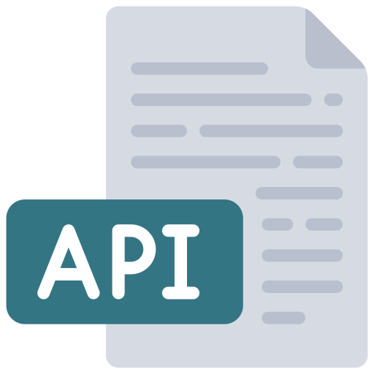
OpenAPI / Swagger
Uses Swashbuckle library by default
Add services: builder.Services.AddEndpointsApiExplorer(); builder.Services.AddSwaggerGen();
Register middlewares: app.UseSwagger(); app.UseSwaggerUI();
Notes:
<a href="https://www.flaticon.com/free-icons/api" title="api icons">Api icons created by juicy_fish - Flaticon</a>

Slide 18
OpenAPI / Swagger (cont.)
app.MapGet("/api/v1/clients/{id:long}", GetClient)
.Produces<ClientModel>()
.Produces(StatusCodes.Status404NotFound)
.WithName("GetClient")
.WithGroupName("v1")
.WithSummary("Get a client by id.")
.WithDescription("Gets a single client by id value.")
.WithTags("Clients")
.WithOpenApi(operation =>
{
operation.Parameters[0].Description =
"Id of the client to retrieve.";
return operation;
});
Notes:
<a href="https://www.flaticon.com/free-icons/api" title="api icons">Api icons created by juicy_fish - Flaticon</a>
Some of these are .NET 7 features – i.e. WithOpenApi(), WithSummary()

Slide 19

Integration testing
Microsoft.AspNetCore.Mvc.Testing
WebApplicationFactory<T> public class DemoApplication : WebApplicationFactory<Program> { protected override void ConfigureWebHost(IWebHostBuilder builder) { builder.ConfigureServices(services => ...); } }
Use client from application.CreateClient() var application = new DemoApplication(); var client = application.CreateClient(); var user = await client.GetFromJsonAsync<UserModel>(“/api/v1/users/1”); Assert.Equal(1, user.Id);
Notes:
<a href="https://www.flaticon.com/free-icons/lab" title="lab icons">Lab icons created by Freepik - Flaticon</a>

Slide 20

Missing features – as against MVC
No built-in support for validation
No built-in view rendering support
Use Razor Pages or Blazor for views
JsonPatch not fully supported
Problem is with System.Text.Json input formatter
Need Newtonsoft.Json for this, or an alternative like SystemTextJsonPatch
No support for OData
Notes:
Support for Model binding can be added with a custom binding shim
<a href="https://www.flaticon.com/free-icons/problem-solving" title="problem solving icons">Problem solving icons created by Mehwish - Flaticon</a>

Slide 21

Minimal API improvements in .NET 8
Notes:
<a href="https://www.flaticon.com/free-icons/process-improvement" title="process improvement icons">Process improvement icons created by Freepik - Flaticon</a>

Slide 22
Improvements in .NET 8
Request Delegate Generator source generator
Support for Native AOT
No need for [FromForm] attribute when binding form parameters
New analyzers for API development
Route tooling
API project template includes .http file
Visual Studio (Code) and Rider .http file support
Visual Studio Endpoints Explorer

Slide 23

Tools and utilities
Notes:
<a href="https://www.flaticon.com/free-icons/work" title="work icons">Work icons created by Freepik - Flaticon</a>

Slide 24

Carter
Modules
Validation
Content Negotiation
Automatic registration
Notes:
<a href="https://www.flaticon.com/free-icons/spy" title="spy icons">Spy icons created by chahir - Flaticon</a>

Slide 25

MiniValidation
https://github.com/DamianEdwards/MiniValidation
Built on top of DataAnnotations
Notes:
https://www.flaticon.com/free-icons/stamp

Slide 26
FluentValidation
Also possible with Carter
Notes:
<a href="https://www.flaticon.com/free-icons/stamp" title="stamp icons">Stamp icons created by Freepik - Flaticon</a>

Slide 27

Conclusion
Notes:
<a href="https://www.flaticon.com/free-icons/conclusion" title="conclusion icons">Conclusion icons created by Kiranshastry - Flaticon</a>

Slide 28
Minimal APIs
Beginner friendly
Low-ceremony definitions
Minimal overhead
Microservice ready
Has new features not supported by ASP.NET Core MVC
Notes:
https://www.flaticon.com/free-icons/api

Slide 29

Alternatives
ASP.NET Core MVC
FastEndpoints - https://fast-endpoints.com/
Notes:
<a href="https://www.flaticon.com/free-icons/decision-making" title="decision making icons">Decision making icons created by Freepik - Flaticon</a>

Slide 30

References
Microsoft Learn and Dev blogs
https://docs.microsoft.com/en-us/aspnet/core/fundamentals/minimal-apis
https://devblogs.microsoft.com/dotnet/category/aspnet/
FluentValidation
https://fluentvalidation.net/
https://khalidabuhakmeh.com/minimal-api-validation-with-fluentvalidation
Project structure
Carter - https://github.com/CarterCommunity/Carter
https://dev.to/this-is-learning/maybe-it-s-time-to-rethink-our-project-structure-with-net-6-2dl
Notes:
<a href="https://www.flaticon.com/free-icons/link" title="link icons">Link icons created by Freepik - Flaticon</a>

Slide 31

@miroslavpopovic, https://miroslavpopovic.com/ https://github.com/miroslavpopovic/minimal-apis-sample
THANK YOU

