Slide 1
Minimal APIs in ASP.NET Core
Miroslav Popović Technical Manager @Seavus @Qinshift
https://miroslavpopovic.com/
https://github.com/miroslavpopovic/
@miroslavpopovic

Slide 2
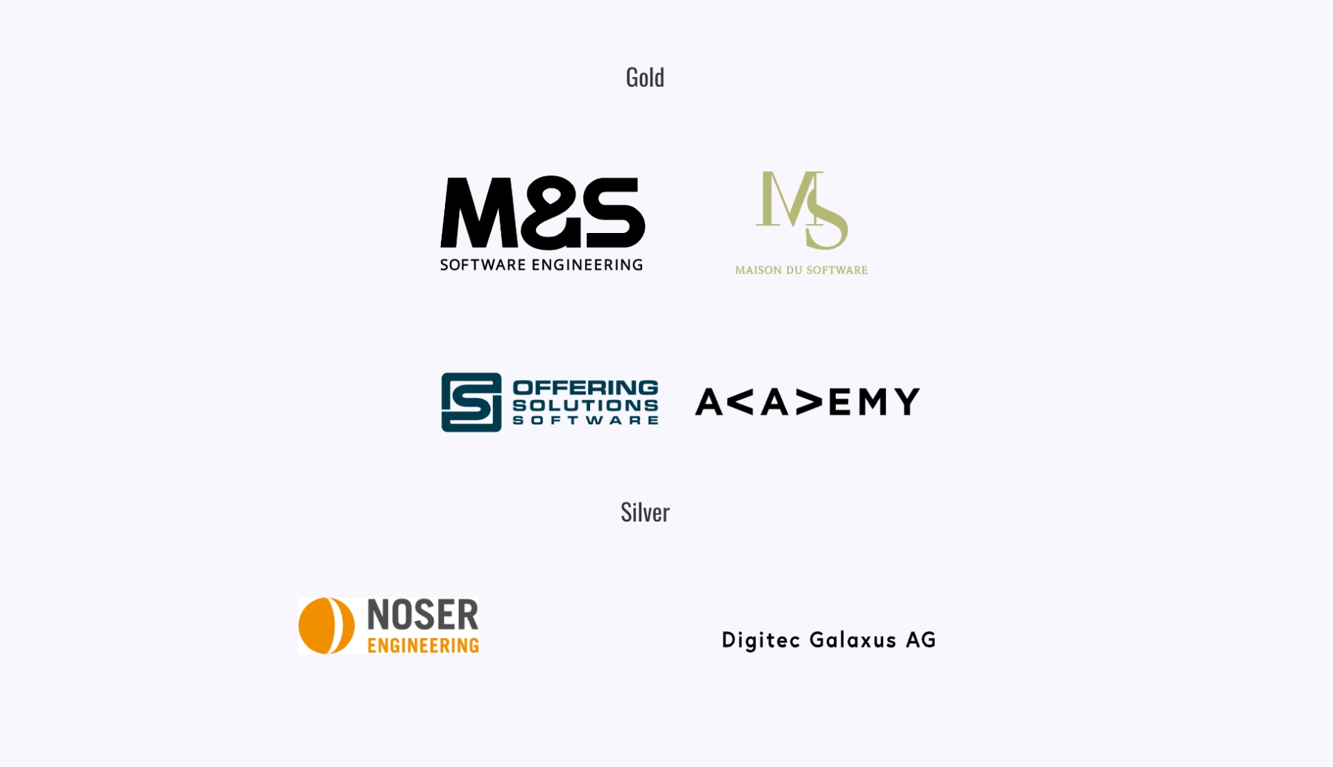

Slide 3

Introduction
All icons in this presentation are downloaded from flaticon.com
Notes:
<a href="https://www.flaticon.com/free-icons/introduction" title="introduction icons">Introduction icons created by Arkinasi - Flaticon</a>

Slide 4

MVC, Razor Pages, Blazor
MVC – ever since ASP.NET MVC
December 10th, 2007 – first CTP
March 13th, 2009 – first release
April 12th, 2022 – Version 5.2.8 (current)
Web API – ever since ASP.NET MVC 4
May 31st, 2012 – first version
ASP.NET Core MVC
June 27th, 2016 – first version – ASP.NET vNext, ASP.NET 5
Merges MVC and Web API
ASP.NET Razor Pages
August 14th, 2017 – first version with ASP.NET Core 2
Blazor
March 22nd, 2018 – first public preview
Web development icons created by piksart - Flaticon
Notes:
<a href="https://www.flaticon.com/free-icons/web-development" title="web development icons">Web development icons created by piksart - Flaticon</a>

Slide 5
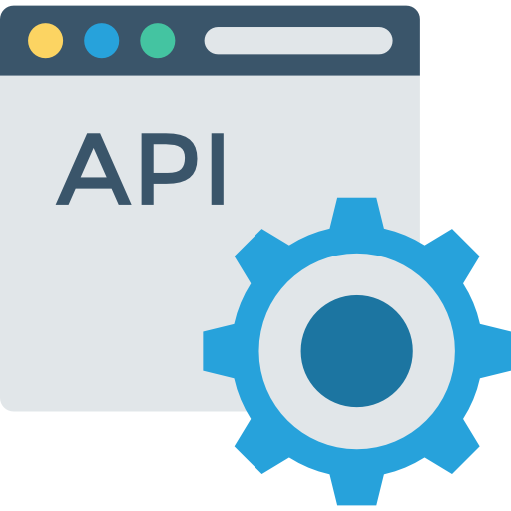
Minimal APIs
New hosting APIs
WebApplication and WebApplicationBuilder
New routing APIs
New templates
Api icons created by DinosoftLabs - Flaticon
Notes:
<a href="https://www.flaticon.com/free-icons/api" title="api icons">Api icons created by DinosoftLabs - Flaticon</a>

Slide 6
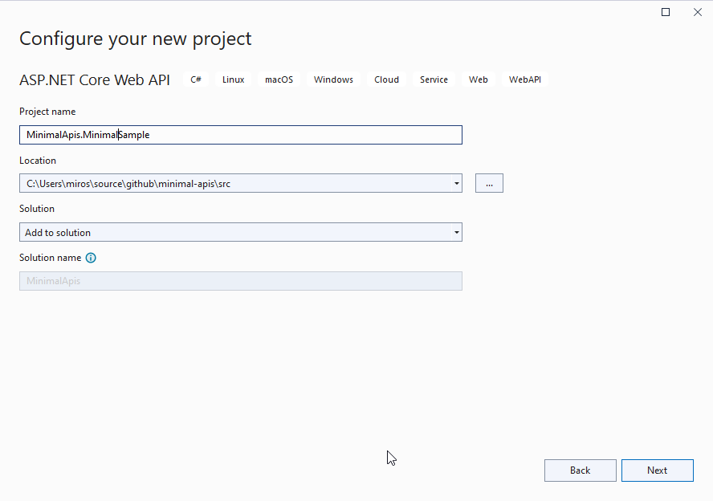
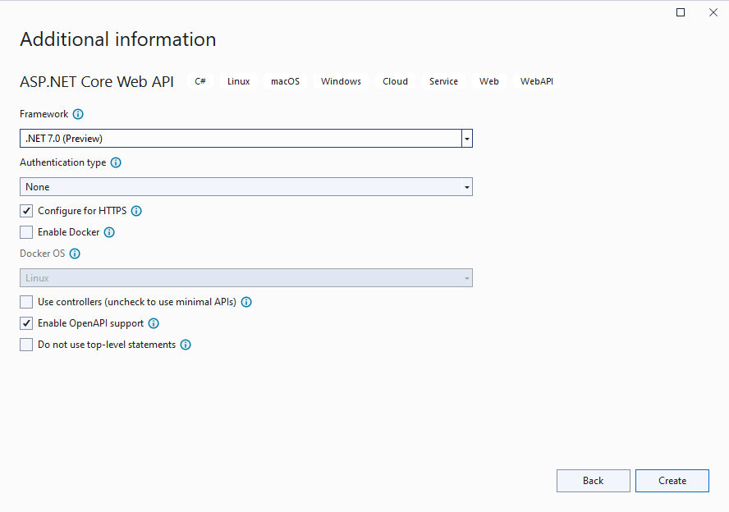
New ASP.NET Core templates

Slide 7
var builder = WebApplication.CreateBuilder(args);
// Add services to the container.
builder.Services.AddEndpointsApiExplorer();
builder.Services.AddSwaggerGen();
var app = builder.Build();
// Configure the HTTP request pipeline.
if (app.Environment.IsDevelopment())
{
app.UseSwagger();
app.UseSwaggerUI();
}
app.UseHttpsRedirection();

Slide 8
var summaries = new[]
{
"Freezing", "Bracing", "Chilly", "Cool", "Mild", "Warm", "Balmy"
};
app.MapGet("/weatherforecast", ()
=> Enumerable.Range(1, 5).Select(index =>
new WeatherForecast
(
DateOnly.FromDateTime(DateTime.Now.AddDays(index)),
Random.Shared.Next(-20, 55),
summaries[Random.Shared.Next(summaries.Length)]
))
.ToArray())
.WithName("GetWeatherForecast")
.WithOpenApi();
app.Run();
internal record WeatherForecast(DateOnly Date, int TemperatureC, string? Summary)
{
public int TemperatureF => 32 + (int)(TemperatureC / 0.5556);
}

Slide 9


Why Minimal APIs?
Performance
Beginner friendliness
Meter icons created by Freepik - Flaticon
User icons created by Freepik - Flaticon
Notes:
<a href="https://www.flaticon.com/free-icons/meter" title="meter icons">Meter icons created by Freepik - Flaticon</a>
<a href="https://www.flaticon.com/free-icons/user" title="user icons">User icons created by Freepik - Flaticon</a>

Slide 10

Minimal APIs Features
Notes:
<a href="https://www.flaticon.com/free-icons/feature" title="feature icons">Feature icons created by Freepik - Flaticon</a>

Slide 11

Routing
app.MapGet("/", () => "This is a GET");
app.MapPost("/", () => "This is a POST");
app.MapPut("/", () => "This is a PUT");
app.MapDelete("/", () => "This is a DELETE");
app.MapGroup("/");
app.MapMethods( "/options-or-head", new[] { "OPTIONS", "HEAD" },
() => "This is an options or head request ");
Different icons created by Freepik - Flaticon
Notes:
<a href="https://www.flaticon.com/free-icons/different" title="different icons">Different icons created by Freepik - Flaticon</a>

Slide 12

Parameter Binding
app.MapGet("/{id:int}",
([FromRoute] int id,
[FromQuery(Name = "p")] int page,
[FromServices] Service service,
[FromHeader(Name = "Content-Type")] string contentType
[FromBody] Person person) => {});
Special types:
HttpContext, HttpRequest, HttpResponse
CancellationToken – bound to HttpContext.RequestAborted
ClaimsPrincipal
Stream, or PipeReader – from body
IFormFile, IFormFileCollection
Full request binding
[AsParameters]
Custom binding
TryParse, BindAsync
Binding icons created by Freepik - Flaticon
Notes:
<a href="https://www.flaticon.com/free-icons/binding" title="binding icons">Binding icons created by Freepik - Flaticon</a>

Slide 13

Responses
string – HTTP 200 with body
T – HTTP 200 with JSON body
IResult
Results.Json(new { value = “demo” }), Results.Text(“demo”)
Results.StatusCode(405), Results.NotFound(), Results.NoContent(), Results.BadRequest()...
Results.Stream(stream, “application/json”)
Results.Redirect(“/somewhere-else”)
Results.File(“file.name”), Results.Bytes(byteArray)
Results.Problem(), Results.ValidationProblem()
TypedResults
Better for unit testing (no conversion), code readability, less chance of runtime error
OpenAPI metadata provided automatically
More complex endpoint handler return type
async Task<Results<Ok<Todo>, NotFound>> …
Return icons created by toempong - Flaticon
Notes:
<a href="https://www.flaticon.com/free-icons/return" title="return icons">Return icons created by toempong - Flaticon</a>

Slide 14

IEndpointFilter
IRouteHandlerFilter in first .NET 7 previews
public interface IEndpointFilter { ValueTask<object?> InvokeAsync( EndpointFilterInvocationContext context, EndpointFilterDelegate next); }
Similar to middlewares
.AddEndpointFilter()
either as generic argument or lambda method
Funnel icons created by Freepik - Flaticon
Notes:
<a href="https://www.flaticon.com/free-icons/funnel" title="funnel icons">Funnel icons created by Freepik - Flaticon</a>
Can be executed prior to the endpoint execution, after the endpoint execution, or short circuit and return response
Executed in order of definitions

Slide 15
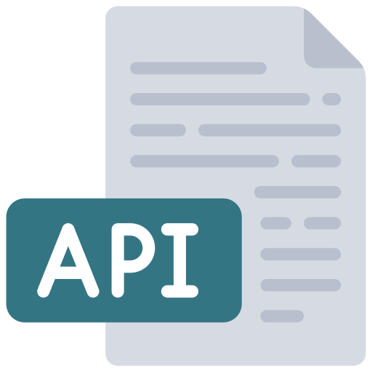
OpenAPI / Swagger
Uses Swashbuckle library by default
Add services: builder.Services.AddEndpointsApiExplorer(); builder.Services.AddSwaggerGen();
Register middlewares: app.UseSwagger(); app.UseSwaggerUI();
Api icons created by juicy_fish - Flaticon
Notes:
<a href="https://www.flaticon.com/free-icons/api" title="api icons">Api icons created by juicy_fish - Flaticon</a>

Slide 16
OpenAPI / Swagger (cont.)
app.MapGet("/api/v1/clients/{id:long}", GetClient)
.Produces<ClientModel>()
.Produces(StatusCodes.Status404NotFound)
.WithName(nameof(GetClient))
.WithGroupName("v1")
.WithTags("Clients")
.WithOpenApi(operation =>
{
operation.Summary = “Get a client by id.”;
operation.Description = “Gets a single client by id value.”;
operation.Parameters[0].Description = "Id of the client to retrieve.";
return operation;
});
Api icons created by juicy_fish - Flaticon
Notes:
<a href="https://www.flaticon.com/free-icons/api" title="api icons">Api icons created by juicy_fish - Flaticon</a>
Some of these are .NET 7 features – i.e. WithOpenApi(), WithSummary()

Slide 17
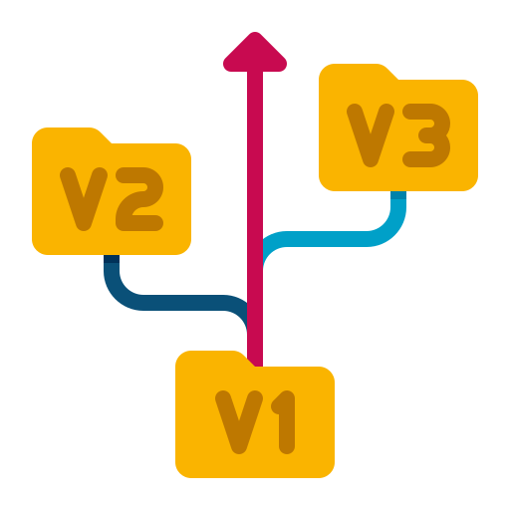
Versioning
Use Api.Versioning.Http and Api.Versioning.ApiExplorer libraries
services .AddApiVersioning() .AddApiExplorer();
var versionSet = app .NewApiVersionSet() .HasApiVersion(new ApiVersion(1, 0)) .Build(); var clients = app.MapGroup(“/api/v{version:apiVersion}/clients”) .WithApiVersionSet(versionSet);
app.UseSwaggerUI(options => { foreach (var description in app.DescribeApiVersions()) { options.SwaggerEndpoint( $"/swagger/{description.GroupName}/swagger.json", description.GroupName); } });
Version control icons created by Flat Icons - Flaticon

Slide 18

Authorization
Define authorization and policies: builder.Services.AddAuthorization( o => o.AddPolicy("AdminsOnly", b => b.RequireClaim("admin", "true")));
Use middleware - app.UseAuthorization();
Require authorization with or without policy: app.MapGet("/auth", [Authorize] () => "This endpoint requires authorization."); app.MapGet("/admin", [Authorize("AdminsOnly")] () => "The /admin endpoint is for admins only."); app.MapGet("/auth2", () => "This endpoint requires authorization") .RequireAuthorization(); app.MapGet("/admin2", () => "The /admin2 endpoint is for admins only.") .RequireAuthorization("AdminsOnly");
[AllowAnonymous] or .AllowAnonimous()
Authorization icons created by piksart - Flaticon
Notes:
<a href="https://www.flaticon.com/free-icons/authorization" title="authorization icons">Authorization icons created by piksart - Flaticon</a>

Slide 19

CORS
Define services: builder.Services.AddCors(options => { options.AddPolicy(name: AllowSpecificOrigins, builder => { builder.WithOrigins( "https://dotnetday.ch", "https://dotnetday.ch"); }); options.AddDefaultPolicy(builder => ...); });
Use middleware: app.UseCors();
Require CORS: app.MapGet("/", () => “Default CORS policy"); app.MapGet("/cors", [EnableCors(MyAllowSpecificOrigins)] () => "This endpoint allows cross origin requests!"); app.MapGet("/cors2", () => "This endpoint allows cross origin requests!") .RequireCors(MyAllowSpecificOrigins);
Compare icons created by GOWI - Flaticon
Notes:
<a href="https://www.flaticon.com/free-icons/compare" title="compare icons">Compare icons created by GOWI - Flaticon</a>

Slide 20

Integration testing
Microsoft.AspNetCore.Mvc.Testing
WebApplicationFactory<T> public class DemoApplication : WebApplicationFactory<Program> { protected override void ConfigureWebHost( IWebHostBuilder builder) { builder.ConfigureServices(services => ...); } }
Use client from application.CreateClient() var application = new DemoApplication(); var client = application.CreateClient(); var user = await client.GetFromJsonAsync<UserModel>(“/api/v1/users/1”); Assert.Equal(1, user.Id);
Lab icons created by Freepik - Flaticon
Notes:
<a href="https://www.flaticon.com/free-icons/lab" title="lab icons">Lab icons created by Freepik - Flaticon</a>

Slide 21

Missing features – as against MVC
No built-in support for validation
No built-in view rendering support
Use Razor Pages or Blazor for views
No built-in content negotiation
JsonPatch not fully supported
Problem is with System.Text.Json input formatter
Need Newtonsoft.Json for this, or an alternative like JsonPatch or SystemTextJsonPatch
There are workarounds
No support for OData
OData routing is based on controllers
Problem solving icons created by Mehwish - Flaticon
Notes:
Support for Model binding can be added with a custom binding shim
<a href="https://www.flaticon.com/free-icons/problem-solving" title="problem solving icons">Problem solving icons created by Mehwish - Flaticon</a>

Slide 22

Minimal API improvements in .NET 8
Process improvement icons created by Freepik - Flaticon
Notes:
<a href="https://www.flaticon.com/free-icons/process-improvement" title="process improvement icons">Process improvement icons created by Freepik - Flaticon</a>

Slide 23
Improvements
Support for Native AOT
Only partial, has a separate Web API template
Request Delegate Generator source generator
<EnableRequestDelegateGenerator>
Using C# 12 interceptors
Slim and empty builders
Binding
No need for [FromForm] attribute when binding form parameters
Complex form binding support
Antiforgery support
New analyzers for API development
Header dictionary check, route handler parameter interface check, check RequestDelegate
Simplified auth and identity
Support for generic attributes
[Produces<T>], [ProducesResponseType<T>], [MiddlewareFilter<T>], [ModelBinder<T>]…
Process improvement icons created by Freepik - Flaticon
Notes:
<a href="https://www.flaticon.com/free-icons/process-improvement" title="process improvement icons">Process improvement icons created by Freepik - Flaticon</a>

Slide 24
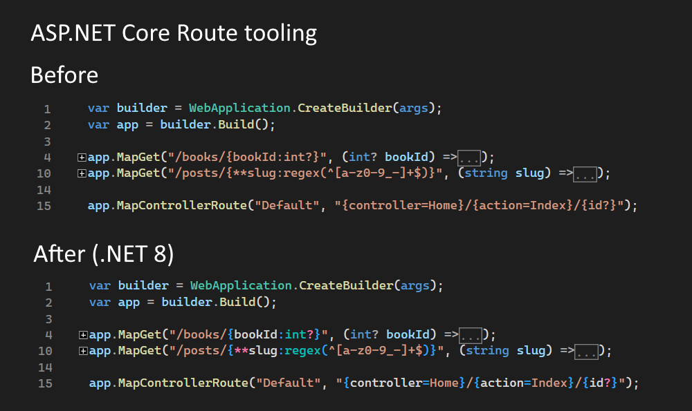
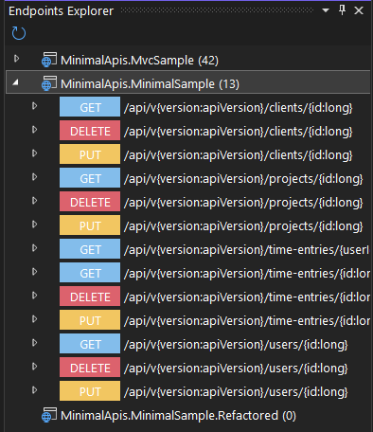
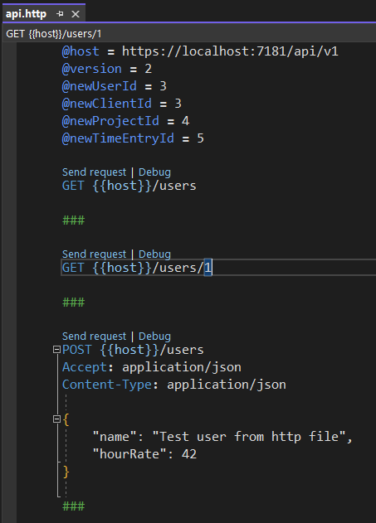
Improvements - tools
Route tooling
API project template includes .http file
Visual Studio (Code) and Rider .http file support
Visual Studio Endpoints Explorer
Visual Studio Dev Tunnels
Notes:
<a href="https://www.flaticon.com/free-icons/process-improvement" title="process improvement icons">Process improvement icons created by Freepik - Flaticon</a>

Slide 25

Tools and utilities
Notes:
<a href="https://www.flaticon.com/free-icons/work" title="work icons">Work icons created by Freepik - Flaticon</a>

Slide 26

Carter
https://github.com/CarterCommunity/Carter
Modules
Validation
Content Negotiation
Automatic registration
Spy icons created by chahir - Flaticon
Notes:
<a href="https://www.flaticon.com/free-icons/spy" title="spy icons">Spy icons created by chahir - Flaticon</a>

Slide 27

Validation
MiniValidation
https://github.com/DamianEdwards/MiniValidation
Built on top of DataAnnotations
FluentValidation
https://fluentvalidation.net/
Also possible with Carter
Stamp icons created by Freepik - Flaticon
Notes:
https://www.flaticon.com/free-icons/stamp

Slide 28

Conclusion
Notes:
<a href="https://www.flaticon.com/free-icons/conclusion" title="conclusion icons">Conclusion icons created by Kiranshastry - Flaticon</a>

Slide 29
Minimal APIs
Beginner friendly
Low-ceremony definitions
Minimal overhead
Microservice ready
Gets all the <3
new features not supported by ASP.NET Core MVC
Api icons created by DinosoftLabs - Flaticon
Notes:
https://www.flaticon.com/free-icons/api

Slide 30

Alternatives
ASP.NET Core MVC
FastEndpoints - https://fast-endpoints.com/
Decision making icons created by Freepik - Flaticon
Notes:
<a href="https://www.flaticon.com/free-icons/decision-making" title="decision making icons">Decision making icons created by Freepik - Flaticon</a>

Slide 31

Should I use it?
In .NET 6 era
If you have small microservices or small number of endpoints
In .NET 7 era
If you don’t have a lot of endpoints requiring MVC features
In .NET 8 era
Most likely, yes
Almost no missing features
First Native AOT support
.NET 9+
More features are coming in
Question icons created by Freepik - Flaticon
Notes:
<a href="https://www.flaticon.com/free-icons/question" title="question icons">Question icons created by Freepik - Flaticon</a>

Slide 32

References
Microsoft Learn and Dev blogs
https://learn.microsoft.com/en-us/aspnet/core/fundamentals/minimal-apis/overview
https://devblogs.microsoft.com/dotnet/category/aspnet/
GitHub
https://github.com/dotnet/aspnetcore
Community
https://andrewlock.net/exploring-the-dotnet-8-preview-the-minimal-api-aot-template/
https://andrewlock.net/exploring-the-dotnet-8-preview-exploring-the-new-minimal-api-source-generator/
Link icons created by Freepik - Flaticon
Notes:
<a href="https://www.flaticon.com/free-icons/link" title="link icons">Link icons created by Freepik - Flaticon</a>

Slide 33

That’s all!
https://github.com/miroslavpopovic/minimal-apis-sample
https://miroslavpopovic.com/
https://github.com/miroslavpopovic/
@miroslavpopovic
Notes:
<a href="https://www.flaticon.com/free-icons/thank-you" title="thank you icons">Thank you icons created by Freepik - Flaticon</a>

