Slide 1

Minimal APIs in ASP.NET Core 6+
Miroslav Popović Technical Lead @ Seavus
https://miroslavpopovic.com/
https://github.com/miroslavpopovic/
@miroslavpopovic

Slide 2

This conference would not be possible without these outstanding supporters!!!

Slide 3

Introduction
All icons in this presentation are downloaded from flaticon.com, the attribution is provided in slide notes
Notes:
<a href="https://www.flaticon.com/free-icons/introduction" title="introduction icons">Introduction icons created by Arkinasi - Flaticon</a>

Slide 4

MVC and Razor Pages
MVC – ever since ASP.NET MVC
December 10th, 2007 – first CTP
March 13th, 2009 – first release
April 12th 2022 – Version 5.2.8 (current)
Web API – ever since ASP.NET MVC 4
May 31st 2012 – first version
ASP.NET Core MVC
June 27th 2016 – first version – ASP.NET vNext, ASP.NET 5
Merges MVC and Web API
ASP.NET Razor Pages
August 14th 2017 – first version with ASP.NET Core 2
Notes:
<a href="https://www.flaticon.com/free-icons/web-development" title="web development icons">Web development icons created by piksart - Flaticon</a>

Slide 5
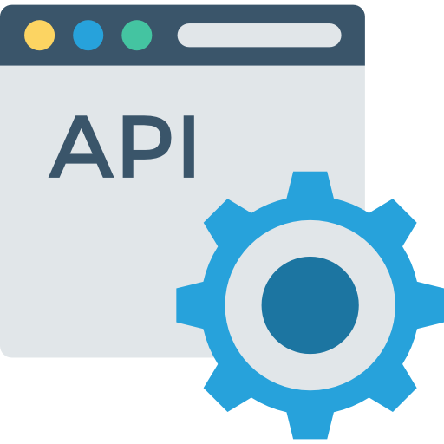
Minimal APIs
New hosting APIs
WebApplication and WebApplicationBuilder
New routing APIs
New templates
Notes:
<a href="https://www.flaticon.com/free-icons/api" title="api icons">Api icons created by DinosoftLabs - Flaticon</a>

Slide 6
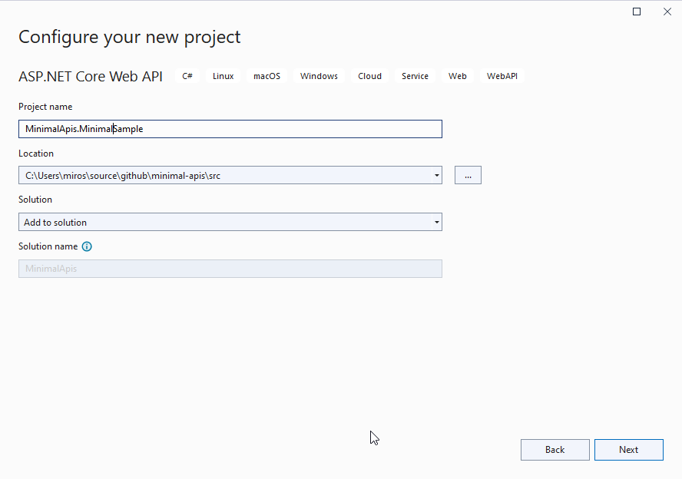
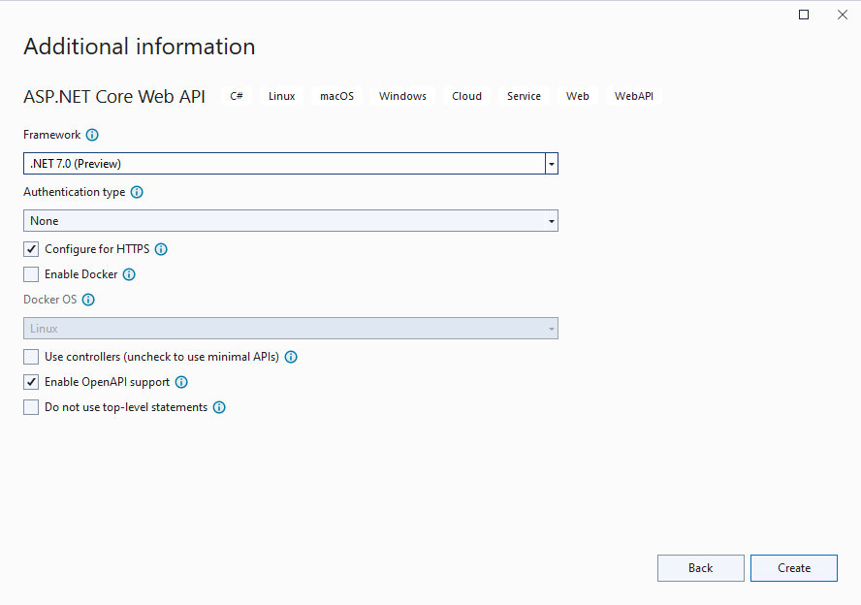
New ASP.NET Core templates

Slide 7
var builder = WebApplication.CreateBuilder(args);
// Add services to the container.
builder.Services.AddEndpointsApiExplorer();
builder.Services.AddSwaggerGen();
var app = builder.Build();
// Configure the HTTP request pipeline.
if (app.Environment.IsDevelopment())
{
app.UseSwagger();
app.UseSwaggerUI();
}
app.UseHttpsRedirection();

Slide 8
var summaries = new[]
{
"Freezing", "Bracing", "Chilly", "Cool", "Mild", "Warm", "Balmy"
};
app.MapGet("/weatherforecast", ()
=> Enumerable.Range(1, 5).Select(index =>
new WeatherForecast
(
DateOnly.FromDateTime(DateTime.Now.AddDays(index)),
Random.Shared.Next(-20, 55),
summaries[Random.Shared.Next(summaries.Length)]
))
.ToArray())
.WithName("GetWeatherForecast")
.WithOpenApi();
app.Run();
internal record WeatherForecast(DateOnly Date, int TemperatureC, string? Summary)
{
public int TemperatureF => 32 + (int)(TemperatureC / 0.5556);
}

Slide 9


Why Minimal APIs?
Performance
Beginner friendliness
Notes:
<a href="https://www.flaticon.com/free-icons/meter" title="meter icons">Meter icons created by Freepik - Flaticon</a>
<a href="https://www.flaticon.com/free-icons/user" title="user icons">User icons created by Freepik - Flaticon</a>

Slide 10

Minimal API Features
Notes:
<a href="https://www.flaticon.com/free-icons/feature" title="feature icons">Feature icons created by Freepik - Flaticon</a>

Slide 11

Routing
app.MapGet("/", () => "This is a GET");
app.MapPost("/", () => "This is a POST");
app.MapPut("/", () => "This is a PUT");
app.MapDelete("/", () => "This is a DELETE");
app.MapMethods( "/options-or-head", new[] { "OPTIONS", "HEAD" },
() => "This is an options or head request ");
Notes:
<a href="https://www.flaticon.com/free-icons/different" title="different icons">Different icons created by Freepik - Flaticon</a>

Slide 12

Parameter binding
app.MapGet("/{id:int}",
([FromRoute] int id,
[FromQuery(Name = "p")] int page,
[FromServices] Service service,
[FromHeader(Name = "Content-Type")] string contentType)
=> {});
Special types:
HttpContext
HttpRequest
HttpResponse
CancellationToken – bound to HttpContext.RequestAborted
ClaimsPrincipal
Notes:
<a href="https://www.flaticon.com/free-icons/binding" title="binding icons">Binding icons created by Freepik - Flaticon</a>

Slide 13

Responses
string – HTTP 200 with body
T – HTTP 200 with JSON body
IResult
Results.Json(new { value = “demo” })
Results.Text(“demo”)
Results.StatusCode(405)
Results.NotFound(), Results.NoContent(), Results.BadRequest()...
Results.Stream(stream, “application/json”)
Results.Redirect(“/somewhere-else”)
Results.File(“file.name”)
Results.Bytes(byteArray)
Results.Problem(), Results.ValidationProblem()
Notes:
<a href="https://www.flaticon.com/free-icons/return" title="return icons">Return icons created by toempong - Flaticon</a>

Slide 14

Authorization
Define authorization and policies: builder.Services.AddAuthorization( o => o.AddPolicy("AdminsOnly", b => b.RequireClaim("admin", "true")));
Use middleware - app.UseAuthorization();
Require authorization with or without policy: app.MapGet("/auth", [Authorize] () => "This endpoint requires authorization."); app.MapGet("/admin", [Authorize("AdminsOnly")] () => "The /admin endpoint is for admins only."); app.MapGet("/auth2", () => "This endpoint requires authorization") .RequireAuthorization(); app.MapGet("/admin2", () => "The /admin2 endpoint is for admins only.") .RequireAuthorization("AdminsOnly");
[AllowAnonymous] or .AllowAnonimous()
Notes:
<a href="https://www.flaticon.com/free-icons/authorization" title="authorization icons">Authorization icons created by piksart - Flaticon</a>

Slide 15

CORS
Define services: builder.Services.AddCors(options => { options.AddPolicy(name: AllowSpecificOrigins, builder => { builder.WithOrigins("http://kulendayz.com", "https://kulendayz.com"); }); options.AddDefaultPolicy(builder => ...); });
Use middleware: app.UseCors();
Require CORS: app.MapGet("/", () => “Default CORS policy"); app.MapGet("/cors", [EnableCors(MyAllowSpecificOrigins)] () => "This endpoint allows cross origin requests!"); app.MapGet("/cors2", () => "This endpoint allows cross origin requests!") .RequireCors(MyAllowSpecificOrigins);
Notes:
<a href="https://www.flaticon.com/free-icons/compare" title="compare icons">Compare icons created by GOWI - Flaticon</a>

Slide 16
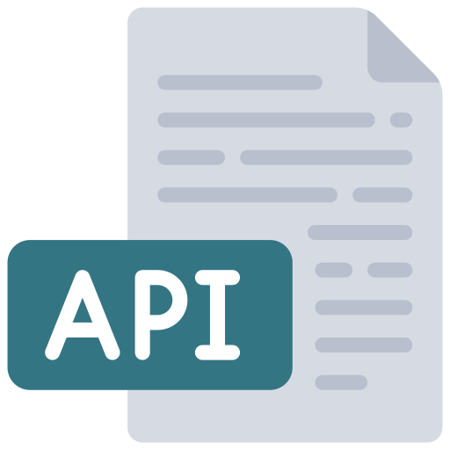
OpenAPI / Swagger
Uses Swashbuckle library by default
Add services: builder.Services.AddEndpointsApiExplorer(); builder.Services.AddSwaggerGen();
Register middlewares: app.UseSwagger(); app.UseSwaggerUI();
Notes:
<a href="https://www.flaticon.com/free-icons/api" title="api icons">Api icons created by juicy_fish - Flaticon</a>

Slide 17
OpenAPI / Swagger (cont.)
app.MapGet("/api/v1/clients/{id:long}", GetClient)
.Produces<ClientModel>()
.Produces(StatusCodes.Status404NotFound)
.WithName("GetClient")
.WithGroupName(“v1")
.WithSummary("Get a client by id.")
.WithDescription("Gets a single client by id value.")
.WithTags("Clients")
.WithOpenApi(operation =>
{
operation.Parameters[0].Description = "Id of the client to retrieve.";
return operation;
});
Notes:
<a href="https://www.flaticon.com/free-icons/api" title="api icons">Api icons created by juicy_fish - Flaticon</a>

Slide 18

Integration testing
Microsoft.AspNetCore.Mvc.Testing
WebApplicationFactory<T> public class DemoApplication : WebApplicationFactory<Program> { protected override void ConfigureWebHost(IWebHostBuilder builder) { builder.ConfigureServices(services => ...); } }
Use client from application.CreateClient() var application = new DemoApplication(); var client = application.CreateClient(); var user = await client .GetFromJsonAsync<UserModel>(“/api/v1/users/1”); Assert.Equal(1, user.Id);
Notes:
<a href="https://www.flaticon.com/free-icons/lab" title="lab icons">Lab icons created by Freepik - Flaticon</a>

Slide 19
Missing features in .NET 6
No filters support – IAsyncActionFilter, IAsyncExceptionFilter...
No model binding support – IModelBinderProvider, IModelBinder, also no form binding like IFormFile
No built-in validation – IModelValidator
No built-in view rendering support – use Razor Pages for views
No support for JsonPatch
No support for OData
No support for ApiVersioning

Slide 20

Minimal API improvements in .NET 7
Notes:
<a href="https://www.flaticon.com/free-icons/process-improvement" title="process improvement icons">Process improvement icons created by Freepik - Flaticon</a>

Slide 21

IEndpointFilter
IRouteHandlerFilter in older previews
public interface IEndpointFilter { ValueTask<object?> InvokeAsync( EndpointFilterInvocationContext context, EndpointFilterDelegate next); }
Similar to middlewares
Notes:
<a href="https://www.flaticon.com/free-icons/funnel" title="funnel icons">Funnel icons created by Freepik - Flaticon</a>
Can be executed prior to the endpoint execution, after the endpoint execution, or short circuit and return response
Executed in order of definitions

Slide 22
Other improvements
IFormFile and IFormFileCollection
builder.Services.AddProblemDetails();
Improved OpenAPI support – more functionality, self describing APIs
Improved unit testability – IResult implementation types are public (OkObjectHttpResult, ProblemHttpResult,...)
Support for Anti-Forgery?

Slide 23

RateLimiting middleware
Primitives defined in System.Threading.RateLimiting
RateLimiter, ConcurrencyLimiter, TokenBucketRateLimiter, FixedWindowRateLimiter, SlidingWindowRateLimiter, PartitionedRateLimiter<Tresource>
RateLimiting Middleware
Configuring policies and attaching them to endpoints
RateLimiterOptions.GlobalLimiter – runs before any endpoint policy – i.e., limit app to handle 1000 concurrent request
https://devblogs.microsoft.com/dotnet/announcing-rate-limiting-for-dotnet/
Notes:
https://devblogs.microsoft.com/dotnet/announcing-rate-limiting-for-dotnet/
<a href="https://www.flaticon.com/free-icons/limits" title="limits icons">Limits icons created by itim2101 - Flaticon</a>

Slide 24

Tools and utilities
Notes:
<a href="https://www.flaticon.com/free-icons/work" title="work icons">Work icons created by Freepik - Flaticon</a>

Slide 25

Carter
Modules
Validation
Content Negotiation
Automatic registration
Notes:
<a href="https://www.flaticon.com/free-icons/spy" title="spy icons">Spy icons created by chahir - Flaticon</a>

Slide 26

MiniValidation
https://github.com/DamianEdwards/MiniValidation
Built on top of DataAnnotations
Notes:
https://www.flaticon.com/free-icons/stamp

Slide 27
FluentValidation
Also possible with Carter
Notes:
https://www.flaticon.com/free-icons/stamp

Slide 28

Conclusion
Notes:
<a href="https://www.flaticon.com/free-icons/conclusion" title="conclusion icons">Conclusion icons created by Kiranshastry - Flaticon</a>

Slide 29
Minimal APIs
Beginner friendly
Low-ceremony definitions
Minimal overhead
Microservice ready
Still not on-par with ASP.NET Core MVC, but getting there
Notes:
https://www.flaticon.com/free-icons/api

Slide 30

Alternatives
ASP.NET Core MVC
FastEndpoints - https://fast-endpoints.com/
Notes:
<a href="https://www.flaticon.com/free-icons/decision-making" title="decision making icons">Decision making icons created by Freepik - Flaticon</a>

Slide 31

References
https://docs.microsoft.com/en-us/aspnet/core/fundamentals/minimal-apis
Migration to ASP.NET Core in .NET 6 by David Fowler
https://devblogs.microsoft.com/dotnet/category/aspnet/
https://devblogs.microsoft.com/dotnet/announcing-rate-limiting-for-dotnet/
https://khalidabuhakmeh.com/minimal-api-validation-with-fluentvalidation
https://www.hanselman.com/blog/minimal-apis-in-net-6-but-where-are-the-unit-tests
https://dev.to/this-is-learning/maybe-it-s-time-to-rethink-our-project-structure-with-net-6-2dl
Notes:
<a href="https://www.flaticon.com/free-icons/link" title="link icons">Link icons created by Freepik - Flaticon</a>

Slide 32

That’s all!
https://github.com/miroslavpopovic/minimal-apis-sample
https://miroslavpopovic.com/
https://github.com/miroslavpopovic/
@miroslavpopovic
Notes:
<a href="https://www.flaticon.com/free-icons/conclusion" title="conclusion icons">Conclusion icons created by Kiranshastry - Flaticon</a>

Slide 33
This conference would not be possible without these outstanding supporters!!!

Slide 34


