Slide 1
OnboardIQ
Internship Project
Smart Employee Onboarding & Identity Service
AWS Serverless Full Stack Application
9 Lambda Functions
4 DynamoDB Tables
Step Functions Workflow
React Frontend on S3
From offer letter acceptance to Day 1 login — fully automated on AWS.
Region: ap-south-1 (Mumbai)
React 18
AWS Lambda
Step Functions
DynamoDB
Cognito

Slide 2
OnboardIQ
PROBLEM
The Problem We're Solving
Traditional employee onboarding is manual, fragmented, and slow.
Before OnboardIQ
With OnboardIQ
HR manually emails every new hire
Automated emails triggered by workflow engine
Documents collected over WhatsApp or email
Secure encrypted S3 upload portal
No visibility into who completed what
Real-time HR dashboard with stage tracking
IT provisions accounts days late
Cognito account created automatically on submit
Managers forget to greet new hires
Manager introduction email sent on joining date
No audit trail or compliance record
Every action timestamped in DynamoDB
OnboardIQ replaces all manual steps with a single AWS Step Functions workflow.

Slide 3
OnboardIQ
OVERVIEW
What OnboardIQ Does
Two portals. One automated pipeline. Zero manual steps.
New Hire Portal
AWS Does Automatically
1
Fill in your profile
Employee record created in DynamoDB
Name · Role · Department · Joining date
Step Functions execution starts
2
Upload 3 documents
ID Proof · Degree Certificate · Offer Letter
S3 validates each document upload
3
Sign 5 policies
Cognito account provisioned
Progress bar fills as each policy is acknowledged
Credentials emailed via SES
4
Manager intro note
Optional message to your reporting manager
Policy sign-off timestamped
5
Done
Manager intro email sent
Credentials arrive in your email inbox
Employee status → ACTIVE

Slide 4
OnboardIQ
ARCHITECTURE
System Architecture
Fully serverless — no servers to manage, maintain, or scale.
Frontend
React 18 + Vite · Hosted on S3 Static Website
↓
API Gateway
REST API · CORS enabled · Routes to Lambda
↓
Lambda
9 Functions · Node.js 20 · ARM64 · 256MB
↓
Step Functions
4-stage state machine: Doc → IT → Policy → Manager Intro
DATA LAYER
DynamoDB 4 Tables
S3 Bucket Encrypted
Cognito User Pool
SES Email
SNS Alerts
Infrastructure as Code: AWS SAM + CloudFormation · Stack: hrms-onboarding-stack · ap-south-1 (Mumbai)

Slide 5
OnboardIQ
SERVICES
AWS Services Used
9 managed services — zero servers to provision or maintain.
Lambda
Step Functions
DynamoDB
9 functions · Node.js 20 · ARM64
4-stage orchestration state machine
4 tables · 3 GSIs · pay-per-request
S3
Cognito
SES
Encrypted document storage + static hosting
User pool · auto-provisions new hire accounts
Transactional emails — welcome, reminders
SNS
API Gateway
SAM / CF
HR team alerts when all documents received
REST API routing all frontend requests
Full infra as code · one-command deploy

Slide 6
OnboardIQ
ER DIAGRAM
Database Schema
Amazon DynamoDB · 4 tables · 3 Global Secondary Indexes
hrms-employees
hrms-onboarding-workflows
hrms-documents
🔑 employee_id PK
🔑 workflow_id PK
🔑 document_id PK
first_name, last_name, full_name
employee_id GSI → FK
employee_id GSI → FK
email
1 → 1
execution_arn
1 → many
doc_type
phone, department, role
current_stage
status (PENDING / UPLOADED)
employment_type, joining_date
overall_status
s3_key, content_type
manager_id → FK
reminder_attempt
verified (boolean)
cognito_user_id
started_at, updated_at
validation_errors
status (ONBOARDING / ACTIVE)
uploaded_at, updated_at
created_at, updated_at
1 → 4
hrms-onboarding-stages
🔑 stage_id PK
workflow_id GSI → FK
stage_name, status
signed_at, completed_at
↺ manager_id self-joins back to employee_id for org hierarchy
Paste the Mermaid diagram in deliverables/02-er-diagram.md at mermaid.live for a rendered version

Slide 7
OnboardIQ
WORKFLOW
The Onboarding Workflow Engine
AWS Step Functions — event-driven, auditable, no servers polling.
Stage 1
Stage 2
Stage 3
Stage 4
Document Collection
IT Provisioning
Policy Sign-off
Manager Intro
Checks DynamoDB for
Creates Cognito user
Checks signed_at
Emails new hire
all 3 uploads
→
Emails temp credentials
→
timestamp in DynamoDB
→
Emails manager
Retries up to 3×
via SES
for 5 policies
Status → ACTIVE
✓ COMPLETE
✓ COMPLETE
✓ COMPLETE
✓ COMPLETE
Wait states pause the execution every 30s (demo) / 24h (production) — zero compute cost while waiting.
If a stage is incomplete after 3 reminders → marked Overdue → workflow fails gracefully.

Slide 8
OnboardIQ
EXECUTION
Live Execution Proof
Real AWS Step Functions execution — Arjun Sharma · EMP-4FEA92A3 · 2026-04-08
Status
Duration
Stages
Time
✓ SUCCEEDED
66 seconds
4 / 4 complete
15:11 – 15:12 IST
15:11:53
DocumentCollection entered
Stage 1 starts
15:11:54
WaitForDocuments
30-second wait — documents uploading
15:12:25
DocumentCollection ✓
All 3 documents received
15:12:25
ITProvisioning entered
Stage 2 — Cognito user creation
15:12:27
ITProvisioning ✓
Cognito account created
15:12:27
PolicySignoff entered
Stage 3 — checks signed_at
15:12:27
WaitForPolicySignoff
30-second wait
15:12:58
PolicySignoff ✓
All 5 policies signed
15:12:58
ManagerIntro entered
Stage 4 — intro emails dispatched
15:12:59
OnboardingComplete ✓
EXECUTION SUCCEEDED — status → ACTIVE
Open AWS Console → Step Functions → hrms-onboarding-workflow → Executions to see the visual graph

Slide 9
OnboardIQ
DEMO A
Demo Walkthrough — Part A
New Hire Experience · follow these steps exactly during the presentation.
App URL: hrms-onboarding-frontend-dev.s3-website.ap-south-1.amazonaws.com
A1
Open the App
Navigate to the URL above → splash animation plays → landing page shows two cards.
A2
Enter New Hire Portal
Click 'New Hire Portal' → another splash → Step 1 of 5 appears.
A3
Fill Profile
First: Priya · Last: Menon · Email: priya.menon@example.com · Dept: Engineering · Role: Frontend Engineer → Continue
A4
Upload Documents
Click each of the 3 cards → upload any PDF → green Uploaded badge appears on each → Continue
A5
Sign 5 Policies
Check all 5 boxes one by one — watch the progress bar fill to 100% → Continue
A6
Manager Intro
Type a note (optional): 'What does the first week look like?' → Submit & Complete ✓
A7
Completion Screen
Completion screen shows all stage badges. Click '← Back to Home'.

Slide 10
OnboardIQ
DEMO B
Demo Walkthrough — Part B
HR Admin Dashboard · PIN-gated · real-time pipeline view.
HR PIN: 1234 (auto-unlocks on the 4th digit — no Enter needed · resets every navigation)
B1
Open HR Dashboard
From landing page click 'HR Admin Dashboard' → splash → PIN gate appears.
B2
Enter PIN
Type 1-2-3-4 — on the 4th digit the screen fades out automatically. Dashboard fades in.
B3
Stats Bar
5 metric cards at top: Total · In Progress · Completed · Docs Pending · Avg Completion %
B4
Search for Your Hire
Type 'Priya' in the search bar → table filters live to show Priya Menon's row.
B5
Expand Detail Panel
Click the row → panel slides open: 4 stages with timestamps + 3 document upload badges.
B6
Refresh
Click Refresh button (top right) → spinner → data reloads from live API.
B7
Status Filters
Use filter pills: All · In Progress · Completed · Pending — each filters the table.

Slide 11
OnboardIQ
DEMO C
Demo Walkthrough — Part C
AWS Console evidence — show evaluators the live backend.
C1 · Step Functions
AWS Console → Step Functions → hrms-onboarding-workflow → Executions tab Click latest SUCCEEDED → Graph view (all states green) → Events tab (full timeline)
C2 · DynamoDB — Employees
DynamoDB → hrms-employees → Explore items → find your employee Show: status = ACTIVE · cognito_user_id populated · all fields correct
C3 · DynamoDB — Stages
DynamoDB → hrms-onboarding-stages → filter by workflow_id Show: all 4 rows with status = COMPLETE and completed_at timestamps
C4 · S3 — Documents
S3 → hrms-onboarding-documents-736786104206-dev → documents/{employee_id}/ Show: 3 uploaded files — ID_PROOF · DEGREE_CERTIFICATE · OFFER_LETTER
C5 · S3 — Encryption
S3 bucket → Properties → Default encryption → AES-256 server-side encryption enabled

Slide 12
OnboardIQ
COST
Cost Estimate — 50 Hires / Month
AWS ap-south-1 pricing · April 2026 · all major services within free tier at this scale.
Service
Monthly Usage
Cost
Pricing Basis
Lambda
750 invocations/mo
$0.00
Covered by 1M free tier
Step Functions
1,650 transitions/mo
$0.00
First 4,000 free
DynamoDB
~6,500 reads + writes
$0.00
25GB always-free tier
S3
75MB · 150 PUTs
$0.004
$0.023/GB storage
SES
400 emails/mo
$0.04
$0.10 per 1,000 emails
Cognito
50 MAUs
$0.00
First 50,000 MAU free
SNS
50 notifications
$0.00
First 1M free
API Gateway
~200 requests/mo
$0.001
$3.50 per million requests
Total monthly cost:
~$0.05 / month (≈ ₹4)
Scales to 5,000 hires/month for ~$5.00

Slide 13
OnboardIQ
Built with
AWS Lambda
From offer letter to Day 1 login.
Step Functions
DynamoDB
S3
Fully automated. Fully serverless. Built on AWS.
Cognito
SES · SNS
Live App
hrms-onboarding-frontend-dev.s3-website.ap-south-1.amazonaws.com
API Gateway
HR PIN
1234
React 18 + Vite
Region
ap-south-1 · Mumbai
AWS SAM
GitHub
github.com/adil-khan-723/onboardiq-hrms-F13
Thank You

Slide 14
OnboardIQ
DEMO OBS
Demo Walkthrough — Observability & Security
Requirement 2 · follow these steps exactly during the presentation.
Key line: Every change — X-Ray, alarms, IAM hardening — is infrastructure as code in template.yaml. One sam deploy applies everything.
O1
X-Ray Service Map
AWS Console → X-Ray → Service Map · Click any Lambda node → show trace with latency + downstream calls. Say: 'Active tracing on all 10 Lambdas via SAM Globals — zero code changes required.'
O2
CloudWatch Dashboard
CloudWatch → Dashboards → hrms-onboarding-observability · Point to 4 widgets: invocations, errors, p99 duration, alarm status. Say: 'One unified dashboard — built as IaC, deploys automatically with sam deploy.'
O3
Trigger Alarm Live
Lambda → hrms-alarm-simulation → Test (empty JSON {}) · Switch to CloudWatch → Alarms → watch flip to ALARM (red) in 60s. Say: '12 alarms defined — error rate >5% and p99 >3s per function, all wired to SNS.'
O4
Show SNS Email
Open adilk81054@gmail.com → show alarm email: state OK → ALARM, threshold crossed, SNS topic hrms-hr-notifications. Say: 'Alert delivered to team email automatically — no manual monitoring needed.'
O5
IAM Hardening
IAM → Roles → hrms-stage-document-collection-* → show SES resource: arn:aws:ses:<region>:<account>:identity/* not '*'. Say: 'Scoped SES from wildcard to account-specific identity ARN across all 7 Lambdas.'
O6
Security Posture Check
S3 bucket → Properties → encryption AES-256 ✓ · Public access → all 4 blocked ✓ · DynamoDB → table → SSEEnabled ✓ Say: 'Encryption at rest, public access blocked, HTTPS-only bucket policy — all in template.yaml.'
O7
Trusted Advisor
AWS Console → Trusted Advisor → show 0 critical findings screenshot. Say: 'Free checks passed. Full suite needs Business plan — but the security posture is clean.'

Slide 15
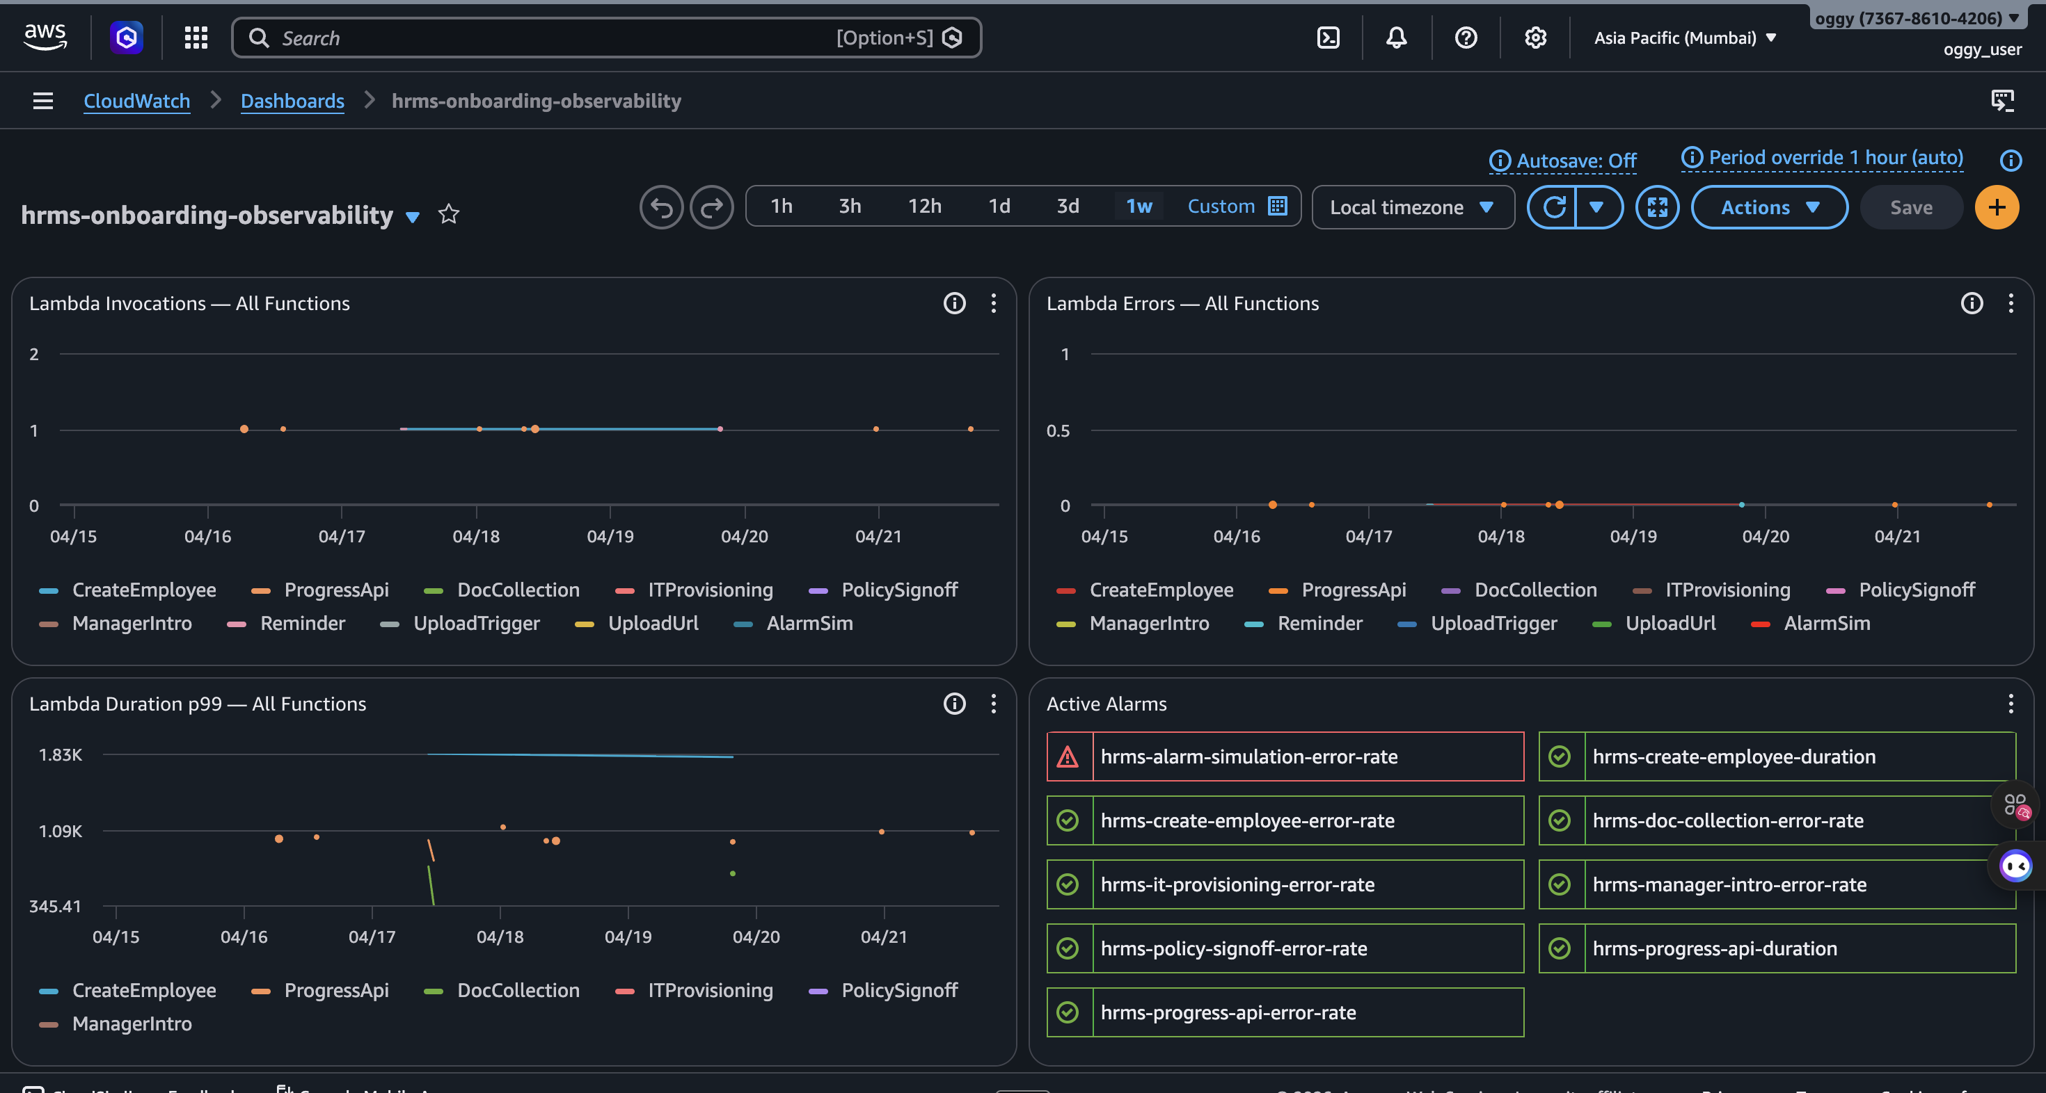
OnboardIQ
OBSERVABILITY
CloudWatch Dashboard — Live
hrms-onboarding-observability · 4 widgets · all Lambda functions · ap-south-1
Dashboard: Lambda Invocations · Lambda Errors · p99 Duration · Active Alarms — all 12 alarms green except demo alarm

Slide 16
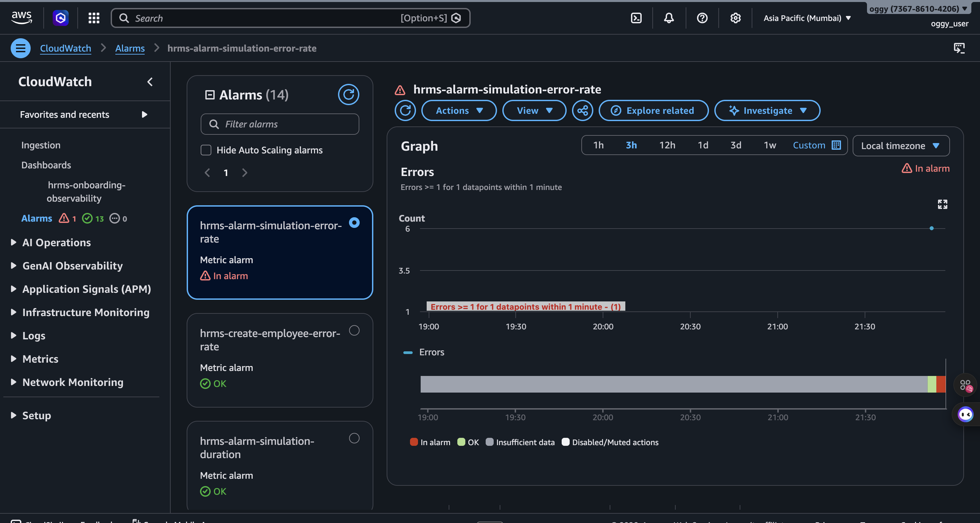
OnboardIQ
ALARM DEMO
Triggered Alarm Demo
hrms-alarm-simulation-error-rate · ALARM state · 6 deliberate errors fired
Alarm triggered at 21:30 IST · 6 errors > threshold of 1 · state: OK → ALARM · SNS email dispatched automatically

Slide 17
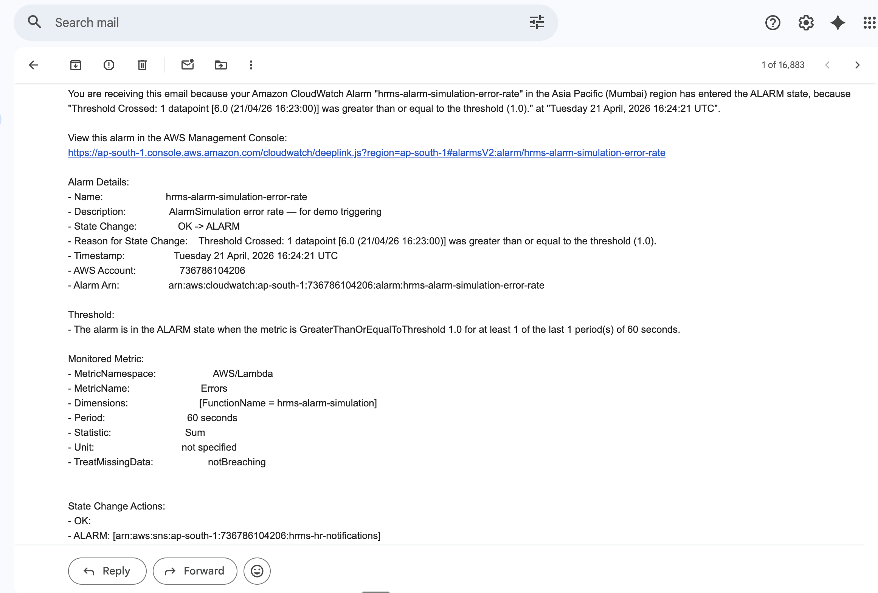
OnboardIQ
ALERT EMAIL
SNS Alarm Email — Received
AWS CloudWatch → SNS → adilk81054@gmail.com · state change OK → ALARM
Email received at 16:24:21 UTC · Alarm: hrms-alarm-simulation-error-rate · SNS Topic: hrms-hr-notifications · Account: 736786104206

Slide 18
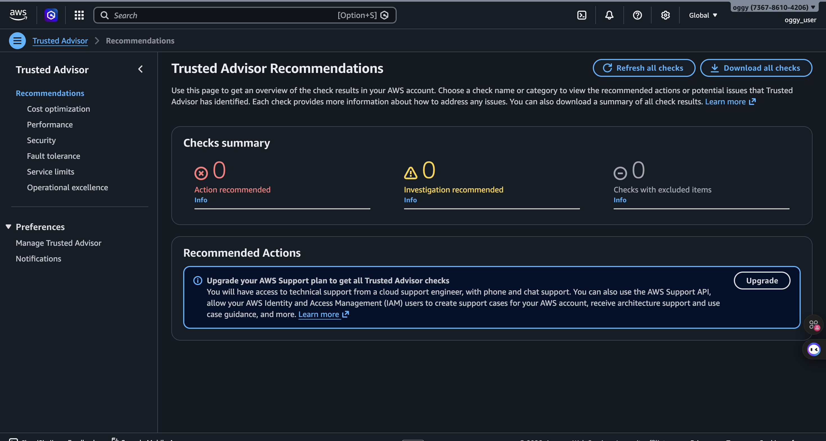
OnboardIQ
SECURITY
AWS Trusted Advisor
Free checks run — 0 critical findings · all security posture checks passed
Basic support plan: full check suite requires Business/Enterprise plan · S3 public access blocked · DynamoDB SSE enabled · IAM scoped

Slide 19
OnboardIQ
IAM AUDIT
IAM Security Hardening
Before & after — SES permissions scoped across all Lambda functions.
BEFORE — Overly broad
AFTER — Least privilege
hrms-stage-document-collection
hrms-stage-document-collection
ses:SendEmail / ses:SendRawEmail · Resource: '*'
ses:SendEmail / ses:SendRawEmail · arn:aws:ses:<region>:<account>:identity/*
hrms-create-employee
hrms-create-employee
ses:SendEmail / ses:SendRawEmail · Resource: '*'
ses:SendEmail / ses:SendRawEmail · arn:aws:ses:<region>:<account>:identity/*
hrms-stage-it-provisioning
hrms-stage-it-provisioning
ses:SendEmail / ses:SendRawEmail · Resource: '*'
ses:SendEmail / ses:SendRawEmail · arn:aws:ses:<region>:<account>:identity/*
hrms-stage-policy-signoff
hrms-stage-policy-signoff
ses:SendEmail / ses:SendRawEmail · Resource: '*'
ses:SendEmail / ses:SendRawEmail · arn:aws:ses:<region>:<account>:identity/*
hrms-stage-manager-intro
hrms-stage-manager-intro
ses:SendEmail / ses:SendRawEmail · Resource: '*'
ses:SendEmail / ses:SendRawEmail · arn:aws:ses:<region>:<account>:identity/*
hrms-send-reminder
hrms-send-reminder
ses:SendEmail / ses:SendRawEmail · Resource: '*'
ses:SendEmail / ses:SendRawEmail · arn:aws:ses:<region>:<account>:identity/*
hrms-document-upload-trigger
hrms-document-upload-trigger
ses:SendEmail / ses:SendRawEmail · Resource: '*'
ses:SendEmail / ses:SendRawEmail · arn:aws:ses:<region>:<account>:identity/*
Also added: xray:PutTraceSegments + xray:PutTelemetryRecords on all Lambdas · Cognito + Step Functions were already resource-scoped ✓

Slide 20
OnboardIQ
COST
Cost Estimate — 50 Users / Day
All services itemised · ap-south-1 · April 2026 · includes observability layer.
Service
Monthly Usage
Cost
Pricing Basis
Lambda
31,000 invocations/mo
$0.00
Within 400K GB-s free tier
API Gateway
~4,650 requests/mo
$0.02
$3.50 per million requests
DynamoDB
~231K reads + writes
$0.42
On-demand · SSE enabled
S3
150 uploads · 300MB
$0.01
$0.025/GB · versioning on
SES
12,000 emails/mo
$1.20
$0.10 per 1,000 emails
Cognito
50 MAUs
$0.00
First 50,000 MAU free
Step Functions
30,000 transitions/mo
$0.65
$0.000025 per transition
CloudWatch
Logs + Dashboard + Alarms
$4.45
1 dashboard $3 · 12 alarms $1.20
X-Ray
31,000 traces/mo
$0.00
Within 100K free-tier traces
SNS
~200 notifications/mo
$0.00
First 1M free
Total monthly cost at 50 users/day:
~$6.75 / month
X-Ray + CloudWatch observability included

