Slide 1
Lecture 9
Version control with Git

Slide 2
Problems Working Alone
Ever done one of the following?
  Had code that worked, made a bunch of changes and saved it, which broke the code, and now you just want the working version back…
  Accidentally deleted a critical file, hundreds of lines of code gone…
  Somehow messed up the structure/contents of your code base, and want to just “undo” the crazy action you just did
  Hard drive crash!!!! Everything’s gone, the day before deadline.
Possible options:
  Save as (MyClass-v1.java)
    Ugh. Just ugh. And now a single line change results in duplicating the entire file…

Slide 3

On a single project, a team of software engineers work together toward a release
All team members work on the same code and develop their respective parts
An engineer may be responsible for an entire class
Or just a few methods within a particular class

Slide 4
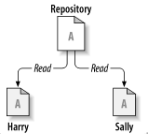
Files have to be shared among developers on a team project
Shared files can be kept in some type of Repository where they can be accessed and worked on by multiple individuals
Harry and Sally get their own respective
local Working Copies of the Master File in the Repository

Slide 5
What might you use for a Repository?
Would any of these work?
USB/SD drive
Private network drive
  E.g. shared “X:” drive
Cloud drive
  Google drive
  Dropbox
  iCloud
Image: http://svnbook.red-bean.com/

Slide 6
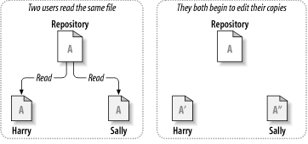
Sharing files can lead to big problems…
Adds some method
Modifies some other method
Image: http://svnbook.red-bean.com/

Slide 7
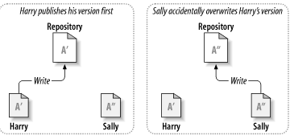
The problem to avoid:
Harry’s changes are still held locally…
Image: http://svnbook.red-bean.com/

Slide 8
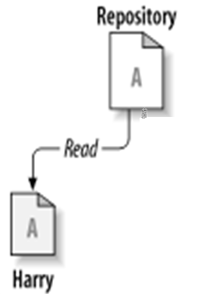
Harry’s changes are lost
‘’
Harry’s local file gets overwritten with
Sally’s latest changes.
‘’
Image: http://svnbook.red-bean.com/

Slide 9
The Issue: Effective management of software artifacts, especially code
Some acronyms:
SCM – Source Code Management
SCCM – Source Code Configuration Management
RCS – Revision Control System
VCS – Version Control System
DVCS - Distributed Version Control Systems

Slide 10
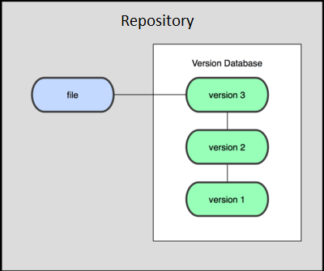
Revision/Version History might help
…but USB/SD, private network drives do not maintain revision history
Cloud drives (e.g. Google Drive, Dropbox, iCould/Time Machine) maintain a (limited) history of the various revisions of a file
  Google Drive: keeps last 100 revisions or last 30 days
    Supported in “Classic” mode only – going away?
IF you detect a collision, you can manually merge the differences and resynchronize your work
  Might be workable for two people – what about 5 or 10?

Slide 11
Any other disadvantages to
Google Drive/Dropbox/iCloud
Security?
Support (bug fixes and new features)?
Ownership of stored information?
Cost?
Ease of Use?
Acceptance?

Slide 12
Special-purpose Revision Control Systems have been around a lot longer than Google Drive or Dropbox
SCCS, 1972 (IBM)
RCS, 1982 (Unix)
  SourceSafe 1995 (Microsoft)
CVS, 1986 (multi-platform)
SVN, 2000 (multi-platform)
Git and Mercurial, 2005 (multi-platform)
The way these work has evolved over the years

Slide 13
Features of version control systems
All changes to a file are tracked
  Version histories show who, what, when
Changes can be reverted (rewound to any earlier version)
Changes between revisions are easy to identify

Slide 14
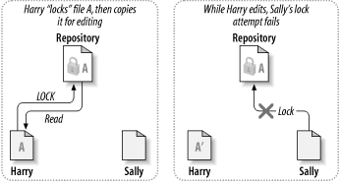
The Lock-Modify-Unlock solution
Early systems followed this model (RCS, SourceSafe)
Sally must wait until Harry releases the lock,
although she can retrieve a “readonly”
version of the file in the meantime.
Image: http://svnbook.red-bean.com/

Slide 15
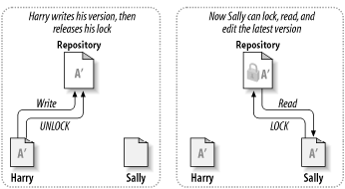
Lock-Modify-Unlock only allows a single user to edit the file at a time
Sally must continually poll the system to
see if the file has been unlocked, or Harry
needs to tell her when he unlocks it.
Image: http://svnbook.red-bean.com/

Slide 16
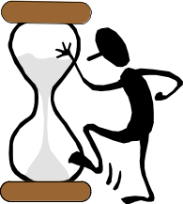
Lock-Modify-Unlock has certain drawbacks:
Harry has to remember to release his lock before Sally (or anyone else) can acquire the lock in order to edit
Sally has to wait for Harry to finish before editing (editing must be done sequentially)
  Harry might be adding some new methods (takes a long time)
  Harry might forget to release the lock before going home (or on vacation!)

Slide 17
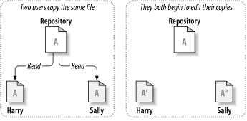
The Copy-Modify-Merge solution allows concurrent editing
CVS, SVN use this model
Harry adds new methods
Sally adds
comments
Image: http://svnbook.red-bean.com/

Slide 18
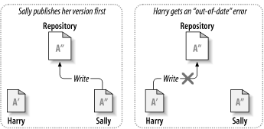
The Repository recognizes conflicts
Harry is prevented from writing
Image: http://svnbook.red-bean.com/

Slide 19
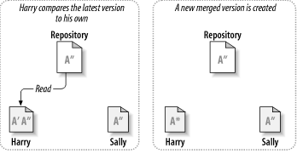
Conflicting versions of the files are merged
Conflicts are automatically resolved in many cases using robust merging algorithms.
However, manual merging is sometimes necessary and can introduce errors.
Image: http://svnbook.red-bean.com/

Slide 20
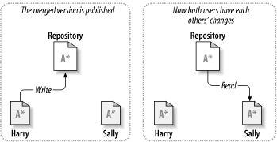
The Repository keeps both users synchronized
Image: http://svnbook.red-bean.com/

Slide 21


Copy-Modify-Merge is generally easy to use and manage
Users can work in parallel
Most of the time, concurrent changes don’t overlap
  People generally don’t edit exactly the same code simultaneously, so merging is done automatically in many cases
  Amount of time spent resolving conflicts is nearly always less than the time that would be spent waiting for a lock to be released

Slide 22
The benefit of CVCS (Centralized Version Control Systems) makes collaboration amongst developers along with providing an insight to a certain extent on what everyone else is doing on the project. It allows administrators to fine-grained control over who can do what.
It has some downsides as well which led to the development of DVS. The most obvious is the single point of failure that the centralized repository represents if it goes down during that period collaboration and saving versioned changes is not possible. What if the hard disk of the central database becomes corrupted, and proper backups haven’t been kept? You lose absolutely everything.

Slide 23
Subversion’s main drawback is the centralized nature of the Repository
A repository is typically hosted on a server.
Version history is on the server, not on your local PC
If the server or network become unavailable, everyone gets stuck with the working copy they have.
Image: http://svnbook.red-bean.com/

Slide 24
Distributed Version Control Systems
: Distributed version control systems contain multiple repositories. Each user has their own repository and working copy. Just committing your changes will not give others access to your changes. This is because commit will reflect those changes in your local repository and you need to push them in order to make them visible on the central repository. Similarly, When you update, you do not get others’ changes unless you have first pulled those changes into your repository.

Slide 25
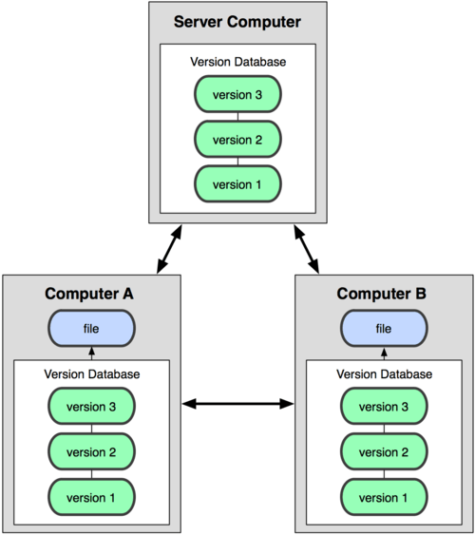
Distributed Version Control
A “remote master” repository is typically hosted on a server.
Clones of the remote repository are maintained on each user’s computer
If the server goes down, users can continue sharing code (provided they can connect over a network) by synch’ing to each others’ repositories
If the network is unavailable, users can continue reading & writing to their own local repository – synch’ing with others later
Git and Mercurial use this model
Image: http://git-scm.com/book/

Slide 26
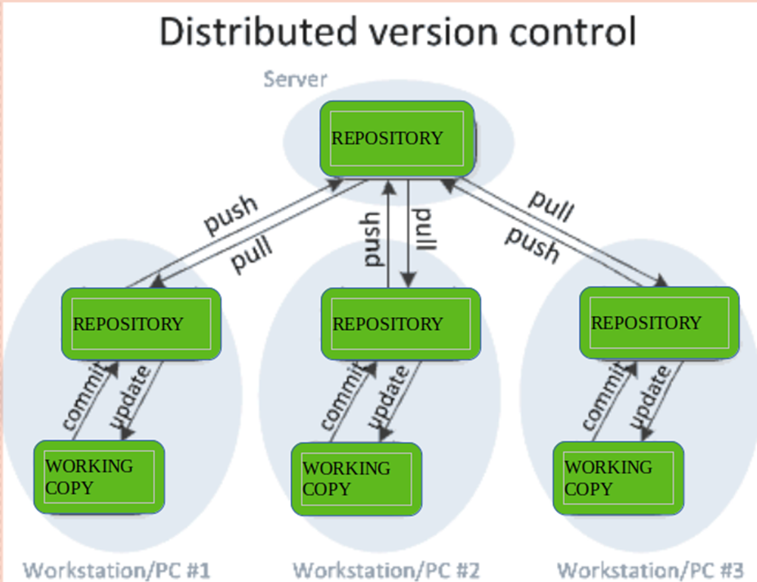
The most popular distributed version control systems are Git, and Mercurial. They help us overcome the problem of single point of failure.

Slide 27
Repositories
Repository (aka “repo”): a location storing a copy of all files.
  you don't edit files directly in the repo;
  you edit a local working copy or “working tree”
  then you commit your edited files into the repo
There may be only one repository that all users share (CVS, Subversion)
Or each user could also have their own copy of the repository (Git, Mercurial)
Files in your working directory must be added to the repo in order to be tracked.

Slide 28
What to put in a Repo?
Everything needed to create your project:
  Source code (Examples: .java, .c, .h, .cpp )
  Build files (Makefile, build.xml)
  Other resources needed to build your project: icons, text etc.
Things generally NOT put in a repo (these can be easily re-created and just take up space):
  Object files (.o)
  Executables (.exe)

Slide 29
Git Resources
At the command line: (where <verb> = config, add, commit, etc.)
$ git help <verb>
$ git <verb> --help
$ man git-<verb>
Free on-line book: https://git-scm.com/book/en/v2
Git tutorial: http://schacon.github.com/git/gittutorial.html
Reference page for Git: http://gitref.org/index.html
Git website: http://git-scm.com/
Git for Computer Scientists: http://eagain.net/articles/git-for-computer-scientists/

Slide 30
History of Git
Came out of Linux development community
Linus Torvalds, 2005
Initial goals:
  Speed
  Support for non-linear development (thousands of parallel branches)
  Fully distributed
  Able to handle large projects like Linux efficiently
Notes:
Initial goals were to support development of Linux

Slide 31
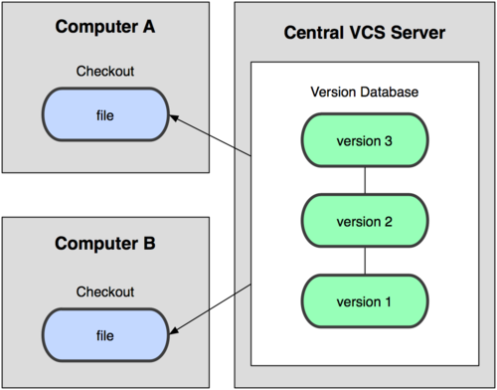
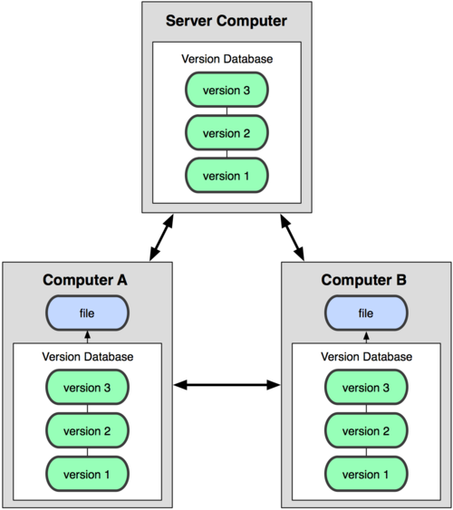
Git uses a distributed model
Centralized Model
Distributed Model
(CVS, Subversion, Perforce)
(Git, Mercurial)
Result: Many operations are local
Notes:
http://git-scm.com/book/en/Getting-Started-About-Version-Control

Slide 32

A Local Git project has three areas
Unmodified/modified
Files
Staged
Files
Committed
Files
Note: working directory sometimes called the “working tree”, staging area sometimes called the “index”.

Slide 33
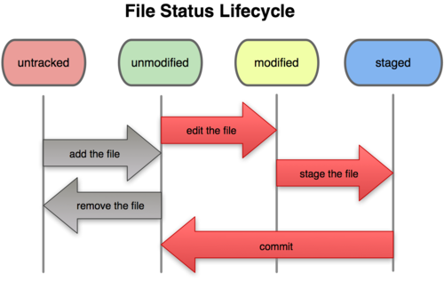
Git file lifecycle

Slide 34
Basic Workflow
Basic Git workflow:
Modify files in your working directory.
Stage files, adding snapshots of them to your staging area.
Do a commit, which takes the files as they are in the staging area and stores that snapshot permanently to your local Git directory (your local copy of the repo).
Notes:
  If a particular version of a file is in your local git directory, it’s considered committed.
  If it’s modified but has been added to the staging area, it is staged.
  If it was changed since it was checked out but has not been staged, it is modified.

Slide 35
Get ready to use Git!
Set the name and email for Git to use when you commit:
  $ git config --global user.name “Bugs Bunny”
  $ git config --global user.email bugs@gmail.com
  You can call git config –-list to verify these are set.
  These will be set globally for all Git projects you work with.
  You can set variables on a project-only basis by not using the --global flag.
The latest version of git will also prompt you that push.default is not set, you can make this warning go away with:
  $ git config --global push.default simple
You can also set the editor used for writing commit messages:
$ git config --global core.editor emacs (it is vim by default)
vim tips: “a” add, “esc” when done adding, “wq:” to save and quit
vim editor: http://www.gentoo.org/doc/en/vi-guide.xml
vim ref card: http://tnerual.eriogerg.free.fr/vimqrc.pdf

Slide 36
Create a local copy of a repo
Two common scenarios: (only do one of these)
  To clone an already existing repo to your current directory:
$ git clone <url> [local dir name]
This will create a directory named local dir name, containing a working copy of the files from the repo, and a .git directory which you can ignore (used to hold the staging area and your local repo)
Example: git clone git@gitlab.cs.washington.edu:rea/superTest.git
    To create a Git repo in your current directory:
    $ git init
    This will create a .git directory in your current directory which you can ignore (used to hold the staging area and your local repo).
    Then you can commit files in your current directory into the local repo:
    $ git add file1.java
    $ git commit –m “initial project version”

Slide 37
Git commands
command | description
git clone url [dir] | copy a git repository so you can add to it
git add files | adds file contents to the staging area
git commit | records a snapshot of the staging area
git status | view the status of your files in the working directory and staging area
git diff | shows diff of what is staged and what is modified but unstaged
git help [command] | get help info about a particular command
git pull | fetch from a remote repo and try to merge into the current branch
git push | push your new branches and data to a remote repository
others: init, reset, branch, checkout, merge, log, tag

Slide 38
Adding & Committing files
The first time we ask a file to be tracked, and every time before we commit a file we must add it to the staging area:
$ git add README.txt hello.java
This takes a snapshot of these files at this point in time and adds it to the staging area.
  Note: To unstage a change on a file before you have committed it:
  $ git reset HEAD filename
To move staged changes into the local repo we commit:
$ git commit –m “Fixing bug #22”
Note: You can edit your most recent commit message (if you have not pushed your commit yet) using: git commit –-amend
Note: These commands are just acting on your local version of repo.
Notes:
Note: To unstage a change on a file before you have committed it:
$ git reset HEAD filename
Note: To unmodify a modified file:
$ git checkout -- filename

Slide 39
Status and Diff
To view the status of your files in the working directory and staging area:
$ git status or
$ git status –s
(-s shows a short one line version)
To see difference between your working directory and the staging area (This shows what is modified but unstaged):
$ git diff
To see difference between the staging area and your local copy of the repo (This shows staged changes): (--staged is synonymous)
$ git diff --cached
Notes:
Git diff HEAD will show diff between working tree and staging area vs. the repo

Slide 40
After editing a file…
$emacs rea.txt
$ git status
# On branch master
# Changes not staged for commit:
# (use "git add <file>..." to update what will be committed)
# (use "git checkout -- <file>..." to discard changes in working directory)
#
# modified: rea.txt
#
no changes added to commit (use "git add" and/or "git commit -a")
$ git status -s
M rea.txt ← Note: M is in second column = “working tree”
$ git diff ← Shows modifications that have not been staged.
diff --git a/rea.txt b/rea.txt
index 66b293d..90b65fd 100644
--- a/rea.txt
+++ b/rea.txt
@@ -1,2 +1,4 @@
Here is rea's file.
+
+One new line added.
$ git diff --cached ← Shows nothing, no modifications have been staged yet.
$

Slide 41
After adding file to staging area…
$ git add rea.txt
$ git status
# On branch master
# Changes to be committed:
# (use "git reset HEAD <file>..." to unstage)
#
# modified: rea.txt
#
$ git status -s
M rea.txt ← Note: M is in first column = “staging area”
$ git diff ← Note: Shows nothing, no modifications that have not been staged.
$ git diff --cached ← Note: Shows staged modifications.
diff --git a/rea.txt b/rea.txt
index 66b293d..90b65fd 100644
--- a/rea.txt
+++ b/rea.txt
@@ -1,2 +1,4 @@
Here is rea's file.
+
+One new line added.

Slide 42
Viewing logs
To see a log of all changes in your local repo:
$ git log or
$ git log --oneline (to show a shorter version)
  1677b2d Edited first line of readme
  258efa7 Added line to readme
  0e52da7 Initial commit
git log -5 (to show only the 5 most recent updates, etc.)
Note: changes will be listed by commitID #, (SHA-1 hash)
Note: changes made to the remote repo before the last time you cloned/pulled from it will also be included here

Slide 43
Pulling and Pushing
Good practice:
Add and Commit your changes to your local repo
Pull from remote repo to get most recent changes (fix conflicts if necessary, then add and commit those changes to your local repo)
Push your changes to the remote repo
To fetch the most recent updates from the remote repo into your
local repo, and put them into your working directory:
$ git pull origin master
To push your changes from your local repo to the remote repo:
$ git push origin master
Notes: origin = an alias for the URL you cloned from
master = the remote branch you are pulling from/pushing to,
(the local branch you are pulling to/pushing from is your current branch)
Notes:
$ git remote -v
origin https://github.com/rea2000/santalist.git (fetch)
origin https://github.com/rea2000/santalist.git (push)

Slide 44
Avoiding Common Problems
From CSE 331: http://courses.cs.washington.edu/courses/cse331/18wi/tools/versioncontrol.html#git-pitfalls
Do not edit the repository (the .git directory) manually. It wasn't designed for modifications by humans.
Try not to make many drastic changes at once. Instead, make multiple commits, each of which has a single logical purpose. This will minimize merge conflicts. This is good coding practice in general.
Always git pull before editing a file. It's easy to forget this. If you forget, you may end up editing an outdated version, which can cause nasty merge conflicts.
Don't forget git push after you have made and committed changes. They are not copied to the remote repository until you do a push.

Slide 45
Branching
To create a branch called experimental:
$ git branch experimental
To list all branches: (* shows which one you are currently on)
$ git branch
To switch to the experimental branch:
$ git checkout experimental
Later on, changes between the two branches differ, to merge changes from experimental into the master:
$ git checkout master
$ git merge experimental
Note: git log --graph can be useful for showing branches.
Note: These branches are in your local repo!

Slide 46
SVN vs. Git
SVN:
  central repository approach – the main repository is the only “true” source, only the main repository has the complete file history
  Users check out local copies of the current version
Git:
  Distributed repository approach – every checkout of the repository is a full fledged repository, complete with history
  Greater redundancy and speed
  Branching and merging repositories is more heavily used as a result

Slide 47
Wrap-up
You *will* use version control software when working on projects, both here and in industry
  Rather foolish not to
  Advice: just set up a repository, even for small projects, it will save you time and hassle
HW9 (Git) has more details and walks you through creating a Git repo and adding to a shared repo.

