Slide 1
Case Study from Indian E-Commerce Customer
Customer satisfaction is most important factor that guarantee success of online E- commerce store
Important key to stimulate for Purchase & Re-Purchase intentions & customer loyalty
Five Major factors that success of each E-Commerce company Service, Quality, System Quality, Information quality , Trust and Benefit
Important things to Analysing the Customer Retention or Re-purchasing from different E-Commerce company

Slide 2
The important thing to Analyse the customer retention or re-purchasing the product from different E-commerce company like Amazon.in, Flipkart.com, Myntra.com, Paytm.com, Snapdeal.com.
E-commerce company providing different strategies like marketing and investing huge amount of money to increase sales and improve the good quality of products to the customer.
Based on the different factors like Offers Availability, Fast delivery, Return & Replacement option if customer not happy with the product, Refund Timeline , Payment option Availability, Data security there are number of factors that customer Re- purchase the product from different E-commerce site
Our project is to Analyse on what basis customer purchase the product from different E-commerce company and Re-Purchase the product.
We fetch some of the data from different E-Commerce website to analyse on what basis the customer purchase or Re-purchase the product from the E-commerce company.

Slide 3
Analysing the data from different E-Commerce site
We fetch some of the dataset from different E-Commerce company to analyse on what basis the customer Re-purchase the product from different E-Commerce company
In this dataset it have 269 Rows and 71 columns with different columns names

Slide 4
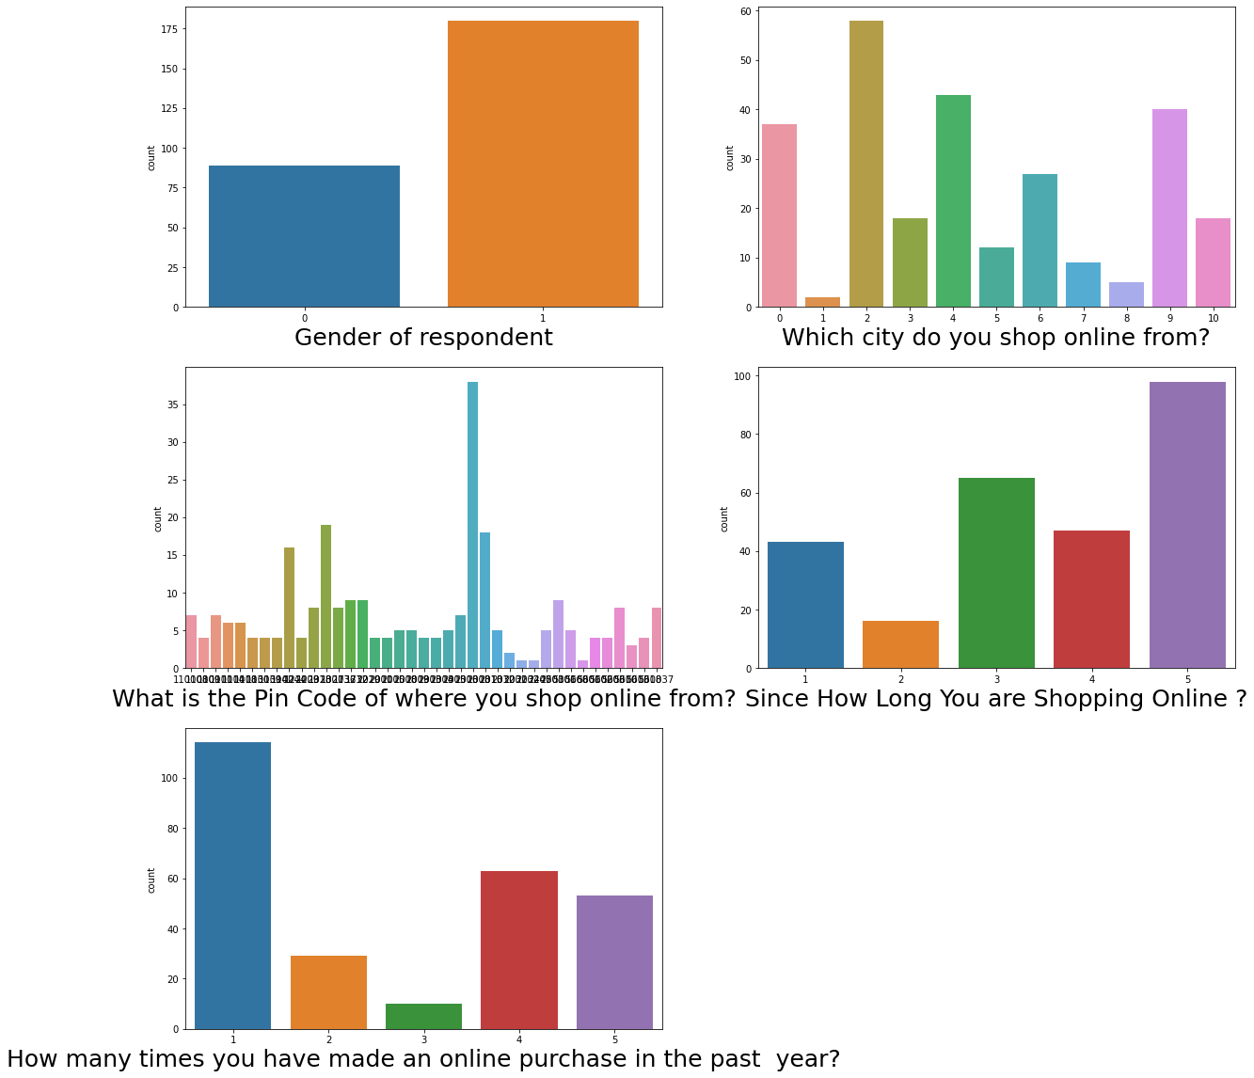
Customer Personal Information
Customer Personal information contains different columns like Gender, City, Pincode, From how many years customer shopping, how many times customer purchase online.
As per the Analysis it seems Female purchase more as compare with Male.
From city Delhi most of the people purchase online.
201308 Pincode has large number of online purchase.
Most of the customer purchasing online from past 5 years.
Minimum average of customer purchasing 5times in Year.

Slide 5
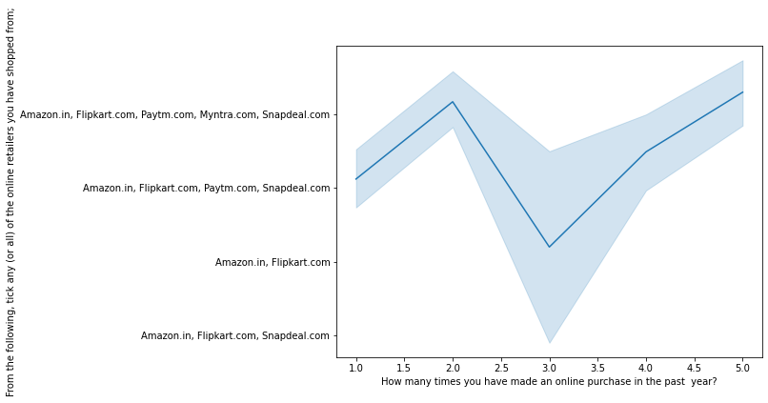
Customer purchasing details
Analysing the customer purchasing from different E-Commerce Company
Analysing from past few years from which E-commerce

Slide 6
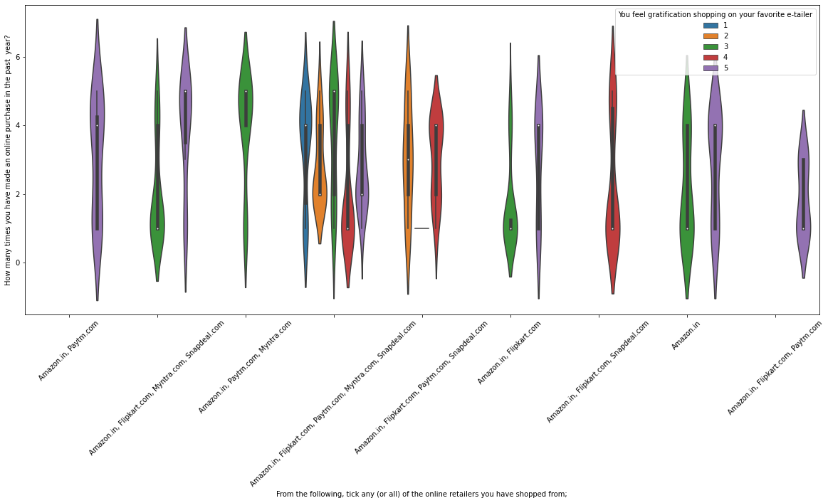
Customer Favourite Retailer
In this Analysis showing the customer Favourite retailer from where the customer purchasing online from past year
In this Analysis Different Retailer company like Amazon, Flipkart, Paytm, Snapdeal, & Myntra
In this Analysis most of the customer purchase the product from past year from Amazon & Flipkart

Slide 7
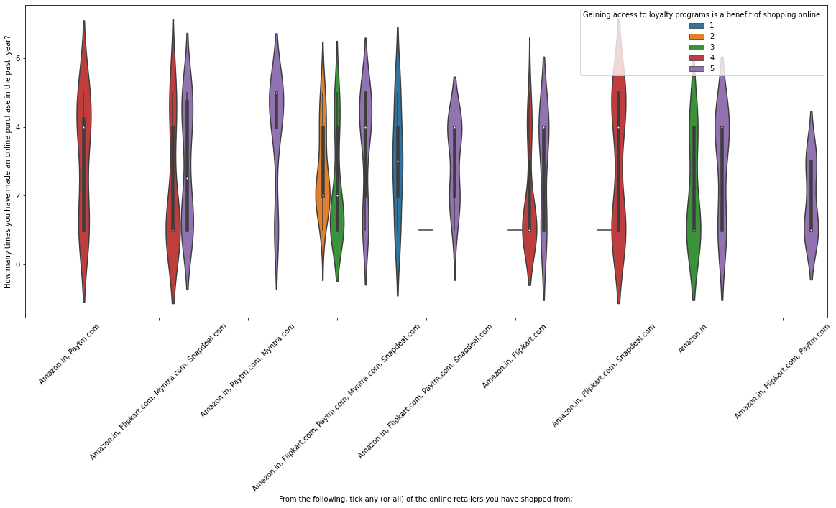
Customer Favourite Retailer
In this Analysis we checked from which favourite Retailer customer gaining benefits from Different E-Commerce company
Compare with different columns with customer Favourite retailer and the customer purchase from past year and the benefit gaining the offers from which E-commerce company
With this analysis we seen that from Amazon, Flipkart, Snapdeal, Paytm customer find the benefits from this E-commerce site

Slide 8
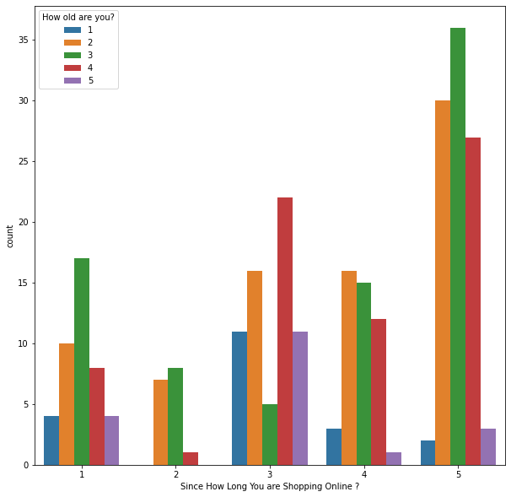
From how many years customer purchasing
We need to analyse from how many years customer purchasing online and how old the customer
From this Analysis customer purchasing online from the past 5 years at the Age of 35
At the Age of 35 customer purchasing online from past years

Slide 9
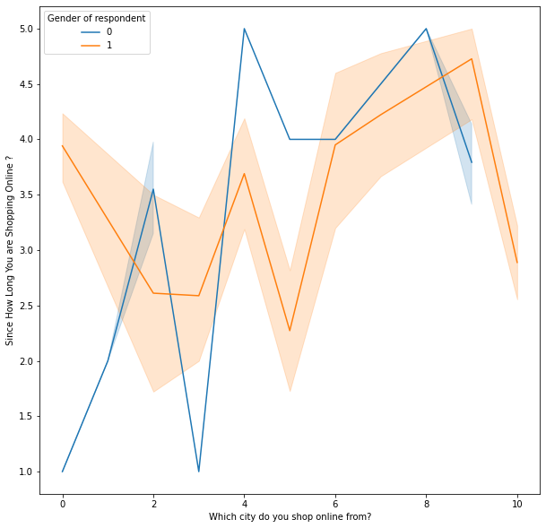
Customer purchase from different cities
Number of customers purchasing from different cities , In this Analysis we compare with Gender in which cities they purchase from pas years
In this Analysis it seems that in Delhi city most of the customer purchasing online
The female customer purchasing online more than Male from past years
Different cities have different analysis where compare with other cities Delhi has the high rating on online purchasing

Slide 10
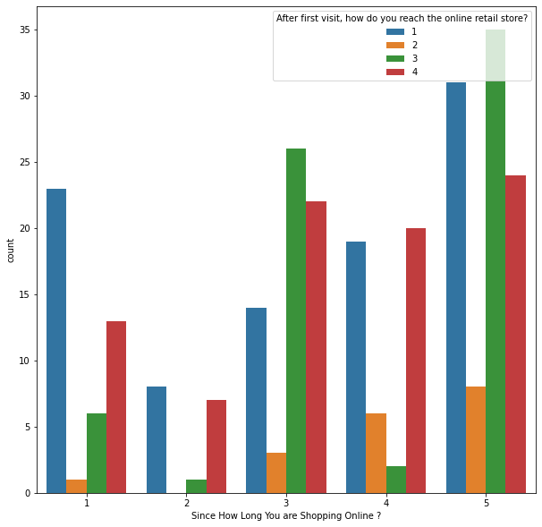
Customer First visit online E-commerce site
In this Analysis we check the number of customer purchasing online from past year and what they visit first time on retail store
From this Analysis most the customer who purchase from past 5 years first they visit Search Engine to search from the products

Slide 11
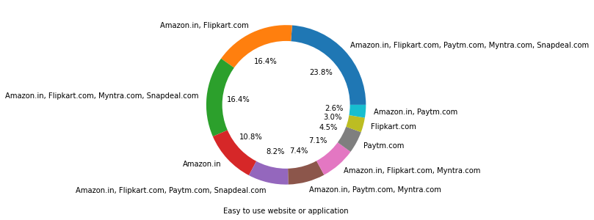
E-commerce website Performance
In this Analysis we check the Web site Application how it's easy to use
In this Analysis we seen that the E-Commerce company like Amazon, Flipkart, Snapdeal, Myntra and Paytm are very easy for customer to use

Slide 12
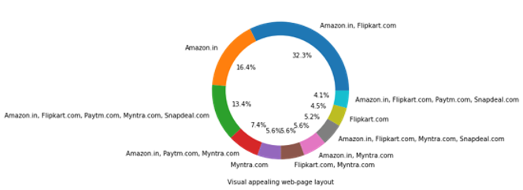
E-commerce website Performance
In this Analysis we check the E-commerce visual appealing web- Page Layout
In this Analysis we seen that Amazon and Flipkart has high rate of visual appealing web page Layout

Slide 13
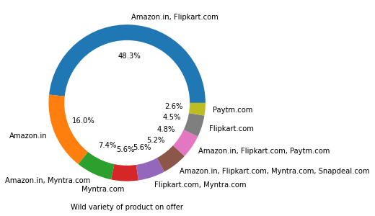
E-commerce website Performance
Ini this Analysis we check the E-commerce variety of product available on website
Through this Analysis we seen that Amazon and Flipkart has the high rate Variety of products available of E-commerce website

Slide 14
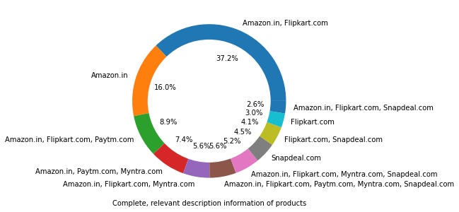
E-commerce website Performance
In this Analyse we check the on which E-commerce website has the complete relevant description information of products available
From this Analysis we seen that on the E-commerce website like Amazon and Flipkart has the high rating for complete and relevant information of products available

Slide 15
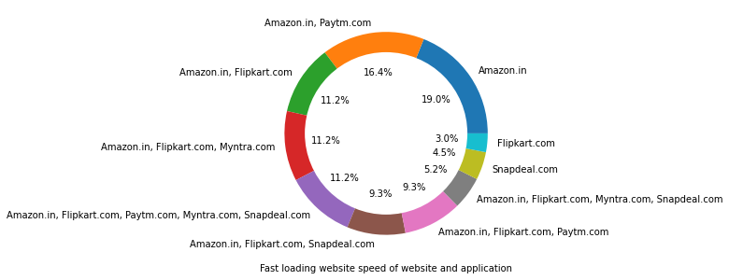
E-commerce website Performance
In this Analysis we check the E-commerce company website or Application has the fast loading page
From this Analysis we seen that E-commerce company like Amazon has the high fast page loading speed as compare with different E-commerce website or Application page loading speed

Slide 16
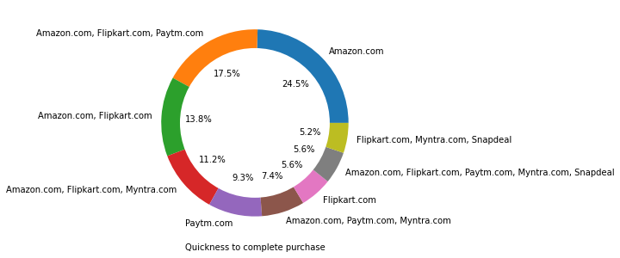
E-commerce website Performance
In this Analysis we checked E-commerce company has the Quickness to complete purchase
In this Analysis we seen that Amazon has the high rate of quick to complete purchase product

Slide 17
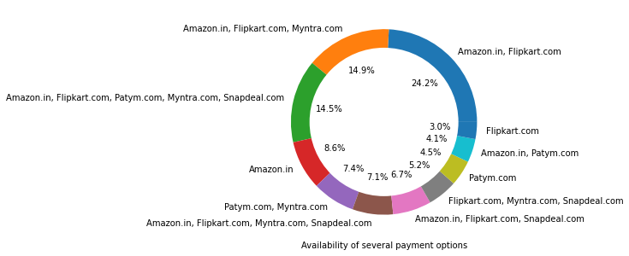
E-commerce website Performance
In this Analysis we checked the Availability of several Payment option on different E-commerce company website or Application had
We see that Amazon and Flipkart has the several payment option Availability

Slide 18
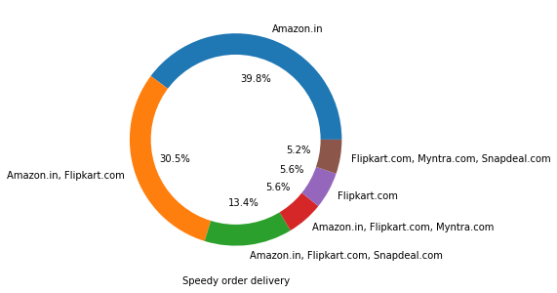
E-commerce website Performance
In this Analysis we checked which E-commerce has the high speed order delivery
We see that Amazon has high rate of speed order delivery as compare with other E-commerce company

Slide 19
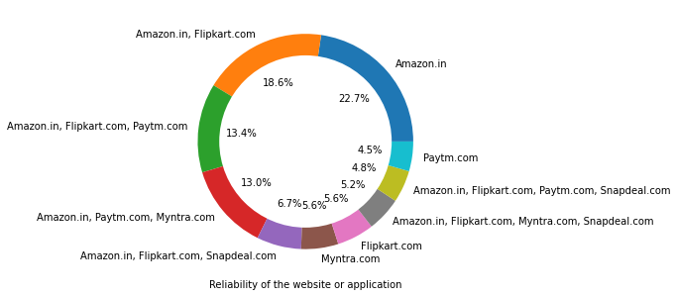
E-commerce website Performance
In this Analysis we checked which E-commerce company has the reliability of the website or Application
We see that Amazon has the high rate of reliability of the website or Application

Slide 20
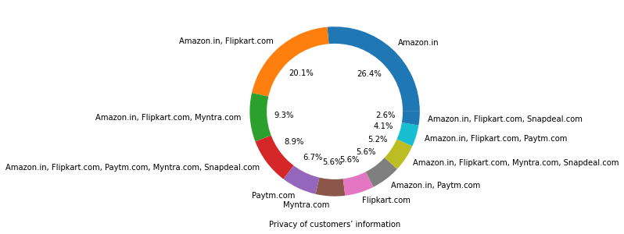
E-commerce website Performance
In this analysis we checked the E-commerce has the high rate of privacy of customer information
We see that Amazon E-commerce company has the high rate of security of privacy of customer information

Slide 21
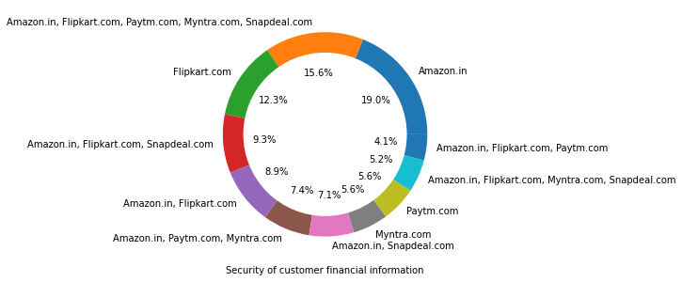
E-commerce website Performance
In this Analyse we checked which E-commerce has high security of customer financial information
We see that Amazon E-commerce company has the high security of customer financial information

Slide 22
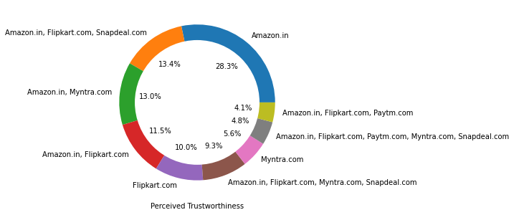
E-commerce website Performance
In this Analysis we checked which E-commerce company has the Perceived Trustworthiness
We see that Amazon E- commerce company has the high perceived trustworthiness as compare with other E-commerce Company

Slide 23
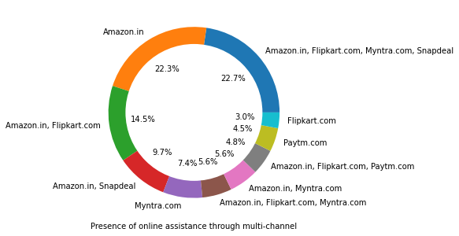
E-commerce website Performance
In this Analysis we checked which E-commerce company has the high Presence of online assistance through Multi-channel
We see that Amazon , Flipkart , Myntra and Snapdeal has the high presence of online assistance through multi-channel

Slide 24
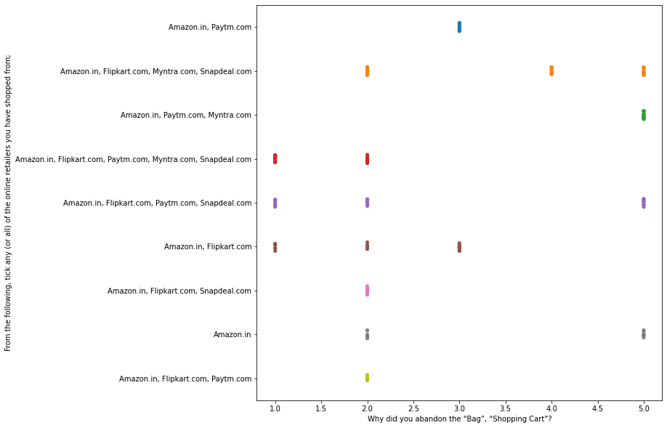
Customer Abandoned product from cart
In this Analysis we checked from which E-commerce company does the customer abandoned product from the cart
We see that from this analysis most of the customer abandoned product from each website there is no any particular E-commerce company has the high rate

Slide 25
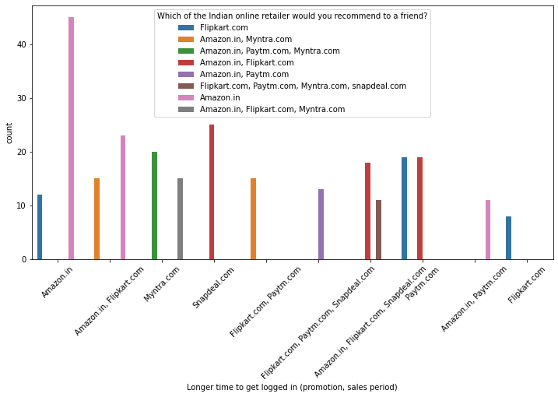
Negative thing about E-commerce company
In this Analysis we checked which E-commerce company has the longer time to get Logged in promotion or sales period
We see that Amazon E- commerce company has the high rate of issue of logged in while if there is any sales or any promotion period as compare with other E-commerce company has during the sales or promotion time

Slide 26
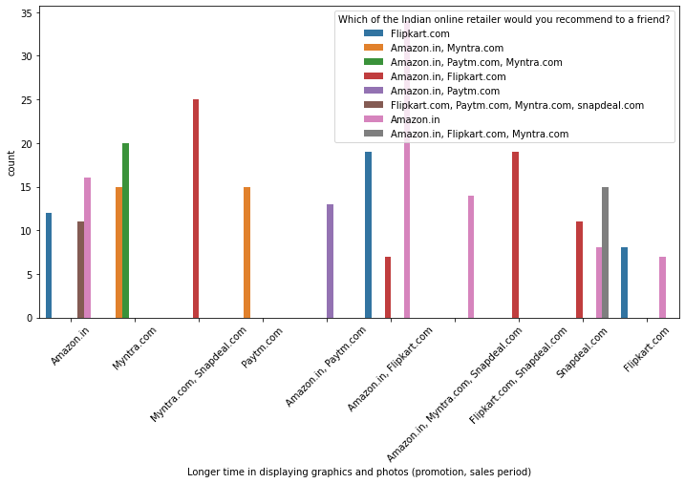
Negative thing about E-commerce company
In this Analysis we checked which E-commerce company has the Longer time in displaying graphics and product photos during sales or promotion time
We see that Amazon has the highest issue while displaying the product photos during the sales or promotion time as compare with other E-commerce company

Slide 27
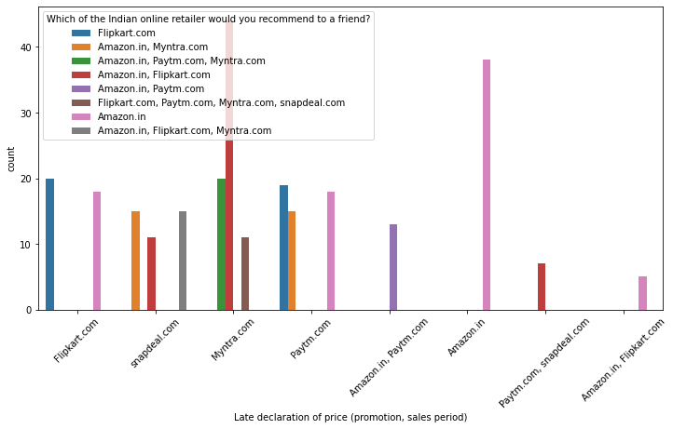
Negative thing about E-commerce company
In this Analysis we checked which E-commerce company has the Late declaration of price during sales or promotion time
We see that Amazon and Flipkart has the high rate of issue for displaying the price during the sales and promotion time

Slide 28
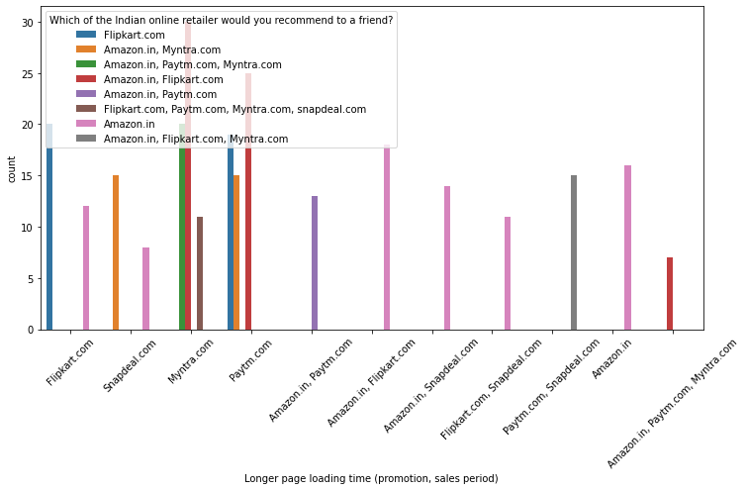
Negative thing about E-commerce company
In this Analysis we checked which E-commerce company has the Longer Page Loading during the sales or promotion time
We see that Amazon and Flipkart has the high issue rating for longer time taken to load the page during sales or promotion time

Slide 29
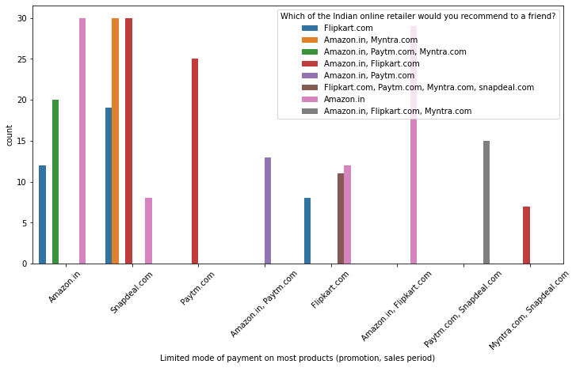
Negative thing about E-commerce company
In this Analysis we checked which E-commerce company has the limited Payment option during the sales or promotion time
We see that Amazon, Flipkart and Myntra E-commerce company has the issue with the limited payment option during sales and promotion time

Slide 30
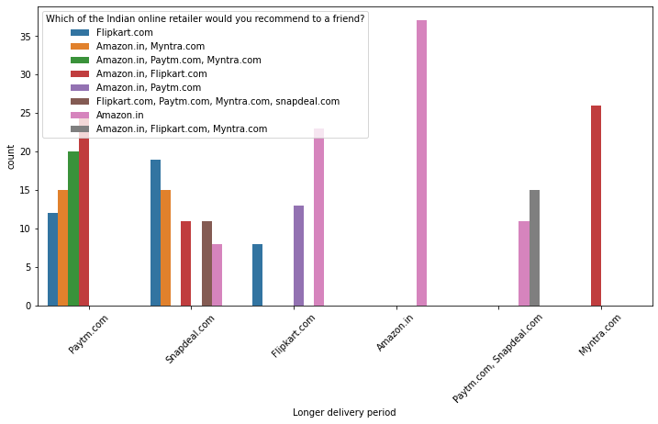
Negative thing about E-commerce company
In this Analysis we checked which company has the longer time for delivery product
We see that Amazon E-commerce company has taken the highest long delivery time as compare with other E-commerce company

Slide 31
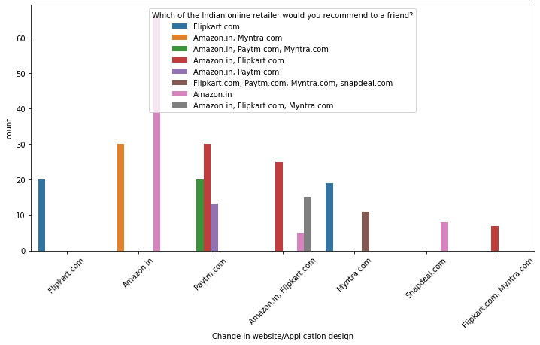
Negative thing about E-commerce company
In this Analysis we checked which E-commerce company has Changed in website/Application
We see that Amazon has the issue with changing the website or Application design change as compare with different E-commerce company

Slide 32
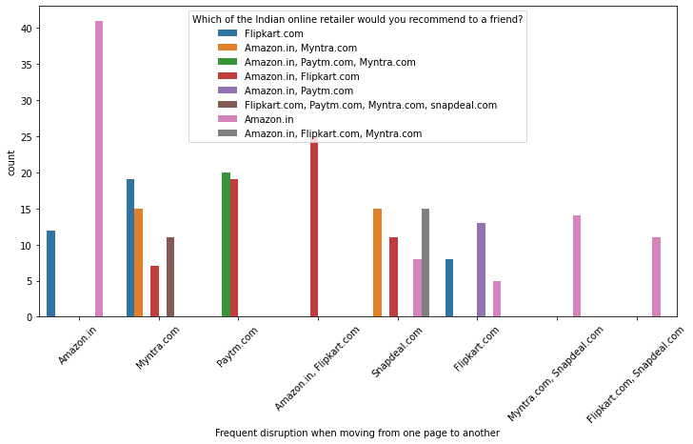
Negative thing about E-commerce company
In this Analysis we checked frequent disruption when moving from one page to another page
We see that Amazon the has the frequent disruption when moving from one page to another page

