Slide 1


Arsenal football club team stats database.
Aditya Bamidipati Lakshmana Murthy 13133638

Slide 2
About
The database is about the football team Arsenal’s squad statistics.
The tables are divided based on competitions, players, year, and individual player statistics for that season.
A season will have a set of players and there can also be players who have played for the club in different seasons (year).
There are multiple competitions but each competition will have its own set of player statistics.
Each player will have multiple statistics based on whether or not they have played in any competition.

Slide 3
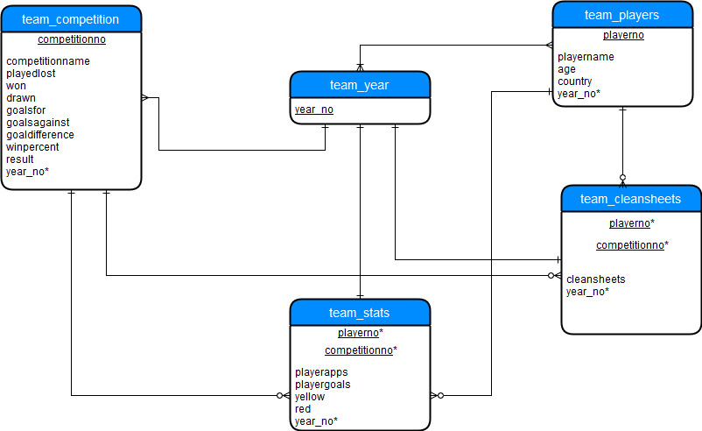
Entity Relationship Diagram

Slide 4
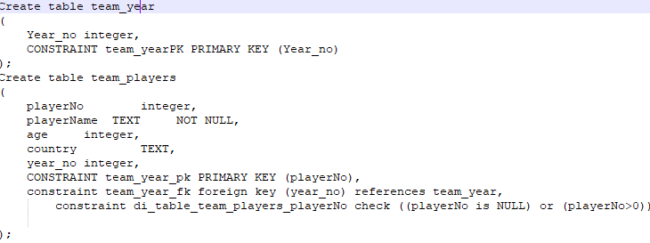
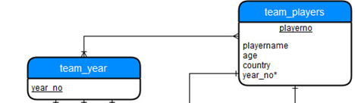
Many to Many relationship
The idea is that a year_no represents a season.
Each season will have a bunch of players representing the team.
Many players can also have represented the team in the years before this season and will represent the team in the coming seasons.
This creates a many to many relation.

Slide 5
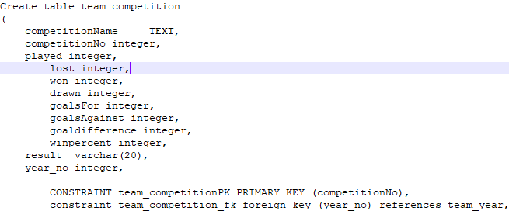
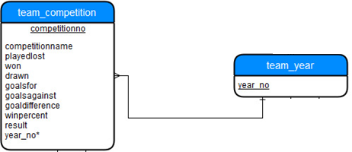
One to Many relationship
A season (year_no) can have many competitions but each competition’s stats will only belong to a particular year.
The season 2017 had five competitions. Each stat available for the competition will only belong to that particular season.

Slide 6
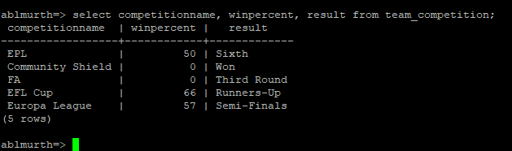
Simple query of a single table
Selecting competition name, win percent and result of competitions from table team_competition using command:
Select competitionname, winpercent, result from team_competition;

Slide 7
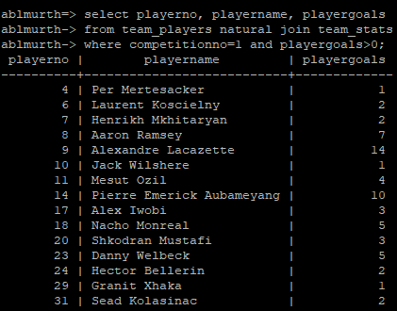
A query with natural join
Selecting player with at least one goals from the first competition:
Select playerno, playername, playergoals
from team_players natural join team_stats
where competitionno=1 and playergoals>0;

Slide 8
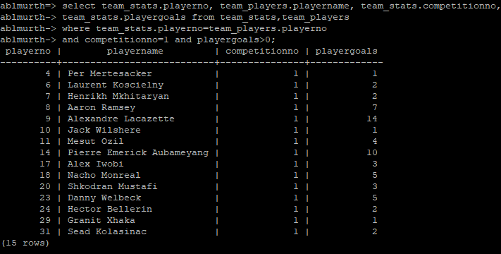
A cross product query equivalent to the query above
Code:
Select team_stats.playerno, team_players.playername, team_stats.competitionno, team_stats.playergoals from team_stats, team_players where team_stats.playerno=team_players.playerno
and competitionno=1 and playergoals>0;

Slide 9
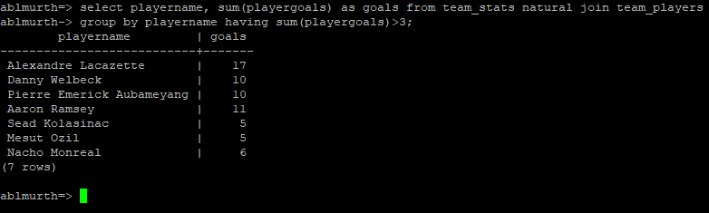
A query involving a “Group by”
Selecting players who’ve scored more than three goals in all competitions.
Select playername, sum(playergoals) as goals from team_stats natural join team_players group by playername having sum(playergoals)>3;

Slide 10
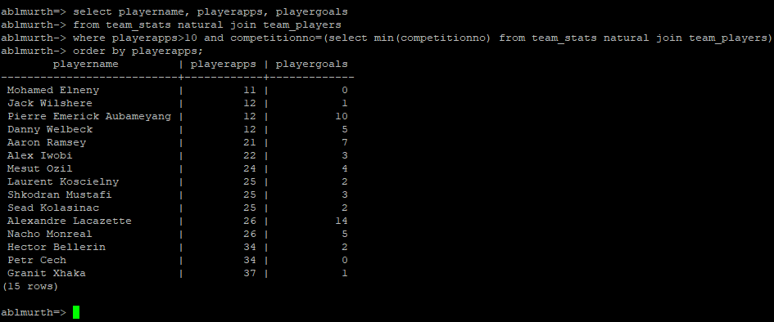
A query with sub query
Players who have played more than 10 games in the first competition.
Select playername, playerapps, playergoals from team_stats natural join team_players where playerapps>10 and competitionno=(select min(competitionno) from team_stats natural join team_players) order by playerapps;

Slide 11
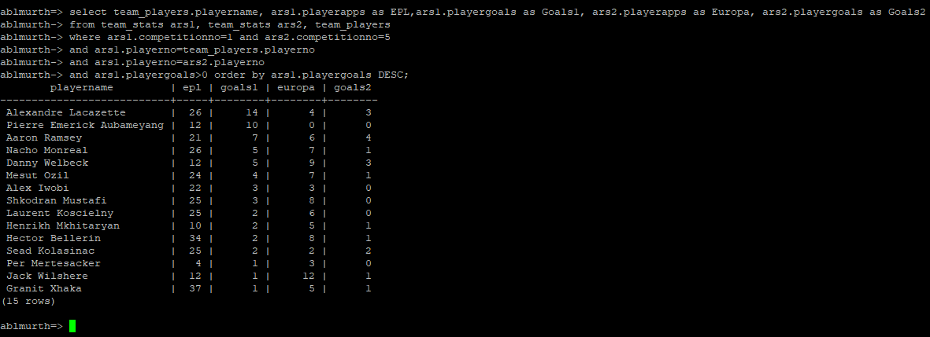
A cross product which cannot be implemented using the words “natural join”
Selecting players and the number of games they have played in EPL and Europa leagues and the number of goals scored in each competition. Players who have scored at least one goal in EPL only have been considered.
Select team_players.playername, ars1.playerapps as EPL, ars1.playergoals as goals1, ars2.playerapps as Europas, ars2.playergoals as goals2 from team_stats ars1, team_stats ars2, team_players where ars1.competitionno=1 and ars2.competitionno=5 and ars1.playerno=ars2.playerno and ars1.playerno=team_players.playerno and ars1.playergoals>0 order by ars1.playergoals DESC;

Slide 12

Check Statements
There are many integer values in the database, hence check constraints such as:
constraint di_table_team_players_playerNo check ((playerNo is NULL) or (playerNo>0)); and
constraint di_table_team_competition_goalsFor check (goalsFor>=0);
Constraint di_table_team_competition_goalsAgainst check (goalsAgainst>=0);
is used to ensure that integers are always either 0 or greater than 0.
In another instance, values such as goal difference cannot be logically incorrect. Given values of goals for as 12 and goals against as 10, the incorrect goaldifference value of 9 was given, which is wrong, hence the violation occurs. The constraint code:
constraint di_table_team_competition_goaldifference check (goaldifference=(goalsFor-goalsAgainst))

Slide 13


Action Statements
PostgreSQL gives the following actions;
ON DELETE RESTRICT - restrict deleting if the key is used as a foreign key
constraint team_year_fk foreign key (year_no) references team_year on delete restrict
CONSTRAINT team_statsFK_competition FOREIGN KEY(competitionNo) REFERENCES team_competition on delete restrict
ON DELETE CASCADE - allows to delete the key even though the value is referenced as a foreign key in another table
CONSTRAINT team_statsFK_players FOREIGN KEY(playerNo) REFERENCES team_players on delete cascade

Slide 14
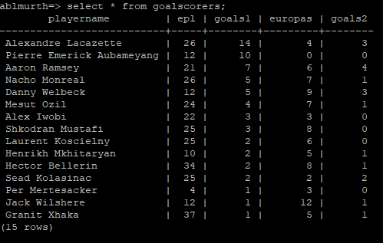
Use of views
View is a named query. It is used in complex queries which need to be used very frequently.
A view called goalscorers:Create view goalscorers as Select team_players.playername, ars1.playerapps as EPL, ars1.playergoals as goals1,ars2.playerapps as Europas, ars2.playergoals as goals2 from team_stats ars1, team_stats ars2, team_players where ars1.competitionno=1 and ars2.competitionno=5 and ars1.playerno=ars2.playerno and ars1.playerno=team_players.playerno and ars1.playergoals>0 order by ars1.playergoals DESC;

Slide 15
THANK YOU!

