Slide 1



Team
Promptzee
REBOOK
The Sustainable Book Cycle:
Buy & Sell Within Campus
PRESENTED BY:
Muhammed Adhil P P
Muhammad Shuhaibh
Nadha K M
28/02/2025

Slide 2


01 | Introduction
02 | Problem Statement
03 | Solution
04 | Key Features
05 | Benefits
06 | SDGs
07 | Technology Stack & Tools
08 | Future Enhancements
09 | Conclusion
INDEX

Slide 3

03/12
Introduction
ReBook is a buy-and-sell platform designed exclusively for our college students to exchange used academic books securely and affordably. By enabling students to resell their semester books, the platform reduces financial strain, minimizes waste, and promotes sustainable consumption.

Slide 4

Problem Statement
04/12
High Cost Of
Books
Wastage Of Resources
Lack Of a Dedicated Platform
Existing Marketplaces Are Not Ideal
Students spend a significant amount on new books every semester..
Unused books often remain idle or get discarded.
Platforms like OLX or Facebook Marketplace are too broad and not tailored to college students’ needs.
No structured system exists within the college for book exchange.

Slide 5


05/12
Solution
ReBook is a secure, college-exclusive platform that allows students to buy and sell used books at reduced prices. The website ensures transactions remain within the campus, fostering a trusted and convenient exchange process.

Slide 6

06/12
Reduces Book Costs Provides an affordable way for students to buy textbooks at a lower price. | Earn While You Sell Students can earn money by selling their used books, turning unused resources into extra income.
Promotes Reuse & Reduces Waste Encourages sustainability by extending the lifecycle of books. | Encourages a Sustainable Mindset Fosters responsible consumption habits among students.
Reduces Paper Waste Supports environmental sustainability by minimizing the demand for new book production. | Creates a Supportive Student Community Builds a network where students help each other by providing affordable learning resources.
Benefits
HOW IT BENEFITS STUDENTS & CAMPUS

Slide 7

07/12
Key Features
Student Authentication Only verified college students can access the platform.
Book Filtering & Sorting Students can sort books for sale according to price. filter based on subject, semester and department. Which makes easy browsing.
Simple & Secure Transactions Buyers and sellers connect through the platform and complete transactions offline within the college, ensuring a safe and hassle-free process.
Cost-Effective & Eco-Friendly Books are resold at less price, reducing financial strain on students while promoting sustainability by minimizing paper waste.

Slide 8


08/12
SDGs
How it aligns with sustainable development goals.
SDG 4
SDG 12
SDG 13
Quality Education
Makes textbooks more affordable, ensuring students from all financial backgrounds have access to learning resources.
Responsible Consumption & Production
Encourages book reuse, reducing waste and demand for new paper production.
Climate Action
Reduces deforestation and carbon footprint associated with book manufacturing.

Slide 9
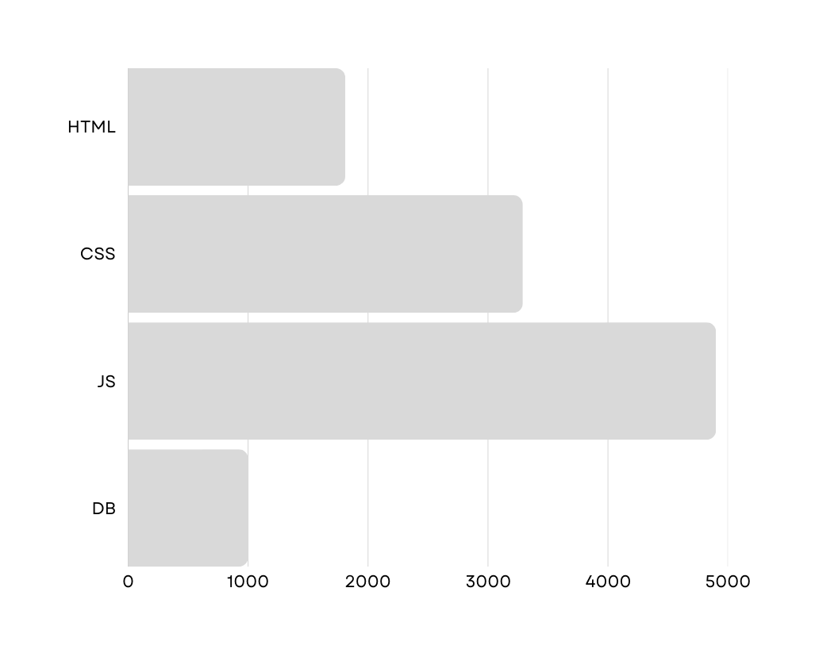
Technology Stack & Tools
09/12
Frontend
HTML, CSS
Backend
Node js
Database
MongoDB
Deployment
Local Host

Slide 10

Feature Enhancements
10/12
Mobile App Version
Expanding to a mobile app for better accessibility.
Automated Pricing Suggestions
AI-based pricing recommendations based on book condition and demand.
Expanded Categories
Including stationery, drawing tools, and expensive architectural tools like drafting kits, model-making materials, and engineering instruments to help architecture students reduce costs.

Slide 11
11/12
Conclusion
ReBook is an innovative, student-centric solution that promotes affordability, sustainability, and convenience in book exchange. By addressing financial and environmental concerns, the platform fosters a self-sustaining ecosystem within the college.

Slide 12
12/12
Thank you
CONTACT US
E-mail
rebook026@gmail.com
Social Media
instagram.com/rebook_rit
Phone
+91 9995005947
College
Rajiv Gandhi Institute of Technology, Kottayam
28/02/2025

