Slide 1
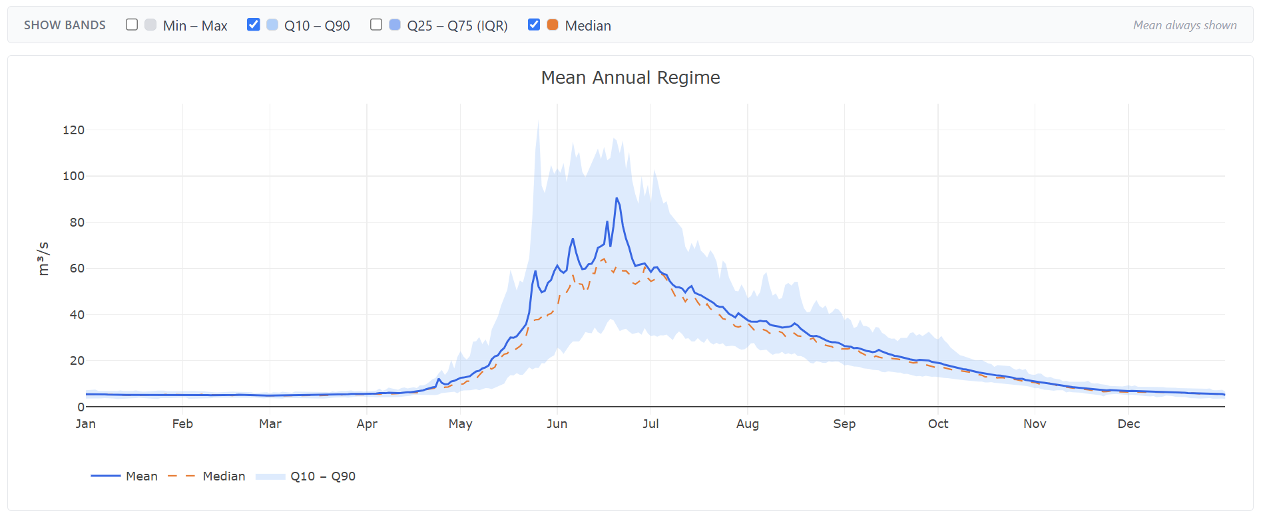
WSC
Hydrometric Analysis App
Interactive web platform for Water Survey of Canada stream-flow data analysis and flood frequency modelling
🌐 ws-cprep.vercel.app
Powered by ECCC HYDAT · Built with Next.js + Python FastAPI

Slide 2
What Is This App?
A one-stop platform for WSC hydrometric data exploration & analysis
Water Survey of Canada (WSC) operates ~2,000 active hydrometric stations across the country. Until now, extracting and analysing that data meant juggling the HYDAT SQLite database, R scripts, or bulky desktop GIS tools.
This app replaces that workflow with a modern, browser-based platform that anyone on your team can open without installing anything. It pulls live data directly from Environment and Climate Change Canada's OGC API, runs all analyses on the fly, and presents results in clear, publication-ready charts.
Key facts:
✅ No software installation — runs entirely in the browser
✅ Live data from ECCC's national HYDAT database (updated daily)
✅ Covers all active & historical WSC stream-flow & water-level stations
✅ Analyses from basic statistics to advanced flood frequency modelling
✅ Export charts, tables, and printable PDF reports

Slide 3
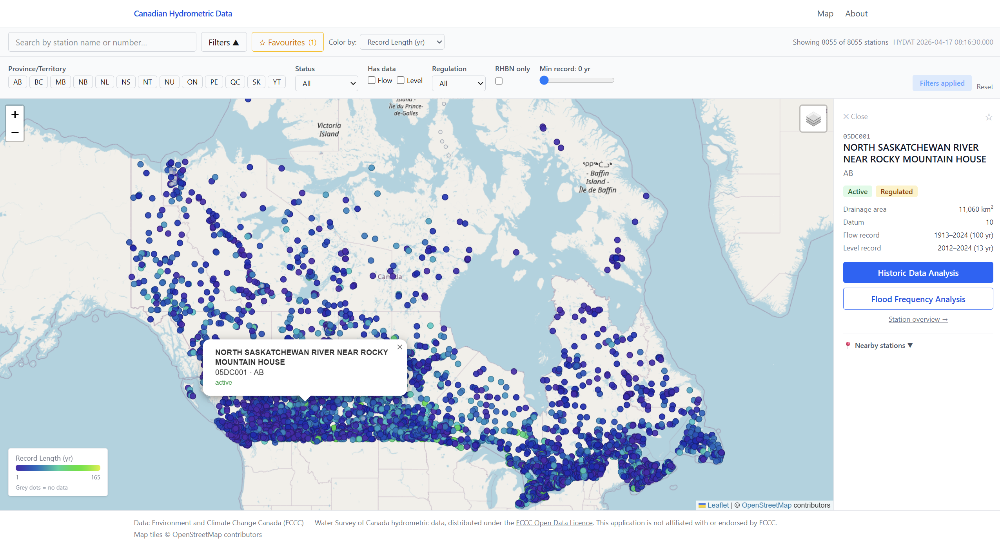
Station Discovery
Find and explore any WSC hydrometric station instantly
Interactive Map
The home screen displays every WSC station on an interactive Leaflet map. Switch between OpenStreetMap and satellite imagery with one click.
Colour-coded by metric
Station markers can be coloured by mean annual discharge, record length, or drainage area — giving an instant spatial overview of the network.
Search & Filter
• Search by station name or ID
• Filter by province or active/historical status
• Save favourite stations for quick access
Station Details
Clicking any station opens its full profile: drainage area, record span, current status, and links to all analysis tabs.
Interactive map showing ~2,000 WSC stations colour-coded by metric

Slide 4
Hydrograph & Baseflow Separation
Visualise the full daily record and decompose flow components
📈 Daily Hydrograph
Plot the complete daily discharge or water-level record for any station. Pan and zoom across decades of data with an interactive timeline.
Features:
• Date-range selector (zoom to any period)
• Toggle discharge ↔ water level
• High-flow event flags on the chart
• Download raw data as CSV
• Variable colour by flow magnitude
🌊 Baseflow Separation
Decompose total discharge into baseflow (groundwater) and quickflow (storm runoff) using two industry-standard digital filters — both running entirely in your browser.
Two methods:
Lyne & Hollick (1979)
3-pass recursive filter (α = 0.925)
Eckhardt (2005)
Two-parameter filter (a = 0.98, BFImax = 0.80)
Output:
Stacked-area chart showing total flow, baseflow, and quickflow bands. Live Baseflow Index (BFI) readout updates as you adjust filter parameters.
HYDROGRAPH

Slide 5
Flow Analysis Tabs
Flow Duration Curve · Annual Regime · Statistical Summary
📉 Flow Duration Curve
Ranks every daily discharge from highest to lowest and plots exceedance probability on a log scale.
• Q10, Q50, Q90 markers
• Identifies high-flow, median, and low-flow regimes
• Essential for environmental flow assessments
• Log-scale discharge axis
📅 Annual Regime
Shows the seasonal pattern of flow throughout the year — averaged across the full station record.
• Mean monthly discharge
• Q10–Q90 uncertainty band
• Reveals snowmelt peaks, summer low-flows, etc.
• Useful for water allocation planning
📊 Statistical Summary
Compact table of key descriptive statistics for the complete daily record at a glance.
• Mean, median, std deviation
• Min, Max, CV
• Record length & completeness
• Annual peak statistics

Slide 6
Trend Analysis
Detect statistically significant long-term changes in streamflow
Mann-Kendall Trend Test
The Mann-Kendall test is the standard non-parametric method for detecting monotonic trends in hydrological time series. It makes no assumptions about the underlying distribution of the data, making it robust even for skewed or non-normal streamflow records.
What the app reports:
▸ Trend Direction:
Increasing / Decreasing / No trend — determined at the selected significance level (α = 0.05 or 0.01).
▸ Sen's Slope:
Magnitude of the trend in m³/s per year (or m/yr for water level). A median-based robust slope estimator.
▸ p-value:
Probability of observing the data under the null hypothesis of no trend. Values < 0.05 are statistically significant.
▸ Annual Peaks Trend:
Separate analysis on the annual maximum series to detect changes in flood magnitude over time.
Results are displayed with an annual time series plot and a Sen's slope regression line, so the direction and rate of change are immediately visible.

Slide 7
Flood Frequency Analysis (FFA)
Estimate design floods for any return period using multiple distributions
Annual Maximum Series (AMS) approach
Fits multiple probability distributions to the annual peak flow series and selects the best fit using information criteria (AIC/BIC).
Distributions fitted:
• GEV — Generalised Extreme Value — most widely used for floods
• Gumbel — Special case of GEV; common in older Canadian practice
• LP3 — Log-Pearson Type III — standard in US & Canadian guidelines
• LN2 — 2-parameter Lognormal
• Pearson 3 — Generalised gamma family
Parameter estimation:
L-moments (default) or Maximum Likelihood (MLE)
Confidence intervals:
90% bootstrap CI on all quantile estimates
Outputs
📈 Frequency curve
Empirical plotting positions + fitted distribution lines on a log return-period axis
📋 Design flood table
Quantiles (m³/s) for T = 2, 5, 10, 20, 50, 100, 200, 500 years
📐 Goodness-of-fit
AIC / BIC scores and K-S test p-value for each distribution
🔄 Plotting positions
Choice of Weibull, Hazen, or Cunnane
⚙️ Estimated-year toggle
Option to exclude provisional or estimated records

Slide 8
Peaks Over Threshold (POT) Analysis
Partial duration series — more data points, better estimates for short records
Why POT?
Traditional flood frequency analysis uses one peak per year (Annual Maximum Series). POT uses every independent flow event above a user-selected threshold — often 3–5× more data points for the same record length. This is especially valuable for stations with short records (<20 years) where AMS gives too few data points for reliable fitting.
▸ Threshold selection:
Drag a slider to set the threshold as a percentile (e.g. Q90) or type a value in m³/s directly. The chart updates live.
▸ Independence filter:
A minimum separation gap (3, 7, 14, or 30 days) ensures only independent peaks are included — no double-counting of the same event.
▸ GPD fitting:
The Generalised Pareto Distribution (GPD) is fitted by L-moments (closed-form, no iteration). Shape and scale parameters are reported.

Slide 9
Printable PDF Report
One-click export of a complete station analysis for client deliverables
🖨️ Print / Save PDF
Every station has a dedicated report page that assembles all key analyses into a single printable document. Click the Print button to open the browser's PDF dialog and save.
Report includes:
• Station metadata (ID, province, drainage area, record span)
• Full hydrograph
• Flow Duration Curve
• Annual Regime (mean + Q10–Q90 band)
• Annual peaks bar chart
• Flood frequency curve (best-fit distribution)
• Design flood quantile table
• Annual statistics table (year-by-year)
• Trend analysis summary paragraph
• Data attribution & disclaimer footer
Report Design
▸ Print-optimised layout
All interactive elements (buttons, nav, methodology panels) are automatically hidden in print mode via CSS @media print rules.
▸ Static charts
Plotly charts switch to a static, high-fidelity render for print — no toolbars or hover overlays.
▸ Page breaks
Each analysis section starts on a fresh page so the report flows cleanly across A4 or Letter paper.
▸ URL to share
The report URL (/stations/XXXXX/report) can be bookmarked or sent directly to colleagues.

Slide 10
Methodology Transparency
Every analysis tab includes an expandable explanation of the method used
Each analysis tab has an 'ℹ About this analysis' accordion panel at the bottom of the page. Expanding it reveals a plain-English explanation of the method, the assumptions made, and peer-reviewed references — so any team member can understand exactly how a result was produced.
Covered in every tab:
• Hydrograph: What daily mean discharge represents; ECCC data collection methods
• Flow Duration Curve: Exceedance probability calculation; interpretation of Q10/Q50/Q90
• Annual Regime: Climatological averaging; interpretation of seasonality
• Annual Statistics: How annual maxima, minima, and volumes are derived
• Low Flow: 7Q10 derivation; relevance to environmental flows
• Trend Analysis: Mann-Kendall theory; Sen's slope; significance testing
• Flood Frequency: AMS approach; L-moments vs MLE; AIC model selection
• POT Analysis: GPD theory; Poisson process assumption; threshold selection guidance
• Baseflow: Lyne-Hollick and Eckhardt filter equations; BFI interpretation
• Goodness of Fit: K-S test; AIC/BIC; how to interpret scores

Slide 11
Technology Stack
Modern, open-source, cloud-hosted — no licences required
🖥️ Frontend
⚙️ Backend (FFA Engine)
🌐 Data Source
• Next.js 16 (React)
• Python 3.12
• ECCC OGC API (live)
• TypeScript
• FastAPI
• National HYDAT database
• Tailwind CSS
• lmoments3
• No local DB needed
• Plotly.js charts
• NumPy / SciPy
• Updated daily by WSC
• Leaflet maps
• Docker on Render
☁️ Hosting
🔒 Architecture
📐 Analysis (client-side)
• Vercel (Next.js)
• Server-side API proxy
• POT / GPD in TypeScript
• Render (Python API)
• No CORS exposure
• Baseflow filters in TypeScript
• GitHub (source control)
• Environment-variable secrets
• Mann-Kendall in TypeScript
• Free tier — $0/month
• Stateless — no user data stored
• FFA distributions via Python API

Slide 12
Try It Now
The app is live — no login, no installation.
🌐 ws-cprep.vercel.app
Search for any Canadian WSC station and all analyses run instantly in your browser.
Source code: github.com/adilch/WSCprep
Data: Environment and Climate Change Canada · National Hydrometric Program · HYDAT database

