Slide 1
Resarch for suitable locations in Baku for Coffee Shops

Slide 2
Introduction
This project aims to find potentially useful regions for opening new coffee shops in Baku city.

Slide 3
Why Coffee shop?
Comparison of tea houses (“сhaikhana”) and coffee shops
Tea house | Coffee shop
Noisy | Quiet (usually)
Mostly men | Both men and women
Suitable for board games | Suitable for study, reading, business talks
Usually nearby apartments only | Everywhere

Slide 4
Data
Data is collected using Google Geocode API;
Foursquare API
Generated by myself
Using data science techniques

Slide 5
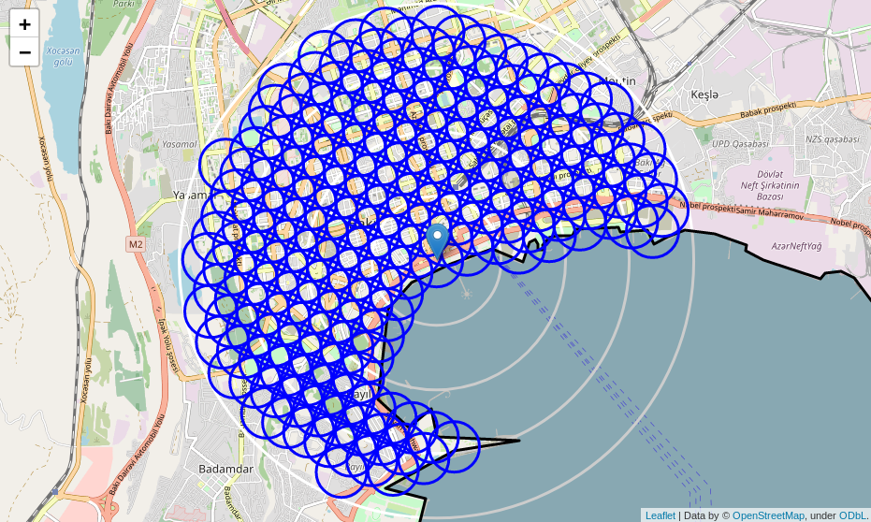
Candidate area

Slide 6
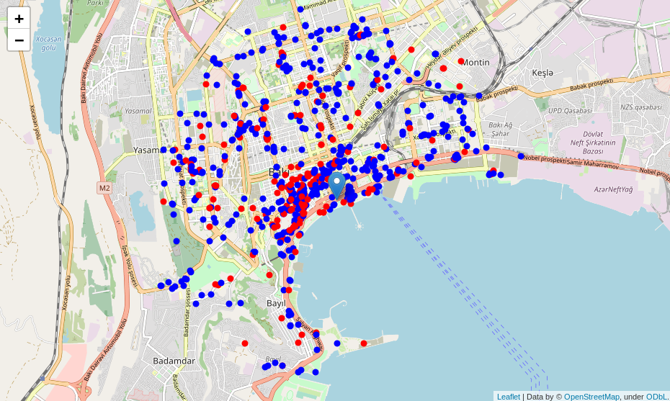
Restaurants and Coffee shops
Restaurants: 746
Coffee shops: 200

Slide 7
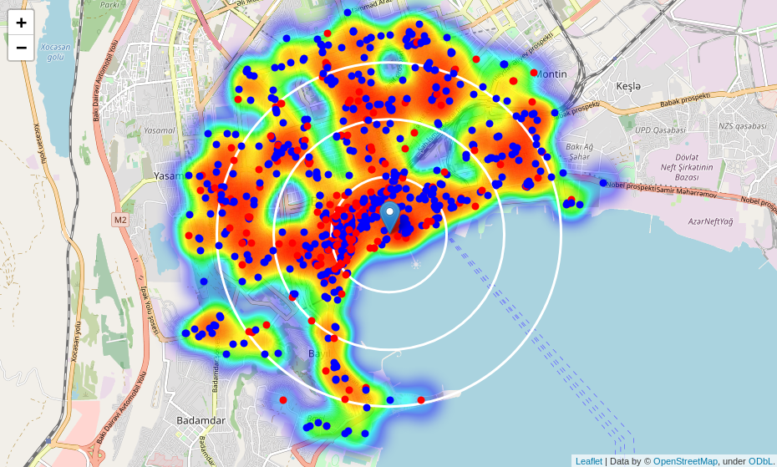
Density of restaurants

Slide 8
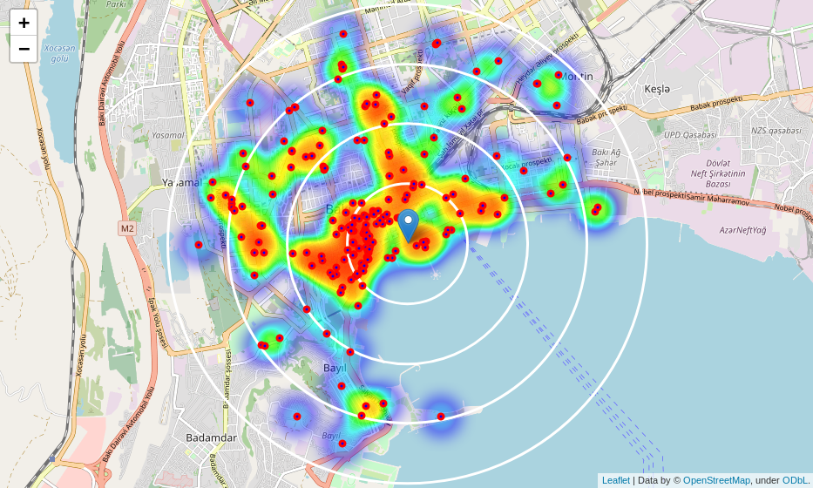
Density of coffee shops

Slide 9
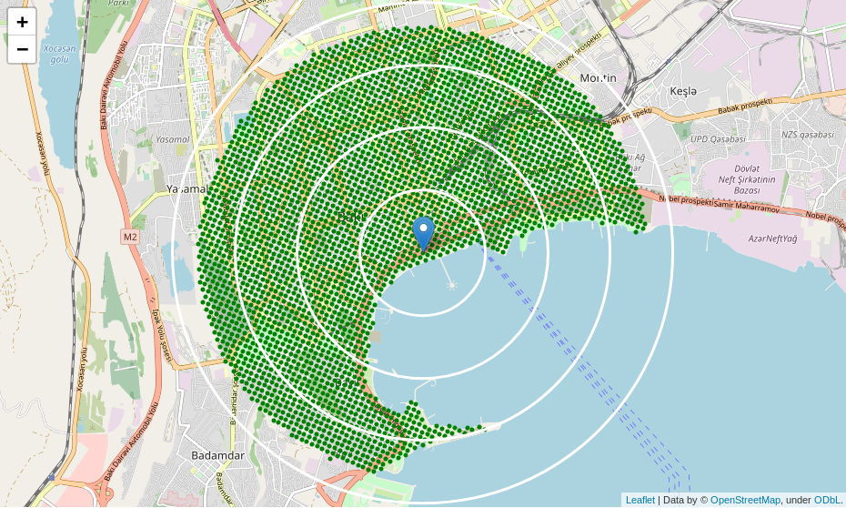
Candidate regions (uncleaned)

Slide 10
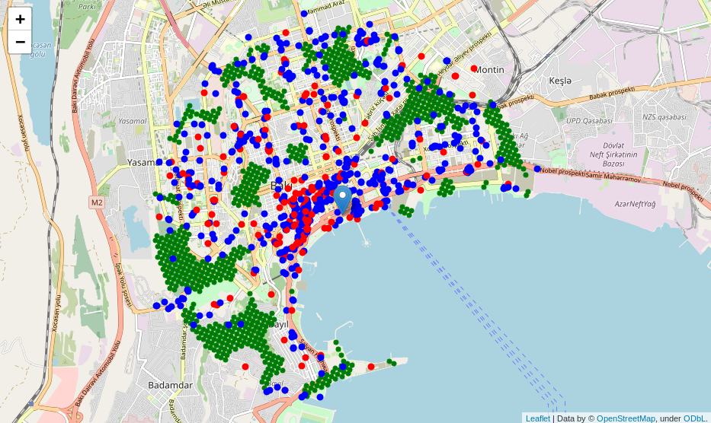
Candidate regions
Restaurants
Coffee shops
Good candidate
regions

Slide 11
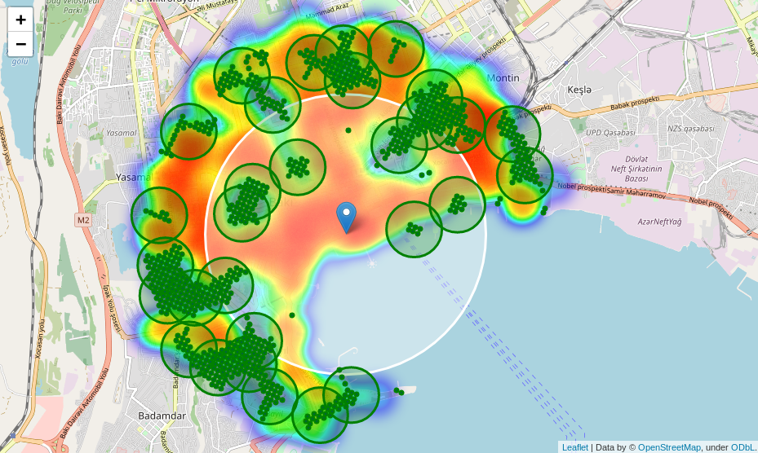
Candidate regions (clusters)

