Slide 1
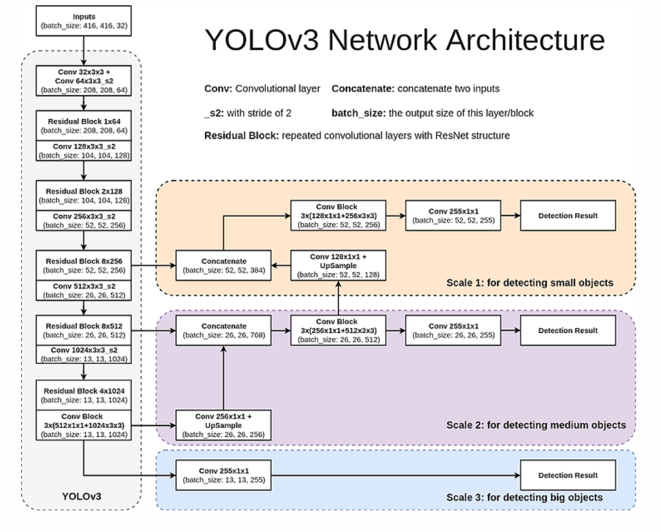
10,13, 16,30, 33,23
30,61, 62,45, 59,119
116,90, 156,198, 373,326

