Slide 1
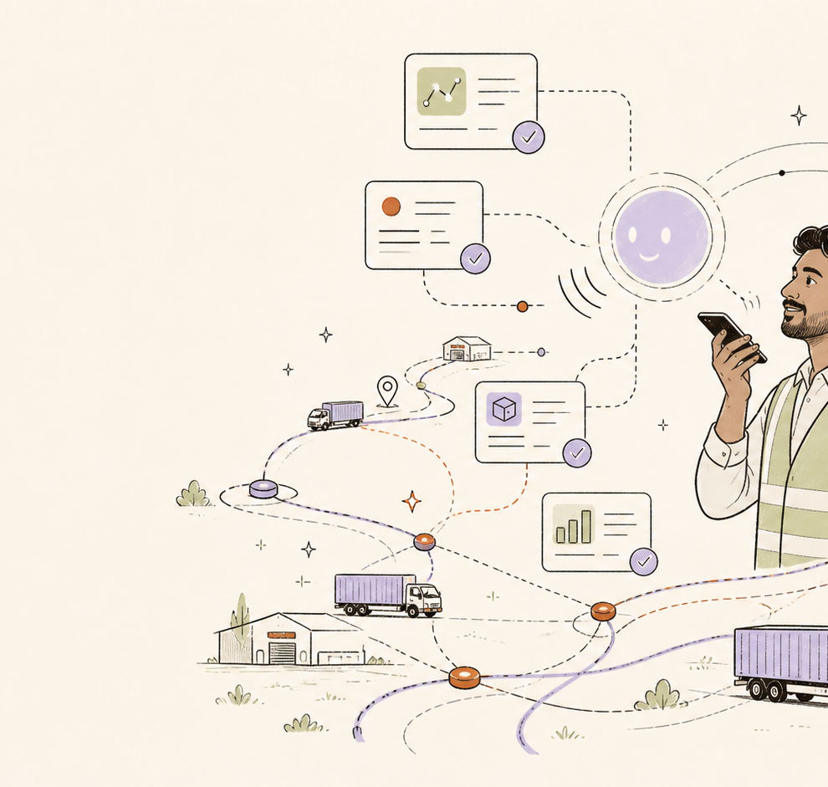
SYNCHUS
OPERATIONAL MEMORY FOR INDIAN LOGISTICS
The company learns at the speed of its ground truth.
Voice, files, field reports and operational systems become one living context layer — with humans retaining authority.
HACKATHON DEMO
Hindi · Hinglish · English
2026
Notes:
Open with the idea, not the software. Synchus is not another dashboard. It is a way for the company to remember what the people closest to the work already know.
[Sources]
Hero illustration: original asset generated with OpenAI image generation for this deck. Product concept and copy: Synchus project team.

Slide 2
THE REAL OPERATIONAL PROBLEM
The system of record is never the whole truth.
Every company has documents, dashboards and people who know what changed ten minutes ago. Those truths rarely meet.
1
2
3
Files & sheets
Operational systems
Ground reality
Contracts, logs, tickets
and scattered exports
Fleet, routes, hubs
and service records
Voice notes, calls
and worker observations
The consequence: decisions are made from partial context, while the people who could complete the picture have no structured way to contribute.
SYNCHUS
02
Notes:
This is the tension we designed for. Not a lack of data. A lack of shared, trusted context between files, systems and the field.
[Sources]
Product framing and copy: Synchus project team. No external statistics used.

Slide 3
THE SYNCHUS CONTEXT LAYER
One living operational memory.
Synchus keeps raw inputs, reasons across connected evidence, separates known from unknown, and stages only useful changes for human approval.
01
02
03
04
Listen
Reconcile
Reason
Act safely
→
→
→
Voice, Telegram, uploads
and existing systems
Match entities, conflicts,
locations and time
Find what matters,
what is missing and why
Answer, stage, approve,
audit and reverse
HUMAN APPROVAL IS THE BOUNDARY
Raw events remain preserved. Canonical context changes only after a person approves it.
SYNCHUS
03
Notes:
Walk through the loop: Listen, reconcile, reason, act safely. The important bit is that Synchus never turns an uncertain field report into permanent truth by itself.
[Sources]
System design: Synchus project team.

Slide 4
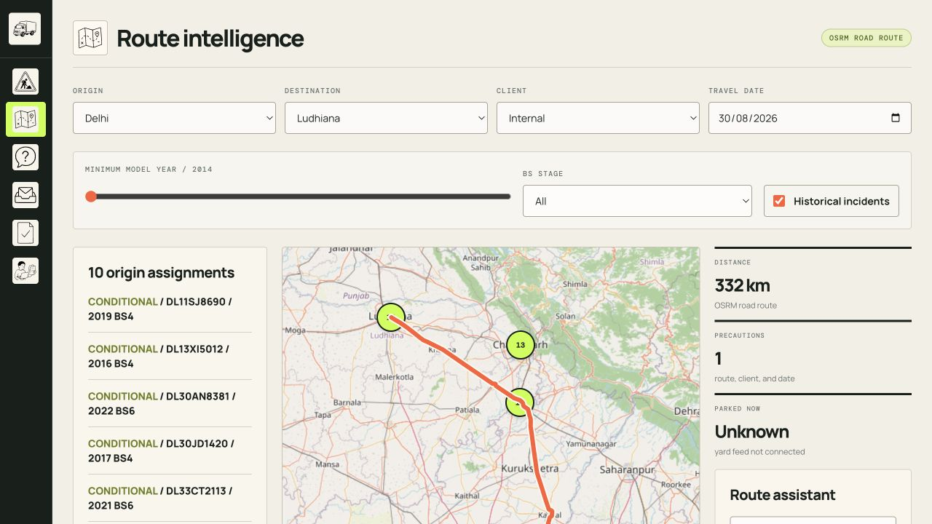
SPATIAL INTELLIGENCE
A route becomes a decision — with evidence.
Select a route and see its hubs, assigned fleet, route precautions, historical patterns and honest gaps in live data.
What the map makes visible
Route geometry and distance
Hub clusters and home assignments
Precautions and historical incidents
What is missing — without pretending it is live
NOT A LIVE GPS CLAIM
The app distinguishes static evidence from live feeds — visibly.
SYNCHUS
04
Notes:
This is not a live-tracking theatre. It is an evidence map. Hubs and fleet assignments are clear. It also plainly says when current positions or yard counts are not connected.
[Sources]
Product screenshot: locally captured from Synchus route intelligence. Basemap: OpenStreetMap contributors. Route geometry: OSRM road route.

Slide 5

GROUND TRUTH, IN THE WORKER’S LANGUAGE
The worker does not fill a form. Synchus conducts the interview.
Hindi, Hinglish or English — voice is the fastest way to get the detail the company is missing.
Worker
“NH44 par blockage hai.”
Synchus
“Kis vehicle, exact location, severity aur expected end time?”
Worker
“DL30AN8381, Murthal, medium, 18:30 tak clear ho sakta hai.”
Synchus
“Confirm karun? Is report ko review ke liye stage kar raha hoon.”
Press Space to begin. Press Space again to stop.
SYNCHUS
05
Notes:
Use this as the live moment. Speak the first worker line. The agent should ask for the minimum information it needs before it stages a report. That turns voice into reliable operational input instead of an unstructured note.
[Sources]
Product screenshot: locally captured Synchus Live interface. Voice intake policy and conversation examples: Synchus project team.

Slide 6
CAPABILITY LAB
When the model is missing, Synchus proposes the smallest safe extension.
Some useful information does not fit today’s tables. Synchus can turn that gap into a reviewable capability proposal — never an unreviewed database mutation.
AGENT PROPOSAL
INCOMING EVIDENCE
HUMAN REVIEW
cold_chain_reading
Cold-chain readings arrive in a CSV.
Approve
or reject.
→
vehicle_registration · text · required
→
“Temperature excursions must be linked to a vehicle, shipment and time window.”
recorded_at · timestamp · required
Approval creates the capability. Rejection preserves the raw evidence and the audit trail.
temperature_c · number · required
NO CURRENT ENTITY EXISTS
shipment_ref · text · optional
REVERSIBLE
SYNCHUS
06
Notes:
This is an important differentiator. When a document describes a new kind of operational fact, the system can propose a bounded schema and its required checks. People approve it. Every extension is reversible and auditable.
[Sources]
Capability Lab design and example: Synchus project team. Demo data: demo/02_cold_chain_readings.csv.

Slide 7
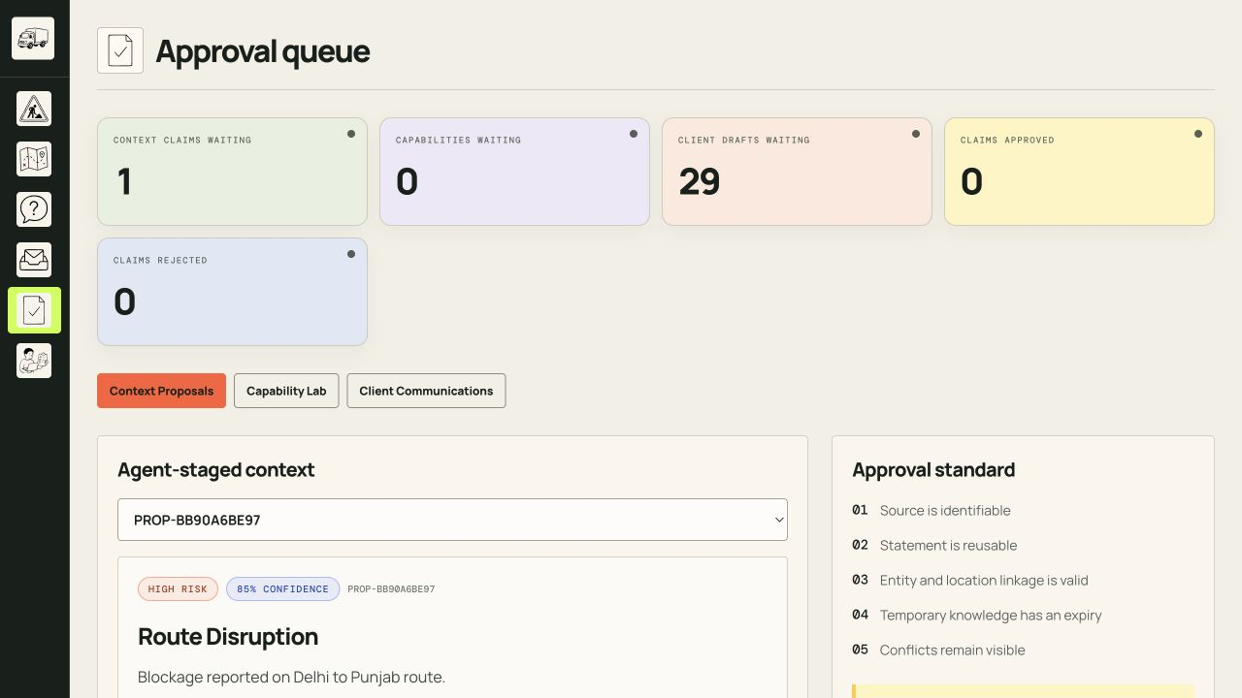
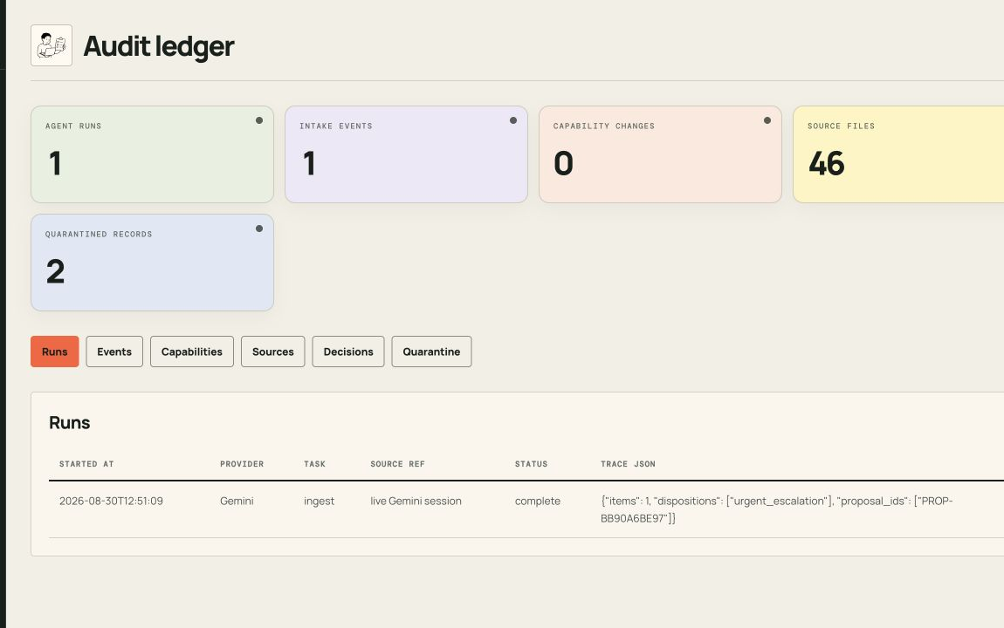
TRUST IS A PRODUCT SURFACE
Useful intelligence, without a black box.
Synchus keeps the source, the reasoning, the uncertainty and the human decision visible together.
Evidence stays linked
Unknowns stay visible
Approvals preserve authority
Changes can be reversed
SYNCHUS
07
Notes:
Show the approval queue and audit ledger together. The answer is not the product. The evidence behind the answer, its uncertainty and the ability to reverse a decision are the product.
[Sources]
Product screenshots: locally captured Synchus approval queue and audit ledger.

Slide 8
THE SYNCHUS PROMISE
Files become evidence.
Voices become structured knowledge.
Maps become decisions.
And through it all, the company keeps its human judgment.
01
02
03
Listen to the field
See the operation
Learn safely
Speak in Hindi, Hinglish or English.
Routes, hubs, fleet and evidence in context.
Propose, approve, audit and reverse.
THE COMPANY LEARNS AT THE SPEED OF ITS GROUND TRUTH
SYNCHUS
Notes:
Close exactly here: “Synchus is not asking the company to become more technical. It is helping the company listen to itself — safely, in the language its people already use.” Then pause.
[Sources]
Closing copy: Synchus project team.

