Slide 1






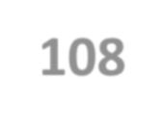



INT -108
Python Programme Topic: Password Generator

Slide 2
Lovely Professional University
Section : K22VR
Name: Adil Husain
Roll no: 44
Regd. no. 12211059
Roll
Name:- Salman Azaze Ahamed Choudhari
Roll no: 43
Regd. No. 12205464
Name:- Kaif Ansari
Roll no: 64
Regd. No. : 12217128
Submitted to : Mr. Avnish Thakur ,
Lovely Professional University Phagwara Punjab

Slide 3
Introduction to project
Random password generator :-
It’s a page of code designed to give an output we call “Random Password” by shuffling and mixing of :
Small case letters
Uppercase letters
Numeric Digits
Punctuation marks
And the thing that makes it amazing is that the user can itself mention upto what length he wants the password (output).

Slide 4


Modules(libraries) Used:
Random Module :-
Random module is used to perform the random generations. We are making use of random.sample() module here. If you will observe in the output, all characters will be unique as random.sample() never repeats same characters in its output.
String Module:-
The string module contains a number of useful constants, classes and a number of functions to process the standard python string.

Slide 5
Composition :-
#importing the necessary libraries/modules:
import random
import string
#greeting the user at the start
print(“ Hello, Welcome to password generator!”)
giving output Hello, Welcome to password generator!
#taking as input the length of the output(password)
he/she wants
length=int(input(“\n Enter the length of the password ))

Slide 6
Composition :-
#defining and storing the string constants in variables
lower=string.ascii_Lowercase
upper=string.ascii_Uppercase
num= string.digits
symbols= string.punctuation
#combining the strings stored in these variables together in a new variable
all=lower+upper+num+symbols
#radomising the data stored in “all” variable and producing shuffled outcome of user’s desired length
a=random.sample(all,length)

Slide 7
Composition :-
#now the data is in the form of list so we need to combine this list using “join” and store it in a variable
password=“”.join(a)
#Final output :-
print(“password”)
It will give the output we are calling random password upto the length given by the user with every letter unique and used only one time in output.

Slide 8

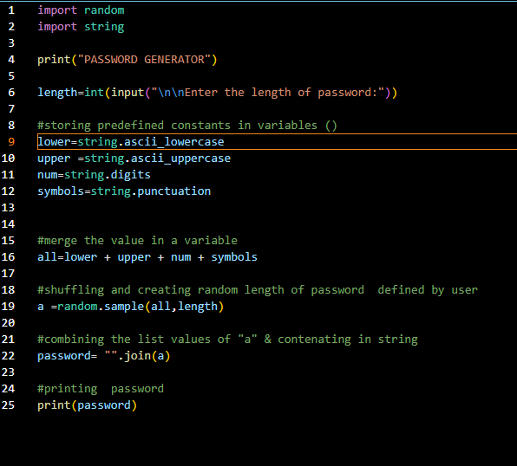
Input code to generate a programme

Slide 9


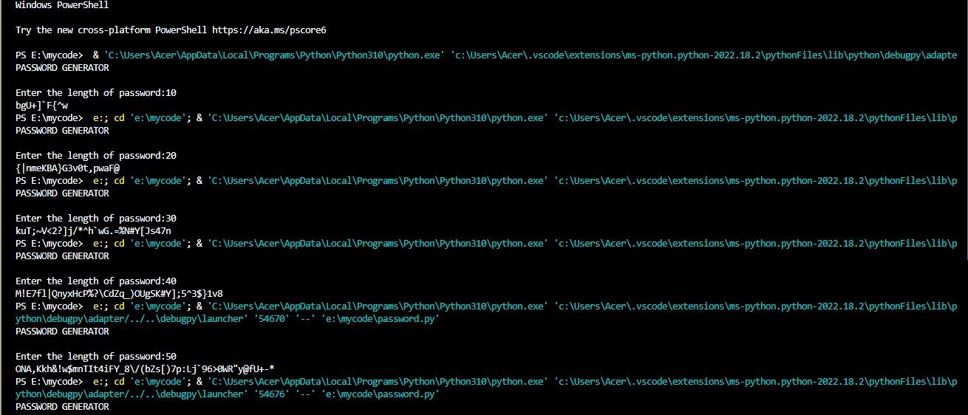
Output of the code is here:

Slide 10


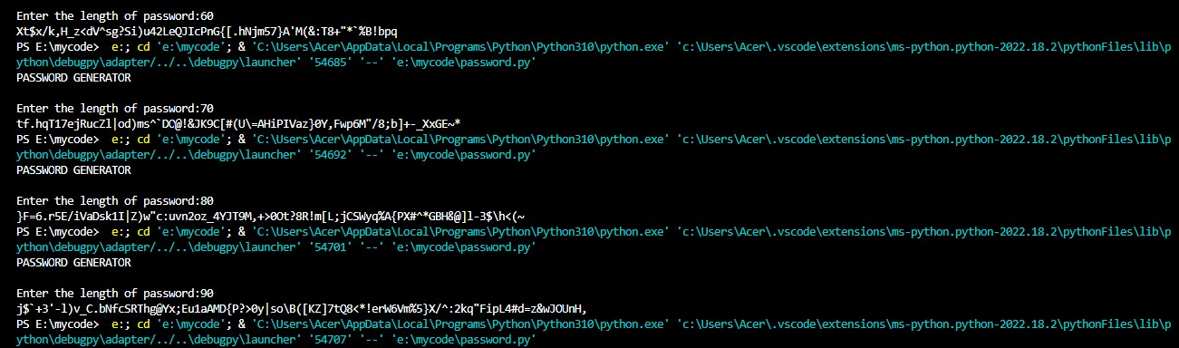
Out put of the code:

Slide 11
THANK YOU
FOR GIVING US SUCH A GREAT OPPORTUNITY TO WORK ON OUR FIRST CODING EXPERIENCE.

