Slide 1

Searching,Sorting algoritms
Team 4:
Chingiz
Adil
Medine
Shefeq

Slide 2
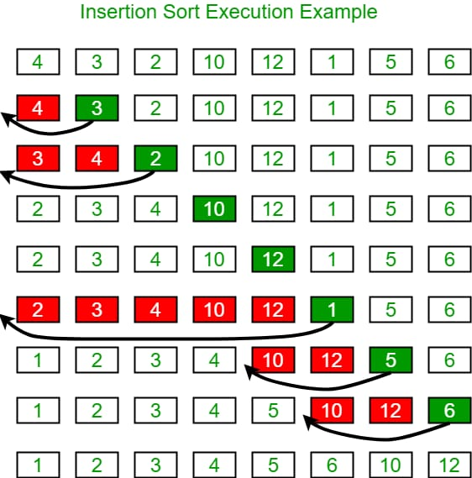
Insertion sort—From the nameAs you can see, the insertion sort array is eachinserts an element in the right place. Insertionsort is a sorting algorithm that places an unsorted element in its proper place.
Insertion sort is a simple sorting algorithm that works similar to the way you sort playing cards in your hands.
If the unsorted card is greater than the card in the hand, it will be placed to the right, otherwise to the left
This algorithm takes O(n) at best, O(n2) at worst, or O(n2) on average

Slide 3
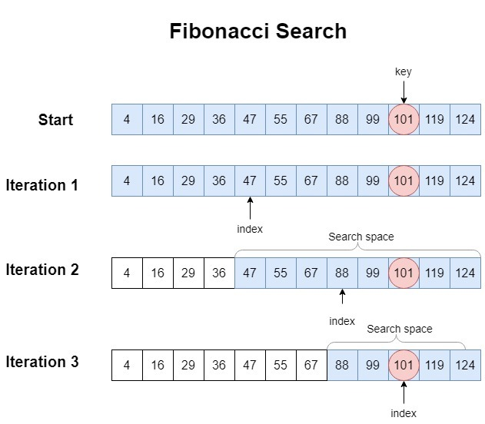
Fibonacci Search is a searching algorithm used to find the position of an element in a sorted arrayFibonacci numbers are determined recursively as F(n)=F(n-1)+F(n-2),F(0)=0,F(1)=1.

Slide 4
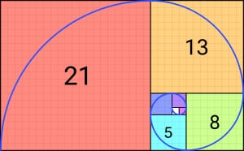
Differences with Binary Search:
Fibonacci Search divides given array into unequal parts.Binary Search uses a division operator to divide range. Fibonacci Search doesn’t use /, but uses + and -. The division operator may be costly on some CPUs.Fibonacci Search examines relatively closer elements in subsequent steps. So when the input array is big that cannot fit in CPU cache or even in RAM, Fibonacci Search can be useful.
The time complexity of the Fibonacci Search Algorithm is O(log n)

Slide 5
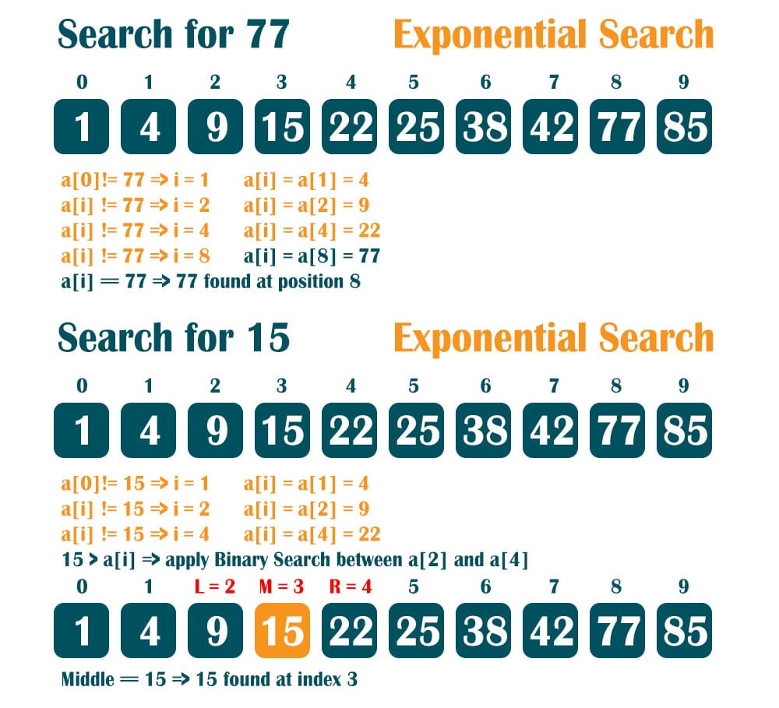
Exponensial search- Eksponensial axtaris
This mechanism is used to find the range where the search key may present.
The exponential search algorithm checks whether the searched element is found by stepping, and if found, the search process ends. But if not found, it divides the search range of the searched element into two parts and repeats the same process for both parts in the re-step. This process continues until the range is small enough to produce one element.Features of exponential search:
• Time Complexity is O(log N).
• Used for an ordered list of items.
• Useful for unbounded searches where the size of the array is infinite

Slide 6
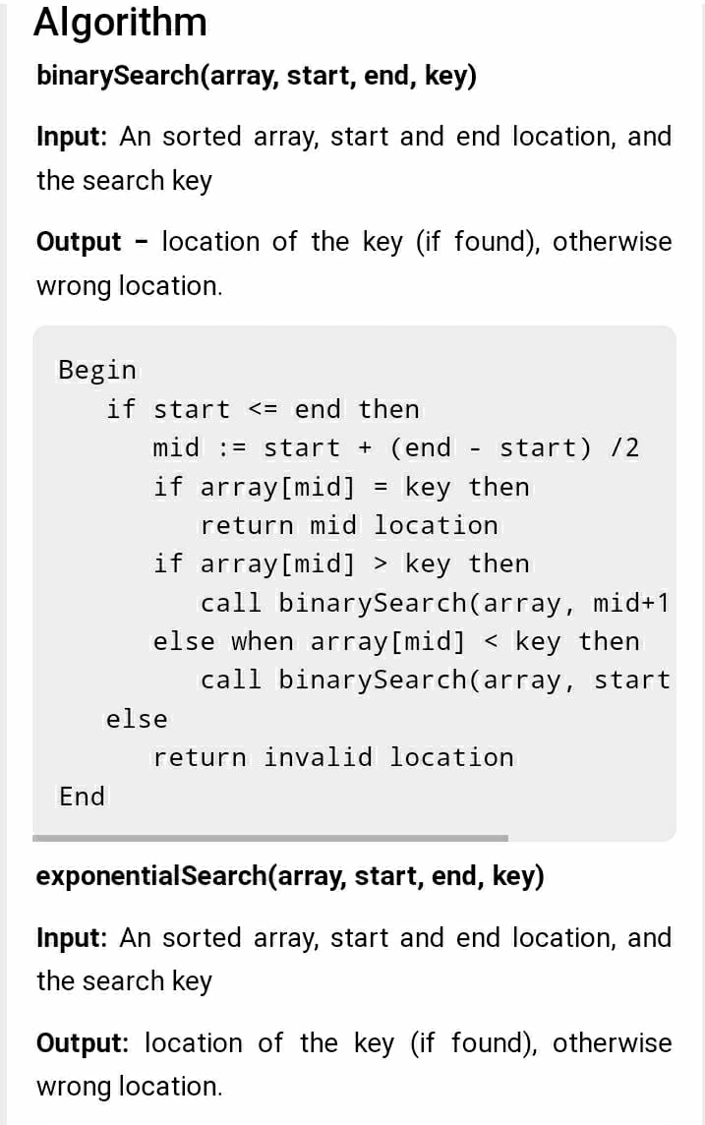
The complexity of Exponential Search Technique
Time Complexity: O(1) for the best case. O(log2 i) for average or worst case. Where i is the location where search key is present.Space Complexity: O(1)

Slide 7
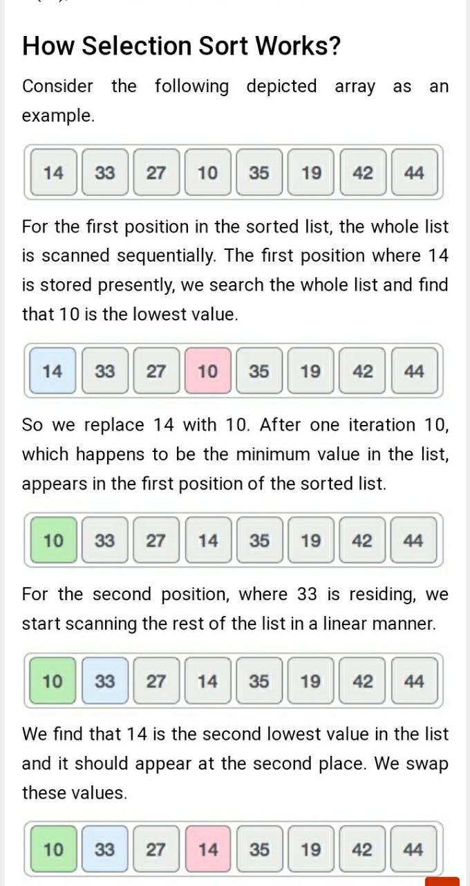
Selection sort- seçim nizamlamasi
This sorting algorithm first selects the smallest of the given array elements and assigns it to index 0. It then selects the minimum among the remaining elements and assigns it to index 1, thereby dividing the array into 2 parts, sorted and unsorted. And this process continues until the last element of the array. the maximum given array is considered to be arranged or sorted in ascending order from minimum to maximum.
This algorithm is not suitable for large data sets as its average and worst case complexities are of Ο(n^2), where n is the number of items.

Slide 8
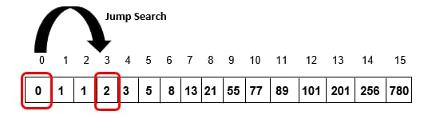
Jump search, also known as block search or the "sqrt(n) search algorithm", is a search algorithm used to find the position of a particular value in a sorted array. It works by dividing the array into blocks of a fixed size and then performing a linear search within each block
The algorithm starts by sorting the least significant digit of each key, then the next significant digit, and so on until the most significant digit is sorted. The algorithm can sort integers in linear time, making it an efficient sorting algorithm for large datasets.

Slide 9
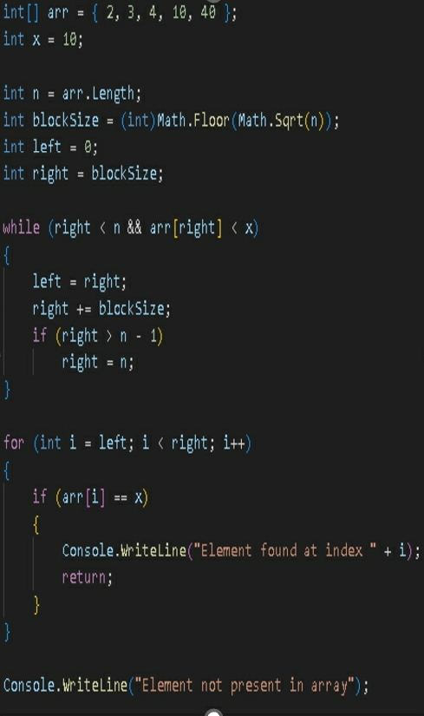
If the value is found, the algorithm returns the index of the item in the array. If the end of the array is reached without finding the value, the algorithm returns -1 to indicate that the value was not found.
Jump search is a relatively efficient algorithm, with a time complexity of O(sqrt(n)). This makes it faster than linear search (which has a time complexity of O(n)) for large arrays. However, it is not as fast as binary search (which has a time complexity of O(log n))

Slide 10
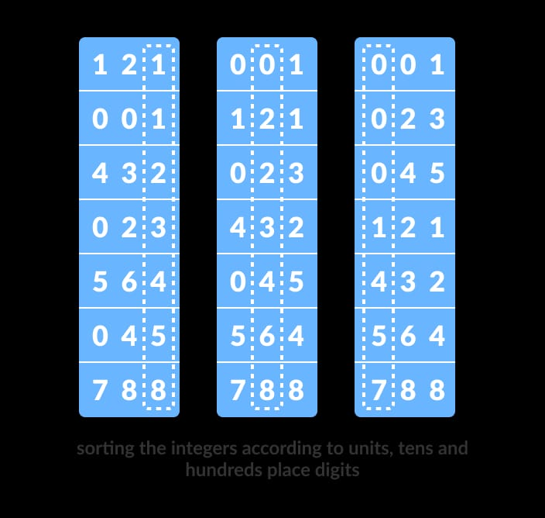
Radix Sort
Radix sort is a non-comparative integer sorting algorithm that sorts data with integer keys by grouping the keys by the individual digits that share the same significant position and value. It's also known as bucket sort or digital sort.
The algorithm starts by sorting the least significant digit of each key, then the next significant digit, and so on until the most significant digit is sorted. The algorithm can sort integers in linear time, making it an efficient sorting algorithm for large datasets
Radix sort works by using a stable sorting algorithm, such as counting sort, to sort the data by each digit in ascending or descending order. Each digit is then sorted based on the previous sorted digits until the entire key is sorted. The process repeats until the most significant digit is sorted, and the keys are sorted in ascending or descending order

Slide 11
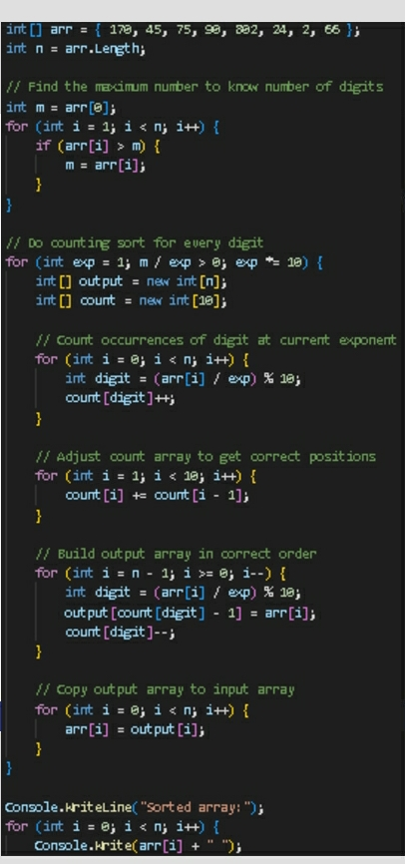
The time complexity of Radix sort is O(d * (n + b)), where "n" is the number of elements to be sorted, "d" is the number of digits in the maximum element, and "b" is the base of the number system used to represent the elements.Radix sort has several advantages, including being efficient for large datasets, having a predictable performance, and having a stable sort. However, it requires the data to have a fixed number of digits, and it can be memory-intensive for large datasets with a large range of values

Slide 12
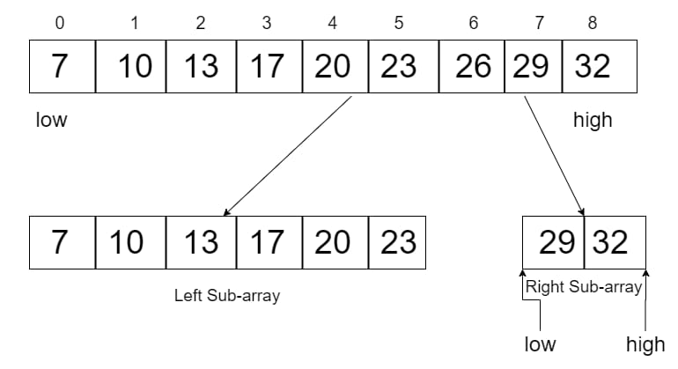
Interpolation search Interpolation search is an improved variant of binary search. This search algorithm works on the check position of the required value. For this algorithm to work properly, the data collection must be in a sorted form and evenly distributed. Binary search has more Time complexity than linear search. For the average case O(log2(log2n)) and linear search has worst case complexity of Ο(n) while Binary search has Ο(log n). Space complexity: O(1) There are cases where the location of the target data may be known in advance. For example, in the case of a phone directory, if we wanted to look up Morphius' phone number. Here, a linear search and even a binary search will seem slow, because we can go directly to the memory area where names starting with the letter "M" are stored

Slide 13
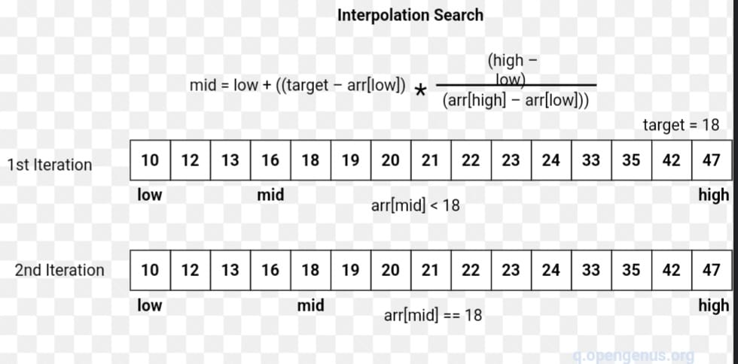
Binary Search Embedding In binary search, if the desired information is not found, the rest of the list is divided into two parts, lower and upper. A search is performed on any of them. Even when the data is sorted, binary search does not use it to check the position of any data
Position Sensing in Interpolation Search Interpolation search finds a specific element by calculating the probe position. By default, the probe position is the position of the middlemost part of the collection. If a match occurs, the index of the element is returned. We use the following method to split the list into two parts. If the middle element is greater than the element, then the probe position is calculated again in the subarray to the right of the middle element. Otherwise, the element is searched in the subarray to the left of the middle element. This process continues in the subarray as well, the size of the subarray is reduced to zero

Slide 14
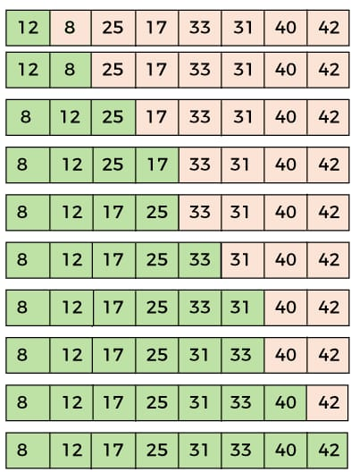
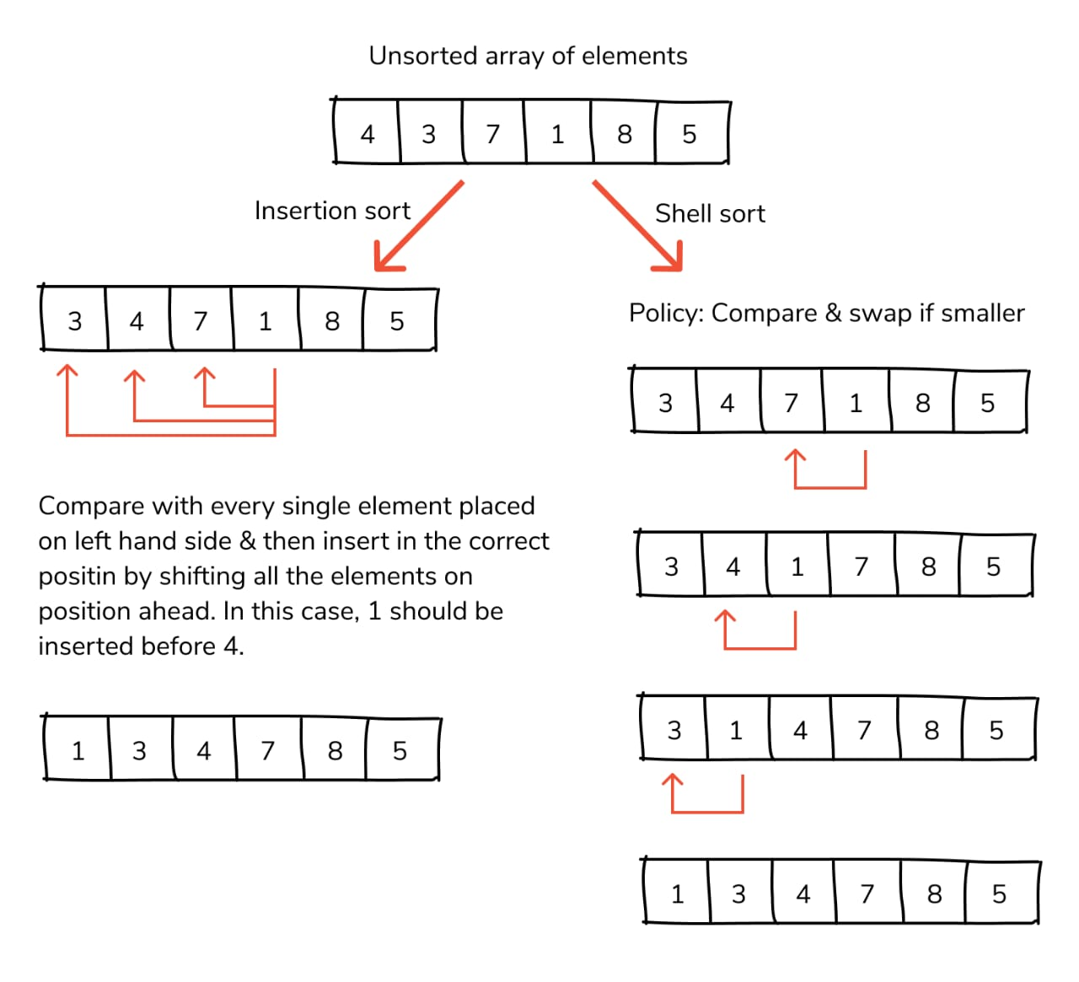
Shell sort is a highly efficient sorting algorithm and is based on the insertion sort algorithm. This algorithm avoids large shifts, such as in input sorting, if a small value is rightmost and needs to be moved leftmost. This algorithm uses incremental sorting on widely spaced elements to sort them first and then to sort less widely spaced elements. This space is called an interval. This interval is calculated based on Knuth's formula - Knut's formula h = h * 3 + 1 where - h is an interval with an initial value of 1. This algorithm is quite efficient for medium-sized data sets because the average and worst-case complexity of this algorithm depends on the sequence of spaces, best known as Ο(n), where n is the number of elements. . And in the worst case Space Complexity is O(n)

