Slide 1
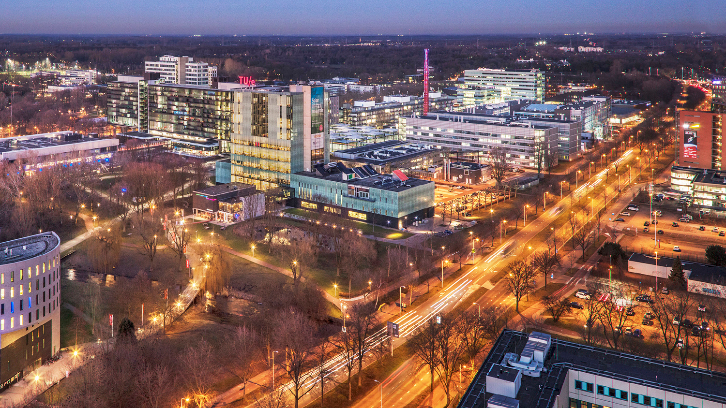
Image-Based Identification and Localisation of Changes in Intraoperative Brain Tumour Resection
Adil Jahouh, 1260340
Mathematics and Computer Science, Visualization
Notes:
Hello everyone, first, thank you all for coming and welcome to my master thesis presentation.
Which is about:

Slide 2
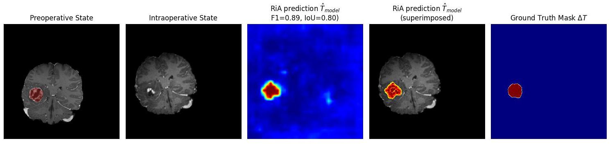
Contents
    Introduction
    Background
    Related work
    Research goals
    Methodology
    Results
    Conclusion
Notes:
Well, in this presentation I will go over a small introduction to the topic of change detection. Furthermore, I will provide some background information over key concepts in MRI and CNNś .
Then we will go over relevant related work to change detection within and outside of the neurological field.
Then we’ll go over the research goals set within the top
Then ill introduce my proposed registration invariant method with the baseline methods
Then we’ll analyze the results of these methods
And finally we’ll discuss the results, limitations and future work. Ending with a conclusion

Slide 3
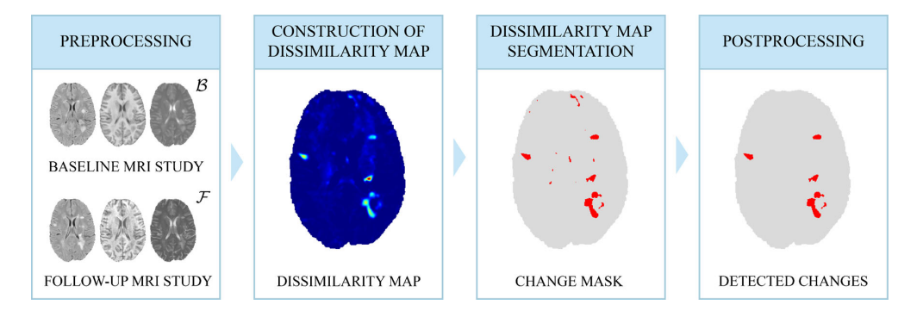
Introduction
“The process of identifying differences in the state of an object or phenomenon by observing it at different times” (Singh, 1989, p. 989)
To include: What (identification) and where (localisation) is the change?
Registration
Artifact correction
Basic method for White Matter Lesions detection (Figure from Lesjak et al., 2016)
Notes:
So change detection is commonly used in fields such as
- The automotive field to enhance self driving
- Monitoring patient progression in the medical field to track thing such as tumor progression
- Agricultural field to track crop management over time
The actual definition of change detection is originilly defined as
- “The process of identifying differences in the state of an object or phenomenon by observing it at different times” (Singh, 1989, p. 989)
This however, has nowadays been extended to where and what has changed as well
Comes with challenge:
- Common approaches rely on registration which is the aligment of this object or phenomen at two different time points in one coordinate spaces. As you can see in the image below this basic method for white matter lesions requires registriation. As two images of the brain taken at two different timpoints (which is referred to as baseline and followup) have to be subtracted to create a DM, and then a change map can be constructed to eventually be filtered out again to generate the actual changes.
This, method, however requires a lot of preprocessing such as registration,
and brain artifact correction such as acquisition differences, and such.

Slide 4
Introduction
Deep Convolutional Neural Networks
Siamese Network of Segmentation models
“Registration-invariant approach to CD, which is able to identify, localise and visualise changes intraoperative brain tumour resection”
Notes:
However, there are methods in computer vision that inherently deal with things such translations, and noise. CNN’s are capable of being invariant to noise and misalignment by applying certain methods. Furthermore they allow for the extraction of feature maps which can be repurposed for the segmentation of for example tumor tissue.
Therefore we propose a regirstion invariant method… This means that we attempt identify if changes have happened between a preopartive scan and intraoperative scan (which is during the operation) and we localize these changes pixel-wise and visualize structural changes by using specific imaging techniques

Slide 5
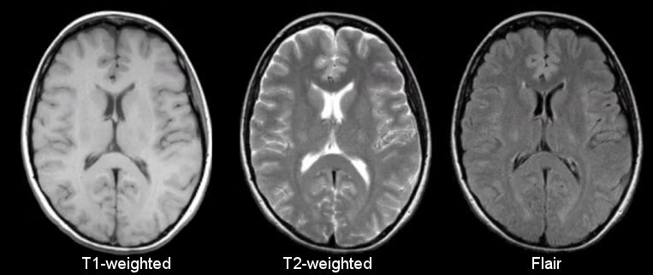
Background
Preoperative (B) and intraoperative (F)
Structural MRI
Imaging techniques
Fat and water concentration
Notes:
For change detection we’ll need a baseline and followupt stat which in the neurological field is is the preopeartive and intraopetive image.
The intraoperative state that shows the structure of the brain after the tumor has been resected and a preoperative state before the operation to compare with.
To acquire tehse anatomical images we’ll be using Magnetic resonance imaging. Mri typical uses magnetic fields and the magnetic properties of hydrogen and fat atoms to map out the physical sstate of the brain, based on the reaction of these atoms on radiofrequencies.
Within structural Mri there are different imaging methods, such as T1-weighted t2-weighted and falir which exhibit differences in settings and highlight different tissue types. T2 for example is more vulnerable to water content whilst flair applies this as well but nullifies cerebral spinal fluid completely. The T1 on the otherhand uses fat concentration to highglight white and gray matter.

Slide 6
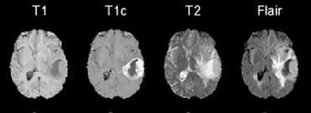
Background
Tumor chacteristics
Notes:
As for the appearnce of tumors within MRI, main tumors which we’ll be discussing such as lgiomas (inside) and meningiomas (outisde brian tissue), can be visualized using these mthods. As gliomas have high water content and appear within the brain and meningiomas appear outside of brain tissue so near the skull and are quite disruptive so can be captured with contrast enhancmenet.

Slide 7
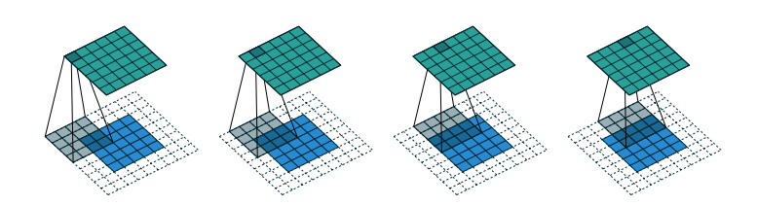
Background
Convolutional Neural Networks
Kernels
Down-sample
Padding
Notes:
In this study we’ll be using segmentation models as our main backbone for change detection. These segmentation models are based on CNN’s.
CNNś use kernels, which are small matrixes that are learnt through the models lifecycle and move over the the input data, extracting features by performing element-wise multiplicant and summations
This however can cause the original input image to downsample, losing tis spatial detail. This is why you often apply operations such as padding to maintain spatial detail.
This and operations such as pooling layers, which are FIXED operations applied to the input data, can downsample the initial input image, allowing for ease in computation and summation of most important featurs
.

Slide 8
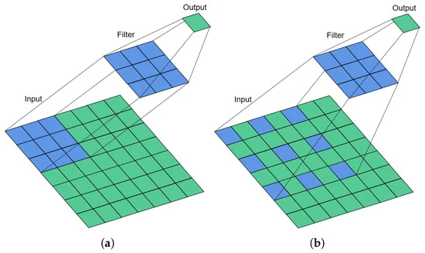
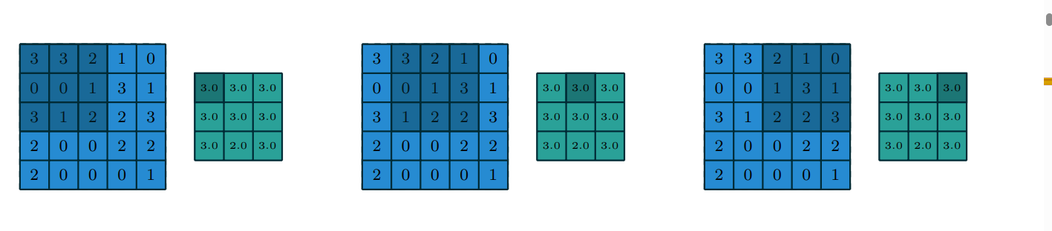
Background
Pooling
Generalisation
Computation
Receptive field (context)
Why is this important?
Loss of spatial detail
Notes:
However, CNNs prefer this loss of spatial detail for the tradeoff of retainment of the most important details. Max-pooling is often applied to only retain the highest intensity value within the model to work with the most important details to not overfit and easy computation. This results in better generalisaiton, lower computational costs and bigger receptive field because we’re working with aggregated data in a smaller field.
Why is this important?
Well, segmentation models want to extract these feature maps, to see hwere the model is exactlyfocussing on. IF we don´t pool we cant capture long-range features as we’re tied to the range of our kernel. But if we do pool we lose Losing spatial detail can be detrimental to segmentation models and thus a common approach is to use

Slide 9
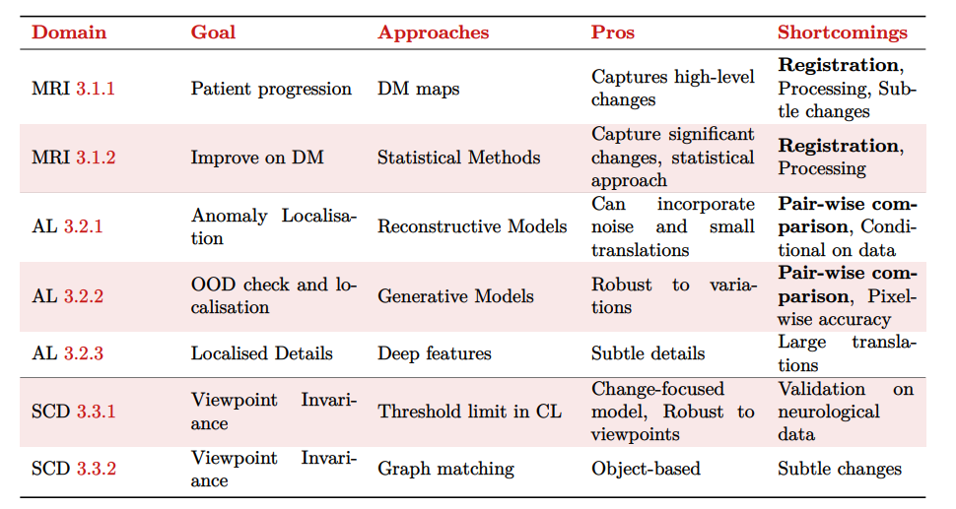
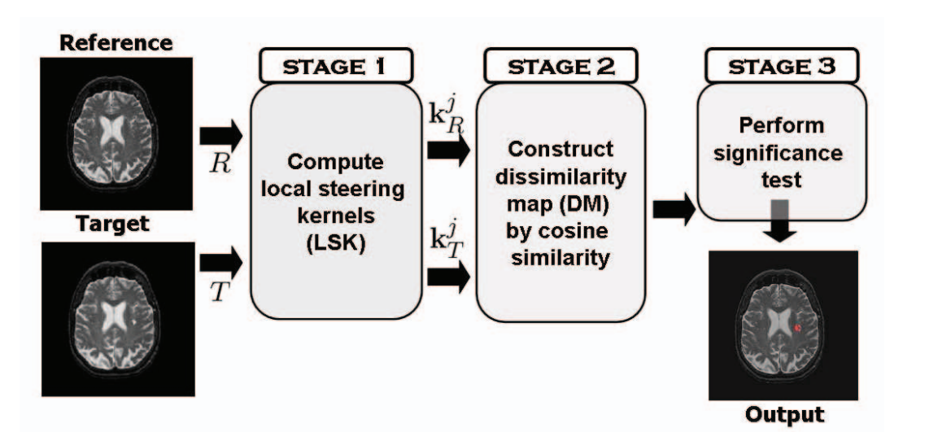
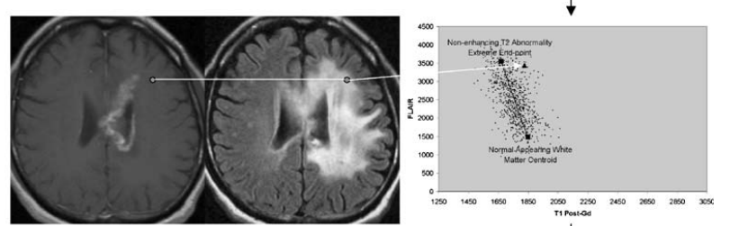
Related work
Notes:
We will also go over some related work regarding change detection. More specifically approaches and methos within the neurological MRI field such as the difference map techniques for patient progression. And several approaches within anomaly localization and scene change detection which relate to the main topic of change detection.
Well one of the most common approaches to change detection in the neurological context is by the use of difference or dissimilarity maps as we’ve sene before. These sometimes come in slightly different approaches such as with LSK but in the end always rely on subtraction of the image and some sort of post-processing
There are also some more sophisticaed statistical approaches such as by the predicition of centroids which model each tissue type in a feature space and assigning each voxel in the mri to a tissue type such as white matter and comparing it at the baseline and follow up to find out the differences.
All these methods however rely on registration, as they use some sort of subtraction or dissimilarity measure on the pixels

Slide 10
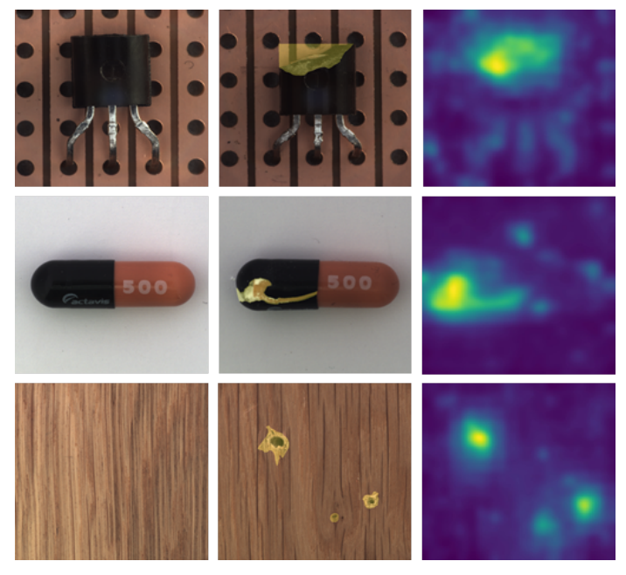
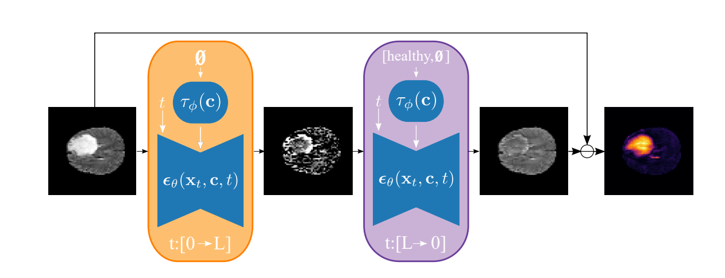
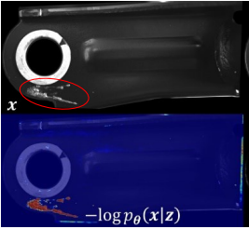
Related work
Notes:
Anomaly localisation is also a field that has been associated with change detection. Withn anomaly localisation the goal is to pixel-wise identify the changes that have happened and this can be done in ways such as reconstructive models
Reconstruction models however like difussion or ae models can train and codition model trained on for examp healthy patients and apply it on a patietn with a tumor for example, the model should not be able to reconstruct the tumor area and after a subtraction can highlight this badly reconstructed area.
For generative approaches, such as a VAE where the latent space is regularised by a distribution. We can then pass out of distribution data, to the encoder and decoder and calculate the pixel-wise log likelihood which indicates if regions are out of distribution.
Then we have deep features methods use neural networks to learn the probalisitc distribution at for example patches in the image using cnn’s and can be compared at inference when a anomalous patch is found.
These all have their pros and cons but none of them are able to inherently process image pairs and deal with unregistered images or large translations.

Slide 11
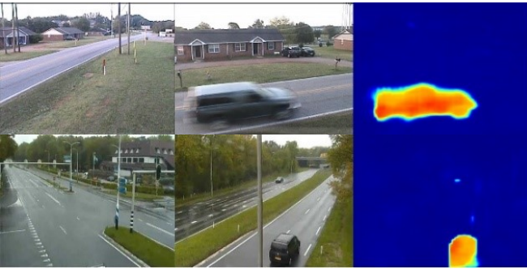
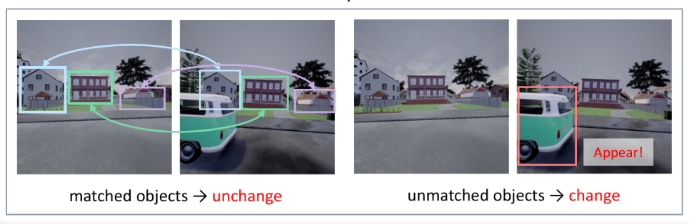
Related work
Notes:
There has also been work research done specifically on this concept of unregistered images with noise, viewpoint differences and other translations. Both these are capable of pairwise comparison implement a siamese network. The first approach uses a thresholded loss function to combat noise and insignificant changes in segmentation models while the graph matching approach compares object detected in two images to view if they matched or didn’t match.
These two methods do allow for pairwise comparison of images to identify changes but still do not provide enough clarity for their performance on for example subtle or small changes in MRI images.

Slide 12
Research Goals
“To develop an image-based method that can identify and localise changes between a baseline and follow-up MRI scan without the need for independent registration between the baseline and follow-up”
1. Identify whether an unregistered image pair exhibits any significant tumour changes
2. Identify and localise pixel-level tumour changes in unregistered image pairs
3. Visualise high-level structural and tissue composition changes in unregistered image pairs
Notes:
We form a research goal for this study which is to..
And we form three subgoals which are

Slide 13
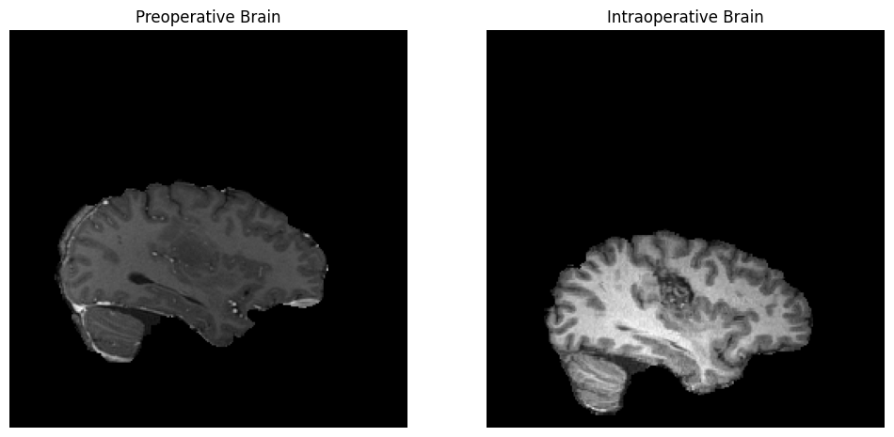
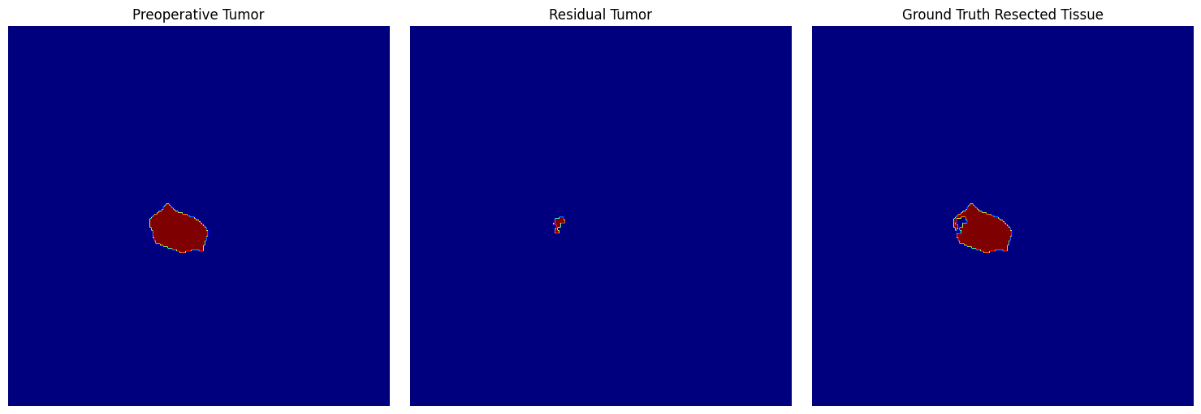
Methodology - Data
Tumor resection data
ReMIND dataset
n = 65, volumetric
T1, T2 and FLAIR
Notes:
For our research we will be using tumor resection data, so we will have MRI scans before and during the operation. We particularly use the ReMIND data set consisting of 100+ patients.
Of which weuse 65 as these contained the right data we needed. This would be the preoperative state brain and tumor segmentation and the intraoperative brain and residual tumor segmentation state.

Slide 14
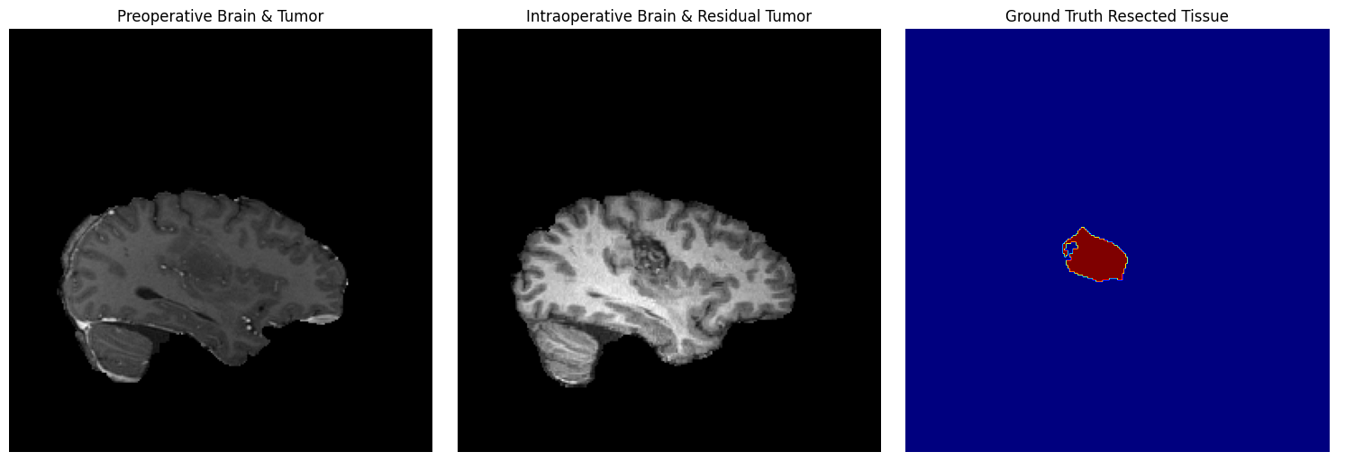
Methodology - Data
Create slices (2D)
n = 5000
Generate ΔT
Label triplets (P0, P1, ΔT)
(P0, P1, ΔT, y)
Notes:
We however, need 2 dimensional data and some sort of ground truth for what has exactly changed. Therefore we convert all volumetric data to 2D. And then we generate what we call a ground truth change map. We call this delta T by just taking the pixel-wise subtraction of these segmentations.
We then create triplets, the preoperative brain state and intraoperative brain state and ground truth change between them

Slide 15
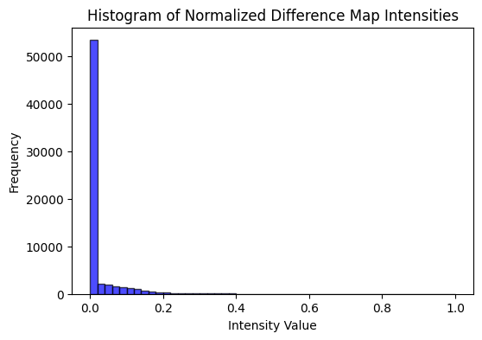
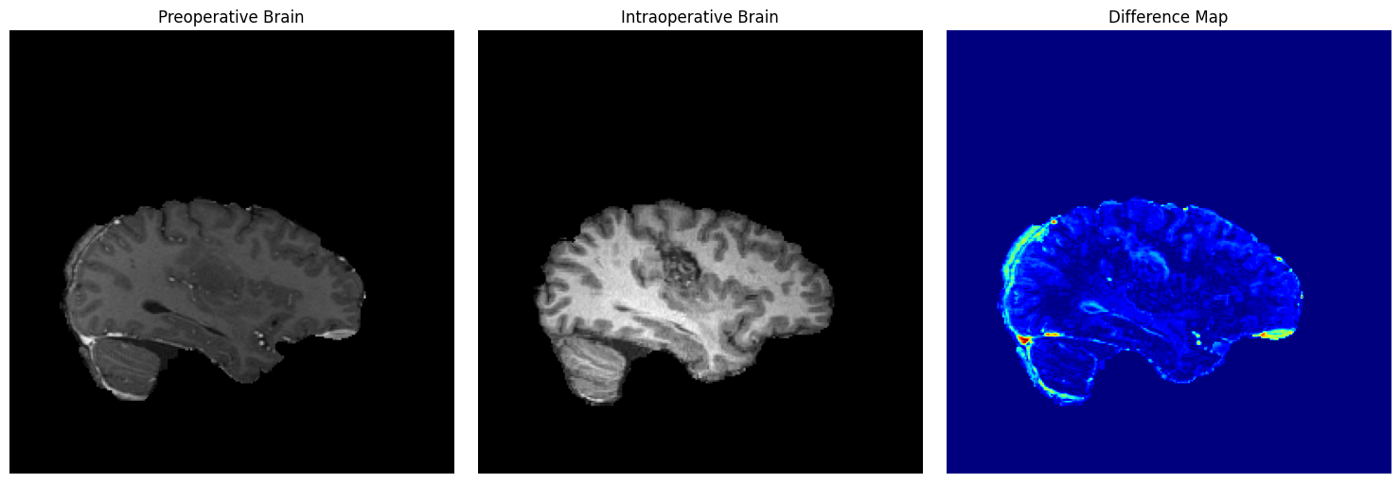
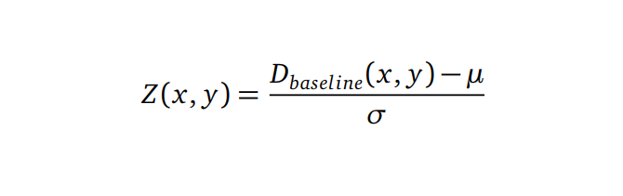
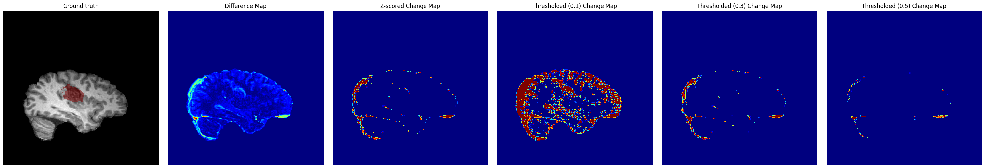

Methodology - Baseline
Baseline approaches
Constraint → registration
Normalised DM
Significance thresholds
Notes:
Before we jump into our approach we also consider some baseline approaches based on what is already sued in the neurological field.
We do need to highlight here that registration is performed, as we cannot apply these methods on unaligned images.
We used a dissimilarity map to highligh a raw difference map and then use diferent thresholding techniques to filter out significant changes.

Slide 16
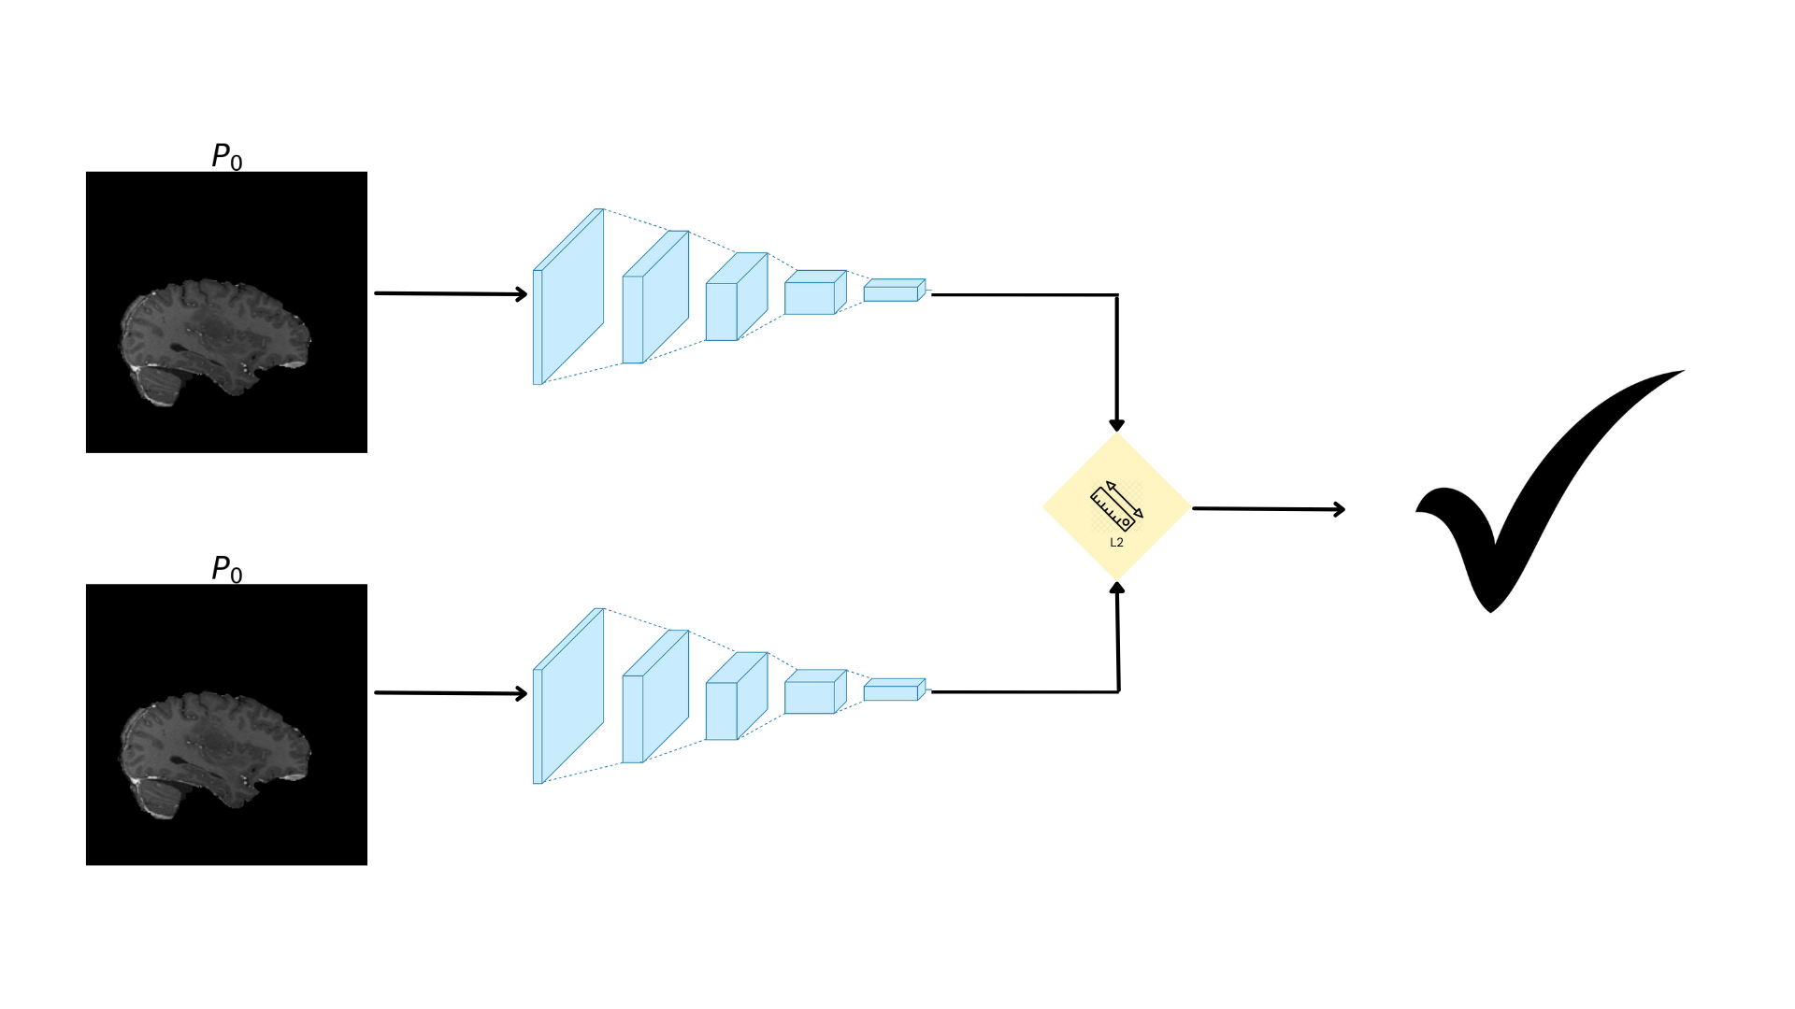
Methodology - Conceptual
Inspired by Guo et al. (2018)
Siamese network
Face recognition
Feature comparison
Notes:
We propose an CD appraoch inspired by guo et al fro the SCD approaches in surveillances cameras. Our approach oss based on the Siamese network architecture. This architecture allows you to pass two images, reusing the same model weights. This technique is used for example a lot for face recognition and checking signatures by comparing features by distance. We can for example pass two similar images and calcluate their distance to check if they indeed are similar

Slide 17
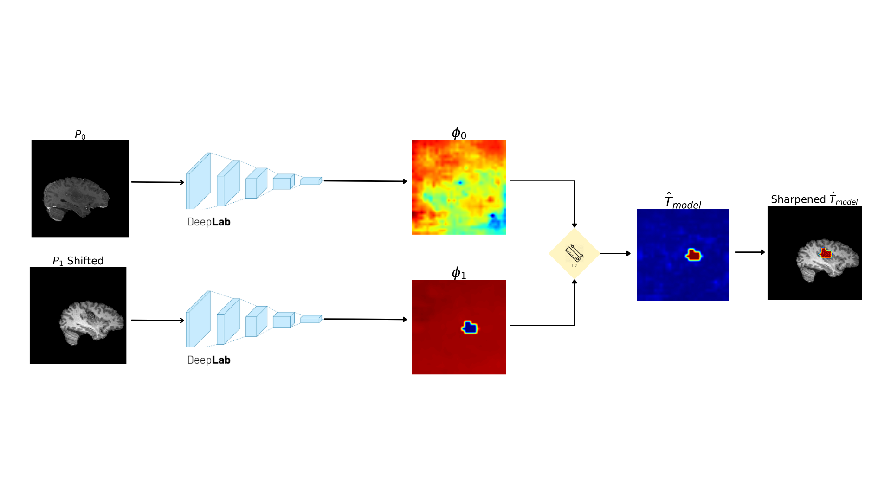
Methodology - Conceptual
Localize change
Context range
No loss of spatial details
Notes:
However, we want to move a step further and localize this change and thus work not with regular CNNś but a segmentation model, namely deeplabV3 to compare the feature maps and get a segmentation map out.
Why specifically DeepLabV3 and not a reguklar CNN, well we discussed earlier that cNN’s tend to down-sample images by applying pooling and CNN. Well deeplab combats this by using a thing called dilation

Slide 18
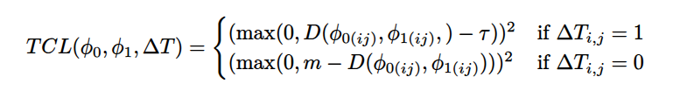
Methodology - Training
Deal with lack of registration and noise
Euclidian distance
Relax penalization
(Dis)similarity is a range
Notes:
Our model needs to be able to deal with noise and unaligned images
, so just takign the euclidian distance between segmentation maps will always result in a wrong answer.
We therefore use an adapted contrastive loss based on euclidian distance that relaxes the euclidian distance.
This it how it works:
- First we input two images, to identify the changes and get back phi0-1 and the actual change map
- IF the pixel we’re looking at right now is not a changed pixel in our ground truth map
- Attribute a loss if the distance between the feature maps pixels is above this tau threshold
- Else if the pixel you’re looking at right now IS in reality an are of resected tumor tissue
- Attribute a loss if this distance is below the m margin

Slide 19
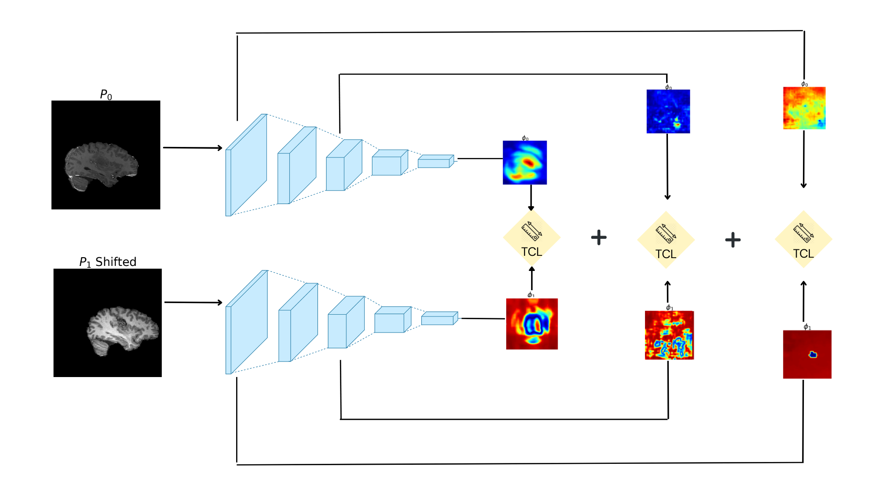
Methodology - Training
Multi Layer Side Output
Control feature map flow
Not during inference
Notes:
For the

Slide 20
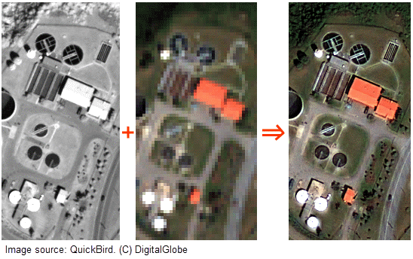
Methodology - Inference
Panchromatic Sharpening
High-level MRI features on change map
Notes:
So post-training we now want to extract the actual change map and visualize the structure of the changed area, so the distance between these features and visualize it.
What we use for this is a technique called panchromatic sharpening, basically we have a grayscale high resolution base image and a low resolution color image and in sattelite imagery you are able to use the grayscale image for its high level features and enhance the color image.
We apply this to our change map, where we apply the high level features here.

Slide 21
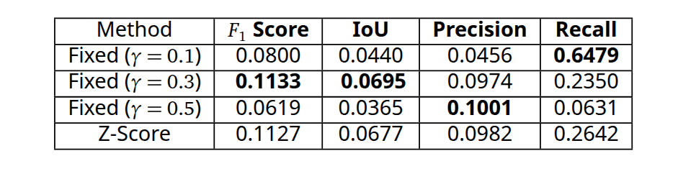
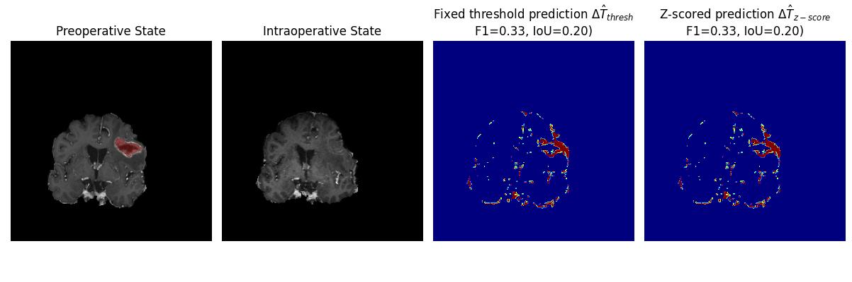
Results - Baseline
Registered
N = 500
Fixed = 0.3

Slide 22
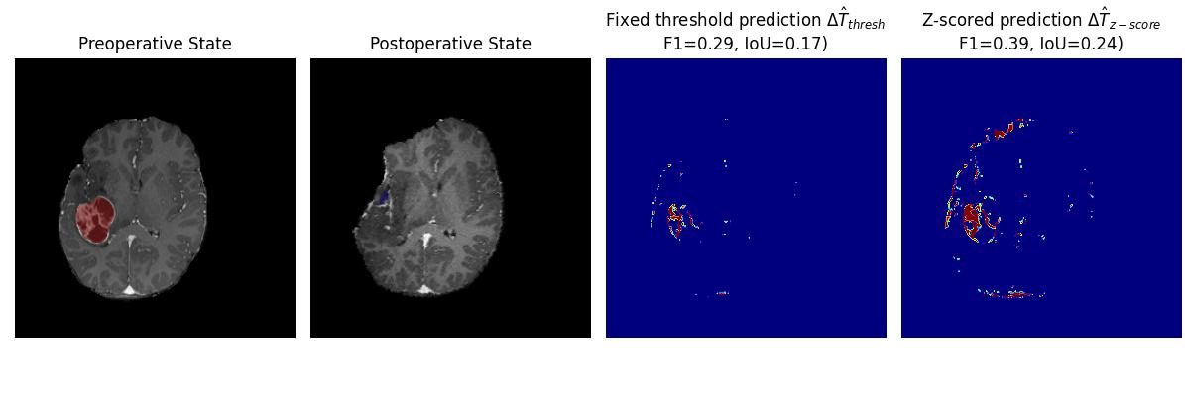
Results - Baseline
0.5 thresh

Slide 23
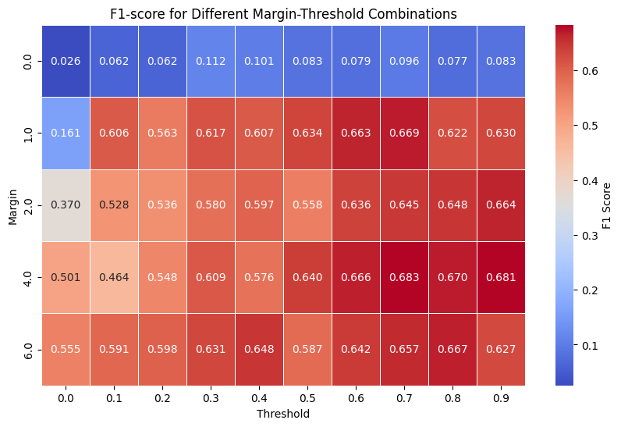
Results - RiA
Registration-invariant

Slide 24
Discussion

Slide 25
Discussion

Slide 26
Discussion

Slide 27
Discussion

Slide 28
Conclusion

Slide 29
Example chart - Column

Slide 30
Example chart - Column

Slide 31
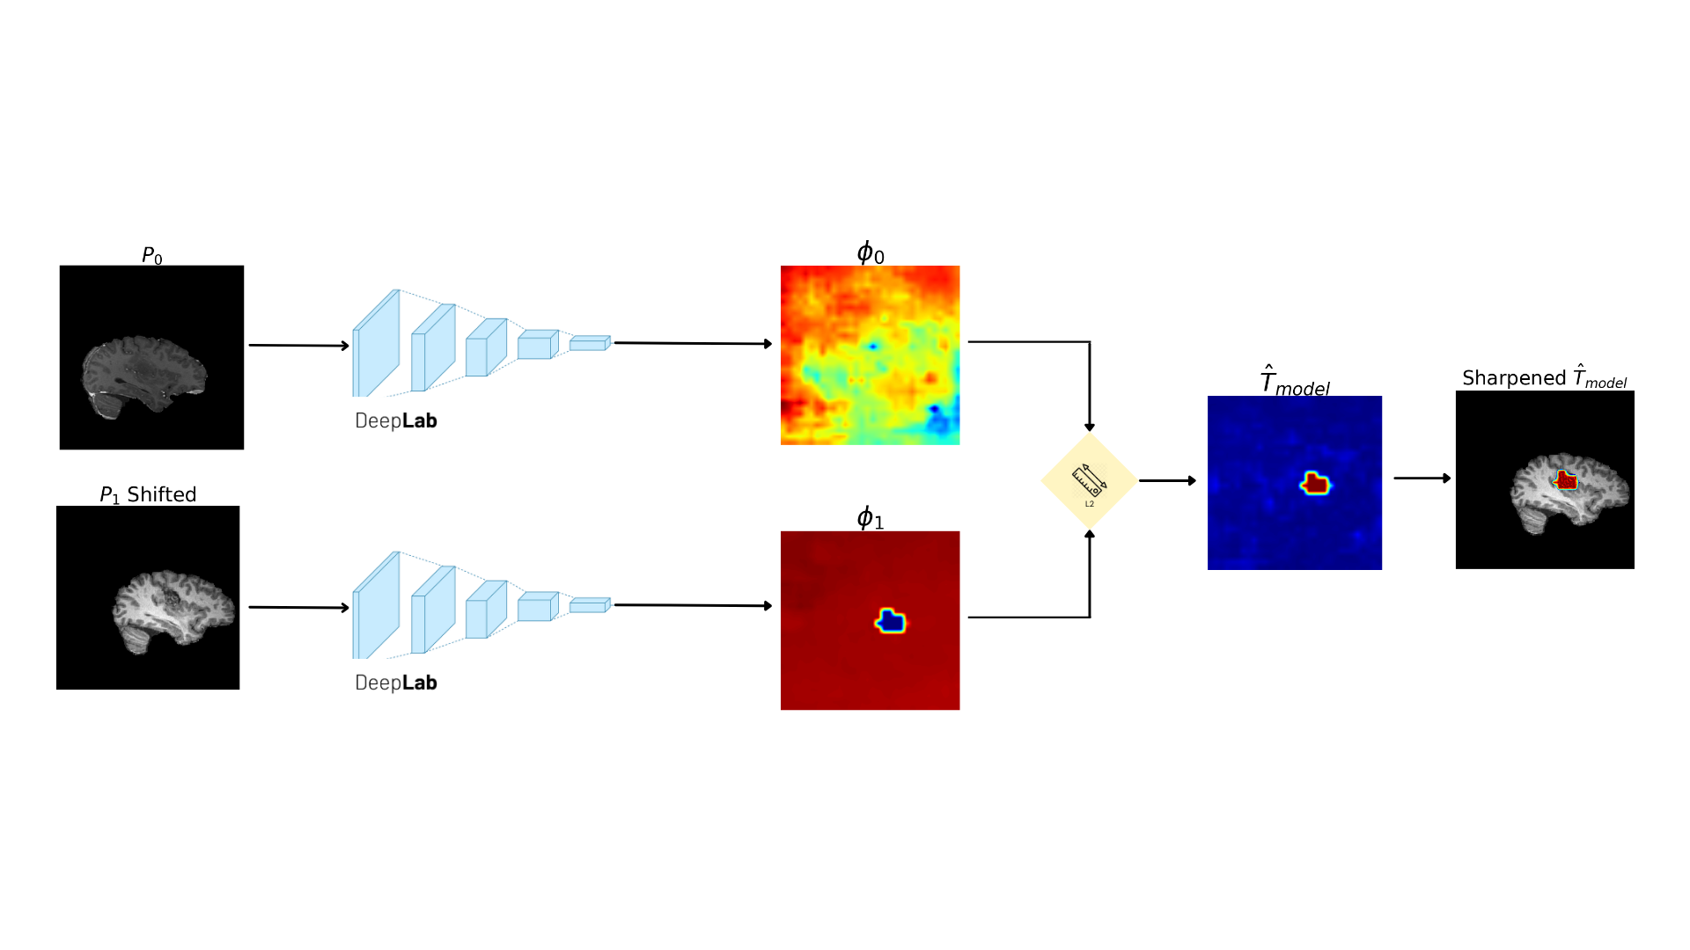
Example chart - Column

Slide 32
Example chart - Column

