Slide 1
Selenium XPath
Most powerful seletor

Slide 2
Primary difference
XPath we can traverse both forward and backward whereas CSS selector only moves forward
XPath can search by text, using contains functionality

Slide 3
General locator strategy
ID first
CSS selector for everything else
When nothing else works, use XPath

Slide 4
What is XPath?
XPath is defined as XML path.
XPath is used to find the location of any element on a webpage using HTML DOM structure.

Slide 5
Types of X-path
There are two types of XPath:
1) Absolute XPath
2) Relative XPath

Slide 6
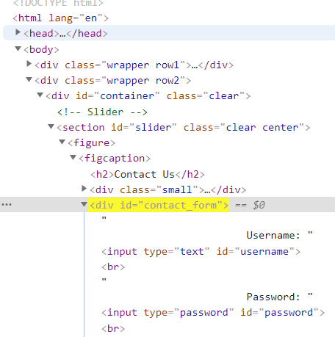
Absolute xpath:
Relative xpath:
/html/body/div[2]/div/section/figure/figcaption/div[2]
//*[@id="contact_form"]

Slide 7
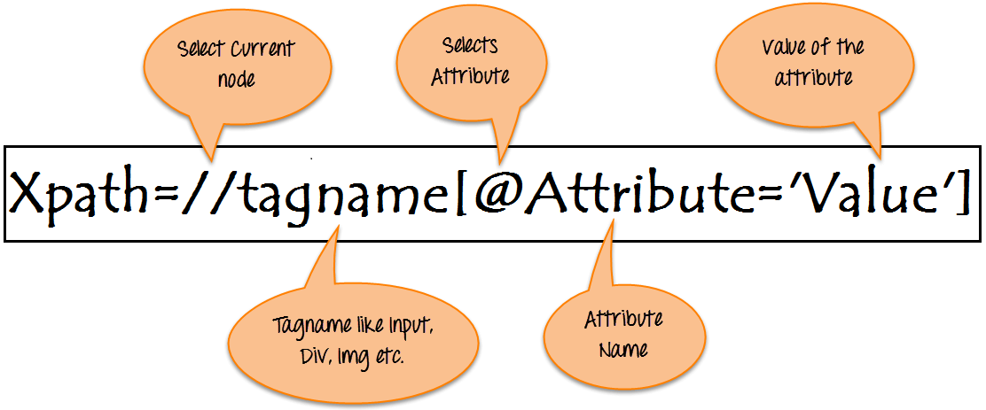
Basic format of Relative XPath

Slide 8
Basic XPath
Xpath=//input[@type='text']
Xpath=//label[@id='message23']
Xpath=//input[@value='RESET']
Xpath=//*[@class='barone']
Xpath=//a[@href='http://demo.guru99.com/']
Xpath= //img[@src='//cdn.guru99.com/images/home/java.png']

Slide 9
Contains():
Xpath=//*[contains(@type,'sub')]
Xpath=//*[contains(@name,'btn')]
Xpath=//*[contains(@id,'message')]
Xpath=//*[contains(@href,'guru99.com’)]
Xpath=//h2[contains(text(),'Popular right now')]

Slide 10
Starts-with function
Xpath=//label[starts-with(@id,'message')]
Ends-with function
Xpath=//label[ends-with(@id,'message')]
The ends-with function is part of xpath 2.0 but browsers generally only support 1.0

Slide 11
Using OR & AND
Xpath=//*[@type='submit' or @name='btnReset']
Xpath=//input[@type='submit' and @name='btnLogin’]
Xpath =//span[@role='menuitem' or @class='text-gray-darker’]
Or = || in java
And = && in java
Xpath =//a[@id='item_0_title_link' or @href='./inventory-item.html?id=0']

Slide 12
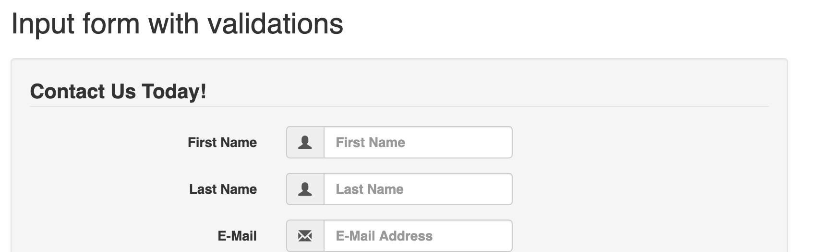
Text()
Xpath=//*[text()='First Name']

Slide 13
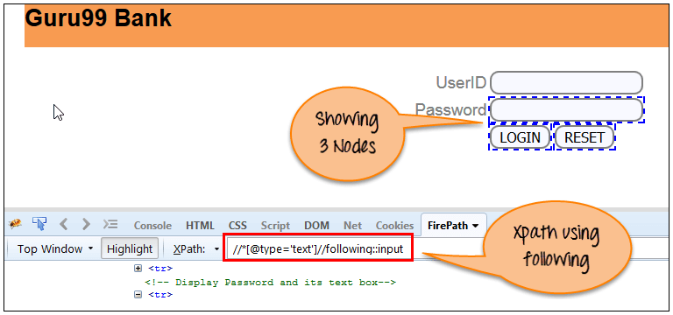
Following
following: This function will return the following elements of the particular component.
Xpath=//*[@type='text']//following::input

Slide 14
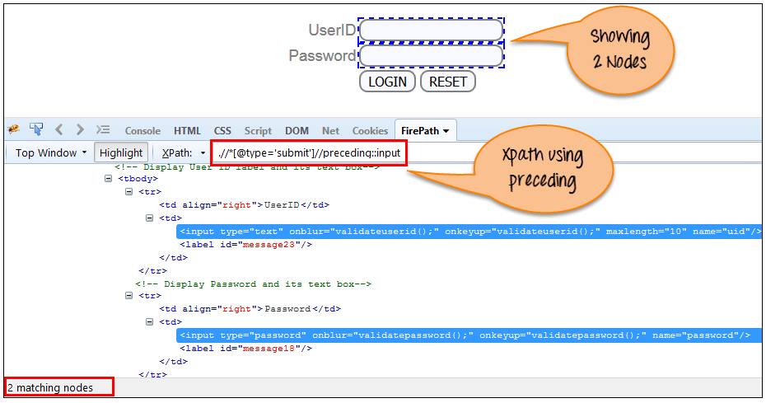
Preceding
Xpath=//*[@type='submit']//preceding::input
all nodes that come before the current node
(//div[@class='inventory_item'])[3]/preceding-sibling::div

Slide 15
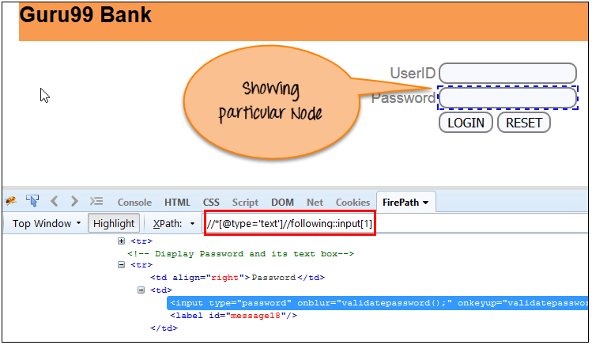
By Index []
Xpath=//*[@type='text']//following::input[1]

Slide 16
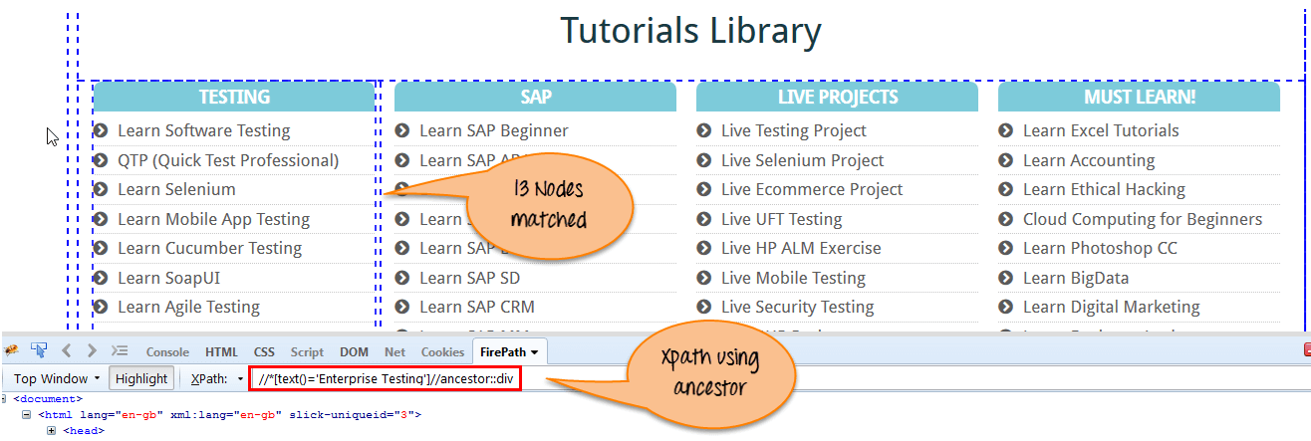
Ancestor
Xpath=//*[text()='Enterprise Testing']//ancestor::div
//div[text()='Sauce Labs Backpack']//ancestor::div
selects all ancestors element (grandparent, parent, etc.)
Xpath=//*[text()='Enterprise Testing']//ancestor::div[1]

Slide 17
Child
Xpath=//*[@id='java_technologies']//child::li
Xpath=//div[@class='cart_list']//a
Selects all children elements of the current node

Slide 18
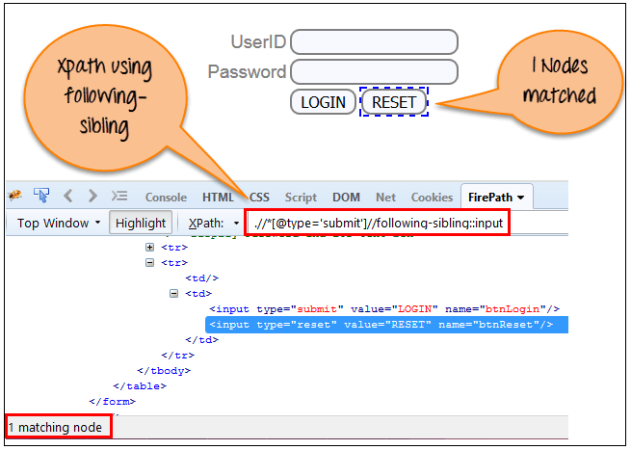
Following-sibling (siblings on same level)
xpath=//*[@type='submit']//following-sibling::input
Preceding-sibling

Slide 19
.. going up one level
xpath=//*[@type='submit']/../span
Xpath=//*[text()='ADD TO CART']/parent::div

