Slide 1
Selenium Basic Methods
Closer look at selenium

Slide 2
WebElement methods
void click(); Clicking on the element.
void submit();
void sendKeys(CharSequence... keysToSend); type in the element
void clear();
String getTagName();
String getAttribute(String name); //image.getAttribute("naturalWidth").equals("0")
boolean isSelected();
boolean isEnabled();
boolean isDisplayed();
String getText();
String getCssValue(String propertyName);
WebElement findElement(By by);
List<WebElement> findElements(By by);

Slide 3
WebDriver Methods
void get(String url);
String getCurrentUrl();
String getTitle();
WebElement findElement(By by);
List<WebElement> findElements(By by);
String getPageSource();
void close();
void quit();

Slide 4
WebDriver Methods
Navigation navigate();
void driver.navigate().to(String url);
void driver.navigate().back();
void driver.navigate().forward();
void driver.navigate().refresh();
Options manage();
Timeouts driver.manage().timeouts();
Window driver.manage().window();
TargetLocator switchTo();
driver.switchTo().frame(String nameOrId);
driver.switchTo().alert();
Driver.switchTo().window()’

Slide 5
What’s a Browser Cookie?
Cookies are small pieces of information websites store on your computer. The information can be a user ID, session ID, or any other text. When you load the website in the future, the browser sends along the cookie to the website, the website can examine the cookie and recognize you.
If you clear your cookies, you’ll be logged out of all websites and websites won’t recognize you.
Cookies are very common – you probably have hundreds or even thousands stored in your browser right now.

Slide 6
What is a timeout
A period of time to wait for an event to occur, if event does not occur, waiting will be interrupted and possibly an error thrown
Examples:
Wait for element to be found
Wait for script to execute
Wait for page to load

Slide 7
Timeouts (Implicit waiting)
driver.manage().timeouts().implicitlyWait(long time, TimeUnit unit);
Specifies the amount of time the driver should wait when searching for an element
driver.manage().timeouts().setScriptTimeout(long time, TimeUnit unit);
Sets the amount of time to wait for an asynchronous script to finish execution before throwing an error.
driver.manage().timeouts().pageLoadTimeout(long time, TimeUnit unit);
Sets the amount of time to wait for a page load to complete before throwing an error.

Slide 8
Window
void maximize();
void fullscreen();
Dimension getSize();
void setSize(Dimension targetSize);

Slide 9
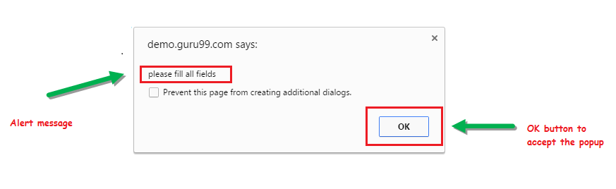
Simple Alert

Slide 10
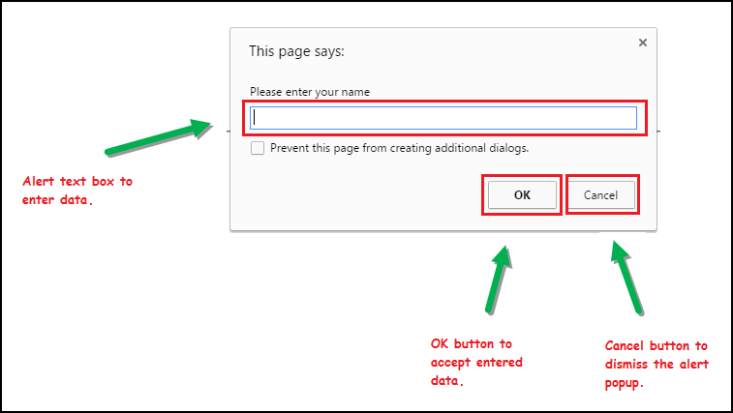
Prompt Alert

Slide 11
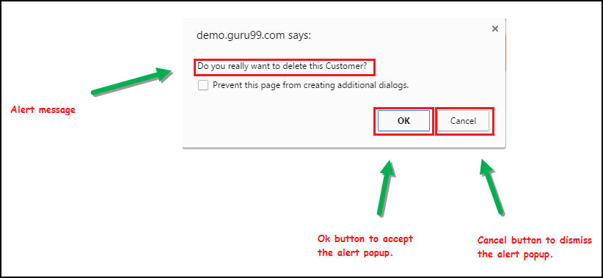
Confirmation Alert

Slide 12
Alert
driver.switchTo().alert().dismiss();
driver.switchTo().alert().accept();
driver.switchTo().alert().getText();
driver.switchTo().alert().sendKeys("Text");

Slide 13
Select Class
Models a SELECT tag, providing helper methods to select and deselect options
<select name="cars" id="cars"> <option value="volvo">Volvo</option> <option value="saab">Saab</option> <option value="mercedes">Mercedes</option> <option value="audi">Audi</option> </select>

Slide 14
Select Methods
selectByVisibleText()/ deselectByVisibleText() | selects/deselects an option by its displayed text
selectByValue()/ deselectByValue() | selects/deselects an option by the value of its "value" attribute
selectByIndex()/ deselectByIndex() | selects/deselects an option by its index (0 based)
isMultiple() | returns TRUE if the drop-down element allows multiple selection at a time; FALSE if otherwise
deselectAll() | deselects all previously selected options
import the org.openqa.selenium.support.ui.Select package
create a Select instance.
Select cars = new Select(driver.findElement(By.id(“cars")));

