Slide 1
Data Science Challenge
Data Intelligence Application

Slide 2
General remarks
Please submit your results as documented program code and a suitable presentation format containing the created visuals (e.g., architecture, charts, API documentation).
Explain the steps that brought you from the input data and problem description to the final deliverable.
Provide a methodology explanation in addition to the program code.
Utilize a markup environment with analytics implementation (e.g., iPython/Jupyter Notebooks) if possible.
Completing all examples is not necessary; the focus is on the approach taken.
Try to complete one of the given examples (failure prediction or regression analysis) with the information given in this presentation, without requesting more details.

Slide 3
Failure prediction with aggregated data
First example

Slide 4
First example Description
The first challenge evaluates your approach to predictive maintenance in a real-world scenario.
The goal is to model and predict component failures. Decide which vehicle should undergo a preventive technical action.
The provided data is already prepared and filtered, and each instance/vehicle is classified as "DAMAGE" or "NO DAMAGE."
Each row corresponds to a unique vehicle identified by an anonymized chassis number, with a limited number of features for this challenge.
The cost for the technical action per vehicle is €600 and for a reactive action (fixing after failure) is €2,000, and a decrease in customer satisfaction and company reputation.

Slide 5
First example Possible Tasks to Perform
Exploratory Data Analysis: Start by performing EDA to understand the data's distribution, identify any patterns, and gain insights into the relationship between features and the target variable. This will help in making decisions about feature selection and engineering.
Data Preprocessing: Clean the data and handle any missing values. Convert categorical variables to numerical representations if needed.
Feature Engineering and Selection: Analyse the features' relevance and importance in predicting component failure. Since interpretability is desired, the candidate may choose to select a subset of features or create new features that are more informative and interpretable. For instance, they could aggregate or combine related features or derive domain-specific metrics.
Algorithm Selection: Given the preference for interpretability, the candidate may first try simple, interpretable models. Then, they can gradually move to more complex models, comparing their performance and interpretability.
Model Training and Evaluation: Split the data into training and validation sets. Train the selected models on the training set and evaluate their performance on the validation set using appropriate binary classification metrics.
Final Model Selection: Based on the evaluation results, the candidate should choose the best-performing model that meets the interpretability requirements for predicting component failures.
Cost-Benefit Analysis: Apply developed model on the vehicle fleet and decide which vehicles need technical interventions.
Visualization: Create visualizations that can help to understand the model's performance, stability and its behaviour.
Reporting: Provide an explanation of your modelling approach, feature selection, model evaluation process and the reasons behind choosing the final model and argue your cost-benefit analysis.

Slide 6
First example Overview of the data
Feature | Description
PSEUDO_VIN | Encrypted VIN for identification of individual instances
TONDUR | A variant of an operating hours counter
EngSpDist_K{1,14} | Distribution of the residence time in 14 disjoint areas of the engine speed range; the idling of the engine takes place in the area of class K1 (sorted in ascending order)
AmbTempDist_K{1,10} | Distribution of the residence time in 10 disjoint areas of the outside temperature; the temperature increases from K1 to K10 (sorted in ascending order)
MILEAGE | Mileage of the vehicle during the diagnosis
DIAGNOSIS_DATE | The date of the readout
REPAIR_DATE | Date of repair (if present, the vehicle has the label "DAMAGE")
TACHOMETER_IN_KM | Mileage during the repair (if present, the vehicle has the label "DAMAGE")
LABEL | Certain class affiliation based on repair history; Target variable for the binary classification

Slide 7
Regression analysis on time series data
Second example

Slide 8
Second example Task Description
In this challenge, you are provided with a dataset containing signals from the high-voltage (HV) battery of an electric vehicle, along with information about the vehicle's usage over a certain time frame.
Your objective is to develop a regression model that accurately predicts the state of health (SoH) of the HV battery based on these signals and usage data. However, the dataset may have issues that need to be addressed, such as cleaning requirements, spikes, varying singal sampling rates, outliers, ...

Slide 9
Second example Suggested Tasks to Perform
Data Cleaning: Prepare the dataset by addressing missing values and eliminating outliers or spikes in the HV battery signals that are physically implausible. Some signals might not be relevant to the task.
Feature Engineering and Selection: Analyze the dataset to identify relevant signals and usage-related features that may influence the state of health of the HV battery. Utilize appropriate techniques for feature selection to improve model performance.
Data Visualization: Create visualizations to gain insights into the HV battery signals and usage patterns, helping to understand their relationships with the state of health.
Modelling Approach: Choose an appropriate regression model algorithm to predict the state of health of the HV battery. Clearly describe the model you selected and the reasons for your choice.
State of Health (SoH) Regression Analysis: Perform a detailed regression analysis to understand the relationship between the selected features and the state of health values of the HV battery.
Validation Strategy: Decide on a suitable validation strategy to assess the model's performance.
Evaluation Metrics: Choose appropriate metrics to evaluate the performance of your regression model.
Confidence Bands: Calculate confidence bands for the model's precision to account for uncertainties arising from data quality and potential model blind spots.
Model Interpretability: Discuss the interpretability of the selected regression model and explore methods to make it more understandable.

Slide 10

Second example Overview of the data
Battery signals [unit]:
Electric Vehicle Battery Current [Amp]
Electric Vehicle Battery Pack Voltage [V]
Vehicle Battery Voltage [V]
Vehicle Battery Voltage (Battery 2) [V]
High Voltage Battery Maximum Cell Voltage [V]
High Voltage Battery Minimum Cell Voltage [V]
High Voltage Battery Maximum Cell Temperature [°C]
High Voltage Battery Minimum Cell Temperature [°C]
HV Battery Positive Contactor Temperature [°C]
High Voltage Battery Coolant Inlet Temperature [°C]
Normalised Cumulative Battery Discharge When Ignition Is On [Cn]
Normalised Cumulated Discharge From Battery When Engine Off [Cn]
Electric Vehicle Battery - Displayed State Of Charge [%]
Electric Vehicle Battery - Maximum State Of Charge [%]
Electric Vehicle Battery - Minimum State Of Charge [%]
Battery SoH indicators [unit]:
Electric Vehicle Battery - Minimum State Of Health (Capacity Fade) [%]
Electric Vehicle Battery - Maximum State Of Health (Capacity Fade) [%]
Electric Vehicle Battery - Minimum State Of Health (Power Fade) [%]
Electric Vehicle Battery - Maximum State Of Health (Power Fade) [%]
Timestamps:
Global Real Time
ABS_TIME
Vehicle signals [unit]:
Vehicle Speed Sensor [km/h]
Total Distance [km]
Cabin Temperature [°C]
External Ambient Temperature [°C]
Air Quality Sensor [%]
Driver Seatbelt Sensor State [-]

Slide 11
Data Engineering Workflow
Bonus

Slide 12
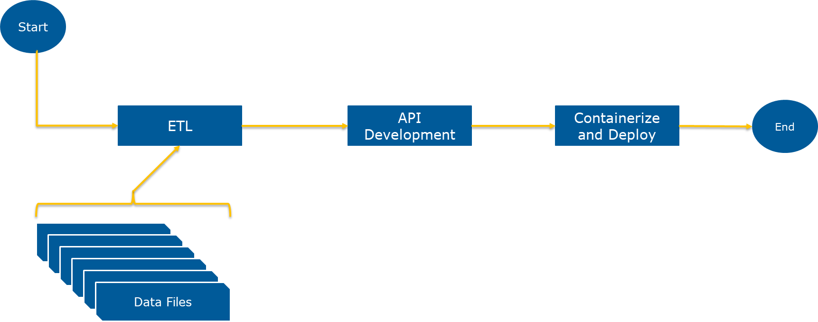
Data Processing Workflow
You will get bonus points if you can use the following process workflow for any of the previously mentioned tasks:

Slide 13
Workflow Steps
Build up a simple ETL pipeline
Extract meta-data and signals of interest from the raw measurements
Create a simple database schema and store the extracted data in a database you prefer
Write a few SQL statements to load the data from the database
API Development
Develop an API that interacts with the database created within the ETL process
The API should include at least one endpoint of type POST, GET and DELETE
The API should have the inference endpoint (in case of a developed model)
Containerize your solution and deploy the build and serve it locally

Slide 14
Questions
General Topics

Slide 15
Questions / Scenarios
How can you avoid overfitting your model?
You are given a data set consisting of variables with more than 30 percent missing values. How will you deal with them?
How would you validate the correctness of a complex algorithm, especially if the input data is changing over time?
How would you deploy a trained model? How would you monitor and maintain?
How would you integrate GitHub actions or GitLab CI/CD pipelines?
You are in contact with a premium OEM customer. They have very huge warranty costs for one of their powertrain components. They would like to have a predictive maintenance project with your team to reduce future warranty costs. But unfortunately, they have no customer data from the field available. What would you suggest for a possible PoC?

