Slide 1
AVL – Challenge Adil Mukhtar (adilmukhtar600@gmail.com)

Slide 2
Vehicle Damage Classification
Task completed
Data Analysis
Model Selection and Development
REST APIs
MongoDB
Logging data for future model improvements along with predictions
Image and containerization

Slide 3
Data Analysis & Model Development
Feature Selection
Data Preprocessing
Model Comparison
Model Selection
Data Analysis
Modeling
Model Save
Feature Analysis
Feature Engineering
Model Training
Hyperparams
Optimization

Slide 4
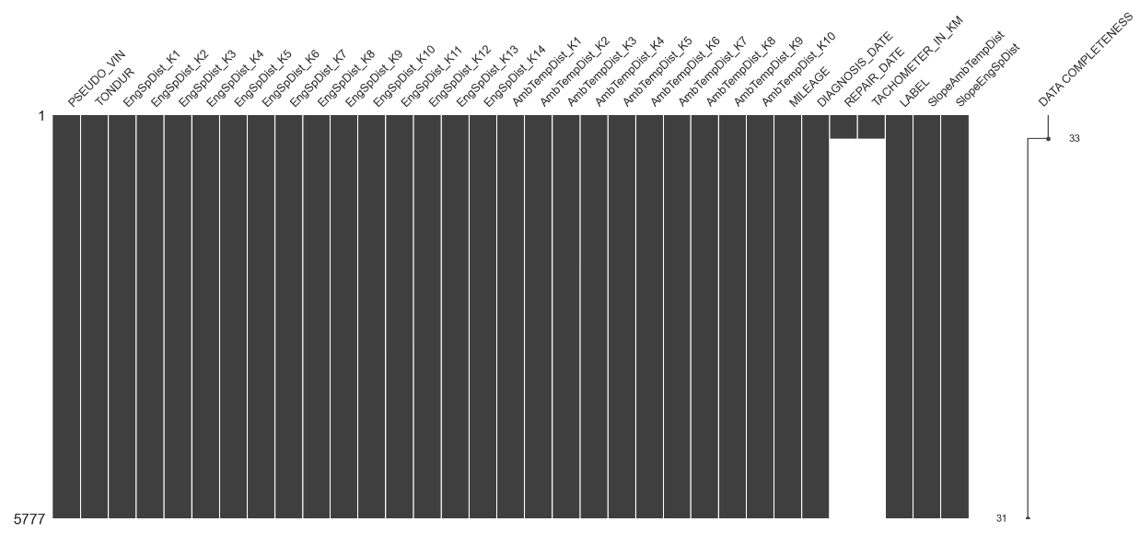
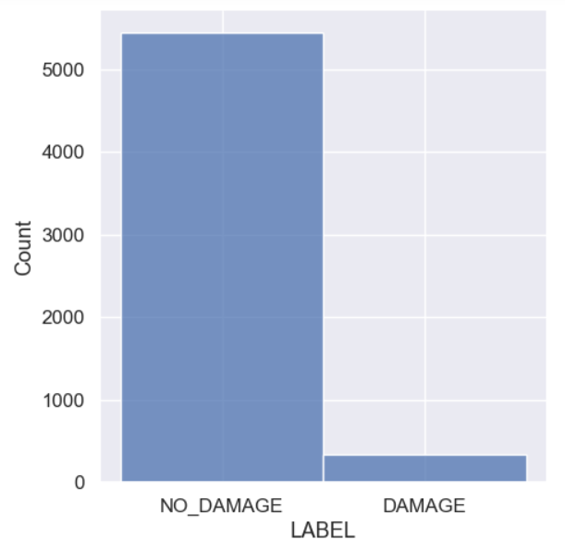
Data Analysis
Highly imbalanced dataset
5.82% data available for damage class
More than 90% of the data is missing for REPAIR_DATE and TACHOMETER_IN_KM variables
No duplicate records

Slide 5
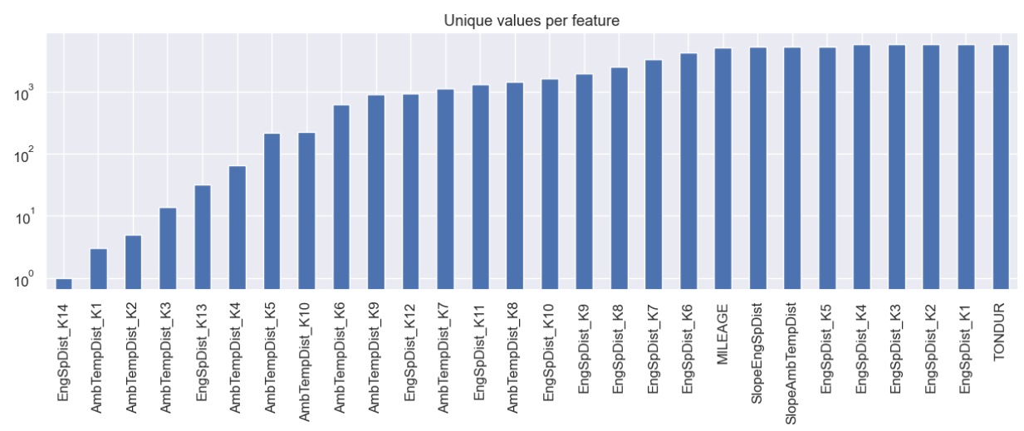
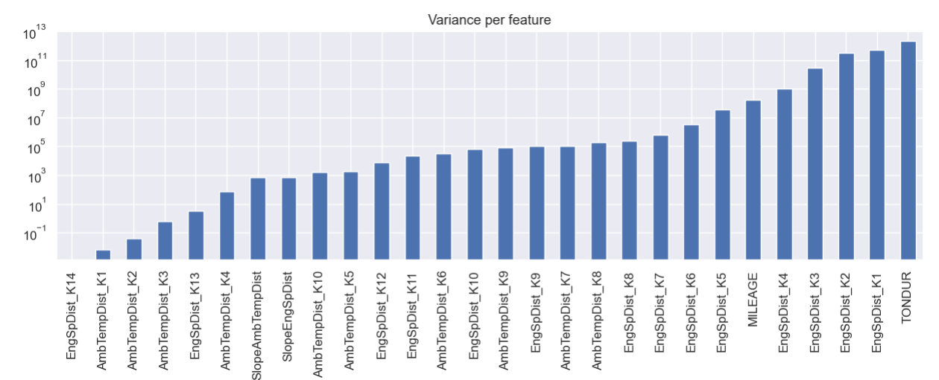
Data Variance
Variance is low for various features, e.g., EngSpDist_K14, AmbTempDist_K1, etc.
Cut off at AmbTempDist_K4

Slide 6
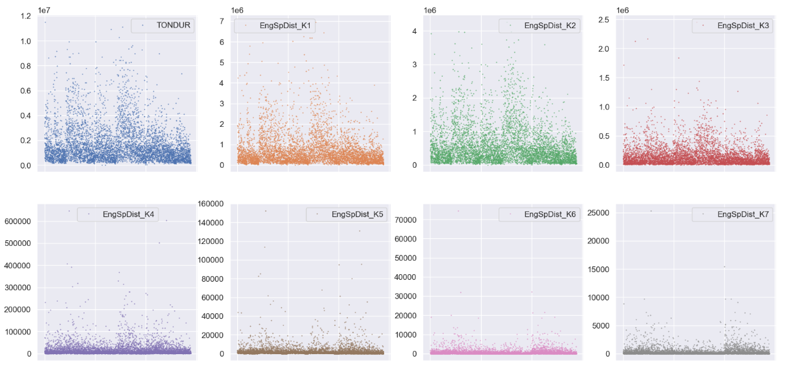
Data Correctness
Plotting data points with idx and values to see the overall correctness of the data
The data looks correct as the values are in specific range, there are outliers as the distribution are extremely +ve skewed

Slide 7
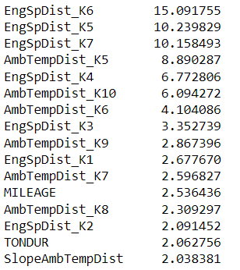
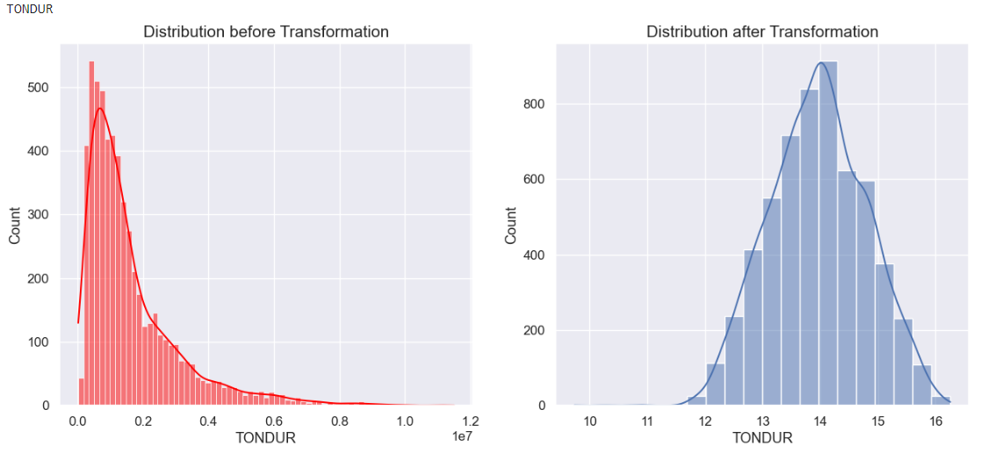
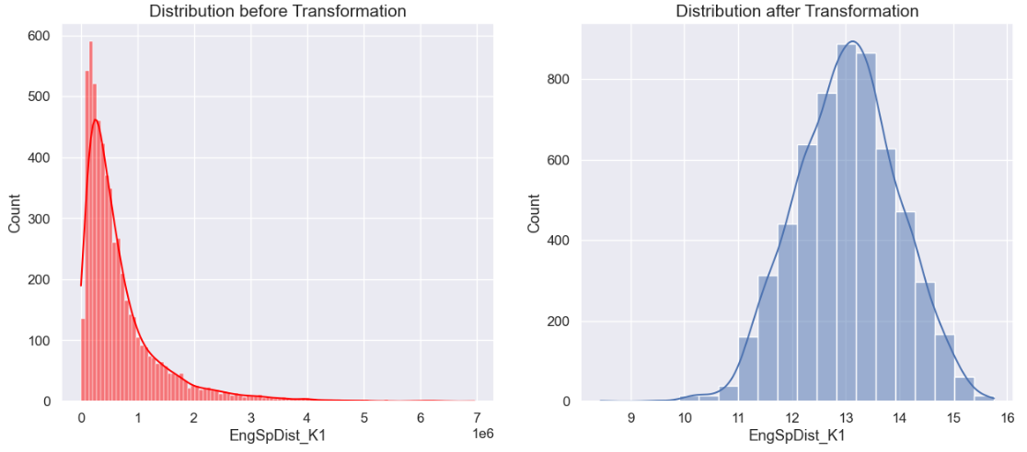
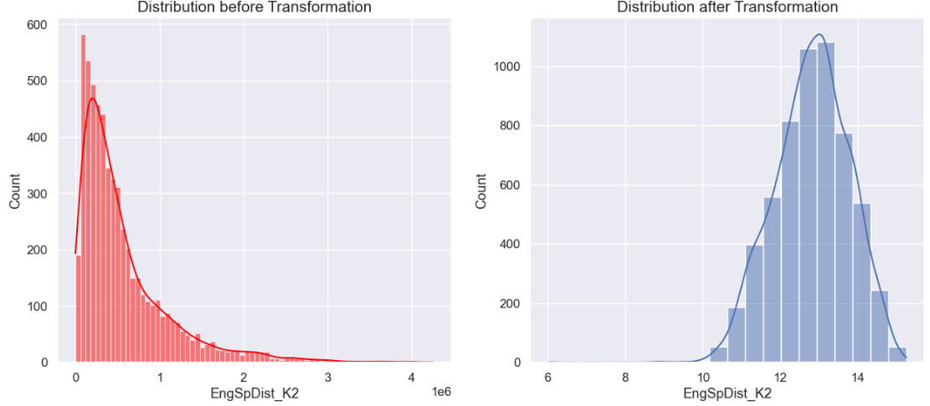
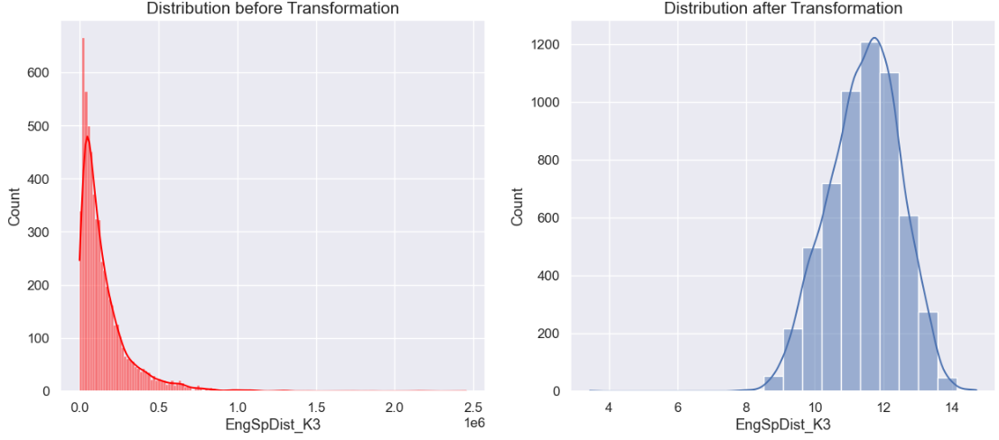
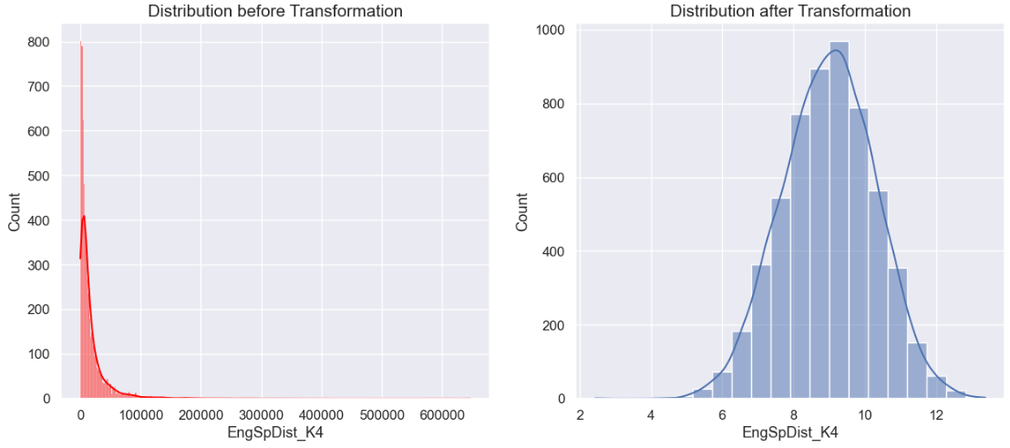
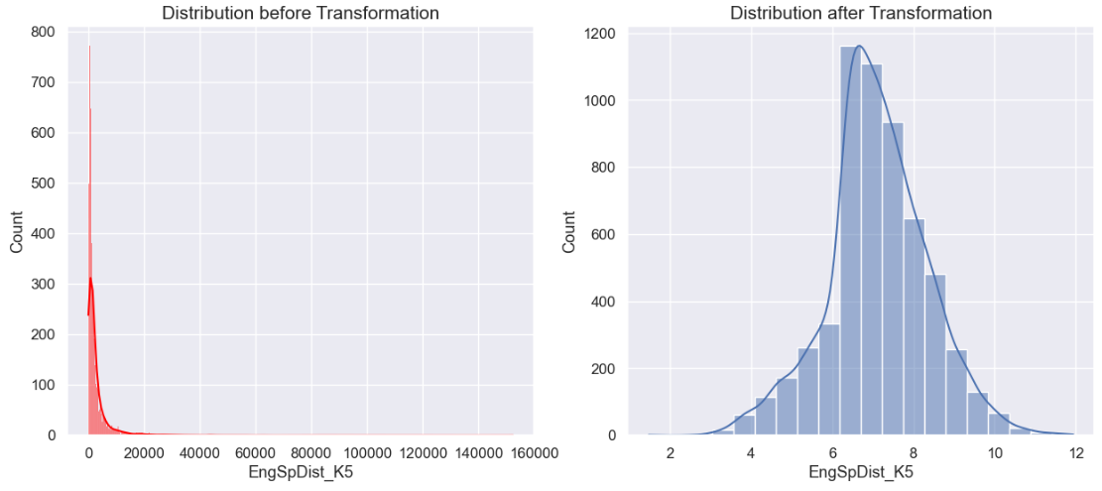
Skew Analysis
Log transformation

Slide 8
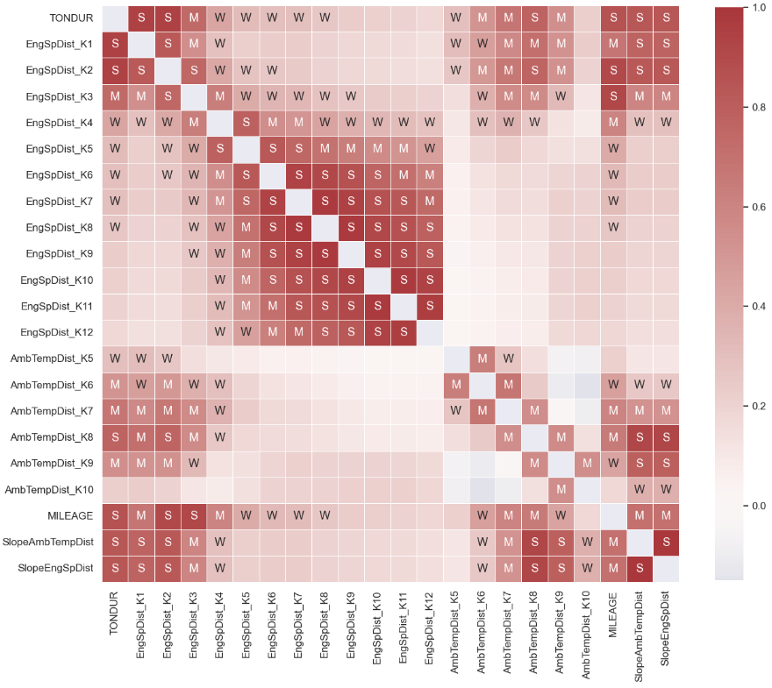
Correlation Analysis.
Many features are highly correlated
Drop one from each with more than 95% correlation
Following features are dropped based on correlation analysis
17 features left including dependent variable
'EngSpDist_K8', 'EngSpDist_K9', 'EngSpDist_K10', 'EngSpDist_K11', 'EngSpDist_K12', 'SlopeEngSpDist'

Slide 9
Feature Engineering
Rate of change (slope)
Speed
Amb Temperature

Slide 10
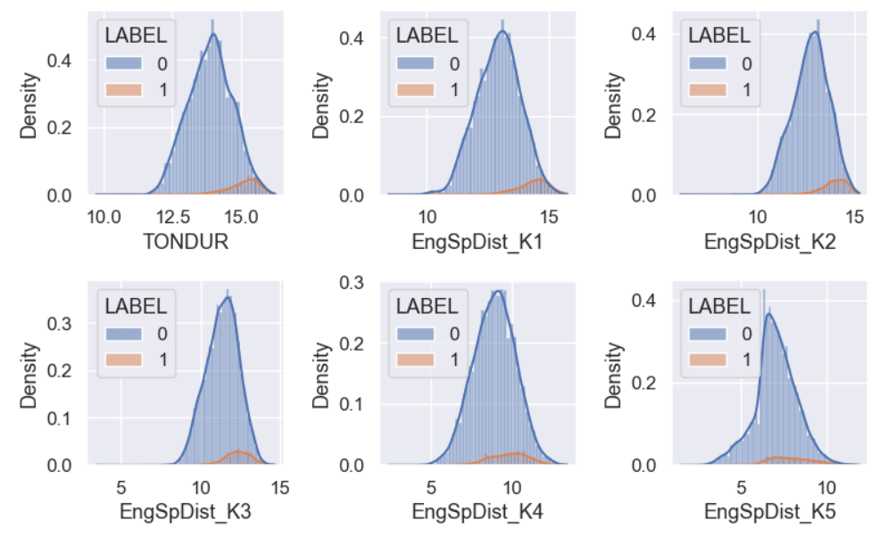
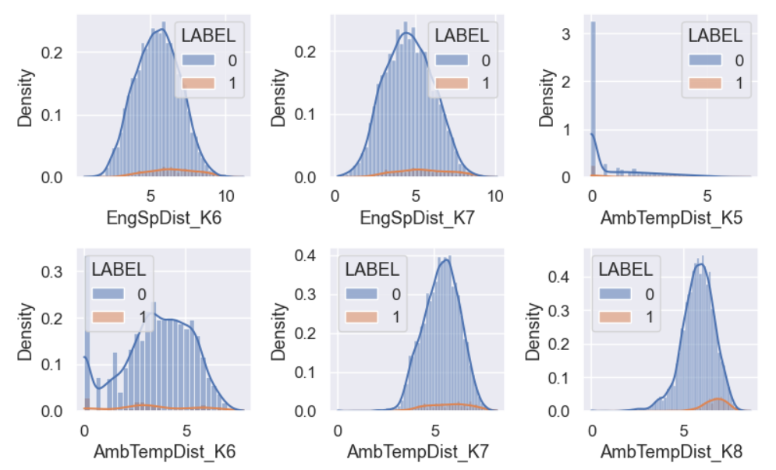
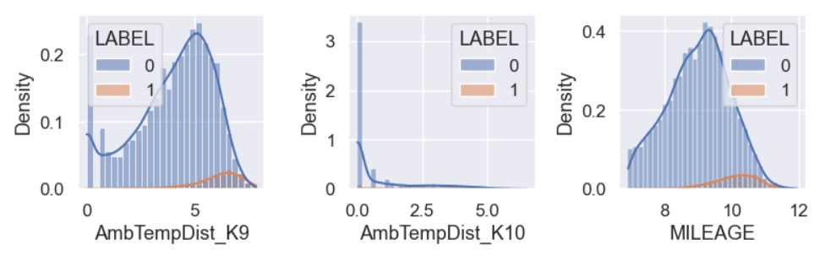
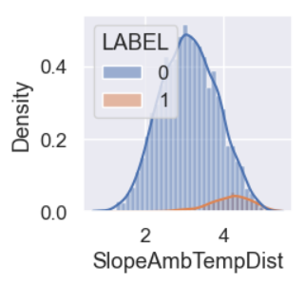
Distribution w.r.t. Dependent Variable

Slide 11
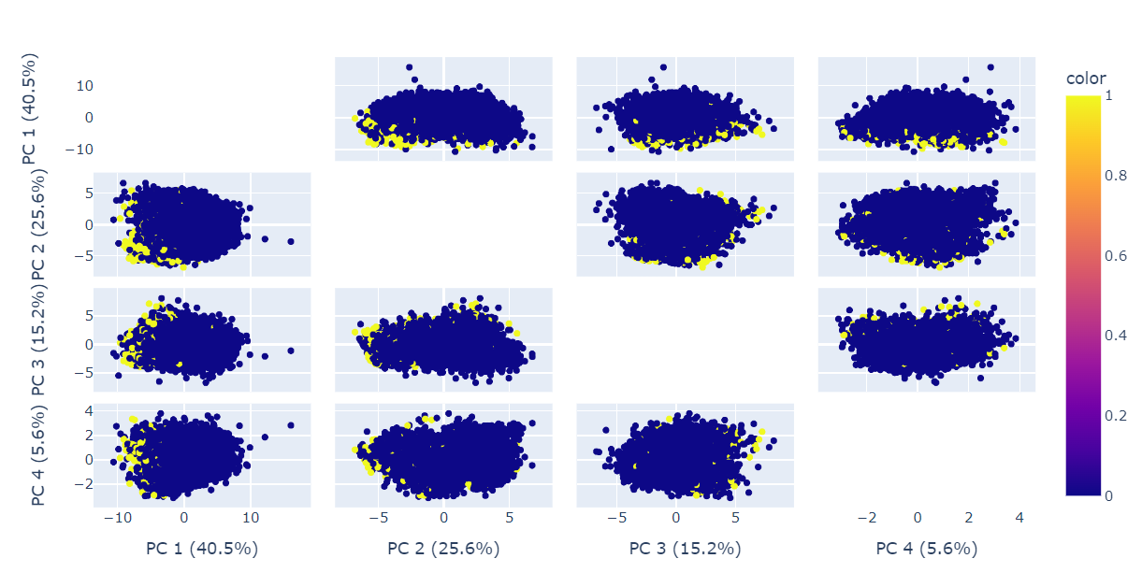
PCA Analysis
Top 4 components represent the distribution w.r.t. to the dependent variable
Both classes overlaps with few exception

Slide 12
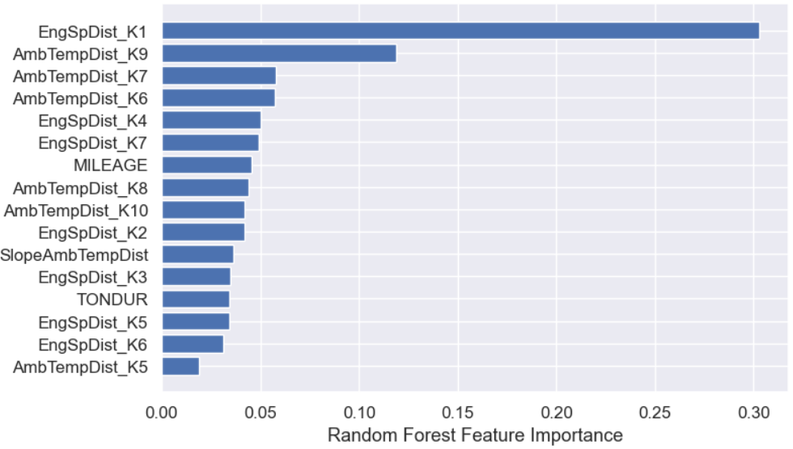
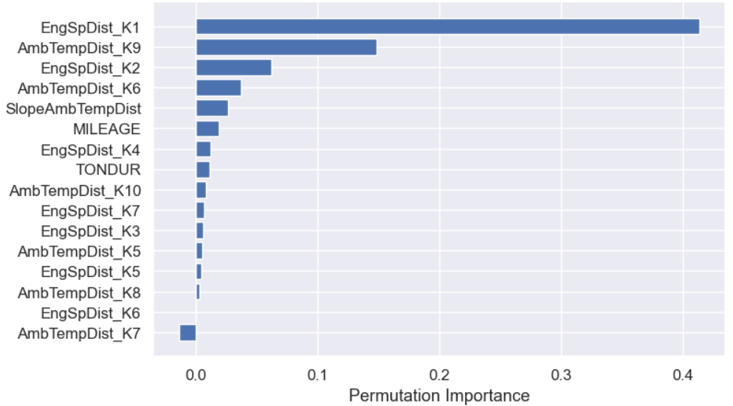
Feature Importance
Although both techniques rank the same features with high importance, i.e., cut off at first 2 features from top, but I would include 17 features for modeling as the data is overlapping for the dependent variable

Slide 13
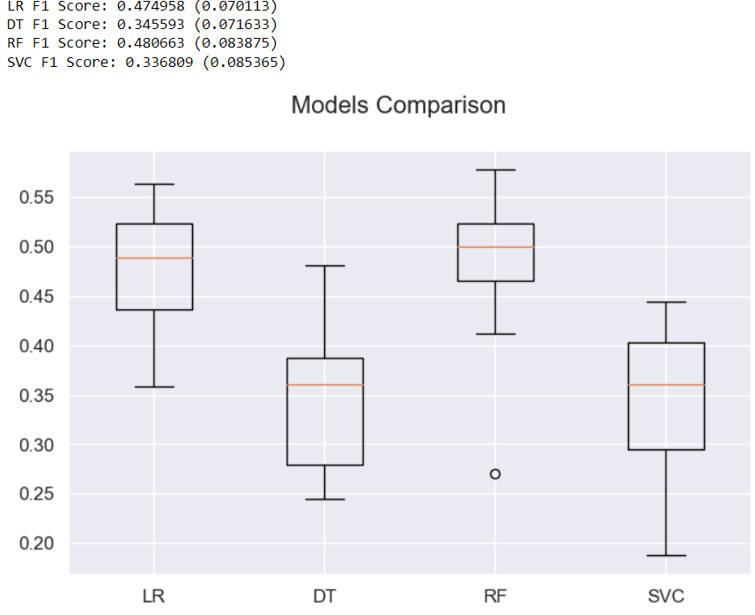
Modeling
Train, Validation, Test
Standardization
10-Fold cross validation
Baselines

Slide 14
Sampling without fine tuning
Up Sampling (SMOTE)
F1 Scores:
Logistic Regression: 0.38
Random Forest: 0.49
Support Vector Classifier: 0.42
Under Sampling (Tomek-Links)
F1 Scores:
Logistic Regression: 0.48
Random Forest: 0.47
Support Vector Classifier: 0.37

Slide 15
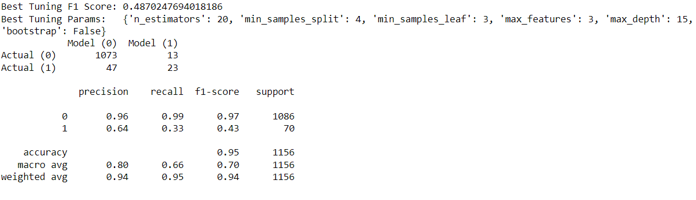
Random forest with Up Sampling and Fine tuning
Ranomized Search Cross Validation
SMOTE

Slide 16
Cost Analysis
Total Vehicles came for inspection: 1156
False Positives: 13
True Positive: 23
False Negatives: 47
True Negatives: 1073
Amount Saved (AmS): (1073*600) + (23*2600) = € 703,600
Amount Wasted Technical Action (AmWT): 13*600 = € 7,800 ( I am assuming vehicle which are flagged damaged will turn out to be non-damage during technical action phase)
Amount Wasted Technical Action and Repair (AmWTR): 47*2600 = € 122,200
Total Amount Saved: AmS – (AmWT + AmWTR) = € 573,600

Slide 17



Architecture
mongodb
API Request

