Slide 1

Heaven’s Light is Our Guide
Department of Computer Science and Engineering
Rajshahi University of Engineering and Technology
CAPTCHA Security Breaking System By Complex Character Recognition Using Deep Convolutional Neural Network
Presented By
Md. Adil Ali
Roll No: 143043
Dept. Of CSE, RUET
Supervised By
Julia Rahman
Assistant Professor
Dept. Of CSE, RUET

Slide 2
Outlines
Objectives
Related Works
Dataset
Dataset Pre-Processing
Proposed Method
Recognition By Deep Convolutional Neural Network
Experimental Analysis
Limitations
Future work
References

Slide 3
Overview of CAPTCHA
CAPTCHA stands for “completely automated public Turing test to tell computers and humans apart.”
A CAPTCHA is a program that protects websites against web robots by generating and grading tests that humans can pass but current computer programs can’t.
CAPTCHA can be different types like image, text, audio, video and puzzle.
Application of CAPTCHA
Protecting Website Registration
Online Polls
Preventing Dictionary Attacks
Protecting Email Addresses from Scrapers

Slide 4
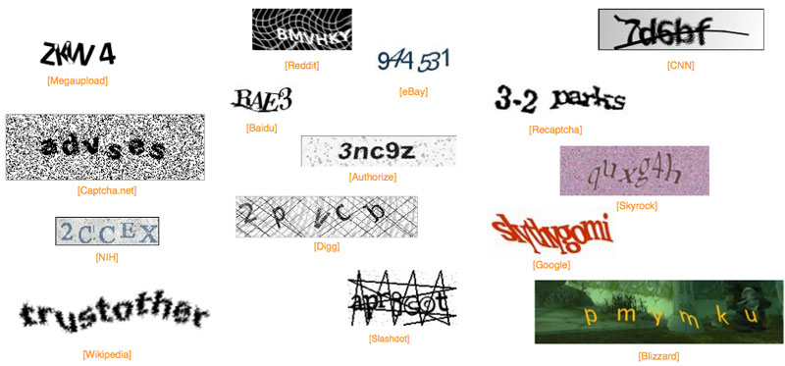
Different types of CAPCHA
Fig 0. captcha of fifteen popular website [13]

Slide 5
Motivation
“ If you want to protect a system from intruder or bots at first you have to break like this system. Then you can take necessary steps to protect your system. ”
…. Khan md. Jahir raihan

Slide 6
Objectives
CAPTCHA Security Breaking
Complex Character Recognition
Finding Weakness of Current CAPTCHA
Making Stronger CAPTCHA System

Slide 7
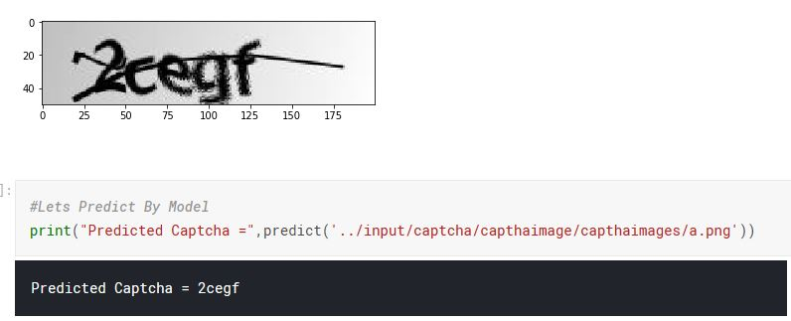
My Objectives
Fig 1: Demo Of CAPTCHA Security Breaking System

Slide 8
Related Works
CAPTCHA: Using hard AI problems for security[1]
Machine Learning System for breaking CAPTCHA[2]
CAPTCHA as a web service [3]
Multi-digit Number Recognition[4-5]
KNN based CAPTCHA breaking [6]
A low cost attack on Microsoft CAPTCHA [8]
CAPTCHA security breaking [10]

Slide 9
















Dataset
CAPTCHA Images Dataset [11] is used here for training and testing purpose. There are total 1070 images. There are total 36 symbols (26 English Letters+ 10 Digit)
Fig. 2. Sample Images of CAPTCHA Images Dataset

Slide 10
Dataset Pre Processing
Images are converted to as gray scale image with one color channel.
Scaled and Reshaped
Labels are OneHotEncoded . Ex: 2 is [0,1,0,0…..0]
Extracted Total Number of Symbols from Images.
Total Number of Symbols are 36
Extracted total number of character per images.

Slide 11
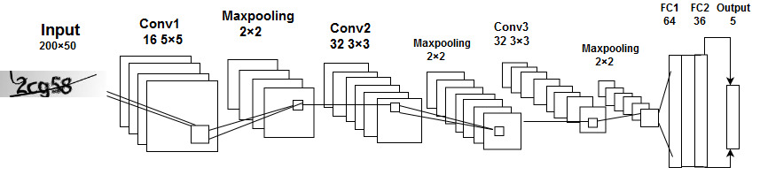
Proposed Method
Fig.3. Proposed Architecture Model of CNN [12]

Slide 12
Deep Convolutional Neural Network
Architecture of this model is inspired by the architecture of previous researchers models [12]. But proposed model is different than inspired models and some changes are made for reducing training time. The proposed architecture is briefly described below.
3 convolutional layers with 3 layers 2×2 maxpooling layer and 2 fully connected dense layers.
First layer has 16 filters and each filter size is 5×5
The last two layers have 32 filters and each filter size is 3×3
RELU (max(0,1)) is used as an activation function.
The pool size of maxpooling layer is 2×2
Dropout (0.2) is used to reduce the overfitting.

Slide 13
Deep Convolutional Neural Network
Among the two fully connected layers, the first one has 64 filters and the last one has 36 filters for the 36 character.
Flattened vector has 5 branches from it. Each branch will predict one letter.
Sofmax function is used for the classification
Adam optimizer is used for updating the weights.

Slide 14
Experimental Analysis
Experimental Environment The experimental environment is configured with Intel Core i7 processor, Tesla k80 GPU and 16 GB of RAM. This environment has reduced our training time by keeping better performance of our model.
Training, Validation and Testing The CAPTCHA dataset contains total of 1070 images. The dataset is divided into training, Validation and testing dataset keeping 776 (80%) images for training and 194 (20%) for validation. Rest of 100 images are for testing.

Slide 15
Experimental Analysis
Training Model Parameters
The training model of our architecture is dependent on some parameters. The parameters of the training model are given in Table I.
Parameters | Value
Learning rate | 0.0001
Batch Size | 32
Epoch | 30
Table 1: Model Parameters

Slide 16
Experimental Analysis
Result Analysis
As the CAPTCHA is based on 5 characters, so in every label there are 5 sub label. By averaging the final result is shown below.
Label Position | Training Accuracy | Validation Accuracy | Testing Accuracy
1 | 98.07% | 98.00% | 99.33%
2 | 95.88% | 94.33% | 92.00%
3 | 94.33% | 92.78% | 85.18%
4 | 95.62% | 89.18% | 90.05%
5 | 97.42% | 88.66% | 86.07%
Full label | 96.26% | 92.18% | 90.32%
Table 2: Result Analysis

Slide 17
Experimental Analysis
Table 3 shows the comparison of proposed method’s result with previous researcher’s result.
Proposed Method (Deep Learning) | Previous Method (Machine Learning) [10]
90.32% | 67.42%
Table 3: Testing Accuracy Comparison with Previous Research

Slide 18
Limitations
Small Number of Samples (1070 images)
Same type of images
Same type of pattern
CAPTCHA is based on 5 Characters.

Slide 19
Future Work
Experiment with Large number of samples
Multiple Dataset
Different type of CAPTCHA
Extends of character per CAPTCHA.
Comparison with other researchers result.

Slide 20
References
[1] L. Von Ahn, M. Blum, N. J. Hopper and J Langford, “CAPTCHA: Using hard AI problems for security,” International Conference on the Theory and Applications of Cryptographic Techniques, Springer, Berlin, Heidelberg, 2003, pp. 294-311.
[2] K. Chellapilla and P. Y. Simard, "Using machine learning to break visual human interaction proofs," Advances in neural information processing systems, 2005, pp. 265-272.
[3] T. Converse, “CAPTCHA Generation as a Web Service.” Proc. Human Interactive Proofs, Springer, Berlin, Heidelberg, 2005, pp. 82-96.
[4] I. J. Goodfellow, Y. Bulatov, J. Ibarz, S. Arnoud and V. Shet, “Multi-digit Number Recognition from Street View Imagery using Deep Convolutional Neural Networks,” Computer Science, 2013.
[5] M. Jaderberg, A. Vedaldi, and A. Zisserman, “Deep features for text spotting,” European conference on computer vision, Springer, Cham, 2014, pp. 512-528.
[6] Y. Wang, Y. Q. Xu, Y. B. Peng, “KNN-based Verification Code Recognition Technology

Slide 21
References
[7] P. Y. Simard, D. Steinkraus and J. C. Platt, “Best practices for convolutional neural networks applied to visual document analysis,” International Conference on Document Analysis and Recognition IEEE Computer Society, Vol. 3, 2003, pp. 958-962.
[8] J. Yan, A. S. E. Ahmad, “A low-cost attack on a Microsoft captcha,” ACM Conference on Computer and Communications Security, CCS 2008,
[9] G. Mori and J. Malik, “Recognizing objects in adversarial clutter: Breaking a visual CAPTCHA,” Computer Vision and Pattern Recognition, 2003. Proc. IEEE Computer Society Conference, Vol. 1, IEEE, 2003, pp.
[10] Wilhelmy, Rodrigo & Rosas, Horacio. (2012). A Comparison of Supervised Learning Algorithms to Solve CAPTCHAs.
[11] CAPTCHA Dataset [Last Accessed:February 2019] https://www.kaggle.com/fournierp/captcha-version-2-images
[12] A. Shawon, M. Jamil-Ur Rahman, F. Mahmud and M. M. Arefin Zaman, "Bangla Handwritten Digit Recognition Using Deep CNN for Large and Unbiased Dataset," 2018 International Conference on Bangla Speech and Language Processing (ICBSLP), Sylhet, 2018, pp. 1-6. doi: 10.1109/ICBSLP.2018.8554900
[13] https://www.helpnetsecurity.com/2011/11/01/how-to-create-effective-captchas/

Slide 22
Thank You

