Slide 1
Metabolomic Biomarker Identification
By Combining Multiple Statistical
and Machine Learning Approaches
Supervised By
Dr. Md. Al Mehedi Hasan
Associate Professor
Department of CSE, RUET
Presented By
Tahsin Masrur
Roll No: 143029
Department of CSE, RUET

Slide 2
Outlines
Motivation
Objectives
Literature Review
Dataset Description
Proposed Work Flow
Implementation Settings
Result
Conclusion and Future Work
References

Slide 3
Motivation
Cancer is a major health problem worldwide.
In USA, cancer is the second leading cause of death ^{[1]}
Worldwide, lung cancer is the
leading cause of cancer death in men
2nd leading cause of cancer death in women ^{[2]}

Slide 4
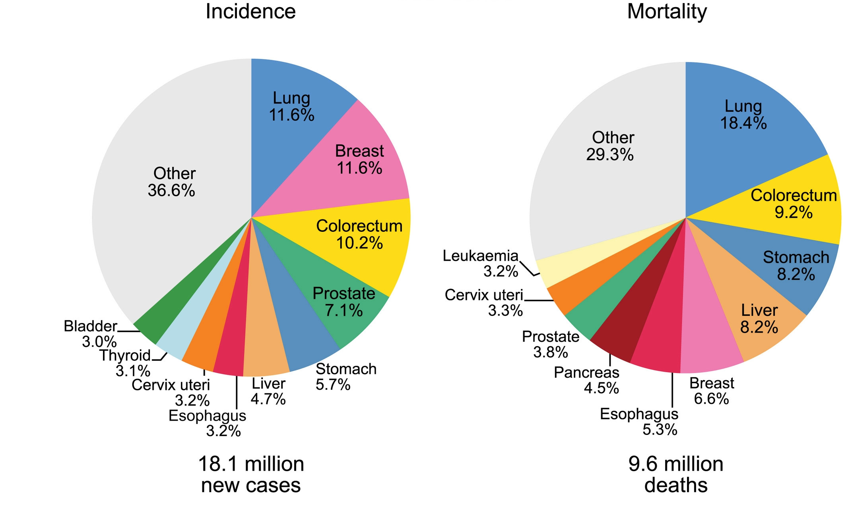
Motivation (cont’d)
Fig 1: Estimated Cases and Deaths for the 10 Most Common Cancers in 2018 ^{[3]}

Slide 5
Motivation (cont’d)
75% patients discover Stage III/IV in diagnosis ^{[4]}
Stage IV has a 1-year survival rate of 15–19% ^{[5]}
Stage I has a 81–85% survival rate ^{[5]}
Thus the importance of early diagnosis!

Slide 6
Metabolomics Data Science
For early diagnosis, metabolomics technology can be used
It measures products of cellular metabolism
Metabolites are basically organic compounds
Starting/intermediate materials in metabolism pathways
Disorders in cellular process
Changes in the level of metabolites

Slide 7
Differentially Expressed (DE) Metabolites
Main Focus
Metabolite level difference between disease and control
Here,
Disease group = Lung cancer patients
Control group = Normal patients
DE metabolites appear differently between disease and
control.
Biomarker is a set of such metabolites

Slide 8
Objectives
Identifying differentially expressed metabolites
Differentiating up-regulated and down-regulated ones
Selecting metabolomic biomarker for lung cancer
Using metabolomic biomarker to diagnose cancer patients

Slide 9
Literature Review
Student’s t-test has been used for various kinds of cancers
Lung Cancer (Kumar N. et al. 2017) ^{[6]}
Colon Carcinoma (Denkert C. et al. 2008) ^{[7]}
Pancreatic Cancer (Nishiumi S. et al. 2010) ^{[8]}
Prostate Cancer (Sreekumar A. et al. 2009) ^{[9]} etc.
Their Objectives -> Selecting Biomarkers

Slide 10
Literature Review (cont’d)
Limitations of Student’s T-test
Student’s t-test is a parametric approach.
It assumes normal distributions
Not as good in handling outliers
compared to non-parametric approaches

Slide 11
Literature Review (cont’d)
Paper Details: N. Kumar, M. Shahjaman, M. N. H. Mollah, S. S. Islam, and M. A. Hoque, “Serum and plasma metabolomic biomarkers for lung cancer,” Bioinformation, vol. 13, no. 6, p. 202, Jun 2017. ⁵
Contributions of Kumar N. et al.
27 influential plasma and 13 serum metabolites
Identification of up-regulated and down-regulated ones
Biomarker declaration via pathway and correlation analysis

Slide 12
Limitations of Kumar N. et al.
Student’s t-test to influential metabolites
Identified up/down regulated only through heatmap
Biomarker classification performance was not verified

Slide 13
Proposed Work Flow
Data Preprocessing
log2 transformation
mean centered
unit variance
Student’s T-Test + Kruskal Wallis +
Mann-Whitney-Wilcoxon
p value < 0.05
Fold Change +
Clustering Heatmap
FC threshold = 1
Support Vector Machine
RBF Kernel
Recursive
Feature Elimination
Top 8 and 5 chosen
as biomarkers

Slide 14
Dataset Description
Plasma Blood Sample
82 subjects
158 metabolites
Contains outliers
41 cancer subjects, 41 control
Serum Blood Sample
82 subjects
158 metabolites
Contains outliers
41 cancer subjects, 41 control
Oliver Fiehn produced these under study ID ST000392 ^{[10]}

Slide 15
DE Metabolite Selection
Most popular technique – Student’s t-test
To overcome t-test shortcomings:
Kruskal-Wallis Test
Mann-Whitney-Wilcoxon Test

Slide 16
DE Metabolite Selection (cont’d)
Final feature selection hybrid model:
Student’s t-test + Kruskal-Wallis + Mann-Whitney-Wilcoxon
if p value < 0.05 in any of the 3 tests:
the metabolite is differentially expressed

Slide 17
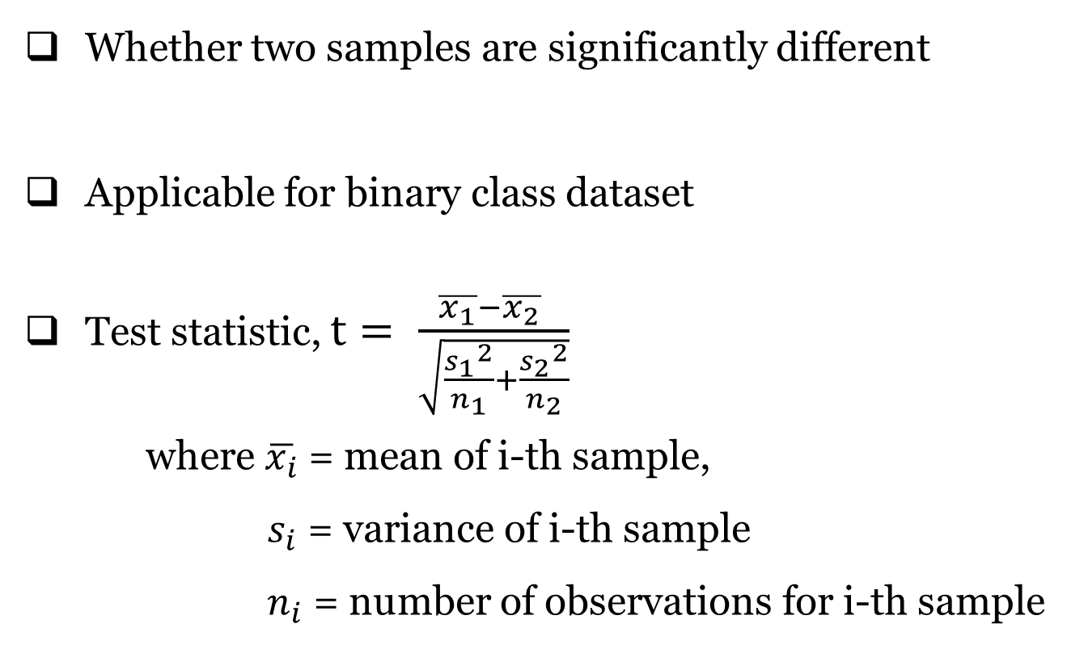
Student’s t-test
Whether two samples are significantly different
Applicable for binary class dataset
Test statistic, $t= \frac{\overline{x_{1}}−\overline{x_{2}} }{\sqrt{\frac{{s_{1}}^{2}}{n_{1}}+\frac{{s_{2}}^{2}}{n_{2}}}}$
where $\overline{x_{i}}$ = mean of i-th sample,
$s_{i}$ = variance of i-th sample
$n_{i}$ = number of observations for i-th sample

Slide 18
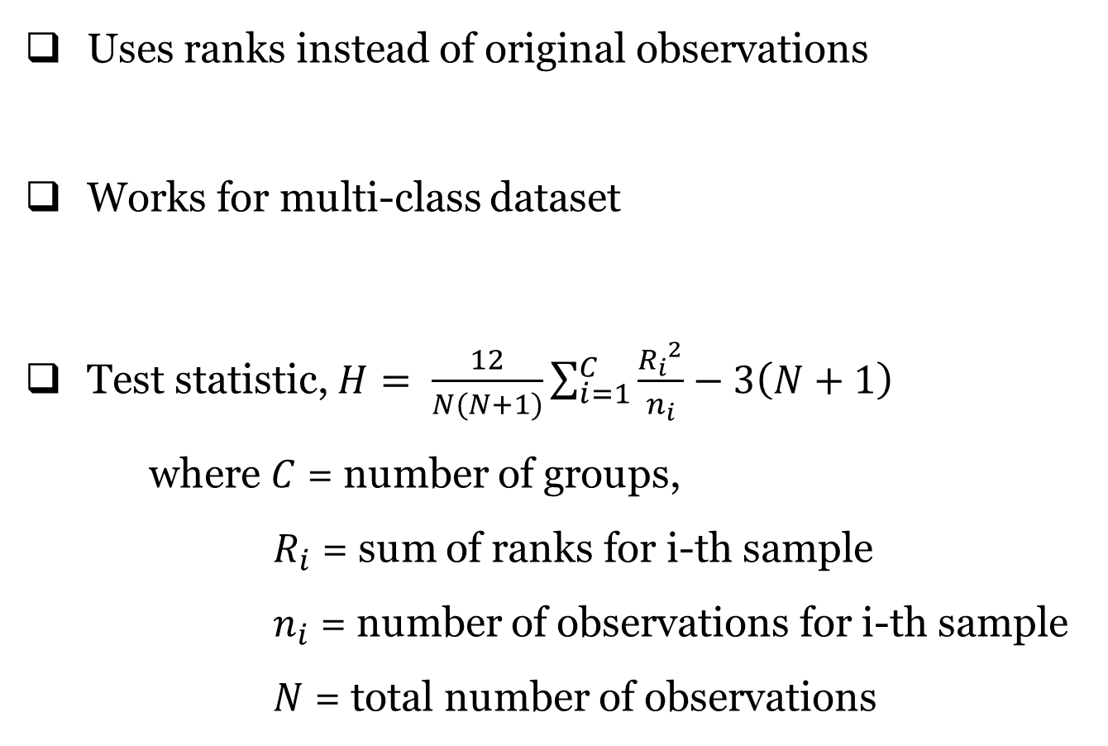
Kruskal-Wallis Test
Uses ranks instead of original observations
Works for multi-class dataset
Test statistic, $H= \frac{12}{N(N+1)}\sum_{i=1}^{C}{\frac{{R_{i}}^{2}}{n_{i}}}−3\left(N+1\right)$
where $C$ = number of groups,
$R_{i}$ = sum of ranks for i-th sample
$n_{i}$ = number of observations for i-th sample
$N$ = total number of observations

Slide 19
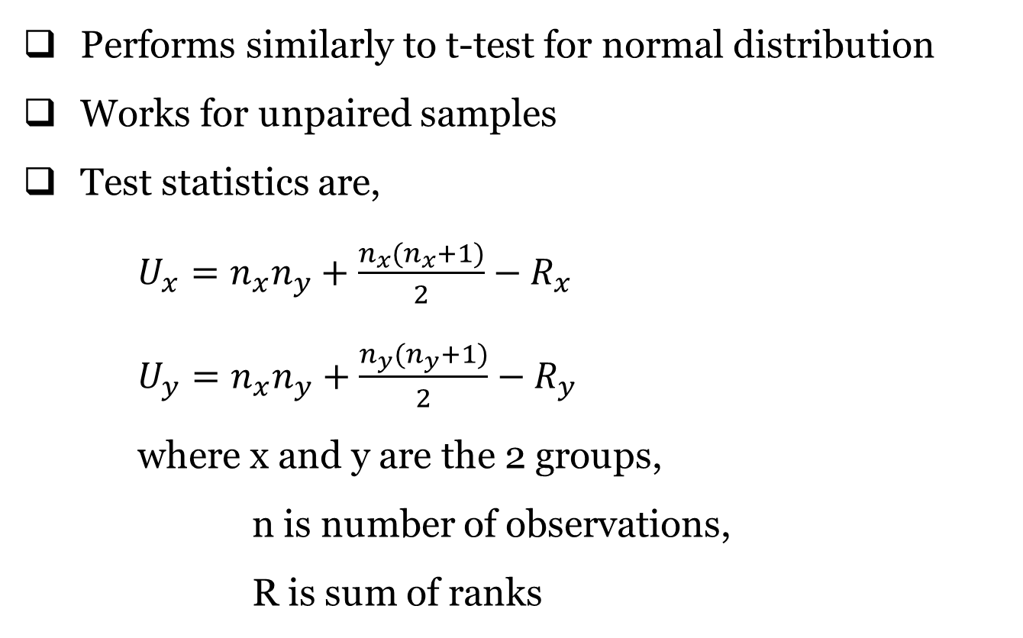
Mann-Whitney-Wilcoxon Test
Performs similarly to t-test for normal distribution
Works for unpaired samples
Test statistics are,
$U_{x}=n_{x}n_{y}+\frac{n_{x}(n_{x}+1)}{2}−R_{x}$
$U_{y}=n_{x}n_{y}+\frac{n_{y}(n_{y}+1)}{2}−R_{y}$
where x and y are the 2 groups,
n is number of observations,
R is sum of ranks

Slide 20
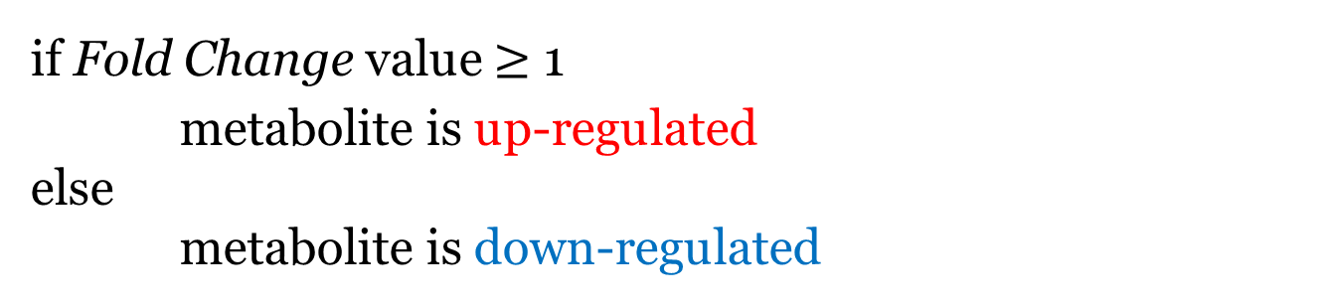
Up/Down Regulated Metabolites
if Fold Change value $≥$ 1
metabolite is up-regulated
else
metabolite is down-regulated
This is further supported with clustering heatmap plot.
Up-regulated metabolites are clustered together.
Same for down-regulated.

Slide 21
Classification Method
For checking classification accuracy,
Support Vector Machine was used.
Radial basis kernel was used.
Grid search and cross-validation for tuning
Used for various combinations of metabolites
(union of all 3 tests, intersection of them etc.)

Slide 22
Biomarker Selection
For choosing biomarkers,
Two approaches were attempted.
1st Approach
ROC curve analysis was done with MetaboAnalyst
Uses Linear SVM as classifier and for feature ranking
Top 10 metabolites chosen as biomarkers
Gives satisfactory AUC value

Slide 23
Biomarker Selection (cont’d)
2nd Approach
Recursive Feature Elimination (RFE)
RFE is a wrapper method
It was used with Random Forest classifier
Top 8 and 5 metabolites chosen as biomarkers

Slide 24
Implementation Settings
Language used : R 3.5.2
Student’s t-test function used : t.test( )
Kruskal-Wallis function used : kruskal.test( )
Mann-Whitney-Wilcoxon function : wilcox.test( )
SVM library : e1071
Heatmap plot libraries : gplots, viridis
ROC analyses software : MetaboAnalyst 4.0
ROC analyses library : ROCR

Slide 25
Results
28 DE Metabolites in plasma sample
13 DE Metabolites in serum sample
Data Preprocessing
log2 transformation
mean centered
unit variance
Student’s T-Test + Kruskal Wallis +
Mann-Whitney-Wilcoxon
p value < 0.05
Fold Change +
Clustering Heatmap
FC threshold = 1
Support Vector Machine
RBF Kernel
Recursive
Feature Elimination
Top 10 chosen

Slide 26
SVM Result
Data Preprocessing
log2 transformation
mean centered
unit variance
Student’s T-Test + Kruskal Wallis +
Mann-Whitney-Wilcoxon
p value < 0.05
Fold Change +
Clustering Heatmap
FC threshold = 1
Support Vector Machine
RBF Kernel
Recursive
Feature Elimination
Top 10 chosen
Dataset | Cost | Gamma | Accuracy
Plasma Sample | 0.5 | 0.00781258 | 87.50%
Serum Sample | 0.2102241 | 0.02209709 | 83.33%

Slide 27
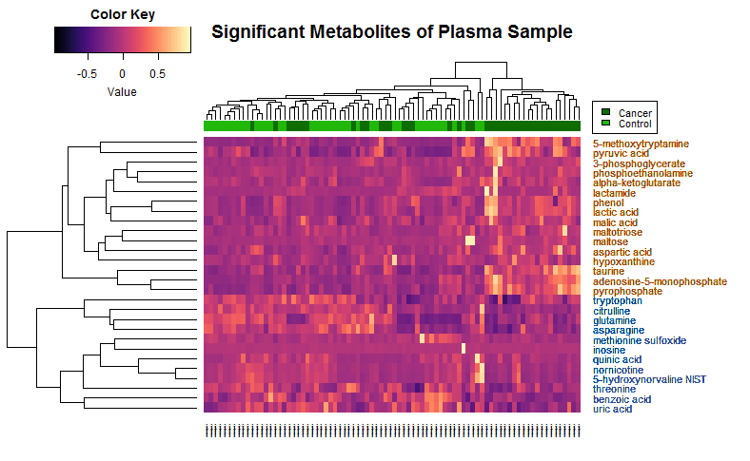
Heatmap Cluster
Up-regulated
Down-regulated
Data Preprocessing
log2 transformation
mean centered
unit variance
Fold Change +
Clustering Heatmap
FC threshold = 1
Student’s T-Test + Kruskal Wallis +
Mann-Whitney-Wilcoxon
p value < 0.05
Support Vector Machine
RBF Kernel
Recursive
Feature Elimination
Top 10 chosen

Slide 28
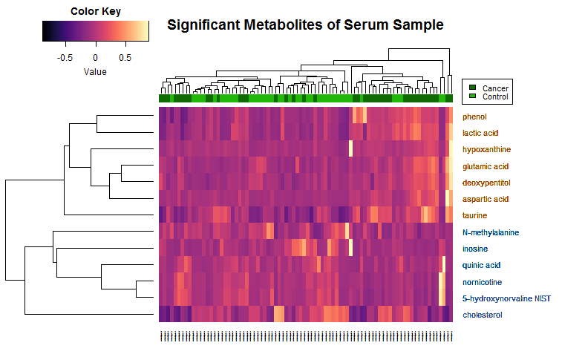
Heatmap Cluster
Up-regulated
Down-regulated
Data Preprocessing
log2 transformation
mean centered
unit variance
Fold Change +
Clustering Heatmap
FC threshold = 1
Student’s T-Test + Kruskal Wallis +
Mann-Whitney-Wilcoxon
p value < 0.05
Support Vector Machine
RBF Kernel
Recursive
Feature Elimination
Top 10 chosen

Slide 29
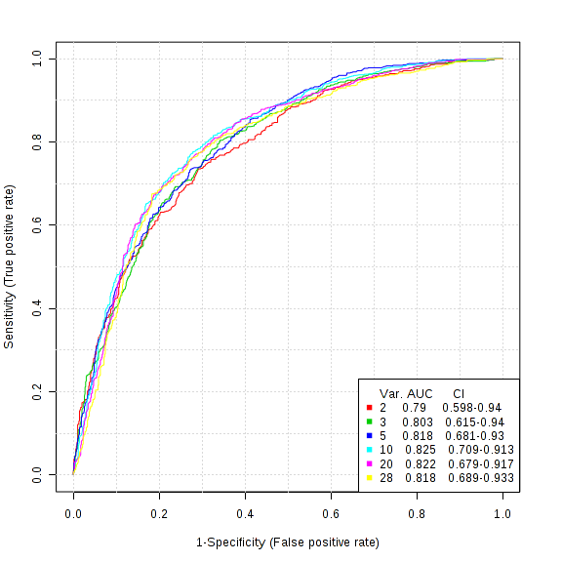
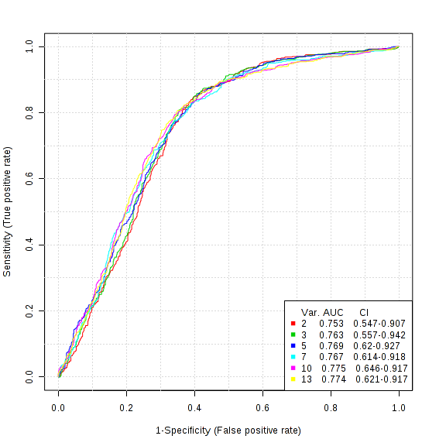
ROC Curve Analyses (1st Approach)
AUC of plasma biomarker: 0.825
AUC of serum biomarker: 0.775
Fig 2: ROC Curve Analyses for plasma and serum blood samples

Slide 30
Published Work
Work so far was even published in a conference recently!
Paper Details: Tahsin Masrur, Md. Al Mehedi Hasan, and Md. Nazrul Islam Mondal, “Metabolomic Biomarker Identification for Lung Cancer By Combining Multiple Statistical Approaches”, International Conference on Electrical, Computer and Communication Engineering (ECCE), 7-9 February, 2019
We have extended this for further improvement.

Slide 31
Final Biomarker Identification
Data Preprocessing
log2 transformation
mean centered
unit variance
No. of metabolites in plasma biomarker | No. of metabolites in serum biomarker
8 | 5
Student’s T-Test + Kruskal Wallis +
Mann-Whitney-Wilcoxon
p value < 0.05
Fold Change +
Clustering Heatmap
FC threshold = 1
Support Vector Machine
RBF Kernel
Recursive
Feature Elimination
Top 8 and 5 chosen as biomarkers
Biomarker | Cost | Gamma | Sensitivity | Specificity | Accuracy | AUC
Plasma | 4 | 0.00390625 | 91.67% | 83.33% | 87.50% | 0.895
Serum | 1 | 2 | 91.67% | 66.67% | 79.17% | 0.882

Slide 32
Conclusion and Future Work
Good performance of identified biomarker in early diagnosis
May be useful in drug designing
In future, we want to improve performance of classification
Investigating protein-protein interaction network
Investigating effects of feature extraction methods
Applying our process on more dataset and diseases

Slide 33
References
1. Siegel RL., Miller KD., Jemal A., , 2018. Cancer statistics, 2018. CA: a cancer journal for clinicians, 61(1).
2. Torre, L.A., Siegel, R.L. and Jemal, A., 2016. Lung cancer statistics. In Lung cancer and personalized medicine (pp. 1-19). Springer, Cham.
3. Bray, Freddie, et al. "Global cancer statistics 2018: GLOBOCAN estimates of incidence and mortality worldwide for 36 cancers in 185 countries." CA: a cancer journal for clinicians 68.6 (2018): 394-424.
4. Walters, Sarah, et al. "Lung cancer survival and stage at diagnosis in Australia, Canada, Denmark, Norway, Sweden and the UK: a population-based study, 2004–2007." Thorax 68.6 (2013): 551-564.
5. Bannister, Neil, and John Broggio. "Cancer Survival by Stage at Diagnosis for England (experimental statistics): Adults diagnosed 2012, 2013, 2014 and followed up to 2015." Produced in collaboration with Public Health England (2016).

Slide 34
References (cont’d)
6. Kumar, Nishith, et al. "Serum and plasma metabolomic biomarkers for lung cancer." Bioinformation 13.6 (2017): 202.
7. Denkert, Carsten, et al. "Metabolite profiling of human colon carcinoma–deregulation of TCA cycle and amino acid turnover." Molecular cancer 7.1 (2008): 72.
8. Nishiumi, Shin, et al. "Serum metabolomics as a novel diagnostic approach for pancreatic cancer." Metabolomics 6.4 (2010): 518-528.
9. Sreekumar, Arun, et al. "Metabolomic profiles delineate potential role for sarcosine in prostate cancer progression." Nature 457.7231 (2009): 910.
10. Miyamoto, Suzanne, et al. "Systemic metabolomic changes in blood samples of lung cancer patients identified by gas chromatography time-of-flight mass spectrometry." Metabolites 5.2 (2015): 192-210.

Slide 35
Thank You ☺
Any questions?

