Slide 1
MQTT Protocol Simulation of a Smarthome System
ENPM 809F: Project Presentation
December 3, 2020
Muhammad Adil Sohail & Waleed Waris

Slide 2
Smarthome Scenario

Slide 3
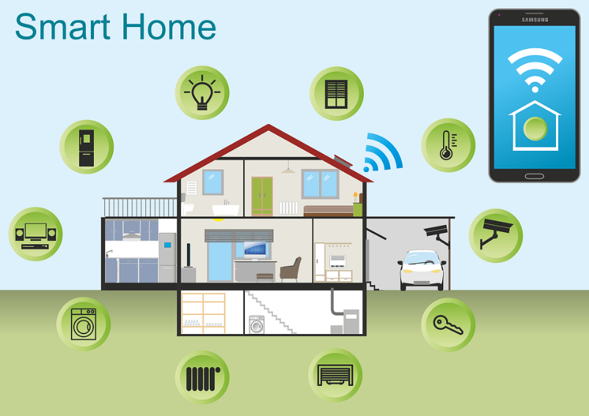
Smarthome Background
Smarthome systems have become increasingly popular over the last decade. They improve the quality and comfort of home life.
A Smarthome system refers to a home setup where devices (such as sensors and controllers) are placed around the house. These devices allow us to monitor home conditions and allow us to control some of these conditions from anywhere with an internet connection using a mobile or other network device.
Examples of this include:
Monitor temperature / Set temperature
Monitor light / Turn light On or Off
Lock / Unlock door
Detect Motion
Monitor CO levels, humidity, lpg levels

Slide 4
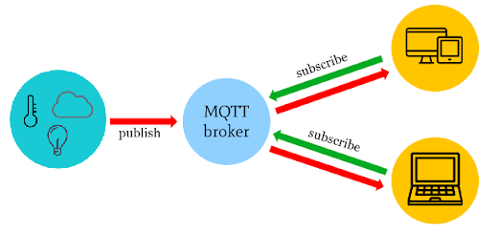
MQTT Background
Message Queuing Telemetry Transport (MQTT) is a standard messaging protocol used Internet of Things (IoT) Applications
It is a lightweight publish/subscribe messaging transport based on a topic that is ideal for connecting remote devices. It allows bi-directional communication.
MQTT ConOps: Clients send messages based on a topic to a MQTT broker - a server that receives all messages from the clients and then routes the messages to appropriate clients. MQTT broker will distribute information to any clients that have subscribed to that topic.
The protocol runs over TCP/IP to provide reliable data delivery
Message
Message
Subscriber
Publisher
Message
Subscriber

Slide 5
MQTT Smarthome Use Case
In this Use Case we have a Smarthome that is equipped with devices:
Clients:
Sensors: CO, Humidity, Light, LPG, Motion, Smoke, Temperature (Monitor Conditions)
Controllers: Light, Fan, Temperature (Control Conditions)
Mobile Device: Receive and display monitor data from sensors, send commands to controllers
MQTT Broker: Local server that will route monitor data information from sensors to mobile device, and route command data information from mobile device to controllers
Smarthome Senor dataset was found on Kaggle.com. Data is from an actual Smarthome application setting where the CO, Humidity, Light, LPG, Motion, Smoke, and Temperature was measured by sensors in the living room of a house for a week.
The Smarthome Sensor dataset will be used to simulate the flow of actual data in a Smarthome setting
A simulation was created in Python to simulate the MQTT Protocol and how it was used in the Smarthome Application

Slide 6
MQTT Smarthome Architecture
Smart Home Environment
MQTT Broker
(Server)
Remote Environment
Subscribe
Mobile Device Application
CO Sensor
Publish, CO Data
Publish, CO Data
Subscribe
Humidity Sensor
Publish, Humidity Data
Publish, Humidity Data
Subscribe
Light Sensor
Publish, Light Data
Publish, Light Data
Subscribe
LPG Sensor
Publish, LPG Data
Publish, LPG Data
Subscribe
Motion Sensor
Publish, Motion Data
Publish, Motion Data
Subscribe
Smoke Sensor
Publish, Smoke Data
Publish, Smoke Data
Subscribe
Temperature Sensor
Publish, Temp Data
Publish, Temp Data
Subscribe
Light Control
Publish, Light CMD
Publish, Light CMD
Temperature Control
Subscribe
Publish, Temp CMD
Publish, Temp CMD
Fan Control
Subscribe
Publish, Fan CMD
Publish, Fan CMD

Slide 7
Simulation Demo

Slide 8
Thank You
Questions?

