Slide 1


OOP PROJECT
Ramisha Faheem CT-005 Adil Aslam CT-023 Rija Asif Butt CT-031
Group Name: WinRAR

Slide 2

INTRODUCTION
This project is best for the ones who love cricket and those who dream of managing their own team. It provides you with the league fixtures, player’s profile, live score at one place. But its main feature is when it lets you manage your own fantasy team. It gets more interesting when you get to know that you can select your own players. The points will be rewarded according to the player’s performance in real matches. Climb at the top of the table by gaining points according to the rules. This fantasy team lets you to be the coach of your own team. A cricket fan will definitely go boom boom after he/she sees this.

Slide 3
WHY PSL FANTASY LEAGUE?
All OOP Concepts
Pakistan Super League Craze
Current Affairs
Not mainstream

Slide 4
ATTRIBUTES
PLAY
-Profile
-Create Team
-My Team
-Rules
-Calculate Points
SCORE
-Live Score
-Results
FIXTURES
TEAM & PLAYERS
-Players List
-Search Players

Slide 5
OOP CONCEPTS USED
Constructor
Destructor
Encapsulation
Abstraction
Inheritance
Polymorphism
Overriding
Interface
Function Overloading
Operator Overloading
Constructor Overloading
Friend Function
STL Library

Slide 6
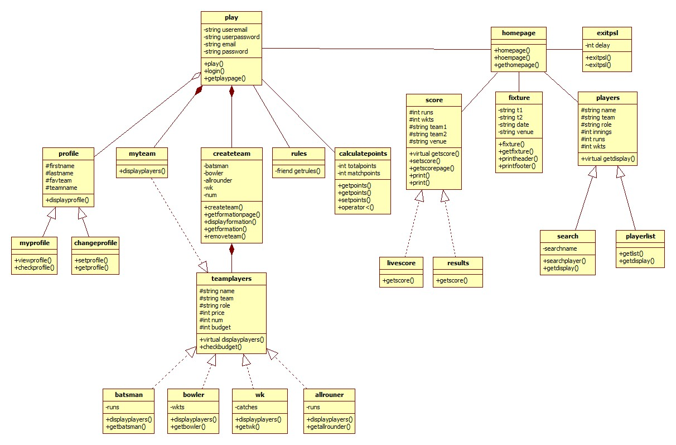
UML DIAGRAM

Slide 7
Constructor
Destructor

Slide 8
Abstraction & Encapsulation

Slide 9
Inheritance

Slide 10
Polymorphism & Overriding

Slide 11
Interface

Slide 12
Function Overloading
void print(string name)
{
cout<<"\n\n\t-x-x-x-x-x-x-x-x-PSL FANTASY LEAGUE-x-x-x-x-x-x-x-x-"<<endl<<endl;
cout<<"\t "<<name<<endl<<endl<<endl<<endl<<endl;
}
void print(void)
{
cout<<"\n\n\n\n\n\n\tx-Exit";
getch();
}

Slide 13
Operator Overloading
bool operator <(const calculatepoints& c)
{
if(totalpoints < c.totalpoints)
return true;
else
return false;
}

Slide 14
Constructor Overloading
homepage(void)
{
system("cls");
cout<<endl<<endl<<endl<<endl<<endl;
cout<<"\t\t WELCOME TO "<<endl<<endl;
}
homepage(int d)
{
delay=d;
Sleep(delay);
cout<<"\t\t************* ************* *"<<endl;
Sleep(delay);
cout<<"\t\t* * * *"<<endl;
.
.
.
}

Slide 15
Friend Function
class rules
{
friend void getrules(rules r)
};
void getrules(rules r)
{
system("cls");
cout<<"\n\n\t-x-x-x-x-x-x-x-x-PSL FANTASY LEAGUE-x-x-x-x-x-x-x-x-"<<endl<<endl;
cout<<"\t Rules"<<endl<<endl<<endl<<endl<<endl;
cout<<"\t1- You have to select your own fantasy team using the players"<<endl;
cout<<"\t in the CREATE TEAM option."<<endl<<endl;
.
.
.
}

Slide 16
STL - Vector
void getpoints()
{
char selectPoints;
int i;
bool loop=true;
vector<int> points;
while(loop)
{
selectPoints=getch();
switch(selectPoints)
{
case '1':
matchpoints=553;
points.push_back(matchpoints);
cout<<"\tMatch 1 added"<<endl;
break;
case '2':
matchpoints=240;
points.push_back(matchpoints);
cout<<"\tMatch 2 added"<<endl;
break;
case '3':
matchpoints=410;
points.push_back(matchpoints);
cout<<"\tMatch 3 added"<<endl;
break;
case '4':
matchpoints=545;
points.push_back(matchpoints);
cout<<"\tMatch 4 added"<<endl;
break;
case '5':
matchpoints=305;
points.push_back(matchpoints);
cout<<"\tMatch 5 added"<<endl;
break;
case 'c':
points.pop_back();
cout<<"\tLast match deleted."<<endl;
break;
case 'p':
loop=false;
totalpoints=0;
for (int i = 0; i < points.size(); i++)
{
totalpoints=points[i]+totalpoints;
}
cout<<"\n\n\t\t-x-x-x-x-x-x- Points : "<<totalpoints<<" -x-x-x-x-x-x-";
points.clear();
getch();
break;
}

Slide 17
CODING
& WORKING

