Slide 1







AI HeatlhWorkshop
Explainability
Muhammad Adil Saleem
25th April 2025

Slide 2


Agenda
Black box models
Global vs Local
Understanding why opaque decision-making in models limits trust and usability.
Differentiating between broad model behavior insights (global) and specific prediction insights (local).
Interpretable models
Post-hoc explanations
Exploring models that are inherently transparent and easier to explain.
Discussing techniques to interpret and explain blackbox models after they’ve been trained.

Slide 3
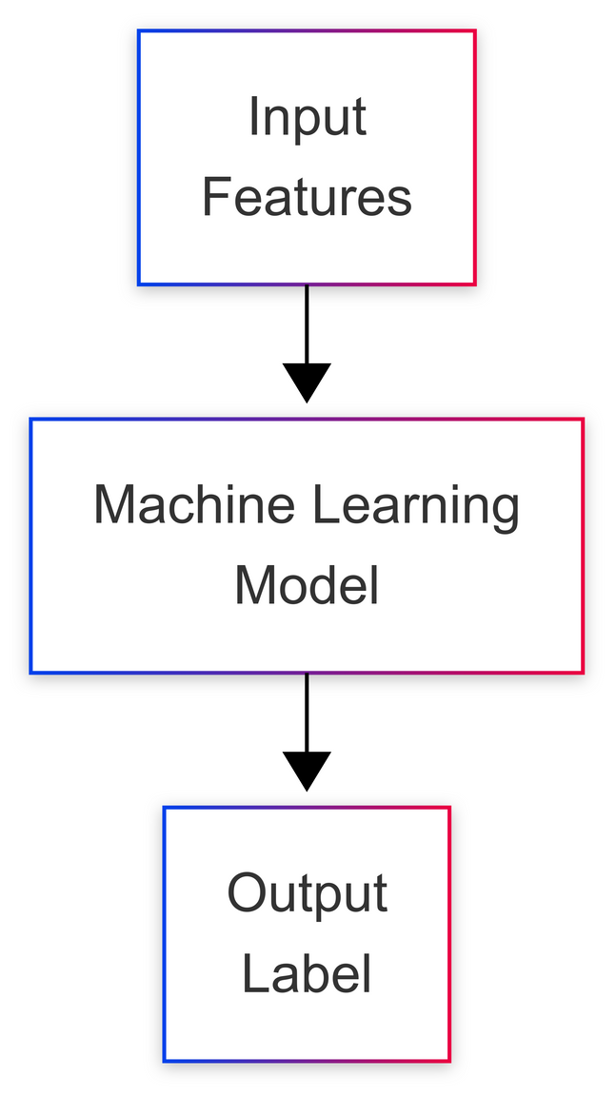
How ML models work?
Machine Learning (ML) models usually work by taking input (features) and output (label), learning patterns from the data during training, and then using those patterns to make predictions or decisions on new, unseen inputs.
Often, these model don’t show how they reached their decision.

Slide 4
Explainability to
the rescue
Explainability in machine learning refers to how a human can understand why a machine model made a certain prediction or decision.

Slide 5

Example
A machine learning model predicts that a patient is likely to develop diabetes.
Using explainability, we find that the key reasons for this prediction are the patient's high glucose level, BMI, and number of pregnancies.
This explanation helps a doctor understand why the model gave that prediction, allowing them to verify it with medical knowledge.

Slide 6

Before we start
Internet
Accelerator
Dataset
Ensure the internet is enabled in the notebook
Ensure the accelerator is turned on - this will speed up code execution where possible
Ensure the dataset is load - we’ll use samples from a world dataset
Follow the instructions provided in the notebook and let us know if you need any assistance

Slide 7

Global Explanations
Global vs Local Explanations
Global explanations provide an overview of the model’s behavior and which features generally influence predictions across the whole dataset.
Local Explanations
Local explanations dive into individual predictions, showing which features contributed most to a specific decision made by the model.

Slide 8
Global Explanation using
Logistic Regression
Intuition
The magnitude of the coefficients (w) is proportional to how important a feature is. The sign also indicates whether it influences positively or negatively.
Logistic regression is like linear regression, but instead of predicting a number, it predicts a label. It still uses
z = w1​*x1​ + w2​*x2 ​+ ⋯ + wn​*xn ​+b
but a little differently than linear regression

Slide 9

Local explanation using
Logistic Regression
Intuition
The magnitude of the coefficients (w) multiplied with the current input is proportional to how important a feature is in making a prediction for the patient under observation.
The features are usually standardized (e.g. between 1 and -1) so that the features are comparable.

Slide 10
Local explanation using
Decision Trees
Intuition
Decision trees works by making branches based upon the features of the input data. When we test an unseen record, it takes a decision path which gives us explainability.
Sometimes, we are concerned about what features are important rather than how much each feature is important.

Slide 11
Interpretable models
Interpretable models vs
post-hoc explainability
Interpretable ML models are inherently explainable but they are generally weak.
Post-hoc explainability
More powerful ML models are not inherently explainable. They require, what we call, post-hoc explainability, to make them explainable.

Slide 12
Explainability with
LIME
Intuition
LIME explains a prediction by creating many small variations of the input and observing how the model's output changes.
LIME or Local Interpretable Model Agnostic Explanations uses a surrogate model (an interpretable model) to make a black-box model explainable.

Slide 13
Explainability with
SHAP
Intuition
SHAP explains a prediction by calculating the contribution of each feature using game theory, treating features like players in a game.
SHAP or SHapley Additive exPlanations can be computationally expensive and is often approximated using different techniques.

Slide 14
Explainability with
Counterfactual Explanations
Intuition
Minimally changing the original input such that the output (label) changes also provides insights on what features are important.
Counterfactual Explanations are unique as they are actionable explanations i.e. it suggests change in original value to flip the output
e.g. diabetes -> no_diabetes

Slide 15

Pitfalls of explainability
Over-simplification
Surrogate models may not capture nuances of very complex models
Computational Cost
Some techniques are computationally prohibitive
Accuracy vs explainability
Interpretable models are not always best models for a task.

Slide 16


Conclusion
Use explainability
Explainability can foster trust of healthcare practitioners in AI based solutions
But choose the right one
There is no silver bullet for explainability, so choose the best one the fits your use case.

Slide 17


Thank you for your attention

