Slide 1
Winning Space Race
with Data Science
Predicting Falcon 9 first-stage landing success
$62M
$165M+
90
advertised SpaceX Falcon 9 launch cost
typical cost of other providers
Falcon 9 launch records used in modeling
Muhammad Adil Salam
IBM Applied Data Science Capstone
Final Presentation
GitHub repository: https://github.com/adilsk007/IBM-Applied-Data-Science-Capstone
IBM Applied Data Science Capstone | SpaceX Falcon 9 Landing Prediction
1

Slide 2
Outline
How the project moves from raw launch data to a landing-success prediction model
01
Business problem and analytical objective
02
Data collection, wrangling and feature engineering
03
EDA with visualization and SQL
04
Interactive analytics with Folium and Plotly Dash
05
Predictive modeling and model comparison
06
Final conclusions and GitHub deliverables
IBM Applied Data Science Capstone | SpaceX Falcon 9 Landing Prediction
2

Slide 3
Executive Summary
The capstone uses an end-to-end data science workflow to estimate booster recovery success
Objective: Predict whether the Falcon 9 first stage will land successfully after launch.
Business value: Successful booster recovery drives the cost advantage of reusable launch vehicles.
Workflow: API data collection, web scraping, cleaning, SQL/visual EDA, Folium maps, Dash dashboard and machine learning.
Key dashboard insight: KSC LC-39A has both the largest number of successful launches and the highest success rate in the dashboard dataset.
Model result: all four classifiers tied at 83.3% test accuracy; Decision Tree achieved the highest cross-validation score.
KSC LC-39A
largest successful launches and highest rate
B5
booster category with highest dashboard success rate
3-4k kg
payload range with strongest success rate signal
IBM Applied Data Science Capstone | SpaceX Falcon 9 Landing Prediction
3

Slide 4
Business Problem
A competitor needs a data-driven way to estimate launch outcome and cost competitiveness
Scenario
Target variable
SpaceY wants to compete with SpaceX. Since SpaceX can reuse first-stage boosters, predicting landing success helps estimate launch cost and bidding competitiveness.
Class = 1
Successful landing
Reusable
first stage recovery changes launch economics
Class = 0
Analytical question
Unsuccessful landing
Can launch features such as payload mass, orbit, launch site, booster version and launch history predict whether the Falcon 9 first stage lands successfully?
IBM Applied Data Science Capstone | SpaceX Falcon 9 Landing Prediction
4

Slide 5
Data Science Methodology
Each lab contributes one required part of the final capstone presentation
1
2
3
4
5
Data collection
Data wrangling
EDA
Interactive analytics
Prediction
SpaceX API + Wikipedia scraping
clean labels and create Class
visual trends and SQL queries
Folium map + Plotly Dash
classification models and comparison
Each notebook was completed and saved as a solved version.
Dashboard screenshots were captured for use in the final stakeholder presentation.
Final deliverables: GitHub repository URL and PDF/PPT presentation.
IBM Applied Data Science Capstone | SpaceX Falcon 9 Landing Prediction
5

Slide 6
Data Collection
Launch records were collected from two complementary sources
SpaceX REST API: launch, rocket, payload, launchpad and landing metadata.
Wikipedia web scraping: Falcon 9 / Falcon Heavy historical launch table.
Data was converted into Pandas DataFrames and exported for later labs.
dataset_part_1.csv
cleaned API-derived launch dataset
spacex_web_scraped.csv
Wikipedia launch data export
API
BeautifulSoup
Pandas
CSV
JSON metadata
HTML tables
structured dataframe
saved datasets
IBM Applied Data Science Capstone | SpaceX Falcon 9 Landing Prediction
6

Slide 7
Data Wrangling
Landing outcomes were converted into a machine-learning target label
Filtered the launch data to Falcon 9 records only.
Replaced missing PayloadMass values with the mean payload mass.
Converted categorical landing outcomes into binary labels: 1 for successful landing and 0 for unsuccessful landing.
Created dataset_part_2.csv for supervised learning and downstream analysis.
Outcome mapping
True ASDS / True RTLS / True Ocean
Class = 1
False ASDS / False RTLS / None / Ocean
Class = 0
IBM Applied Data Science Capstone | SpaceX Falcon 9 Landing Prediction
7

Slide 8
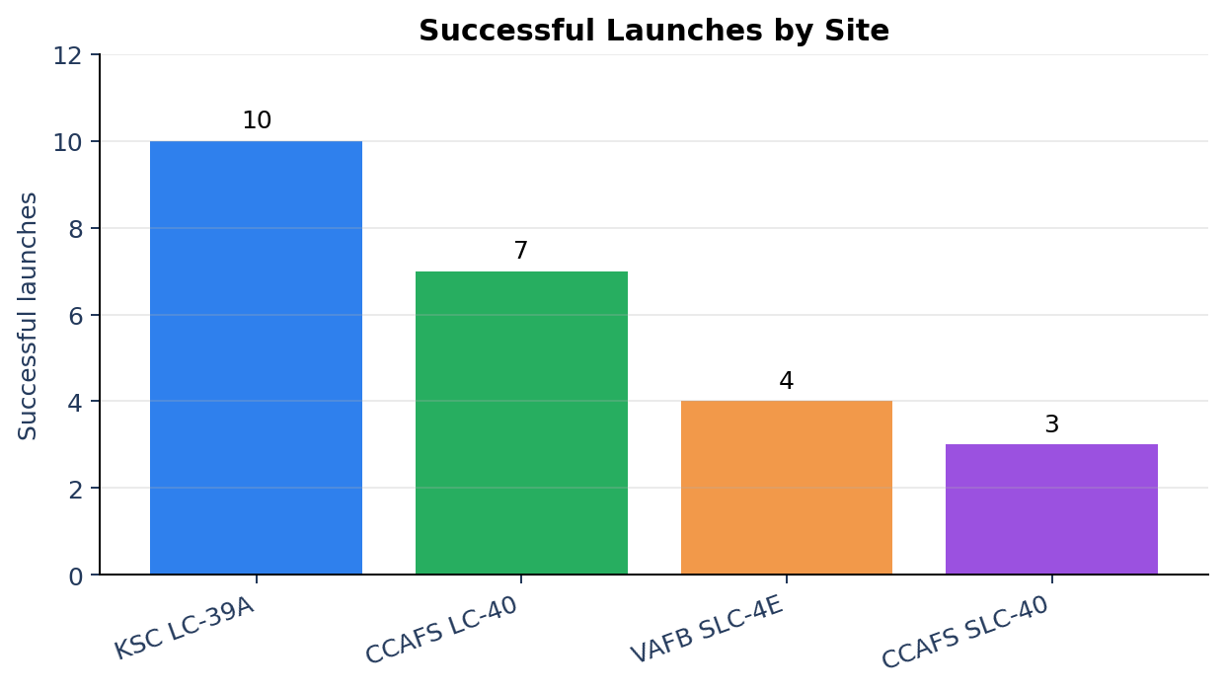
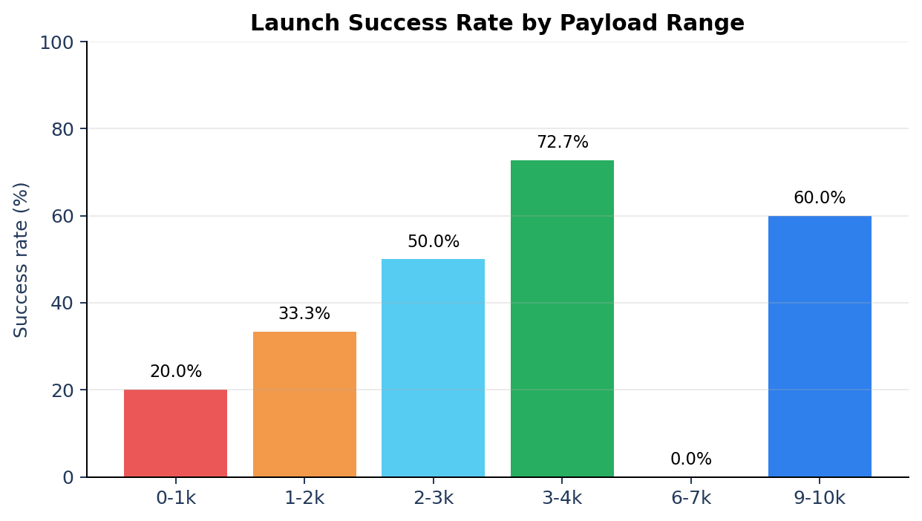
EDA with Visualization
Launch success varies by site, payload range and booster category
Insight: KSC LC-39A leads in successful launches, while payloads around 3,000-4,000 kg show the strongest success-rate signal in the dashboard data.
IBM Applied Data Science Capstone | SpaceX Falcon 9 Landing Prediction
8

Slide 9
EDA with SQL
SQL queries were used to validate launch-site, payload and outcome patterns
SQL question
Result used in final analysis
Unique launch sites
4 launch sites
NASA (CRS) payload mass
45,596 kg total payload mass
Average payload for F9 v1.1
2,928.4 kg
First successful ground-pad landing
2015-12-22
Mission outcome counts
Mostly successful missions in the SQL dataset
Why this matters: SQL gives auditable, reproducible answers for the presentation and supports the visual analysis results.
IBM Applied Data Science Capstone | SpaceX Falcon 9 Landing Prediction
9

Slide 10
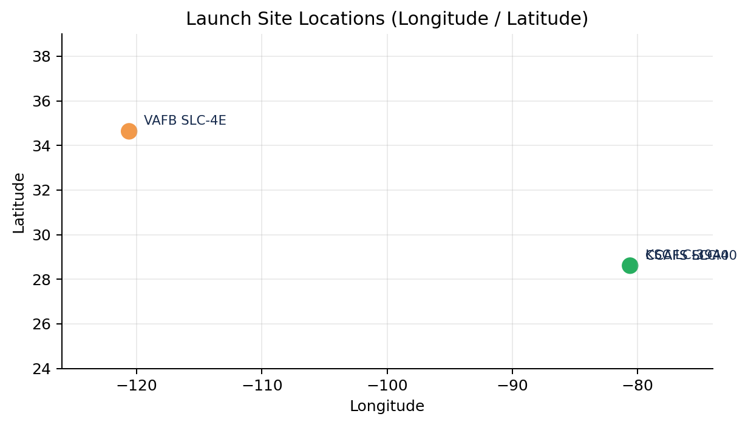
Interactive Map with Folium
Launch locations and nearby infrastructure were explored geographically
All launch sites were plotted using latitude and longitude coordinates.
Markers were colored by landing outcome: successful versus unsuccessful.
Distance calculations were added from a launch site to the coastline and nearby infrastructure.
The exported HTML map should be uploaded to GitHub with the notebooks.
The Folium notebook also exports an interactive HTML map with markers, marker clusters and distance annotations.
IBM Applied Data Science Capstone | SpaceX Falcon 9 Landing Prediction
10

Slide 11
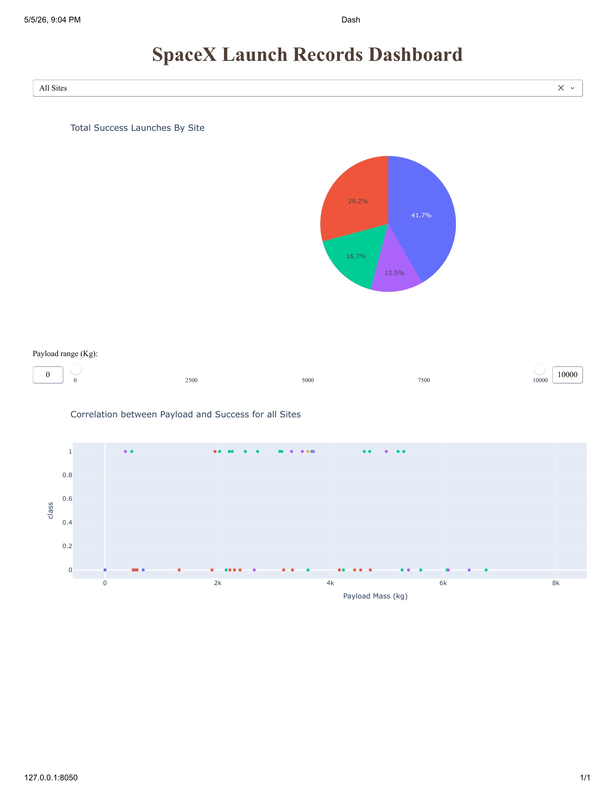
Plotly Dash Dashboard
The dashboard enables interactive visual analytics in real time
Dropdown lets the user select All Sites or an individual launch site.
Pie chart updates to show total successful launches by site or success/failure split for one site.
Payload slider filters the scatter plot by payload mass range.
Scatter plot shows payload mass versus landing outcome, colored by booster version.
IBM Applied Data Science Capstone | SpaceX Falcon 9 Landing Prediction
11

Slide 12
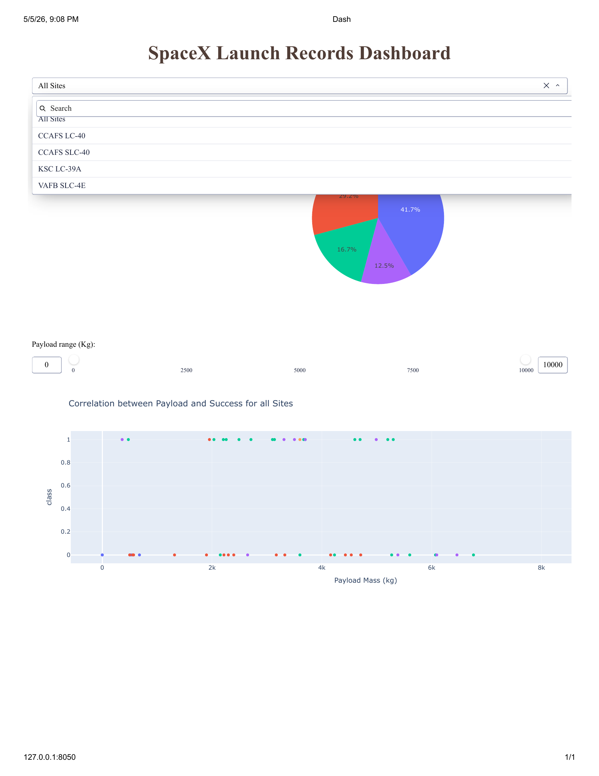
Dashboard Interaction: Launch Site Dropdown
The launch-site selector changes both the pie chart and scatter plot context
All Sites option shows the aggregate view across the dataset.
Specific launch-site selection supports a detailed success-rate comparison.
This screenshot proves Task 1 and Task 2 dashboard requirements are implemented.
4
ALL
available launch-site filters
default dashboard selection
IBM Applied Data Science Capstone | SpaceX Falcon 9 Landing Prediction
12

Slide 13
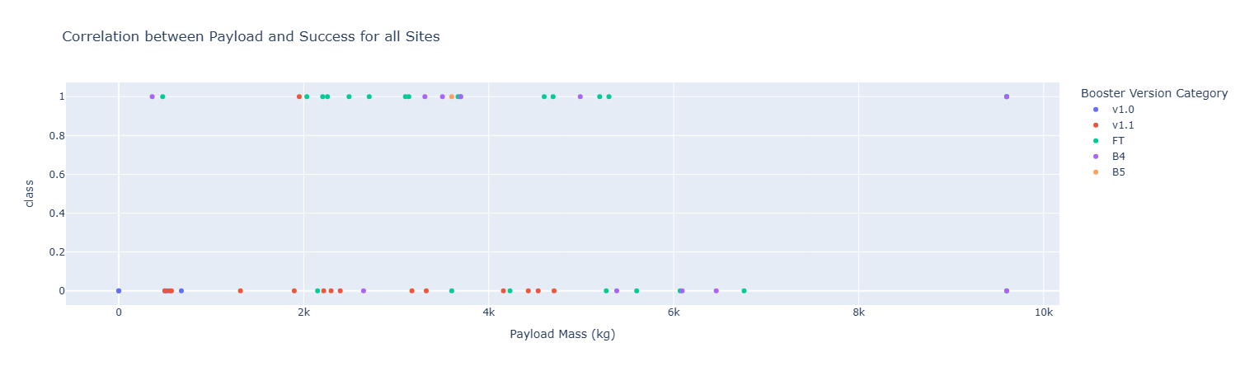
Payload Scatter Plot: All Sites
Each point represents one launch; class 1 means successful landing and class 0 means unsuccessful landing
Interpretation: because the target is binary, points naturally form two horizontal bands. The color label shows booster version category.
IBM Applied Data Science Capstone | SpaceX Falcon 9 Landing Prediction
13

Slide 14
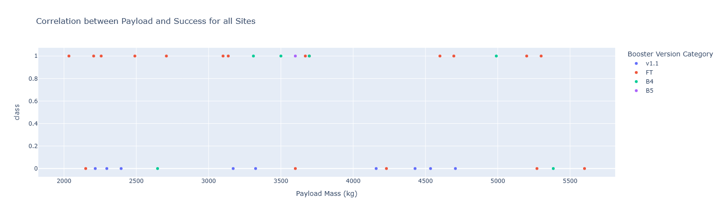
Payload Slider Filter
Changing the payload range filters the scatter plot without changing the app code
Filtered view focuses on payloads in the mid-range band, approximately 2,000-6,000 kg.
The dashboard can be used to visually compare high-success and low-success payload ranges.
This screenshot demonstrates the payload slider and scatter callback working together.
IBM Applied Data Science Capstone | SpaceX Falcon 9 Landing Prediction
14

Slide 15
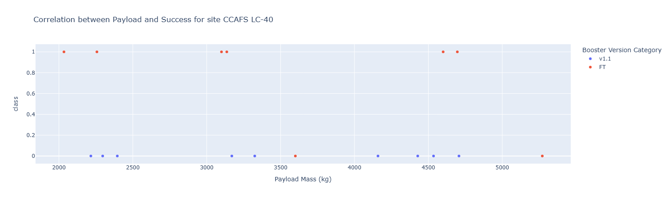
Selected Site View: CCAFS LC-40
Filtering by site provides a site-specific payload-to-outcome view
CCAFS LC-40 view shows fewer points than the all-sites view because the data is filtered to one launch site.
The same binary class interpretation applies: 1 = landed successfully, 0 = did not land successfully.
IBM Applied Data Science Capstone | SpaceX Falcon 9 Landing Prediction
15

Slide 16
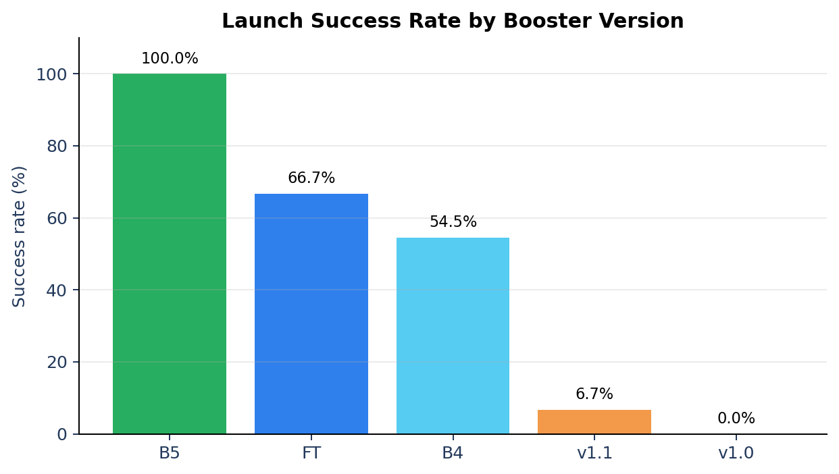
Dashboard Insights
Final visual answers extracted from the interactive dashboard
Largest successful launches
KSC LC-39A - 10 successful launches
Highest launch success rate
KSC LC-39A - 76.9%
Highest payload success range
3,000-4,000 kg - 72.7%
Lowest payload success range
6,000-7,000 kg - 0%
Highest booster success rate
B5 - 100%
Note: percentages are based on the dashboard dataset used in the Dash lab.
IBM Applied Data Science Capstone | SpaceX Falcon 9 Landing Prediction
16

Slide 17
Predictive Analysis: Feature Preparation
Categorical and numerical launch features were prepared for supervised learning
Target label Y was created from the Class column.
Feature matrix X was loaded from dataset_part_3.csv after one-hot encoding.
Features were standardized using StandardScaler.
Data was split into training and testing sets with test_size = 0.2 and random_state = 2.
Feature examples
PayloadMass
Flights
Block
ReusedCount
Orbit_*
LaunchSite_*
Serial_*
GridFins / Reused / Legs
80/20
4
train-test split
classification algorithms compared
IBM Applied Data Science Capstone | SpaceX Falcon 9 Landing Prediction
17

Slide 18
Classification Models and Hyperparameter Tuning
GridSearchCV was used to select strong model configurations
Model
Tuned parameters
Purpose
Logistic Regression
C, penalty, solver
linear baseline classifier
Support Vector Machine
kernel, C, gamma
nonlinear separation
Decision Tree
criterion, depth, split rules
interpretable rules
K-Nearest Neighbors
neighbors, distance metric
similarity-based classifier
All models were evaluated on the same held-out test set.
Models tied on test accuracy, so cross-validation score was also used to interpret model strength.
All models were evaluated after hyperparameter tuning.
IBM Applied Data Science Capstone | SpaceX Falcon 9 Landing Prediction
18

Slide 19
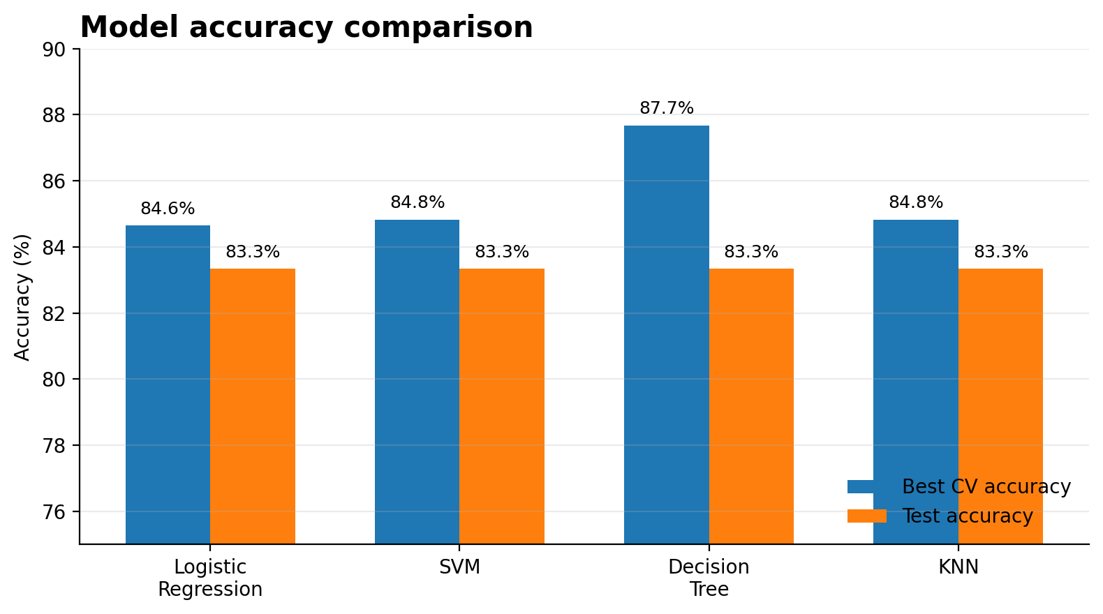
Predictive Analysis Results
All models tied on test accuracy; Decision Tree achieved the highest cross-validation score
Model
Best CV
Test
Logistic Regression
84.6%
83.3%
SVM
84.8%
83.3%
Decision Tree
87.7%
83.3%
KNN
84.8%
83.3%
Test accuracy tie: all models - 83.3%
Decision Tree led cross-validation with 87.7%.
IBM Applied Data Science Capstone | SpaceX Falcon 9 Landing Prediction
19

Slide 20
Conclusion
Falcon 9 booster recovery can be predicted with useful accuracy from historical launch features
Launch site, payload mass range, booster version and launch history are important signals for landing success.
KSC LC-39A stands out as the strongest dashboard site by successful launches and success rate.
B5 booster category has the highest observed success rate in the dashboard analysis.
Mid-range payloads around 3,000-4,000 kg show the strongest success-rate band in the dashboard results.
All models reached 83.3% test accuracy; Decision Tree produced the strongest cross-validation score.
Actionable
use the model to estimate recovery probability
Reusable
landing success supports launch-cost estimation
Portfolio-ready
upload notebooks, app and presentation to GitHub
IBM Applied Data Science Capstone | SpaceX Falcon 9 Landing Prediction
20

Slide 21
GitHub Repository Structure
Upload the solved notebooks, screenshots, datasets and final presentation
IBM-Applied-Data-Science-Capstone/
├── README.md
├── final_presentation.pdf
├── final_presentation.pptx
├── notebooks/
├── dashboard/
├── data/
└── images/
README explains the business problem, workflow, tools and final deliverables.
notebooks/ contains all solved .ipynb labs.
dashboard/ contains the Dash notebook/app file.
data/ contains dataset_part_1.csv, dataset_part_2.csv, dataset_part_3.csv and other generated CSV files.
images/ contains the dashboard screenshots used in this presentation.
IBM Applied Data Science Capstone | SpaceX Falcon 9 Landing Prediction
21

Slide 22
Final Submission Checklist
Before submitting, make sure every required artifact is visible and easy to open
✓
All solved notebooks run from top to bottom
✓
Dash dashboard screenshots saved as PNG
✓
Folium map exported as HTML or screenshot
✓
Final presentation exported to PDF
✓
GitHub repository is public
✓
Coursera submission includes GitHub URL and PDF
Open your repository in a private/incognito browser window before submitting. If it opens without requiring login, the Coursera grader can access it.
IBM Applied Data Science Capstone | SpaceX Falcon 9 Landing Prediction
22

Slide 23
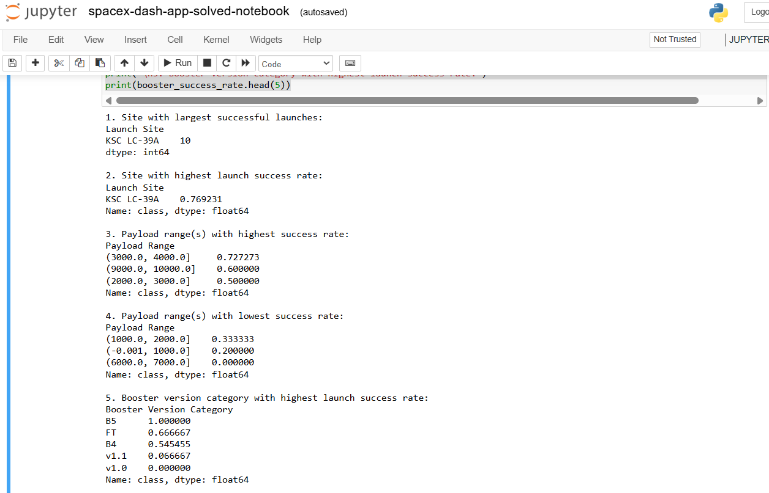
Appendix: Dashboard Evidence
Screenshots captured from the implemented Dash application
IBM Applied Data Science Capstone | SpaceX Falcon 9 Landing Prediction
23

Slide 24
Thank you
Questions?
Project: SpaceX Falcon 9 first-stage landing prediction
GitHub repository: https://github.com/adilsk007/IBM-Applied-Data-Science-Capstone
Author: Muhammad Adil Salam
Final presentation created for IBM Applied Data Science Capstone
IBM Applied Data Science Capstone | SpaceX Falcon 9 Landing Prediction
24

