Slide 1
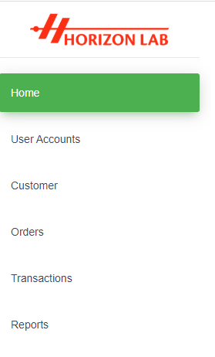
Main Page / Home Page
Create New User
Active Accounts
Inactive Accounts
Create New Customer
Active Customers
Inactive Customers
Place Orders
Place Orders
Order Records
Water Bacteria Records
Water Chemical Records
Add New
Water Test Certificates

Slide 2
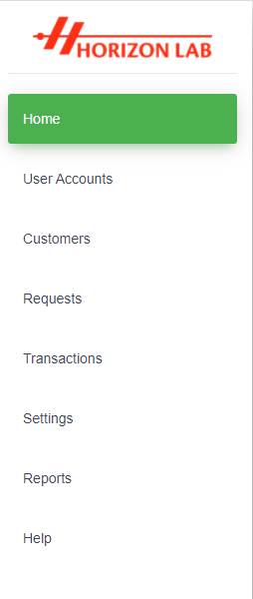
Main Page / Home Page
Create New User
Active Accounts
Inactive Accounts
Create New Customer
Active Customers
Inactive Customers
Create New Request
Request Records
Water Bacteria Records
Water Chemical Records
Add New
Test Package Categories
Test Package Settings
Categorization
Water Test Certificates

Slide 3
