Slide 1
Linear Regression
Theory, Assumptions & RStudio
Based on Andy Field – Discovering Statistics Using R
Muhammad adil zainal abidin

Slide 2
What is Linear Regression?
"A statistical method that models the relationship between one or more predictor variables and a continuous outcome variable by fitting a straight line.”
For prediction and control for confounder , quantifying the relationship -Simple and multiple (crude and adjusted)
Outcome (Y)
Predictor (X)
The Line
The variable we want to predict or explain (dependent variable)
The variable(s) used to predict the outcome (independent variable)
Best-fit line minimising the sum of squared residuals (OLS method)
Other method
Maximum Likelihood Estimation (MLE) for logistic regression
The Regression Equation:
Ŷᵢ = b₀ + b₁Xᵢ + εᵢ
b₀ = intercept b₁ = slope/coefficient εᵢ = error/residual
Field (2013): Discovering Statistics Using R, p. 183

Slide 3
Theory: How OLS Works
Ordinary Least Squares (OLS)
Model Fit: R² & F-ratio
▸ Each data point has a residual: the vertical distance between the observed (Y) and predicted (Ŷ) value
R²
Proportion of variance in Y explained by the model. R² = 0.60 → model explains 60% of variance in Y.
▸ OLS finds the line that minimises the Sum of Squared Residuals (SSR)
Adjusted R²
▸ SSR = Σ(Yᵢ – Ŷᵢ)² → minimised
Penalises for extra predictors. Preferred when comparing models (Field, 2013).
F-ratio
▸ Squaring ensures negative and positive errors don't cancel out
Tests whether the model significantly improves prediction over the mean alone. F = MSₘ / MSᵣ
▸ The resulting b₀ and b₁ are the 'best' linear estimates
β (Beta)
Standardised coefficients allow comparison of predictor importance across different scales.
Field (2013), pp. 184–205

Slide 4
Assumptions of Linear Regression
Linearity
Independence
1
Relationship between X and Y must be linear. Check: scatterplot of X vs Y; residuals vs fitted plot.
2
Observations must be independent of each other. Check: study design; Durbin-Watson test (≈2 = no autocorrelation).
Homoscedasticity
Normality of Residuals
3
Residuals should have constant variance across levels of X. Check: residuals vs fitted plot — no funnel shape.
4
Residuals should be normally distributed. Check: Q-Q plot, histogram of residuals, Shapiro-Wilk test.
No Multicollinearity
No Influential Outliers
5
Predictors should not be too highly correlated (multiple regression). Check: VIF < 10; Tolerance > 0.1 (Field, 2013).
6
Extreme cases unduly influence the model. Check: Cook's Distance > 1 suggests influential cases (Field, 2013).
Field (2013), Chapter 7 – All assumptions must be met for valid inference.

Slide 5
Running Linear Regression in RStudio (Step 1–3)
STEP 01
STEP 02
STEP 03
Load & Inspect Your Data
Visualise the Relationship
Fit the Regression Model
# Load data
library(tidyverse)
data <- read.csv("mydata.csv")
# Inspect
head(data)
str(data)
summary(data)
# Scatterplot
ggplot(data, aes(x = predictor,
y = outcome)) +
geom_point(colour = "steelblue") +
geom_smooth(method = "lm",
se = TRUE) +
theme_minimal()
# Simple linear regression
model <- lm(outcome ~ predictor,
data = data)
# View full output
summary(model)
💡 Ensure outcome is continuous and predictors are correctly coded.
💡 Look for linear trend before fitting the model.
💡 lm() = linear model. Outcome ~ Predictor syntax follows R formula notation.
Assumption 1
Linearity
Field (2013), pp. 211–220 | Code adapted for R / tidyverse

Slide 6
Interpreting the summary() Output
Coefficients:
Estimate Std.Error t value Pr(>|t|)
(Intercept) 10.543 1.234 8.543 <0.001 ***
predictor 0.621 0.087 7.138 <0.001 ***
---
Signif. codes: 0 '***' 0.001 '**' 0.01 '*' 0.05
Residual standard error: 3.21 on 98 df
Multiple R-squared: 0.612
Adjusted R-squared: 0.608
F-statistic: 51.95 on 1 and 98 DF
p-value: < 2.2e-16
Intercept (b₀)
Predicted Y when X = 0
Slope (b₁ = 0.621)
For each 1-unit ↑ in X, Y increases by 0.621
p-value < .001
Predictor is statistically significant
R² = 0.612
Model explains 61.2% of variance in outcome
F-statistic
Overall model is significant (p < .001)
Field (2013), pp. 221–235

Slide 7
Checking Assumptions in RStudio (Step 4)
What to Look For:
Independence
# ── Dubin watson test ──────────────────
dwtest(model)
# ── Diagnostic Plots ──────────────────
# Base R: 4 plots in one window
par(mfrow = c(2,2))
plot(model)
# ── Homoscedasticity ───────────────────
library(lmtest)
bptest(model) # Breusch-Pagan test
# ── Normality of Residuals ─────────────
shapiro.test(residuals(model))
# ── Multicollinearity (if multiple X) ──
library(car)
vif(model) # VIF < 10 = acceptable
tolerance <- 1/vif(model) # > 0.1
# ── Influential Cases ──────────────────
cooksD <- cooks.distance(model)
plot(cooksD, type="h")
abline(h = 1, col="red", lty=2)
Dubin Watson test – p value not significant and value ~ 2 (Assumption 2)
Residuals vs Fitted
Random scatter around zero → linearity & homoscedasticity OK (Assumption 3)
Scale-Location
Horizontal band → constant variance (homoscedasticity)
(Assumption 3) p value should be not significant
Normal Q-Q Plot
Points on diagonal line → residuals are normally distributed
(Assumption 4)
VIF / Tolerance
VIF < 10 and Tolerance > 0.1 → no multicollinearity (Assumption 5)
Cook's Distance
No points above 1 → no unduly influential cases (Assumption 6)
Field (2013), pp. 236–255 | car package by Fox & Weisberg (2019)

Slide 8
VIOLATION 1 LINEARITY
SITUATION
Look visually at scatter plot and residual plot
Scatter plot – DV vs IV
Residual plot – residual vs fitted values
Either transform
Or use non-linear regression
WHAT CAN YOU DO
poly_model <- lm(y ~ poly(x, 2))
plot(x, fitted(poly_model))
✓
Use polynomial regression
✓
spline_model <- lm(y ~ ns(x, df=5))
plot(x, fitted(spline_model))
✓
Use spline regression
✓
✓
Use transformation (i.e log / square root)
✓
y_log <- log(y)
y_sqrt <- sqrt(y)
Field (2013), pp. 255–260 | APA Publication Manual, 7th Ed.

Slide 9
VIOLATION 2 INDEPENDENCE / AUTOCORRELATION
SITUATION
P Value significant or Dubin Watson value not ~ 2
Suggesting time series
Use time series model – ARIMA
WHAT CAN YOU DO
ARIMA
✓
Use time series model
✓
✓
✓
✓
✓
Field (2013), pp. 255–260 | APA Publication Manual, 7th Ed.

Slide 10
VIOLATION 3 Homoscedasticity
SITUATION
residuals vs fitted plot — no funnel shape
Or Breusch pagan test p value significant
Either use robust standard error
Or Transform data
Or use Weighted Least Square (WLS) Method
WHAT CAN YOU DO
✓
Use robust standard error - Use the sandwich package to calculate heteroscedasticity-consistent (HC) standard errors and lmtest for testing.
coeftest(model, vcov = vcovHC(model, type = "HC3"))
✓
✓
Transform data by log transform the outcome - model_log <- lm(log(y) ~ x, data = dataset)
✓
✓
WLS Method
✓
Field (2013), pp. 255–260 | APA Publication Manual, 7th Ed.

Slide 11
VIOLATION 4 Residual normality
SITUATION
Q-Q plot not normal
If sample size is big , result is still robust
Check for outliers as well and remove them
Either transform the dependent variable
Or use robust regression
WHAT CAN YOU DO
✓
Transform the DV - model2 <- lm(log(y) ~ x, data = df)
✓
✓
✓
Robust regression - library(robustbase); robust_model <- lmrob(y ~ x, data = df)
✓
Field (2013), pp. 255–260 | APA Publication Manual, 7th Ed.

Slide 12
VIOLATION 5 MULTICOLLINEARITY
SITUATION
2 or more predictor variables in a regression model are highly correlated, leading to unreliable estimates of the coefficients
Either drop one and re run
Or Ridge regression is a method by which we add a degree of bias to the regression estimates.
WHAT CAN YOU DO
Repeat model without one of the correlated predictors
✓
Drop the highly correlated predictors
✓
✓
Regularization (ridge/lasso regression)
✓
ridge_model <- glmnet(as.matrix(cbind(x1, x2, x3)), y, alpha=0)
summary(ridge_model)
plot(ridge_model)
coef(ridge_model, s = 0.1)
✓
✓
Field (2013), pp. 255–260 | APA Publication Manual, 7th Ed.

Slide 13
VIOLATION 6 OUTLIERS
SITUATION
Cook distance – if value >1 or 4/n
Check data entry first
Or data transformation of the dependent variable
Or delete the outliers
Or using robust regression
WHAT CAN YOU DO
✓
✓
Robust regression-
rlm() (MASS package): Uses Iteratively Reweighted Least Squares (IRLS).
library(MASS)
robust_model <- rlm(y ~ x, data = mydata)
summary(robust_model)
✓
✓
✓
✓
Field (2013), pp. 255–260 | APA Publication Manual, 7th Ed.

Slide 14
Variable Selection Methods
Choosing which predictors to include — four common strategies
Enter (Forced Entry)
Forward Selection
Backward Elimination
Stepwise (Both)
✔ Pros
✔ Pros
✔ Pros
✔ Pros
No data dredging; theory-driven; preferred in epidemiology
Adds only significant variables; efficient for large datasets
Starts with full model; better for correlated predictors
Most flexible; re-evaluates at each step
✘ Cons
✘ Cons
✘ Cons
✘ Cons
Relies on researcher expertise; may include non-significant vars
Misses suppressor variables; order-dependent; inflated α
Computationally intensive; same α inflation issue
Highest risk of over-fitting; not recommended for inference
When to use:
When to use:
When to use:
When to use:
Confirmatory research with a priori hypotheses
Exploratory analysis with many candidate predictors
When you start with a plausible full model
Prediction-focused (not causal) models only
model <- lm(y ~ x1 + x2 + x3, data=df)
summary(model)
library(MASS)
step(lm(y~1,data=df),
scope=~x1+x2+x3,
direction="forward")
full <- lm(y~x1+x2+x3, data=df)
step(full,
direction="backward")
step(full,
direction="both")
⚠ Automatic selection methods inflate Type I error and should not be used for causal inference — prefer Enter method in aetiological studies.

Slide 15
Comparing Selection Methods at a Glance
Summary table for quick reference
Method
Direction
Starting point
Criterion
Best use
Epidemiological use
Enter
All at once
None
Theory / a priori
Confirmatory research
✔ Recommended
Forward
Add predictors
Null model
Lowest p-value
Screening, prediction
⚠ Caution
Backward
Remove predictors
Full model
Highest p-value
Moderate # predictors
⚠ Caution
Stepwise
Both directions
Any
AIC or p-value
Prediction only
✘ Not recommended
AIC (Akaike Information Criterion) — lower AIC = better model. Use AIC for automated selection rather than p-values to reduce multiple testing bias.
# Use AIC-based stepwise (preferred over p-value based)
library(MASS)
step(full_model, direction = "both", k = 2) # k=2 = AIC
# Compare models with AIC
AIC(model1, model2, model3)
# BIC (stricter penalty for complexity)
BIC(model1, model2)

Slide 16
Assessing Model Fit
Use multiple metrics together — no single statistic tells the whole story
R²
R² (R-squared)
AIC
AIC / BIC
Proportion of variance in Y explained by model. R²=0.60 means 60% explained.
Range: 0–1; higher = better fit. Increases with every added variable.
Information criteria for comparing non-nested models. Lower = better. BIC applies a stricter complexity penalty.
R²adj
Adjusted R²
√MSE
RMSE
Penalises for adding non-informative predictors. Use this for model comparison.
Decreases if added variable doesn't improve fit meaningfully.
Root Mean Square Error — average prediction error in Y units. Useful for comparing predictive accuracy across models.
F
F-statistic & p-value
Tests H₀: all β = 0 (null model). Significant F means model explains variance better than intercept-only.

Slide 17
Controlling for Confounders
Multivariable regression adjusts for variables that distort the exposure–outcome relationship
Confounds
Confounder (C)
Confounds
Exposure (X)
Outcome (Y)
True effect
How Multivariable Regression Controls Confounding
1
2
3
4
Include confounders as covariates
Interpretation: Adjusted coefficient
Check % change in coefficient
Report adjusted vs unadjusted
Add suspected confounders (age, sex, BMI…) as additional predictors in the model
β for exposure = effect of X holding all other variables constant
If adding confounder changes β by >10%, it was confounding the association
Always show both crude and adjusted estimates to demonstrate confounding

Slide 18
Running Linear Regression in RStudio
The lm() function fits ordinary least squares regression
# Simple (unadjusted) model
model1 <- lm(sbp ~ smoking, data = mydata)
summary(model1)
# Multivariable (adjusted) model
model2 <- lm(sbp ~ smoking + age + bmi + sex,
data = mydata)
summary(model2)
# Confidence intervals
confint(model2)
# Compare crude vs adjusted
coef(model1)["smoking"] # crude β
coef(model2)["smoking"] # adjusted β
# % change (confounding check)
(coef(model1)[2] - coef(model2)[2]) /
coef(model1)[2] * 100
Reading the summary() Output
Estimate
Regression coefficient (β) — change in Y per unit X
Std. Error
Precision of the estimate; smaller = more precise
t value
Estimate ÷ SE; tests whether β differs from zero
Pr(>|t|)
p-value; <0.05 = statistically significant
R-squared
Proportion of variance in Y explained by model
F-statistic
Tests overall model significance

Slide 19
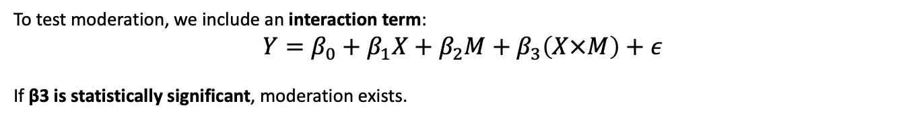
Linear regression - Moderator
To test moderation, we include an interaction term:
$$Y=β_{0}+β_{1}X+β_{2}M+β_{3}\left(X×M\right)+ε$$
If β3 is statistically significant, moderation exists.
Check and visualize
Interpret
Interaction level
model <- lm(Outcome ~ Predictor * Moderator, data = mydata)
summary(model)
library(interactions)
interact_plot(model, pred = Predictor, modx = Moderator)
use sim_slopes from the interactions package
(model, pred = Predictor, modx = Moderator)
examine the effect of on at different levels of (e.g., SD)
Categorical and categorical
Categorical and numeric
Numeric and numeric
Field (2013): Discovering Statistics Using R, p. 183

Slide 20
Linear regression – Mediator
Baron & Kenny Regression Approach (Classic Method)
In this classic method, mediation is tested using three regression models.
Step 1: Total Effect
Step 2: X → Mediator
Step 3: Mediator → Outcome
Y=β0​+β1​X
If β1 is significant → X affects Y.
M=β0​+β1​X
If significant → X influences mediator.
Y=β0​+β1​X+β2​M
Interpretation:
β2 significant → mediator affects Y
If β1 decreases compared to Step 1 → mediation exists
The Regression Equation:
Full mediation - Effect of X on Y disappears after mediator added
Full mediation - Effect of X decreases but remains significant
Field (2013): Discovering Statistics Using R, p. 183

Slide 21
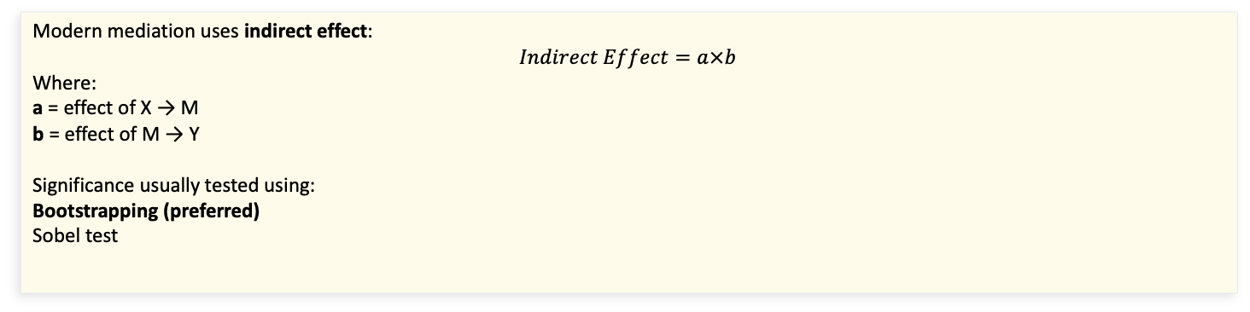
Mediator – modern approach using indirect effect
Modern mediation uses indirect effect:
$$Indirect Effect=a×b$$
Where:
a = effect of X → M
b = effect of M → Y
Significance usually tested using:
Bootstrapping (preferred)
Sobel test
WHAT CAN YOU DO
✓
✓
Bootstrapping - bootstrapping for mediation analysis is commonly done using packages such as mediation, lavaan, or boot.
The easiest and most commonly used approach is the mediation package.
✓
✓
✓
✓
Sobel test , using BDA package – significant p value indicated mediator
✓
Field (2013), pp. 255–260 | APA Publication Manual, 7th Ed.

Slide 22
Reporting Results – APA Style (Field, 2013)
Example Write-Up
A simple linear regression was conducted to predict exam scores from revision hours. The assumptions of linearity, independence, homoscedasticity, and normality of residuals were all met. The model was statistically significant, F(1, 98) = 51.95, p < .001, R² = .61. Revision hours significantly predicted exam scores, b = 0.62, t(98) = 7.14, p < .001. For every additional hour of revision, exam scores increased by 0.62 marks on average.
Reporting Checklist
✓
State assumptions checked and results
✓
Report b (unstandardised) and β (standardised) coefficients
✓
Report F-statistic, df, and p-value for overall model
✓
Report t-value and p-value for each predictor
✓
Report R² (and Adjusted R² for multiple regression)
✓
Describe direction and magnitude of the effect in plain language
Field (2013), pp. 255–260 | APA Publication Manual, 7th Ed.

Slide 23
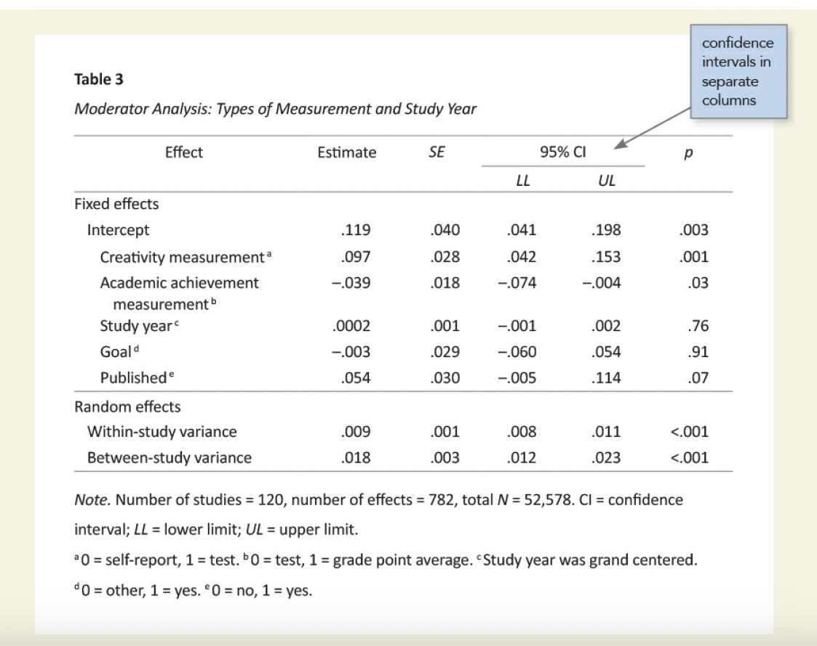
Regression table
Beta coefficient / OR
Standard error
t statistics
p value
Confidence interval

Slide 24
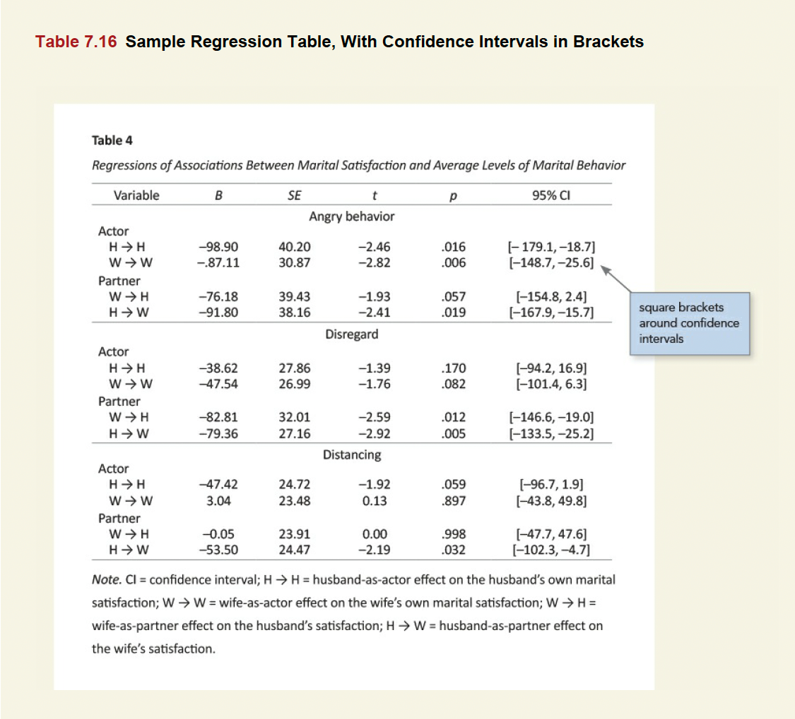

Slide 25
Summary &
Key Takeaways
📚 Key Reference
Field, A. (2013).
Discovering Statistics
Using R.
SAGE Publications.
Chapters 7–8
pp. 183–260
1
Linear regression models a straight-line relationship between X and Y
2
OLS minimises the Sum of Squared Residuals to find the best-fit line
3
Always check the 6 assumptions before interpreting results
4
Use lm() in R; plot(model) gives 4 essential diagnostic plots
5
Report F, R², b coefficients, t-values and p-values in APA style
6
Field (2013) recommends checking Cook's D > 1 for influential cases
Questions & Discussion

