Slide 1


Slide 2

We are a software development company.
We are an association of experienced professionals from different core functional areas and from different industries.
We put our experience & intellect to provide the best and micro level productive and technology integration tools, possible customized solutions to Small & Medium sized Industries and rational reporting.

Slide 3

Financial Accounting - designed for automated management and external reporting of general ledger, accounts receivable, accounts payable and other sub-ledger accounts with a user defined chart of accounts. As entries are made relating to sales production and payments journal entries are automatically posted. This connection means that the "books" are designed to reflect the real situation.

Slide 4
Controlling - represents the company's flow of cost and revenue. It is a management instrument for organizational decisions. It too is automatically updated as events occur.
Asset Management - designed to manage and supervise individual aspects of fixed assets including purchase and sale of assets and depreciation.
Workflow - links the integrated Deta Business Solution modules with cross-application technologies, tools and services.

Slide 5
HR Payroll - is a complete integrated system for supporting the planning and control of personnel activities.
Materials Management - supports the procurement and inventory functions occurring in day-to-day business operations such as purchasing, inventory management, reorder point processing, etc.

Slide 6
Quality Management - is a quality control and information system supporting quality planning, inspection, and control for manufacturing and procurement.
Production Planning - is used to plan and control the manufacturing activities of a company. This module includes; bills of material, routings, work centers, sales and operations planning, master production scheduling, material requirements planning, shop floor control, production orders, product costing, etc.

Slide 7
Sales -helps to optimize all the tasks and activities carried out in sales, delivery and billing. Key elements are; pre-sales support, inquiry processing, quotation processing, sales order processing, delivery processing, billing and sales information system.

Slide 8

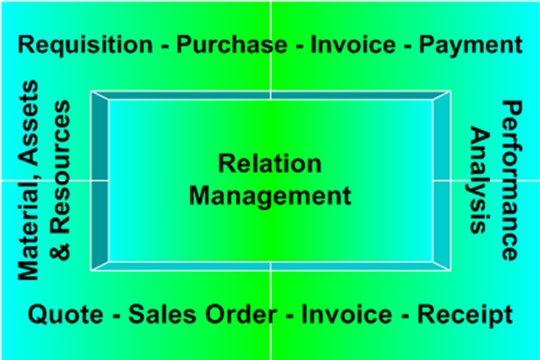

Slide 9

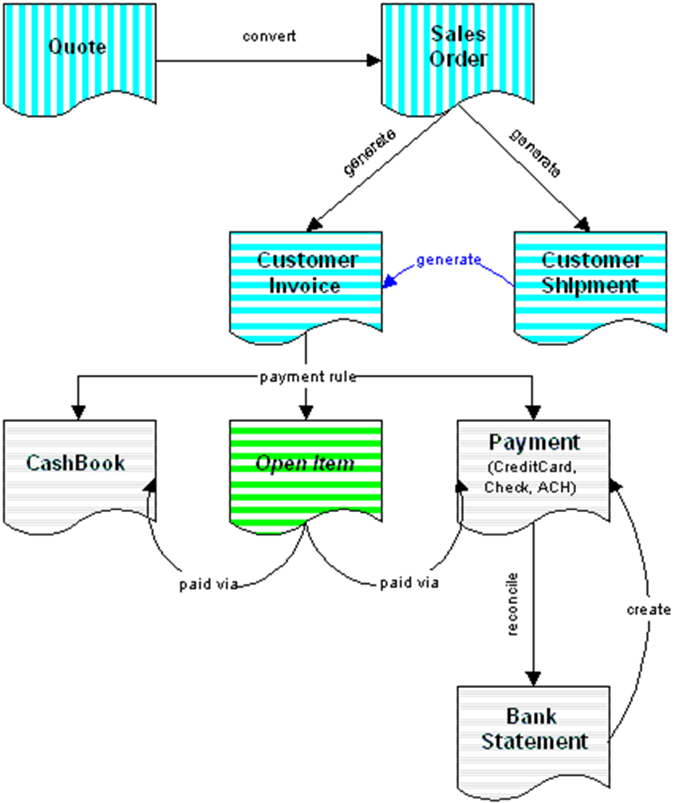

Slide 10

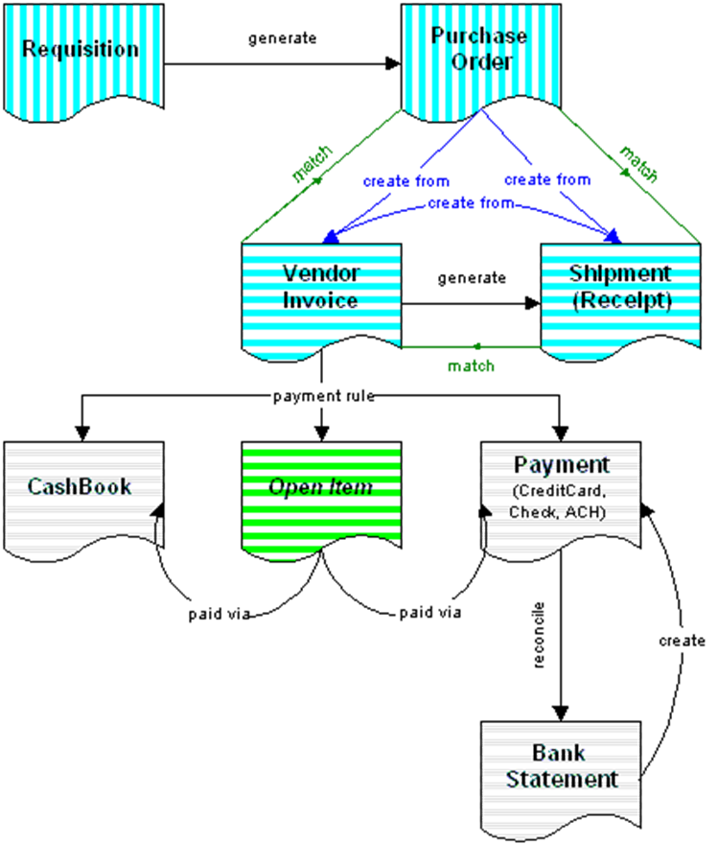

Slide 11

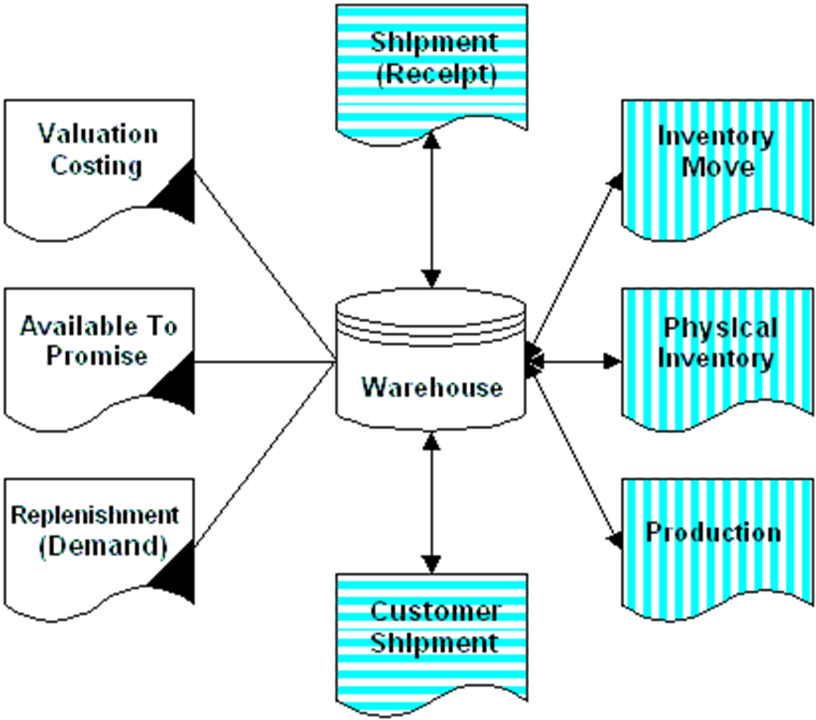

Slide 12

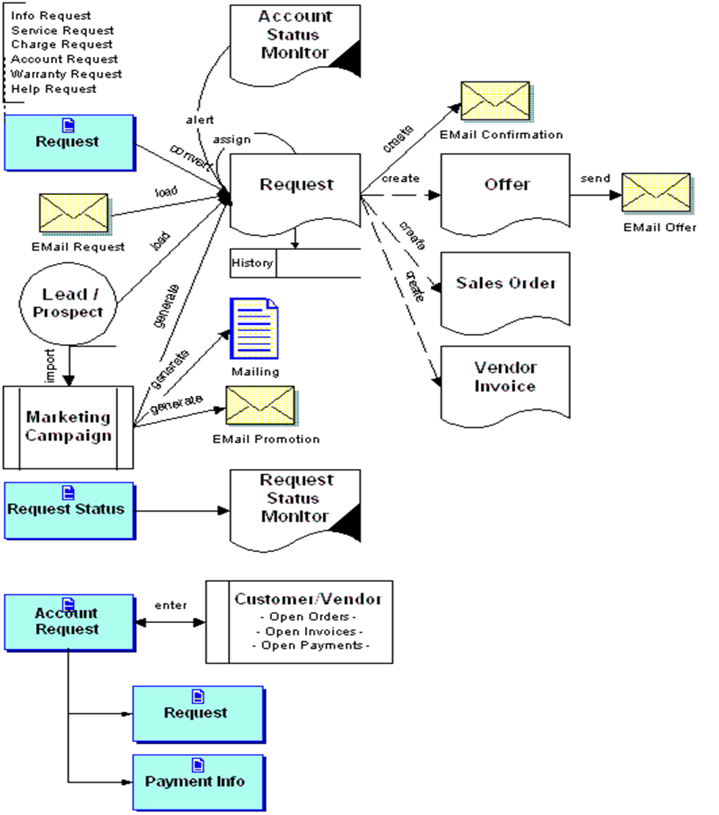

Slide 13

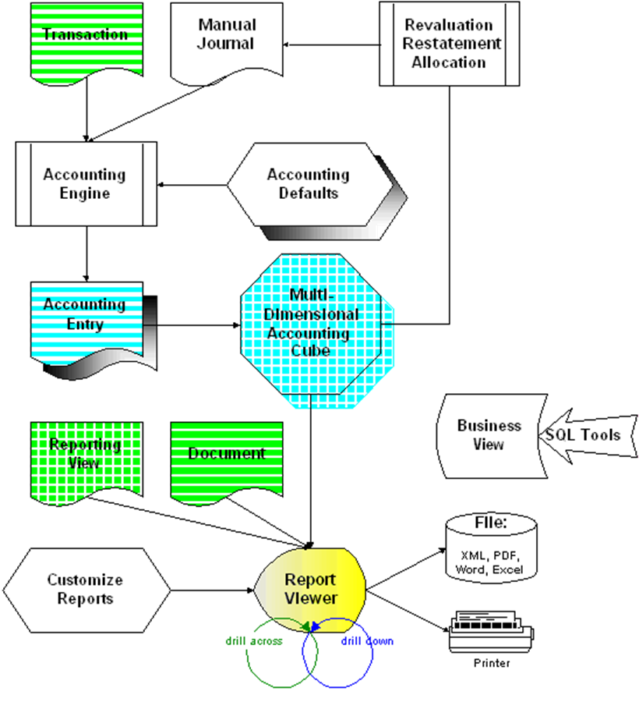

Slide 14
Thanks…

