Slide 1
Secure Gmail
By Aditya Mishra

Slide 2
Purpose

Slide 3
To build a web app named securegmail which will help users to send emails using Gmail but in encrypted format and the receiver decrypts it back using our web app. We implemented the
message encryption by Advanced Encryption Standard (AES) using python cryptography library

Slide 4
Motivation

Slide 5
While sending emails on Gmail we cannot be sure whether the information remains confidential since Google can still access the mails. We wanted to make sure that the content is only
accessible to the desired recipient and no one else has access to the message shared.

Slide 6
Methodology
Built UI using React Js
Used cryptography library provided by python for encryption and decryption purposes.
Used Flask as the backend framework.
Achieved secure key exchange through asymmetric cryptography.

Slide 7
Implementation
1. Sender provides his gmail email and password (google's third party authentication password)
2. Then write his message
3. Create a password for his message then send the mail
4. Sender sends the generated password to the receiver
5. Receiver enters the password provided by the sender
6. Enters the encrypted mail that he received on gmail
7. Finally after the key and encrypted message is verified the real message is displayed.

Slide 8
Outcome

Slide 9
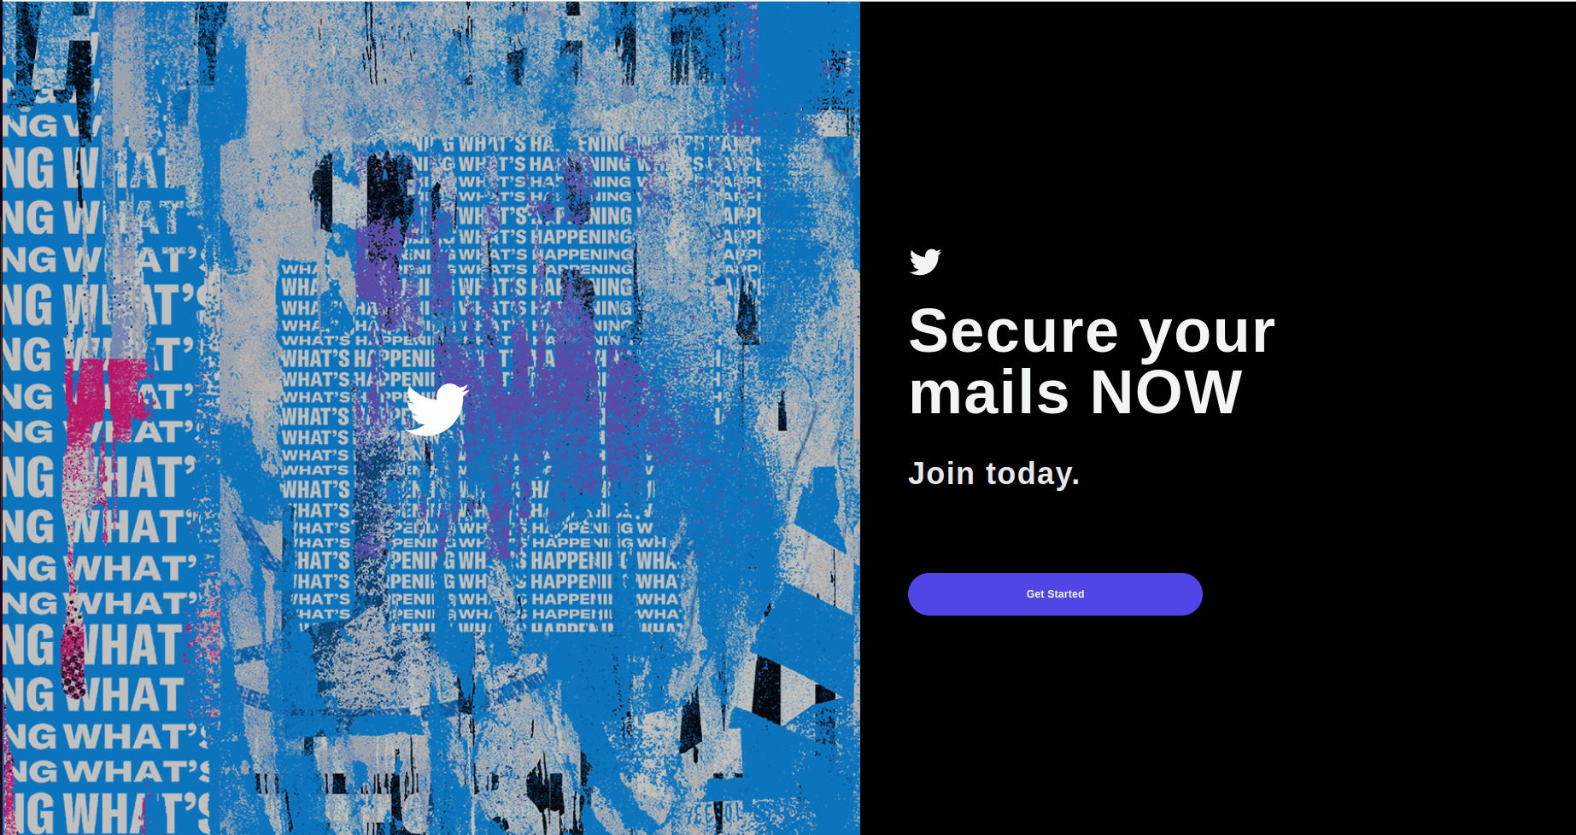

Slide 10
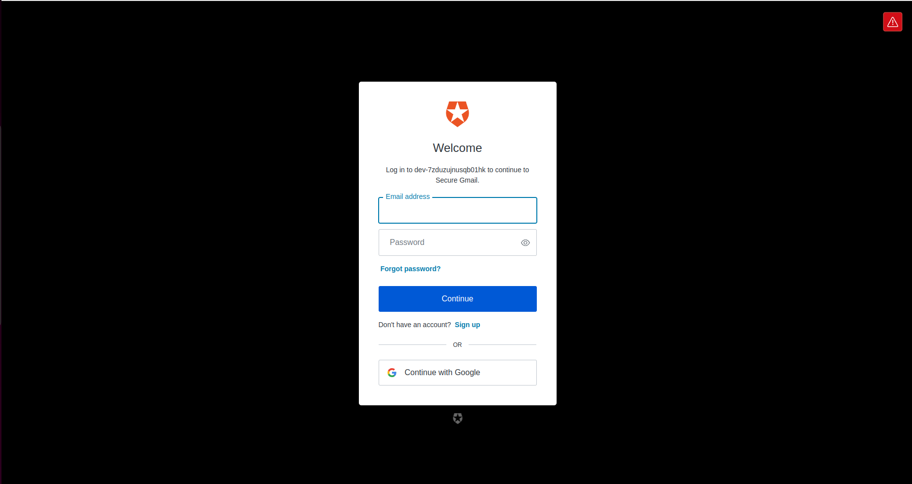

Slide 11
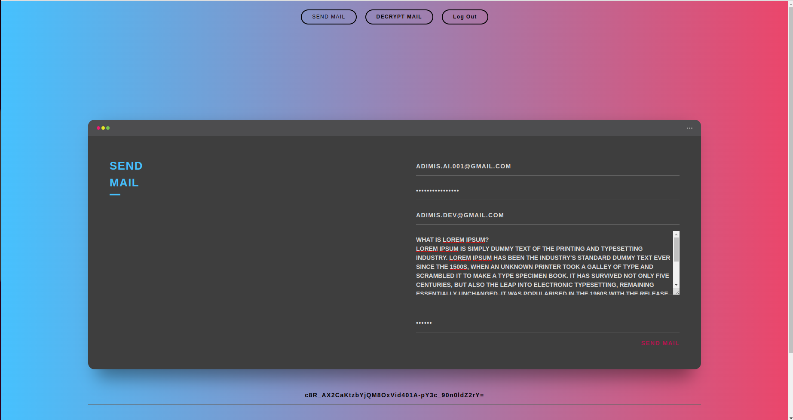

Slide 12
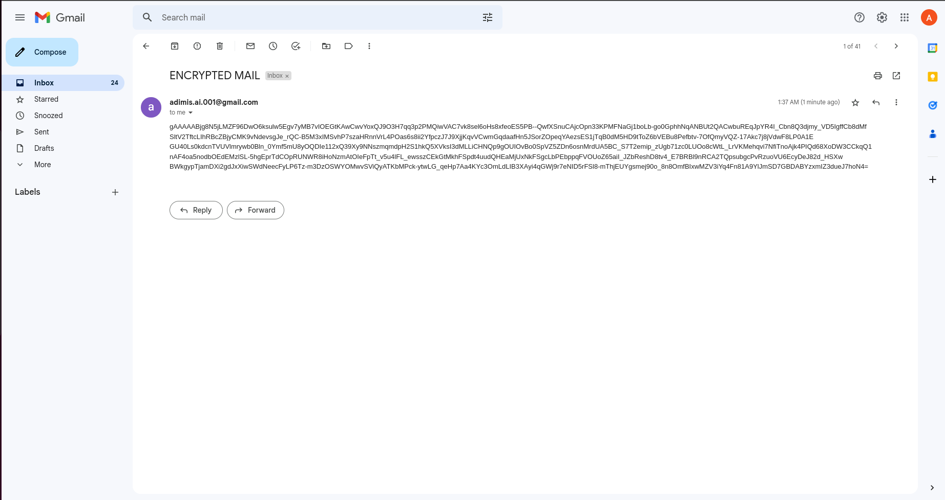

Slide 13
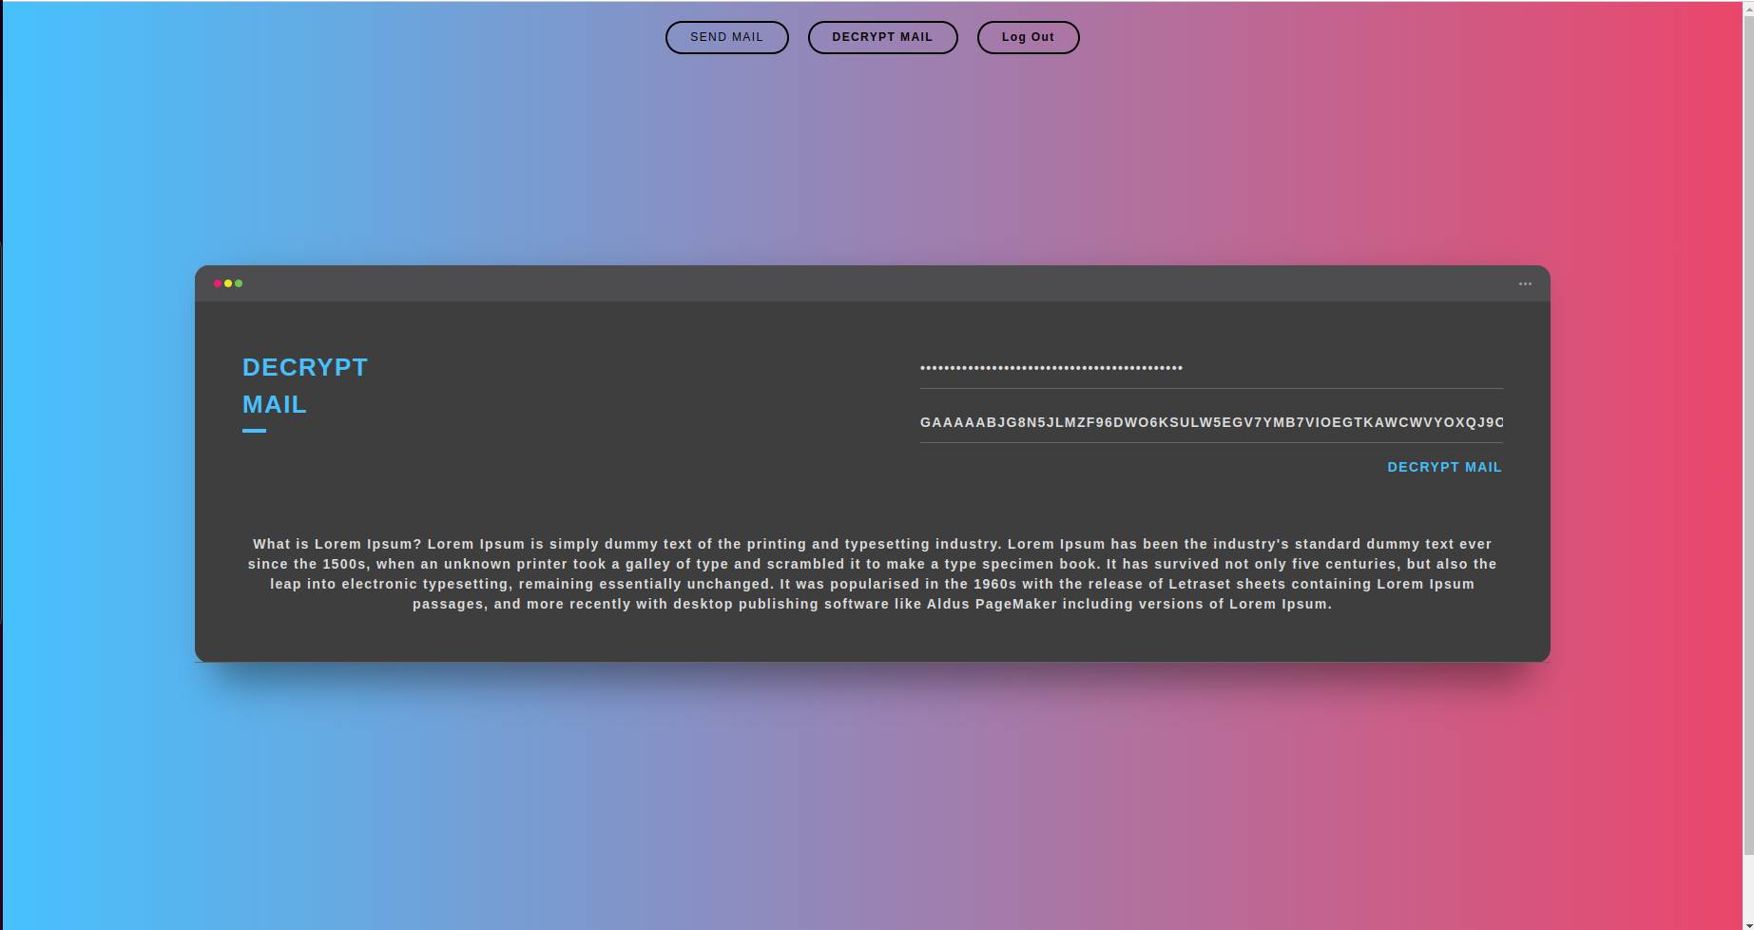

Slide 14
Overall Design

Slide 15
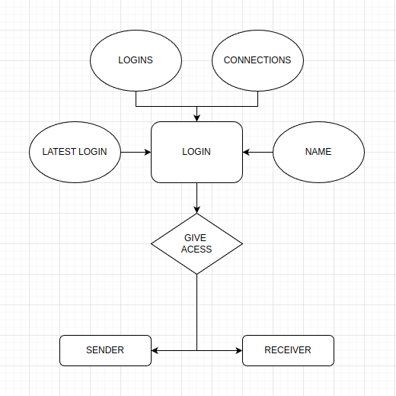
ER Diagram

Slide 16
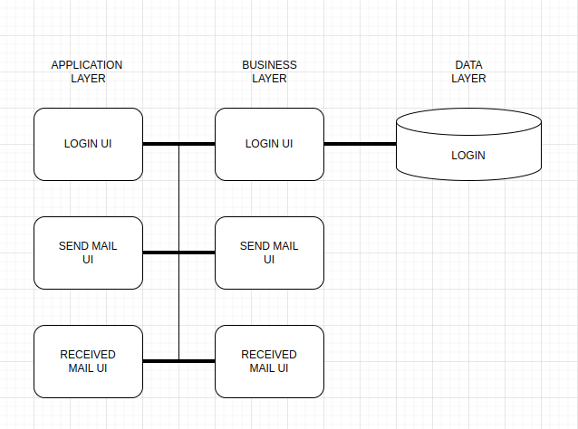
Architecture Design

Slide 17
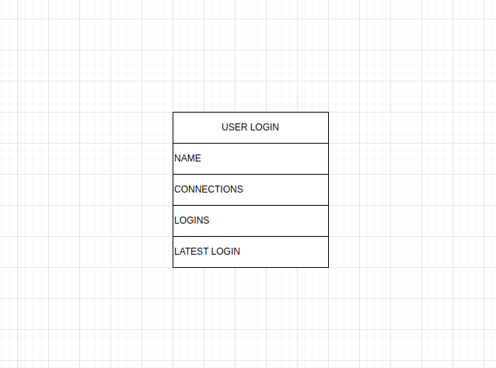
Database Design

Slide 18
Activity Diagram

Slide 19
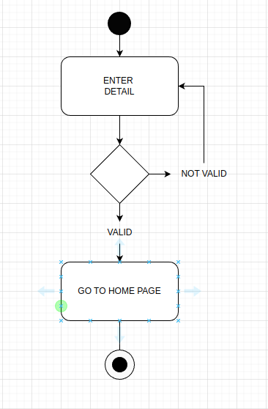
User Login Activity

Slide 20
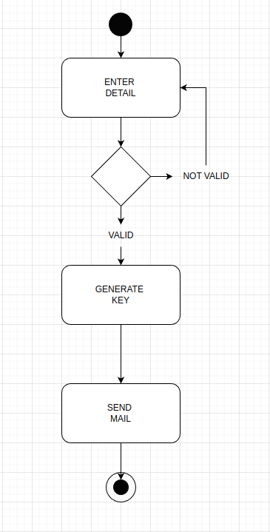
User Send Mail Activity Diagram

Slide 21
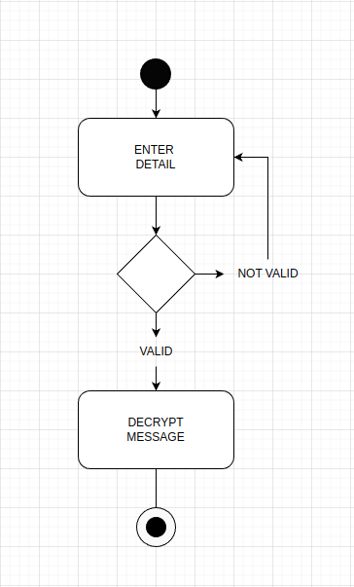
User Receive Mail Activity Diagram

Slide 22
Thank You

