Slide 1

HAPPY PetS SHELTER APP

Slide 2
Brainstorm
School control (students/teachers, grades)
Pet shop/shelter (characteristics, if adopted or not, etc):
Date, disease, pet owner, adoption info,:
Administrator – user/pet

Slide 3
Contents
User Story
Wireframing / Structure
Resources and Features
Tasks/progress

Slide 4
User Story
As a shelter, I would like to help rescuers with abandoned or found pets where:
If the pet has an owner: the shelter can look the owner and inform/return pet
If the pet is rescued: have a complete Kardex of the pet for future adoption
The veterinarian as the shelter owner can help with the adoption/fostering of healthy pets
So that happy pets have happy owners based on matched pets and rescuers

Slide 5
Structure
Acceptance Criteria
When a future rescuer accesses the app:
The homepage displays with the following information:

Slide 6

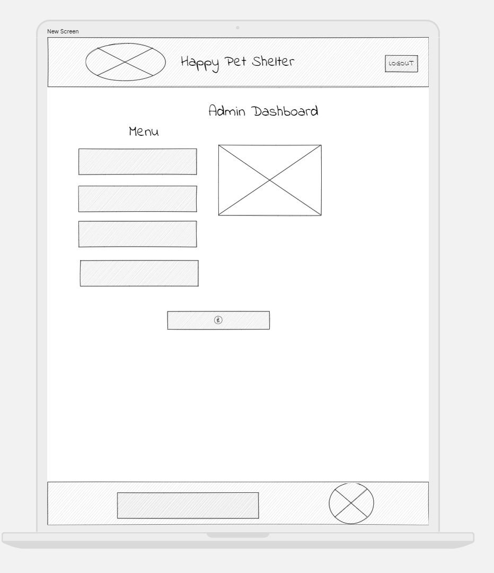
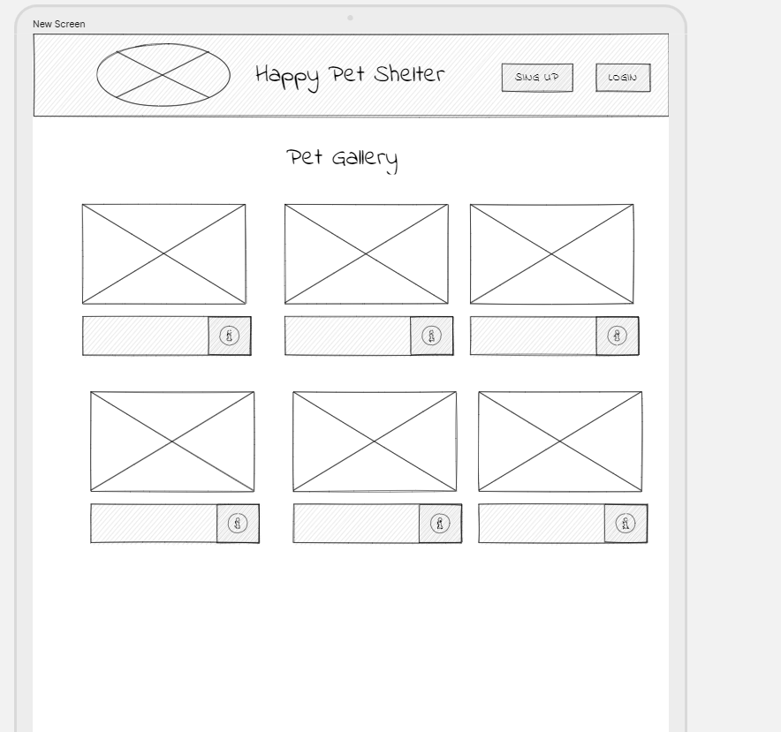

Wire framing

Slide 7
Wire framing

Slide 8
Structure (DATA)
Users
Pets
ID
Status (adopted, shelter)
Date Found
Species
Breed Age
Disease if any
Color
Size
Cage #
Owner or rescuer
Admin
ID...
ID...
userName (default user as ‘shelter’)
Password
rescuerID
eMail
adminPassword
User_id
ID
Pet Category
pet_ID
Create Routes:
User
Employee
Pet
POST register
POST user credentials
GET homepage (desplegar info)
PUT (to update info) or
/home - GET
/register - POST
/login – POST (user/pwd)
/pets – GET (pets list)
/admin/add-pet
/admin/assign-pet - PUT

Slide 9
FE – Front end
BE – Back end
HAPPY PATH
1. User opens app
Init function
server
db connection
seeds
5. User creates user/password
credentials model
Users table
Admin table
Relationships
9. Pet assigned to user
PUT to assign pet to user
10. Display pets per user
Query to display pets per user
2. Pictures display
/home
API route GET – to render pets – BE
Handlebars – BE
Animations, CSS, etc. - FE
6. User logs in
on-click event:
Function to authenticate
Function to authorize
Encrypt password
3. User clicks on picture
On-click function to link to picture – BE
Picture button - FE
7. Redirects to
/pets
API route GET to render pets
Pets model
Pets table
relationships
4. User redirected to register
/credentials/register
/credentials/log-in
API route POST – to register
API route POST – to log-in
Handlebars – BE
Animations, CSS, etc. - FE
8. Users select pet
POST
Default pet status to ‘shelter’
Function to change pet status

Slide 10
1. User opens app
Section | Document/task | Assigned to:
server config/ | connection.js
controllers/ controllers/APIs | index.js /home (GET) /register (POST) /login (POST) /pets (GET – pets list/pictures) /admin (PUT – assign pet)

Slide 11
Future features
Donations
User
Store
Employee
Toys
Food
Outfits

Slide 12
Resources & features
APIs
Styling
Google Fonts
Back-End
Node.js
GitHub
GitHub (git.com) -optional
Anime.js
Repo: https://github.com/adina-hc/happy-pets-shelter-app
Express.js
RESTful API
Handlebars
MySql & Sequelize
Express-session
Bootstrap?/materialize? Pending – investigating a new one
Notes:
Consider talking about:
Gender participation
Youth participation
Disabled participation
Spectator involvement

Slide 13
TASKS timelines TBD
Progress | Issues
Team | Tasks | Not Started | In Progress | Block roads | Closed
Adriano Armendaris | Front end
Emilio Pascual
Jorge Soto
Adina Henderson
Models (relationships), Controllers(Routes, APIs), Interactions, Helpers (date format),
Views, session authentication and authorization, README

